Slide 1
Catchpoint New Normal Survey - CIOs
August 2020

Slide 2
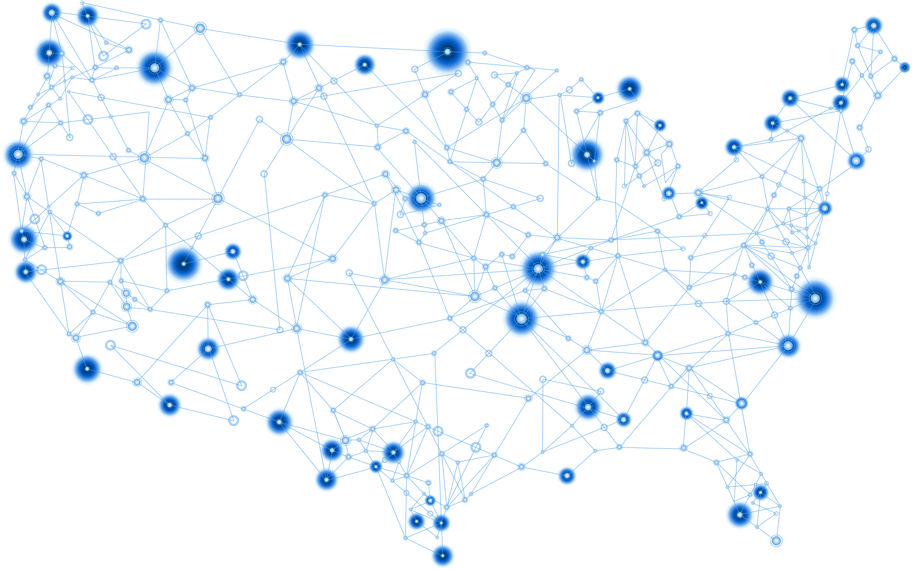


Methodology
Responses:
200 CIO (or equivalent)
200 enterprise managers working full time from home due to COVID-19
From enterprises with >1000 employees
Notes:
Catchpoint commissioned ReRez Research of Dallas, Texas, to survey 200 CIOs and 200 work-from-home managers during July of 2020.
ReRez surveyed 200 CIOs of various sizes:
Small enterprises (1,000 to 2,499 employees)
Medium enterprises (2,500 to 4,999 employees)
Large enterprises (5,000 or more employees)
These enterprises were geographically dispersed across the United States and comprised a wide range of industries.
ReRez also surveyed enterprise managers from enterprises of similar size, all of whom had been required to work from home during the crisis. All these managers have jobs that require the use of a computer for 50 percent or more of their day.

Slide 3
Effects of COVID-19 on Business
Notes:
N=200

Slide 4


Effects of COVID-19 on the Business
Employee working from home at least part time
Customer interactions that were NOT face-to-face
33%
Before COVID-19
57%
Before COVID-19
74%
During COVID-19
87%
During COVID-19
42% (up 27%)
New Normal
63% (up 11%)
New Normal
      Biggest gain: Zoom (or equivalent) = 45% increase
Notes:
The effects during the pandemic, and projected effects in the new normal, show how COVID-19 has changed enterprises.
First, remote “work-from-home” more than doubled during the lockdowns. In the new normal, WFH is expected to decrease, but to still remain 27 percent higher than before the pandemic.
A similar trend was seen for customer interactions, where two thirds of interactions are forecast to be remote in the new normal. The biggest shift has been to Zoom (or equivalent) meetings, which increases by 45% in the new normal.
These are big changes for both the business and for IT …

Slide 5






Challenges posed by COVID-19’s Work from Home Footing
Percent saying this was a somewhat to extremely significant challenge)
    Application performance
    Network reliability
    Employees lack expertise in WFR technologies
    Security issues
66%
63%
63%
63%
Business metrics most affected by COVID-19
IT metrics most affected by COVID-19
Profits
Revenue growth
Employee Productivity
Cyber security
Application reliability
Network availability
Notes:
The biggest challenges cited by IT were
App performance (mentioned by 66% to be a somewhat to extremely significant challenge)
Network reliability (63%)
Employee’s lacking experience with WFR technologies (63%)
Security issues (63%)
Driven by these challenges, enterprises saw declines in both broad business metrics as well as specific IT metrics.

Slide 6
Not all organizations were affected the same way
The very best performing organizations fared FAR better than the worst. We split the respondents into three groups:
TOP TIER
MIDDLE TIER
BOTTOM TIER
  These are the organizations who performed the very best in terms of business and IT metrics.
  These are the organizations who performed the in the middle in terms of business and IT metrics.
  These are the organizations who performed the very worst in terms of business and IT metrics.
We then compared the Top and Bottom tiers to explore those differences, and to explore what the Top Tier was doing differently
Notes:
BUT … not all organizations were affected the same way.
The very best performing organizations fared FAR better than the worst. To tease out those differences, we split the respondents into three groups:
TOP TIER: These are the organizations who performed the very best in terms of business and IT metrics.
MIDDLE TIER: These are the organizations who performed the in the middle in terms of business and IT metrics.
BOTTOM TIER: These are the organizations who performed the very worst in terms of business and IT metrics.
We then compared the Top and Bottom tiers to explore those differences, and to explore what the Top Tier was doing differently.

Slide 7

Top tier performed better in every business metric
The top three business metrics in which the Top Tier was outperforming the Bottom Tier were:
2.6x
2.5x
Revenue growth
2.1x
as likely
as likely
Profit
as likely
Employee satisfaction
Notes:
The Top Tier performed dramatically better in every business metric we examined. Here are the percentages of Top Tier organizations who said they were doing somewhat to extremely well in each area.
Remember, these are enterprises who are actually doing WELL at a time when most companies were struggling.
The top-tier was 2.6 times as likely to report that they were doing well in terms of revenue growth. They were 2.5 times as likely to say they were doing well with profit and 2.1 times as likely to report success with employee satisfaction.

Slide 8
Top tier performed better in every IT metric
The top three IT metrics in which the Top Tier was outperforming the Bottom Tier were:
1.9x
1.6x
1.6x
as likely
Application reliability
as likely
Network reliability
as likely
Cyber-security
Notes:
The same pattern held true with IT metrics as well where the top-tier was 1.9 times more likely to report success with app reliability and 1.6 times as likely to say things were going well with network reliability and security.

Slide 9
Lessons from the top tier
Notes:
What are Top-Tier organizations doing differently in order to delivery such superior performance on both business and IT metrics? Quite a bit, as it turns out …

Slide 10



Focus on reliability
91 percent of the Top Tier have implemented a formal site reliability engineering methodology (SRE). This compares to 69% of Bottom Tier organizations.
As part of this commitment to reliability, 98% of Top Tier organizations say tools that monitor both their employees’ and their customers’ journeys are crucial (compared to 75% and 61% for the Bottom Tier).
This is reflected in the usage of monitoring tools.
In fact, the Top Tier uses 2.8 times as many separate monitoring tools as the Bottom Tier.
91%
69%
98%
75%
98%
61%
2.8x
as many
1.6x
1.6x
1.5x
as likely
Employee device monitoring
as likely
Real user monitoring
as likely
Synthetic/end-user proactive monitoring
Notes:
Focus on Reliability
The top tier is fully committed to reliability. 91 percent of the Top Tier have implemented a formal site reliability engineering methodology (SRE). This compares to 69% of bottom-tier organizations.
As part of this commitment to reliability, 98% of Top Tier organizations say tools that monitor both their employees’ and their customers’ journeys are crucial (compared to 75% and 61% for the Bottom Tier).
This position is reflected in the usage of monitoring tools. In fact, the top tier uses 2.8 times as many separate monitoring tools as the bottom tier:
Employee device monitoring (1.6 times as likely to use employee device monitoring as the bottom-tier)
Real user monitoring (1.6 times as likely to be using)
Synthetic/end-user proactive monitoring (1.5 times as likely to be using)

Slide 11
Focus on work-from home tools
The Top Tier is committed to making Work-from-Home (WFH) employees as productive as possible. For example, the Top Tier is 33 percent more likely to train their employees on work-from-home technologies.
33%
more likely
3x
Top Tier also does a better job of equipping their WFH employees – nearly three times as likely to say their employees’ collaboration tools are extremely effective.
as likely
Top Tier has selected better hybrid cloud providers and are three times as likely to report their vendor enables them to deliver both services and apps.
3x
as likely
Notes:
Focus on Work-from-Home Tools
The Top Tier is committed to making Work-from-Home (WFH) employees as productive as possible. For example, the Top Tier is 33 percent more likely to train their employees on work-from-home technologies.
Top Tier also does a better job of equipping their WFH employees – nearly three times as likely to say their employees’ collaboration tools are extremely effective.
Top Tier has selected better hybrid cloud providers and are three times as likely to report their vendor enables them to deliver both services and apps.

Slide 12




General networking initiatives
Top-Tier organizations are more engaged with cutting edge initiatives that optimize remote work:
1.8x
1.5x
1.5x
1.5x
as likely
as likely
as likely
as likely
Robotic Process Automation
Automation of routing business tasks
SD-WAN
AIOps
Notes:
General Networking Initiatives
Top-Tier organizations are more engaged with cutting edge initiatives that optimize remote work:
1.8 times as likely to be involved with robotic process automation.
1.5 times as likely to be automating routine business tasks.
1.5 times as likely to have implemented SD-WAN.
1.5 times as likely to be involved with AIOps.

Slide 13





Security initiatives
Top-Tier organizations are also more engaged with cutting edge security initiatives:
1.4x
1.4x
as likely
as likely
1.3x
1.3x
1.3x
as likely
as likely
as likely
Security management
Software-defined perimeters
Secure Access Service Edge
Setting-up VPNs
Zero-trust networks
Notes:
Finally, Top-Tier organizations are also more engaged with cutting edge security initiatives:

Slide 14



Recommendations to help spot problems before customers or employees
Proactive (Synthetic) monitoring lets you simulate the kinds of interactions that customers and employees engage in, from their locations. This identifies problems before they can impact customer and employee experience, and while you still have time to fix the problem.
Real user monitoring watches what is happening as your employees work. It spots real problems happening to real users in real time. Think of this as your last line of defense. IT can proactively engage to fix problems as they occur.
Employee device monitoring watch your employee’s specific device to make sure it is performing correctly. IT can spot devices that are struggling and work to resolve any issues before your employees get frustrated.
1.5x
1.6x
1.6x
as likely
as likely
as likely
Synthetic monitoring
Real user monitoring
Employee device monitoring
Notes:
The two biggest threats to enterprises today are lost customers due to bad experience and low employee morale and productivity resulting in undesired turn over.
Face-to-face customer interactions have been replaced with online interactions. You need to ensure these interactions go smoothly, and that there are no technical glitches that undermine your customer relations.
And employees are now mostly working remotely, without in person IT support. Employees now have to rely on consumer-grade infrastructure which was never designed to handle enterprise class apps and high definition video conferencing. These unreliable systems exacerbate morale of an already stressed workforce, lowering productivity and (again), customer dissatisfaction.
Since you are not face-to-face with either your customers nor your employees you need to double down on effective monitoring of customer and employee experience. This will enable you to spots problems before either your customers or your employees notice.
Proactive (Synthetic) monitoring lets you simulate the kinds of interactions that customers and employees engage in, from their locations. This identifies problems before they can impact customer and employee experience, and while you still have time to fix the problem.
The top-tier is 1.5 times as likely to use synthetic monitoring than the bottom tier.
Real user monitoring watches what is happening as your employees work. It spots real problems happening to real users in real time. Think of this as your last line of defense. IT can proactively engage to fix problems as they occur.
The top-tier is 1.6 times as likely to use real user monitoring than the bottom tier.
Employee device monitoring watch your employee’s specific device to make sure it is performing correctly. IT can spot devices that are struggling and work to resolve any issues before your employees get frustrated.

Slide 15
Appendix
Notes:
N=200

Slide 16
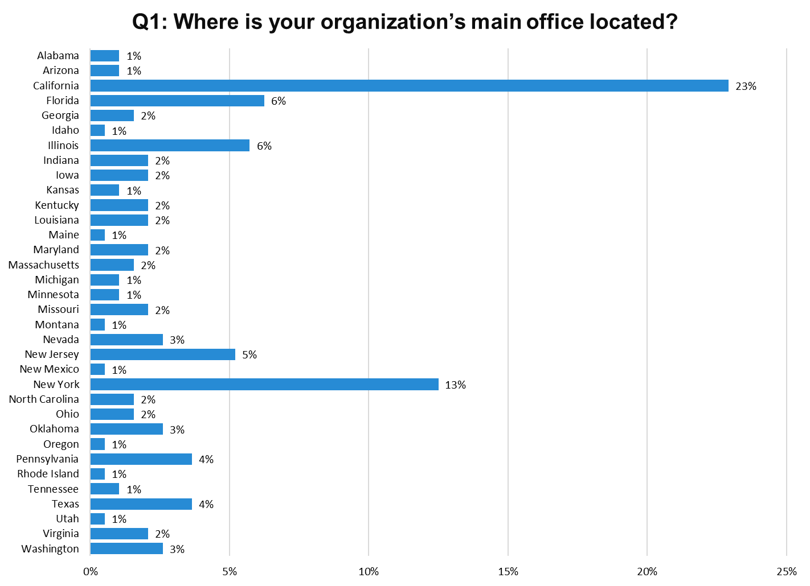
Notes:
N=200

Slide 17
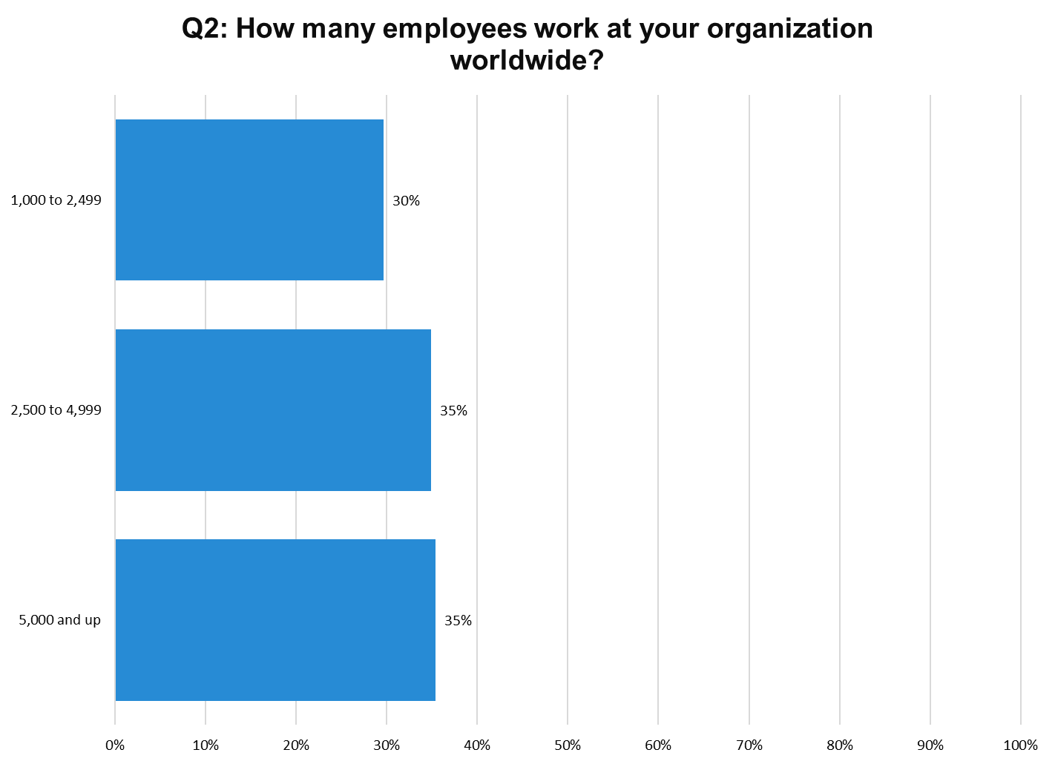
Notes:
N = 112

Slide 18
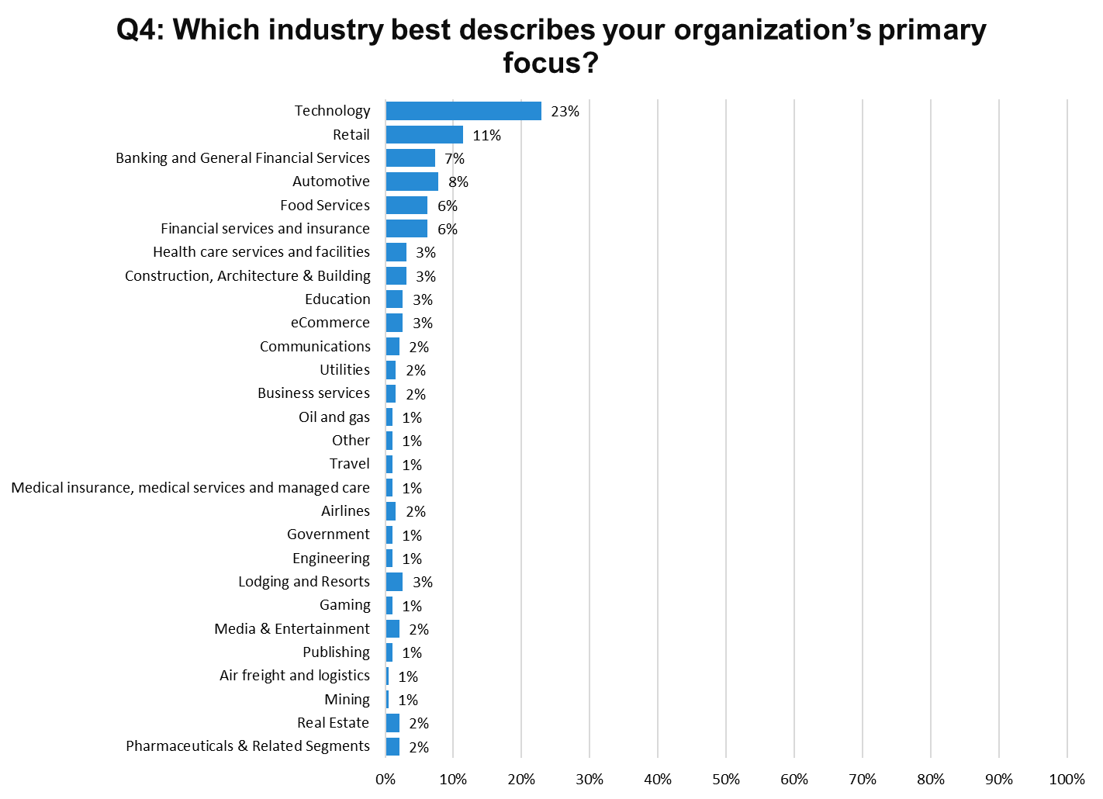
Notes:
N=200

Slide 19
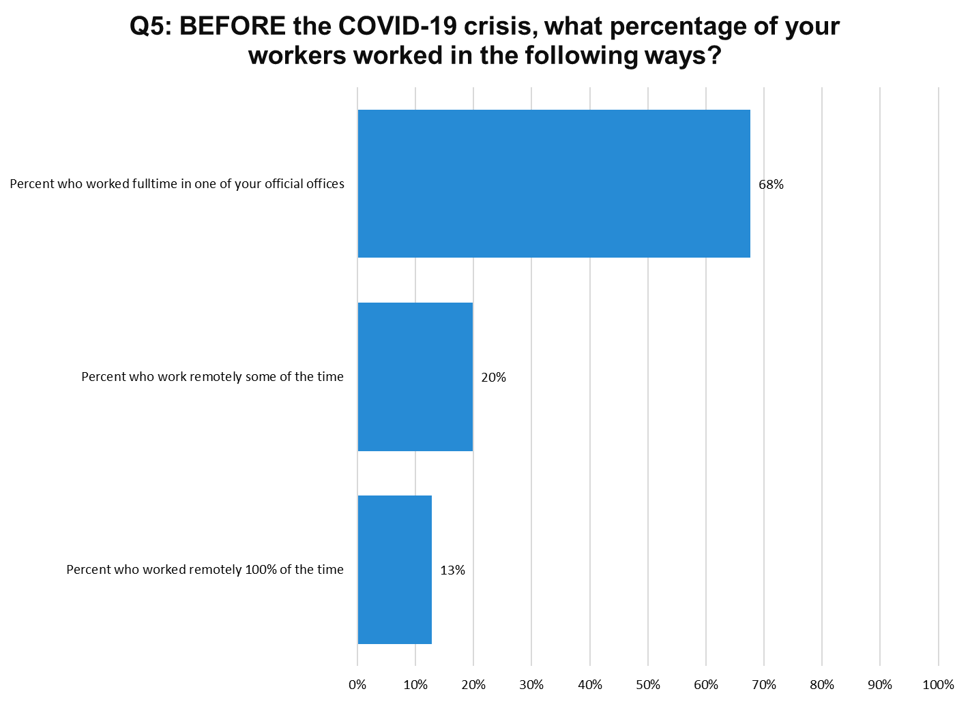
Notes:
N=200

Slide 20
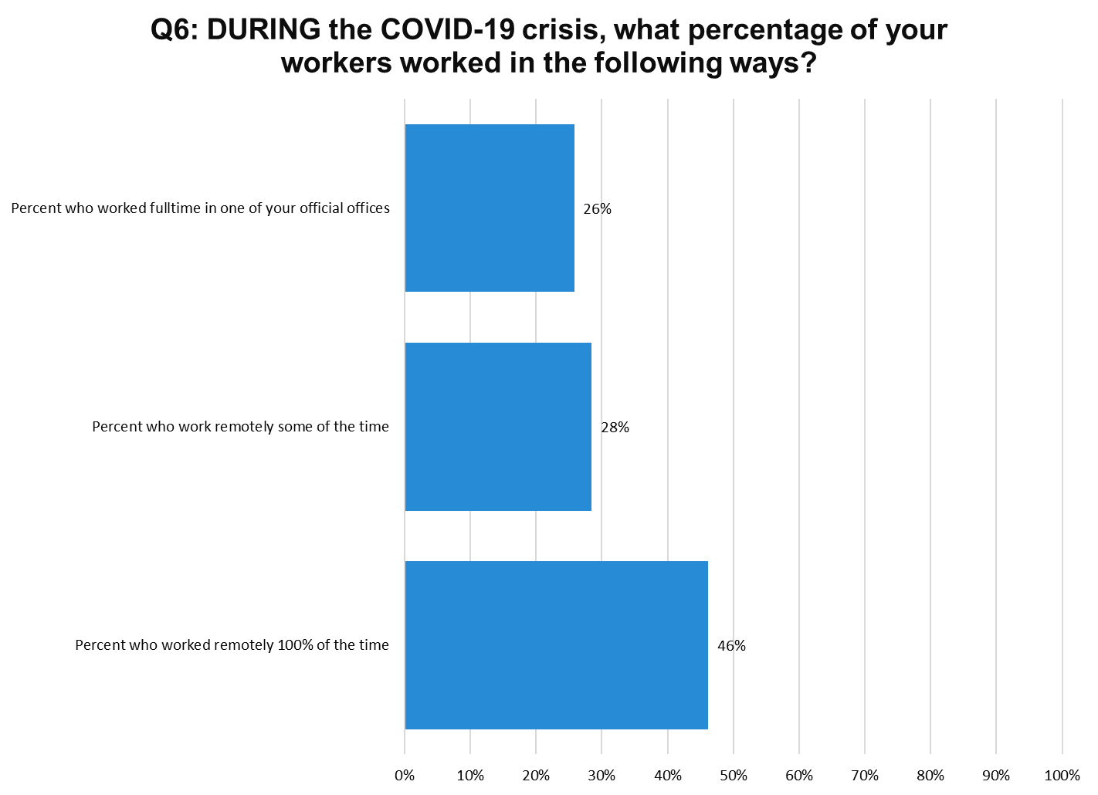
Notes:
N=200

Slide 21
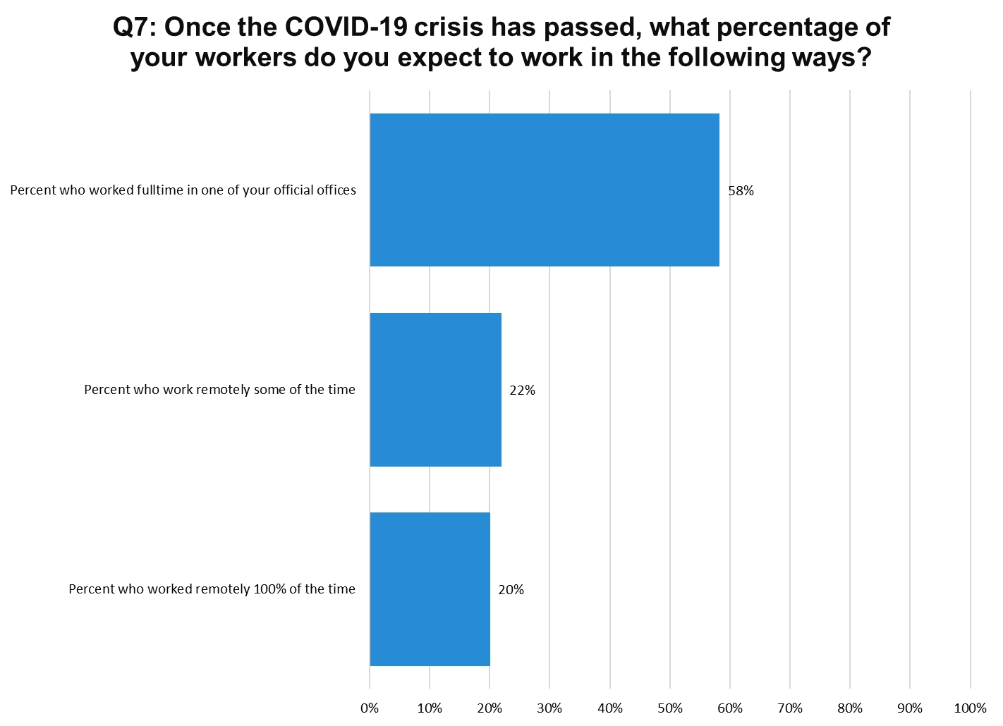
Notes:
N=200

Slide 22
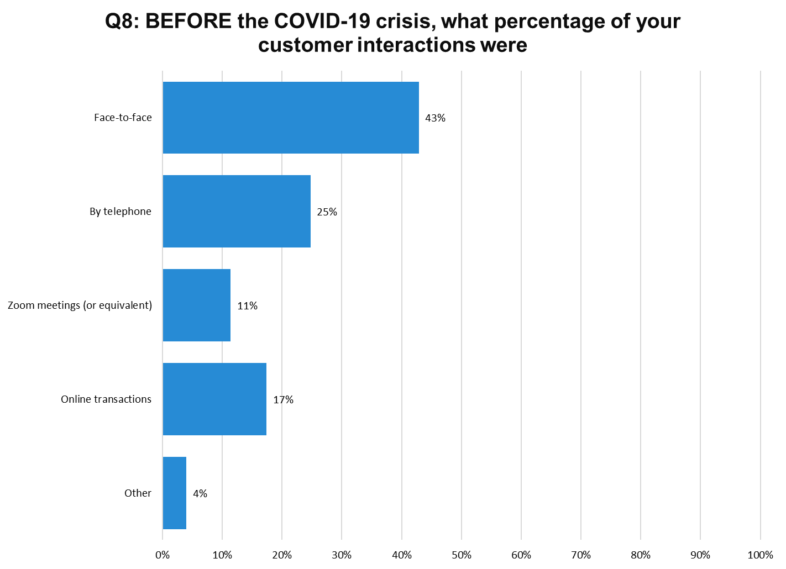
Notes:
N=200

Slide 23
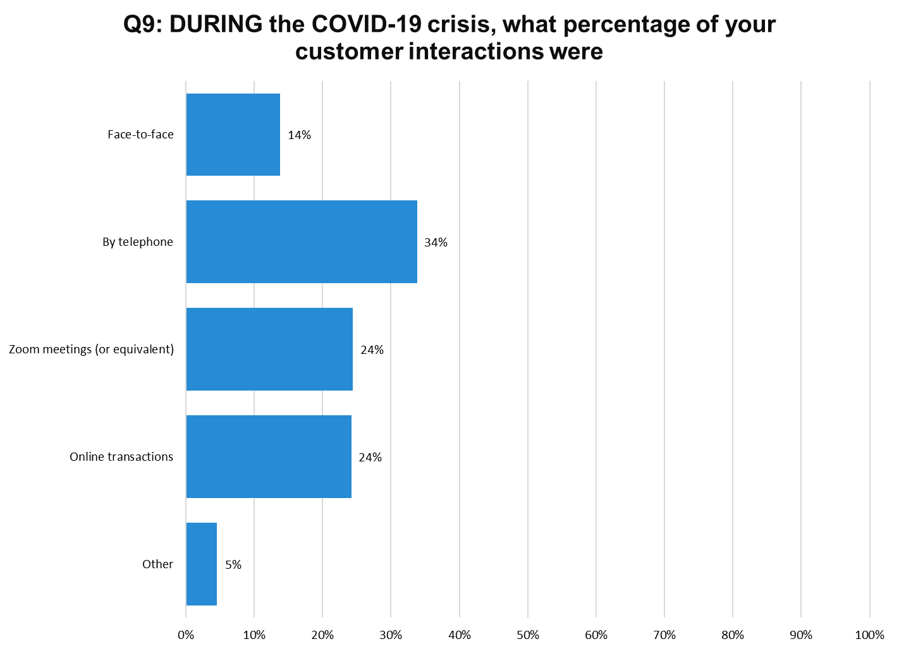
Notes:
N=200

Slide 24
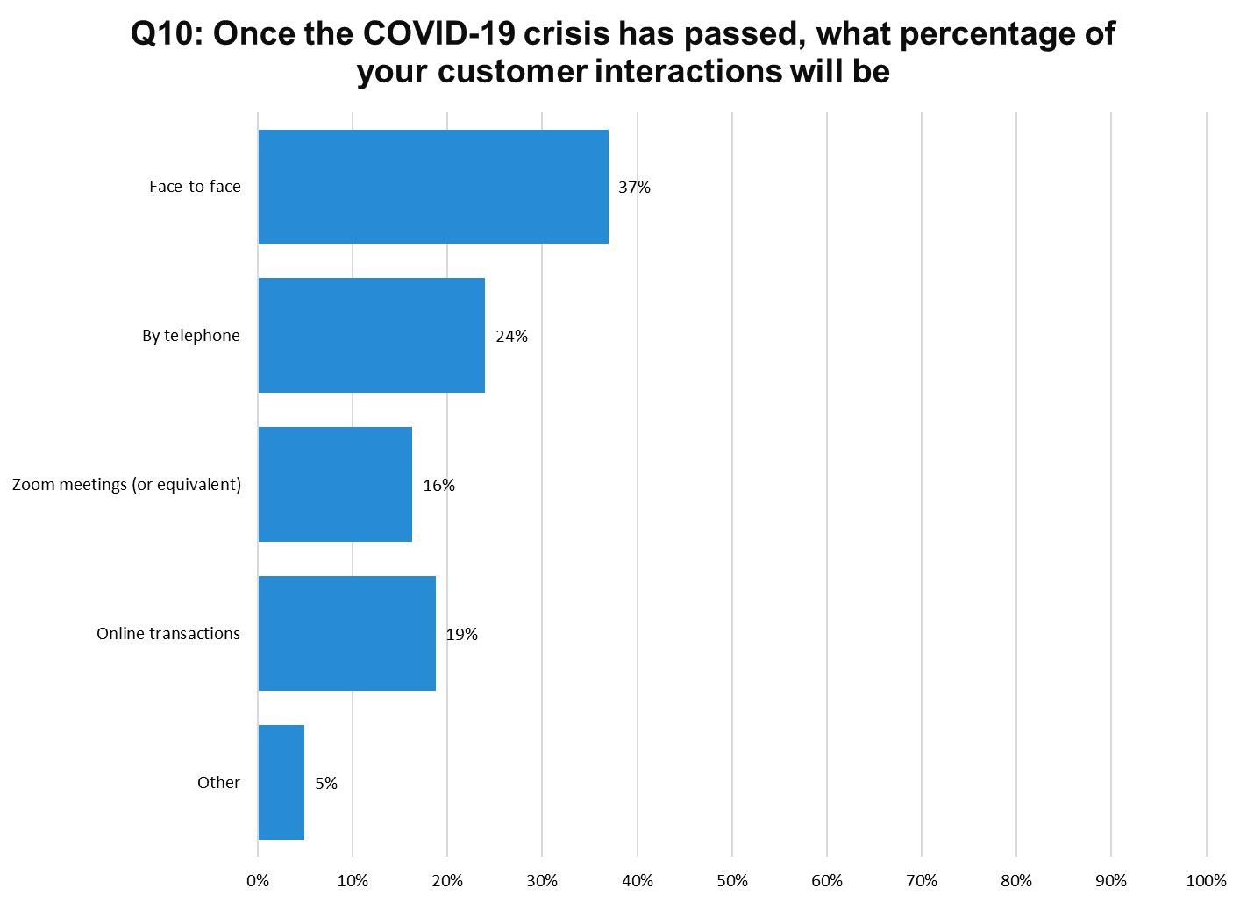
Notes:
N=200

Slide 25
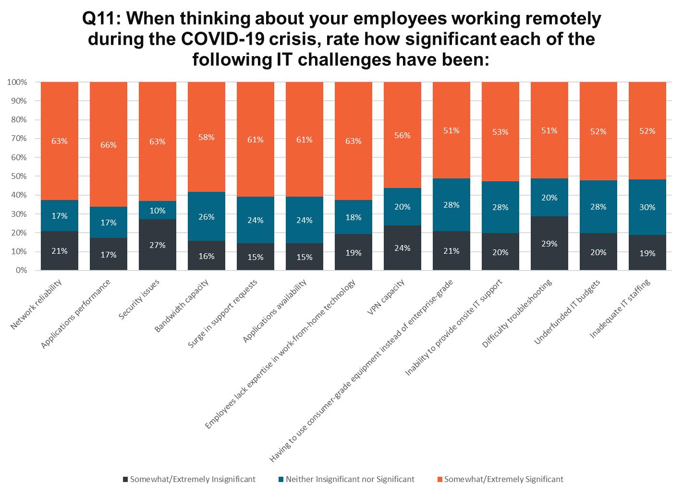
Notes:
N=200

Slide 26
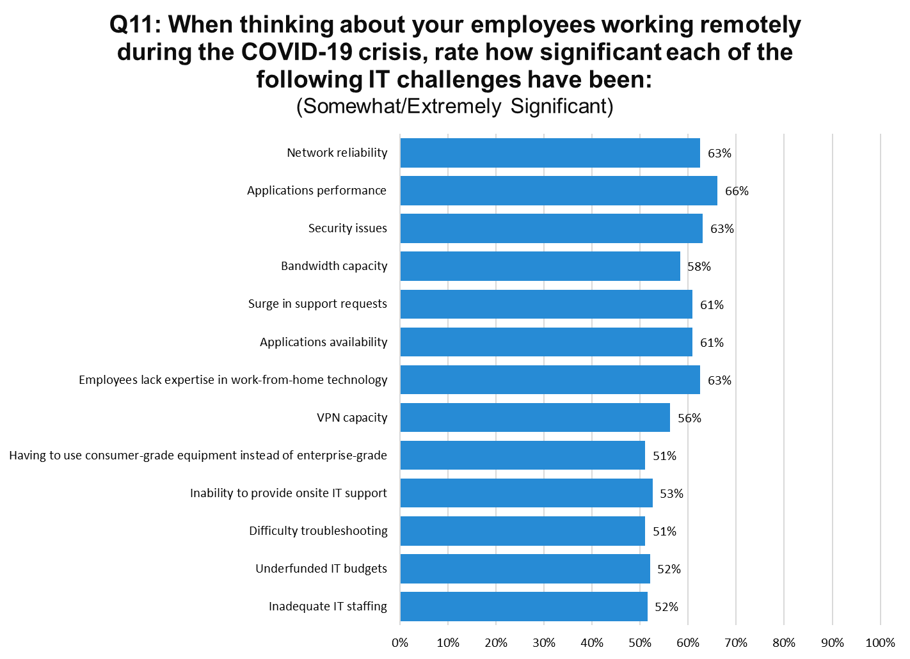
Notes:
N=200

Slide 27
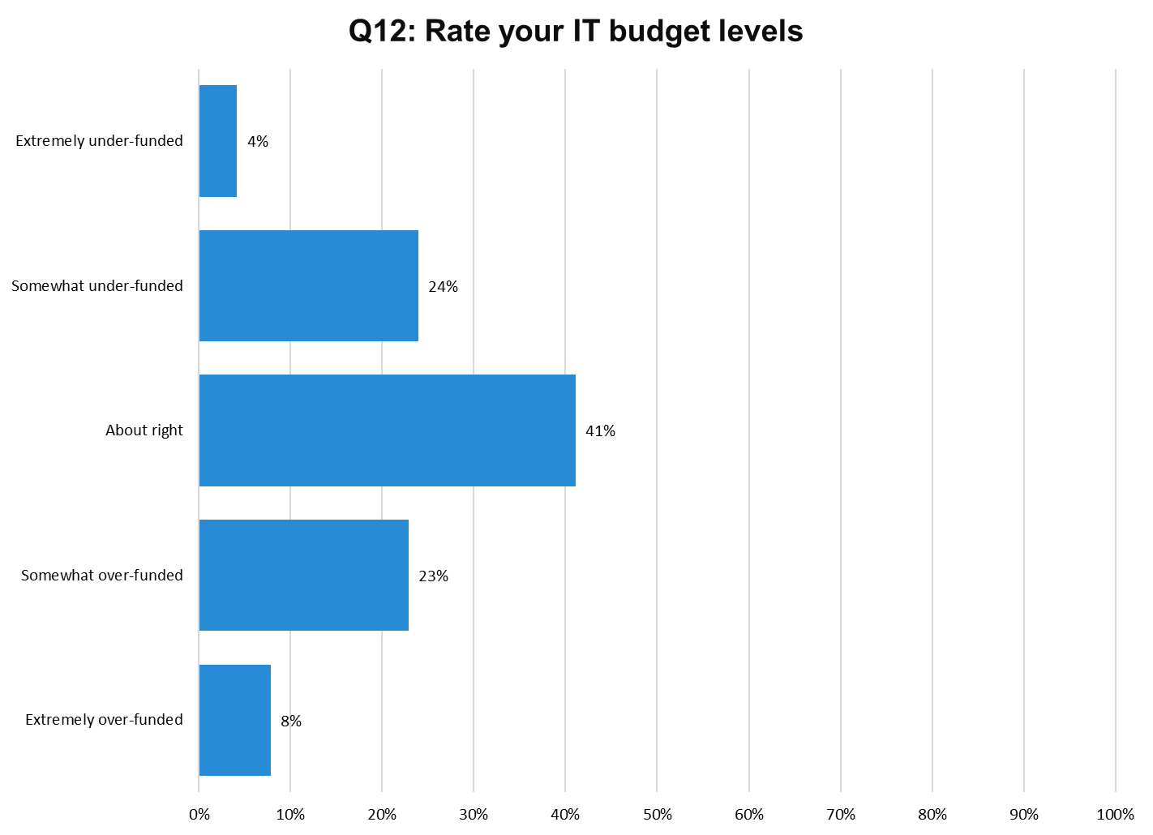
Notes:
N=200

Slide 28
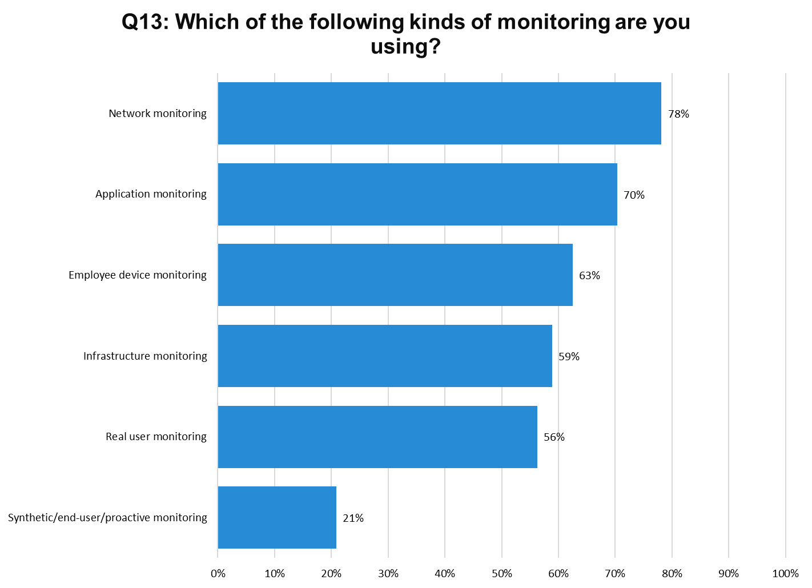
Notes:
N=200

Slide 29
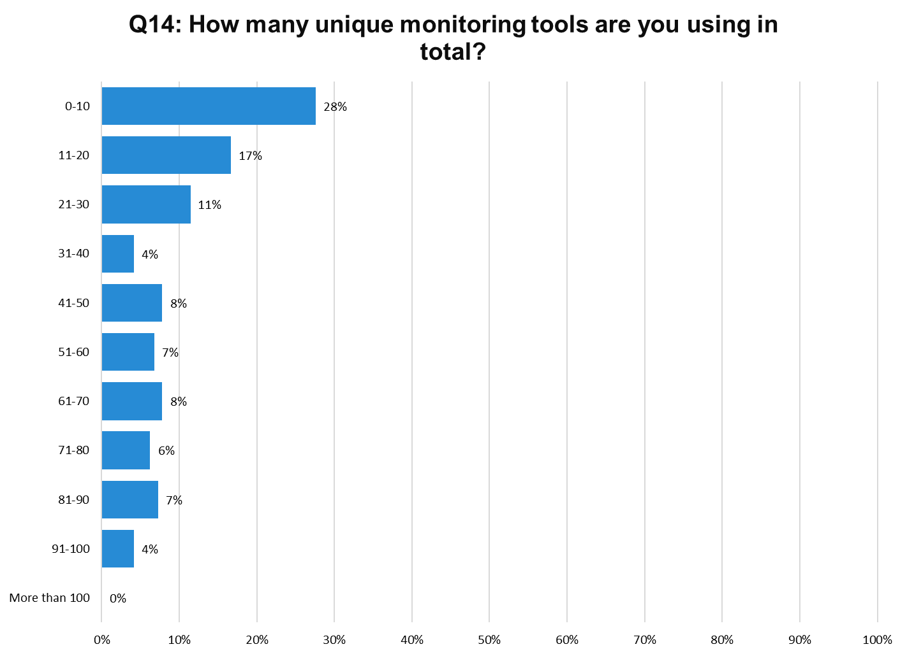
Notes:
N=200
Median = 32.5

Slide 30
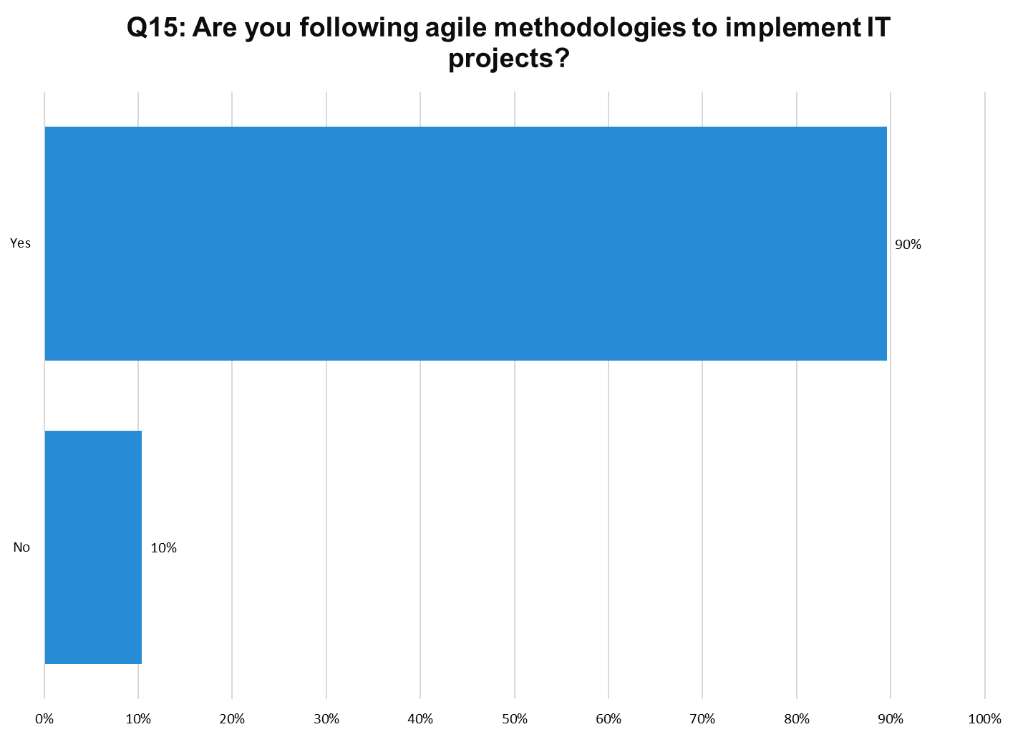
Notes:
N=200

Slide 31
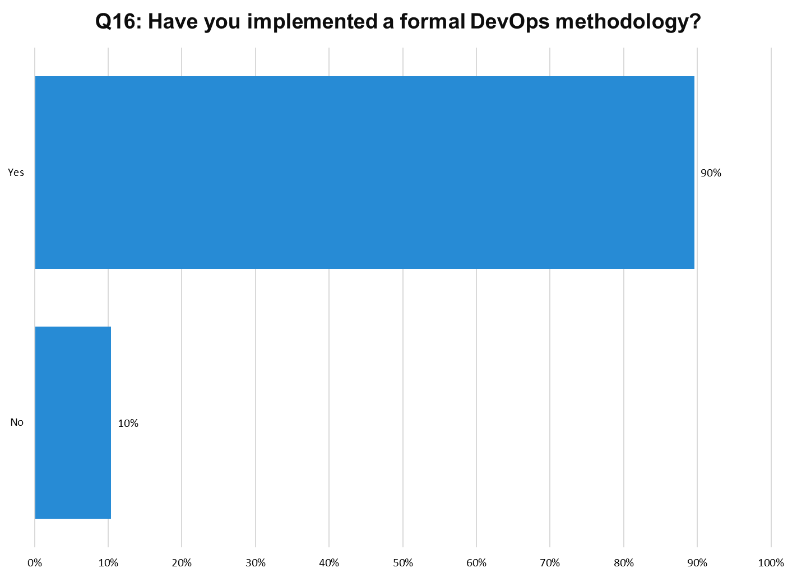
Notes:
N=200

Slide 32
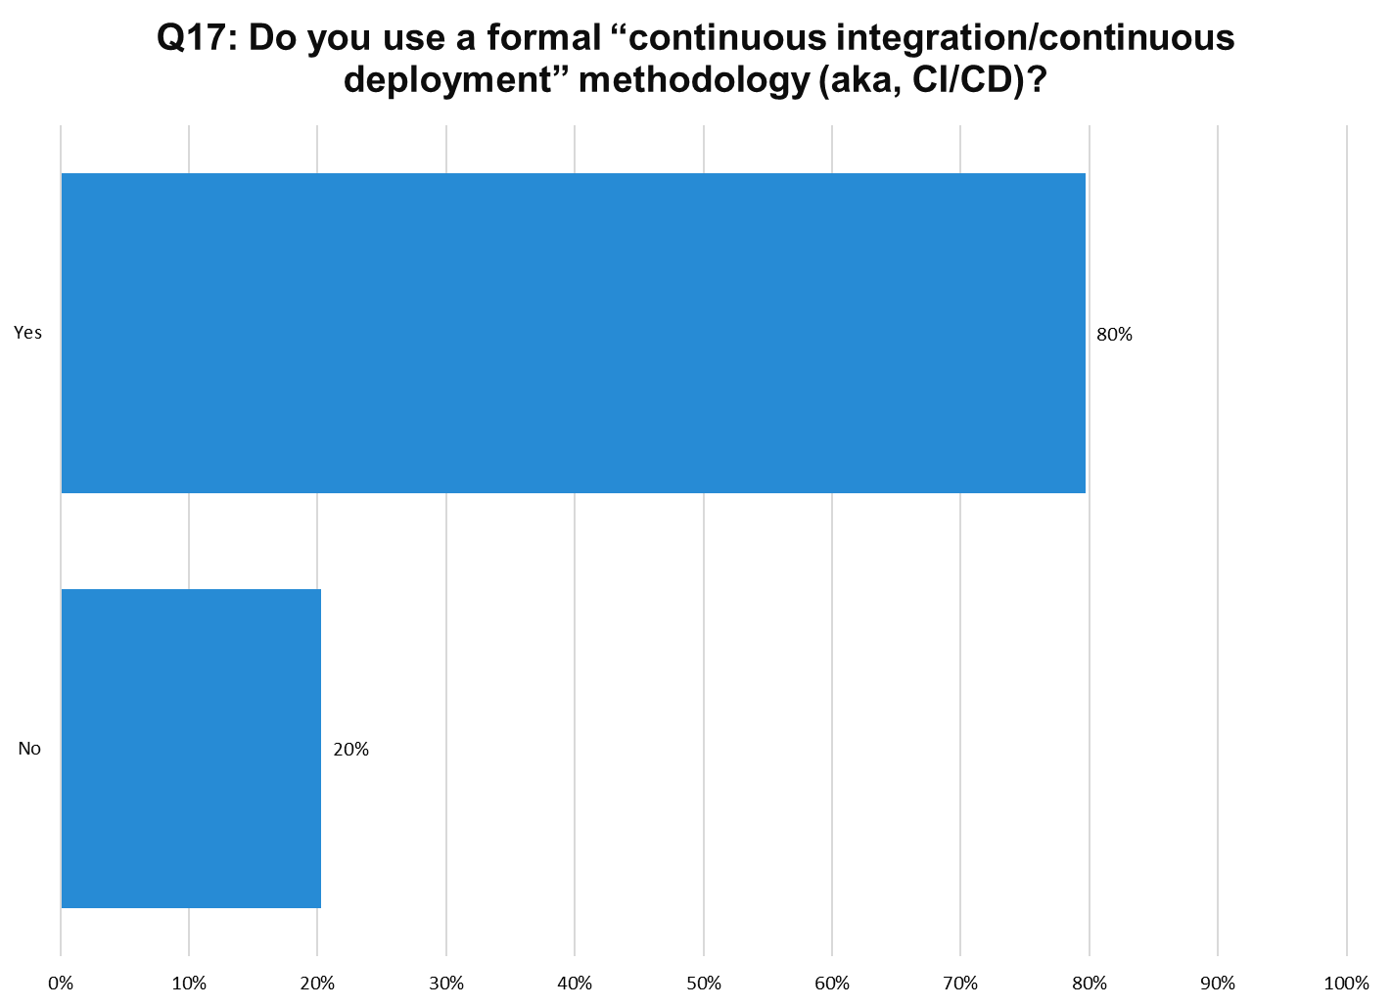
Notes:
N=200

Slide 33
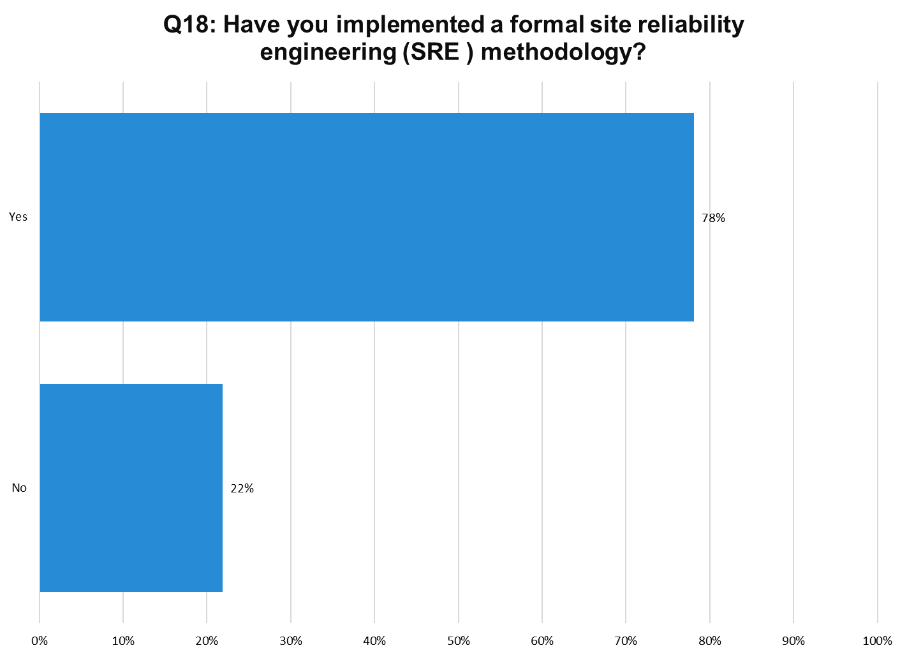
Notes:
N=200

Slide 34
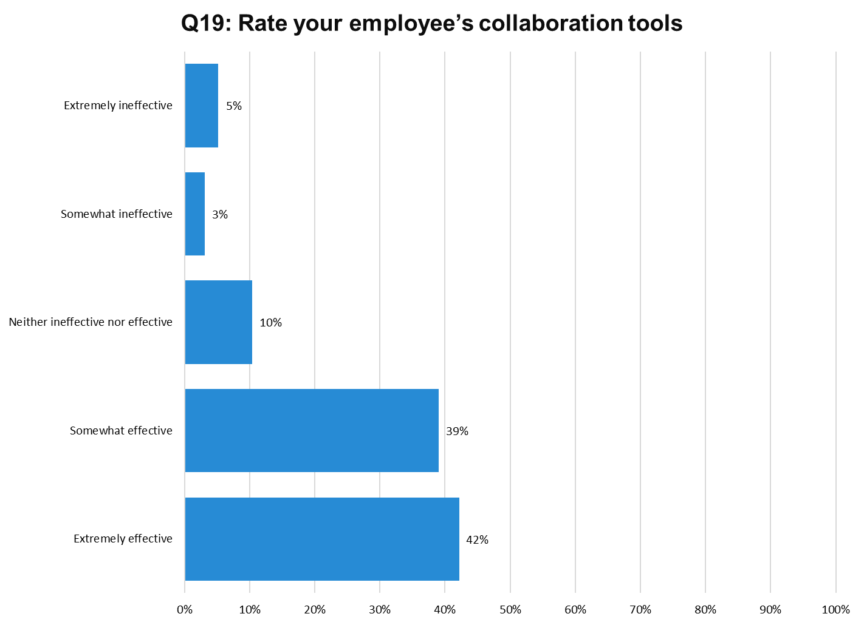
Notes:
N=200

Slide 35
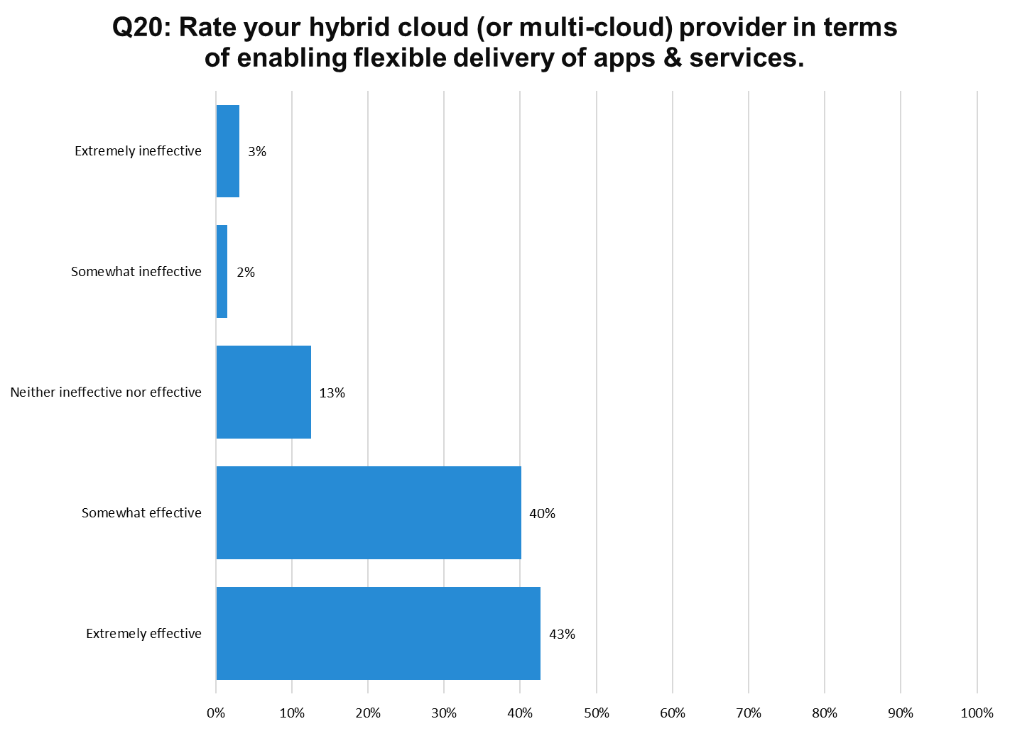
Notes:
N=200

Slide 36
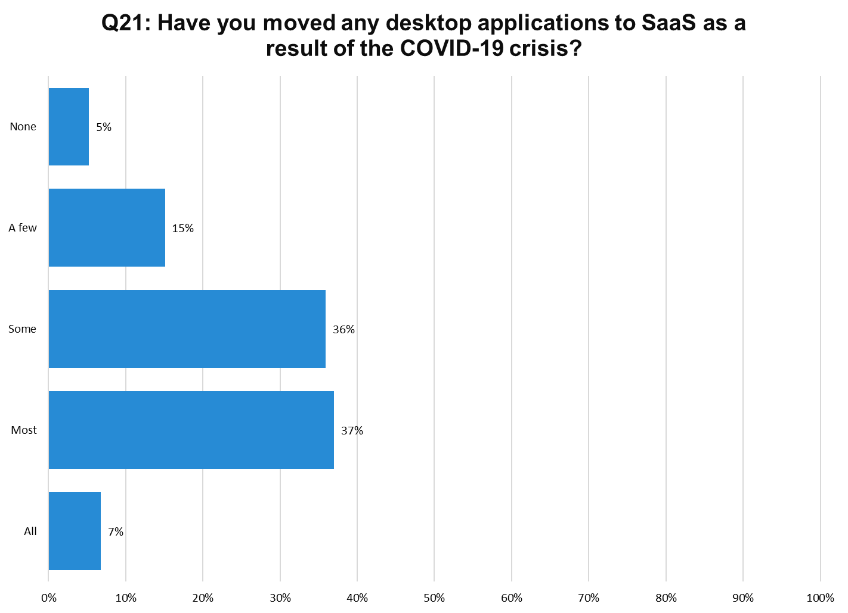
Notes:
N=200

Slide 37
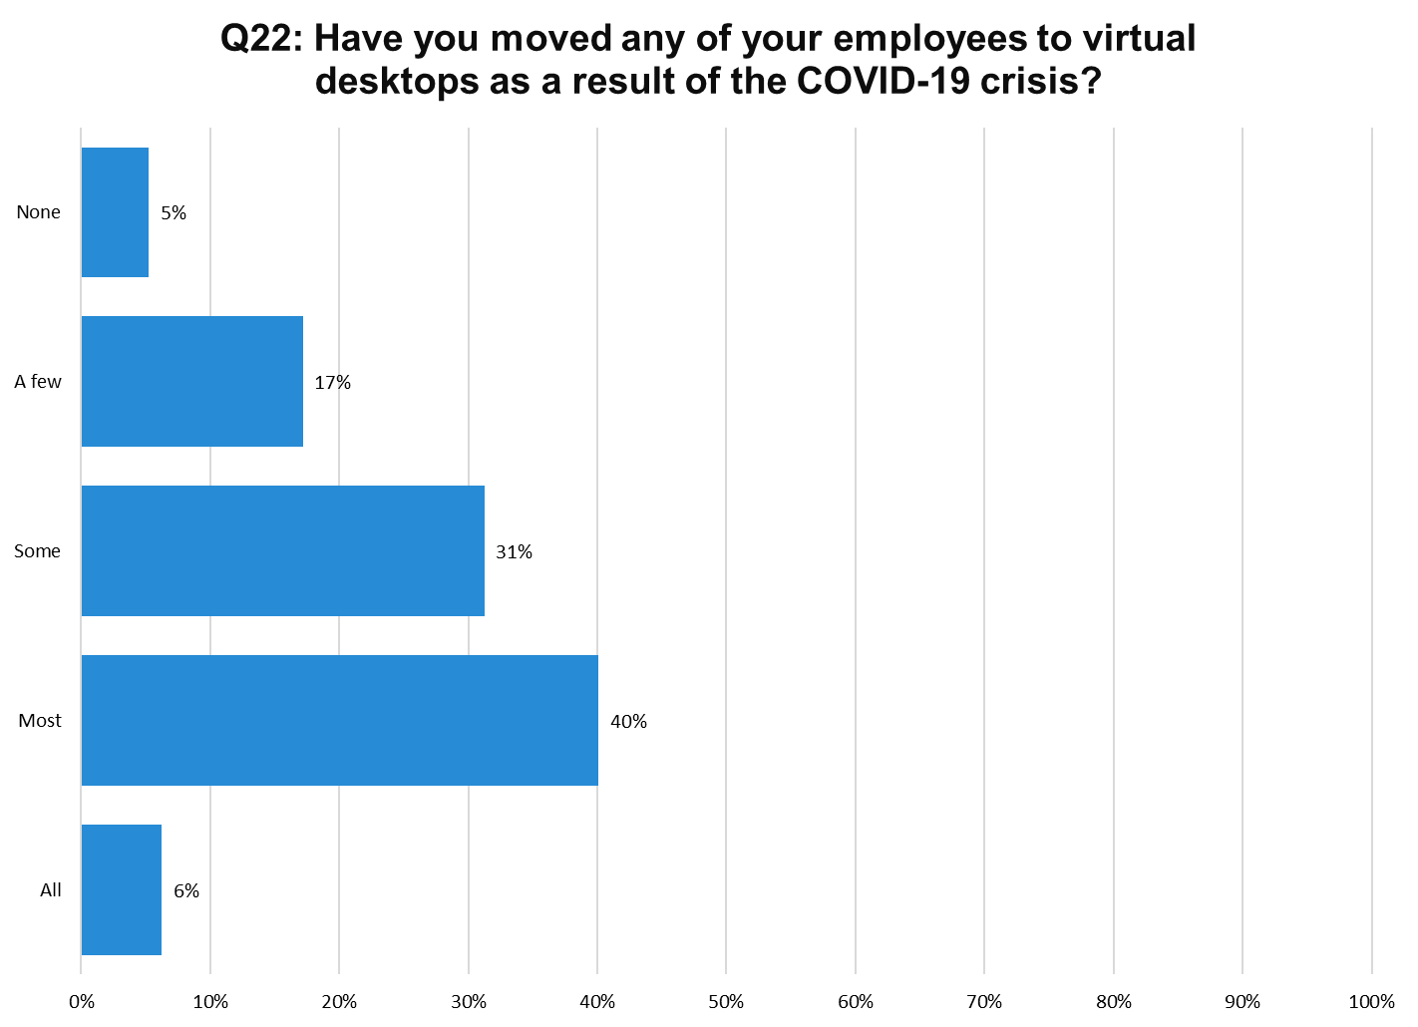
Notes:
N=200

Slide 38
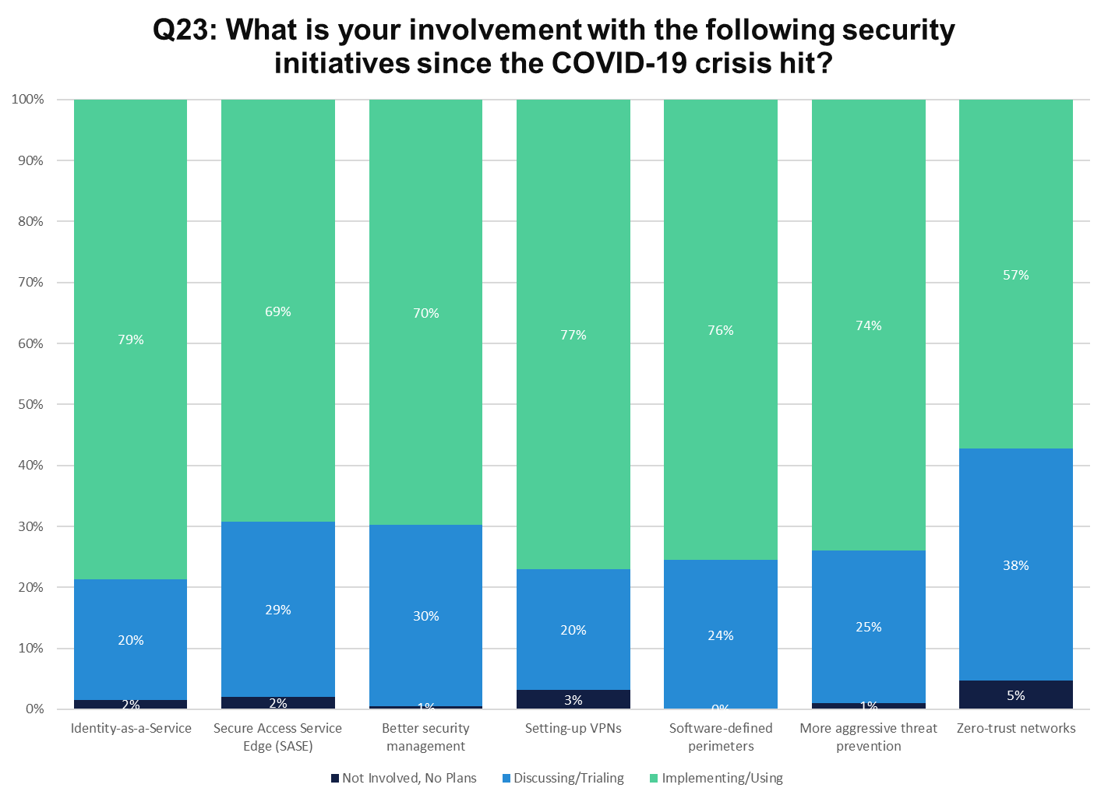
Notes:
N=200

Slide 39
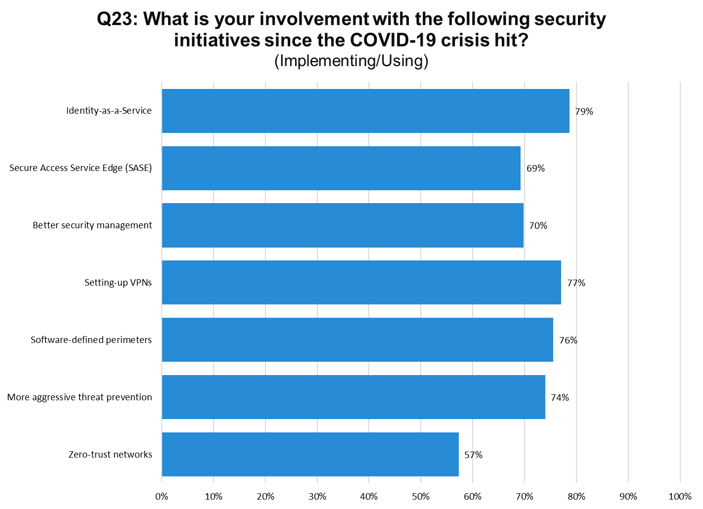
Notes:
N=200

Slide 40
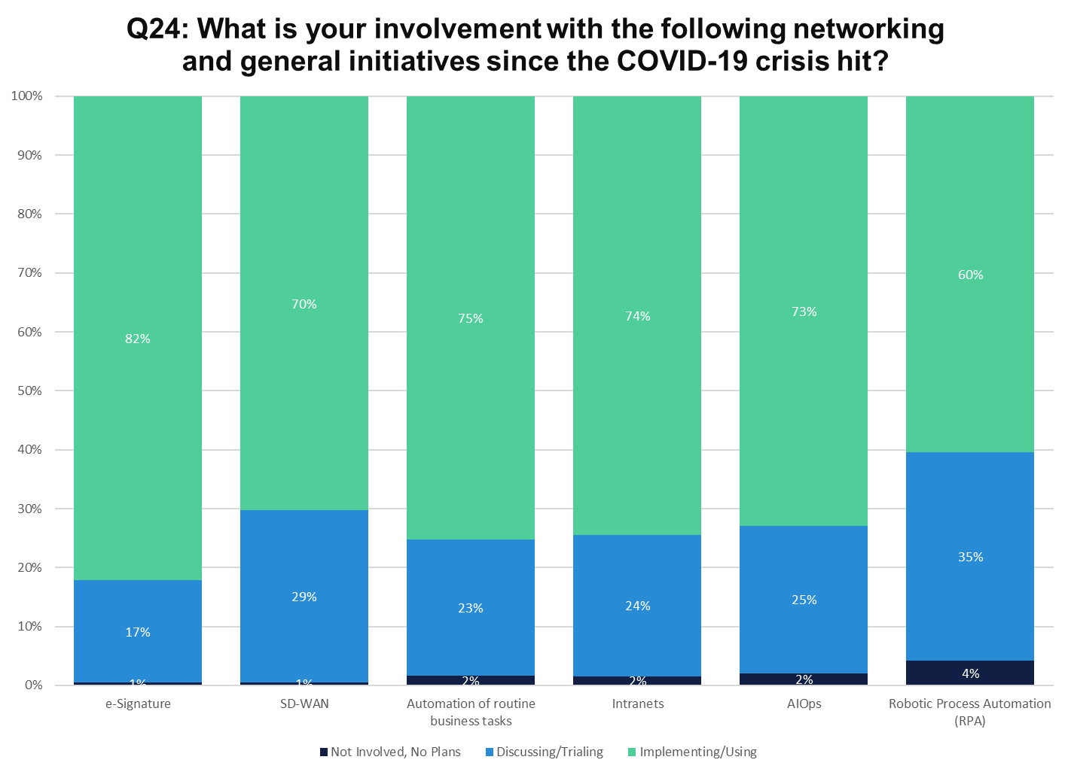
Notes:
N=200

Slide 41
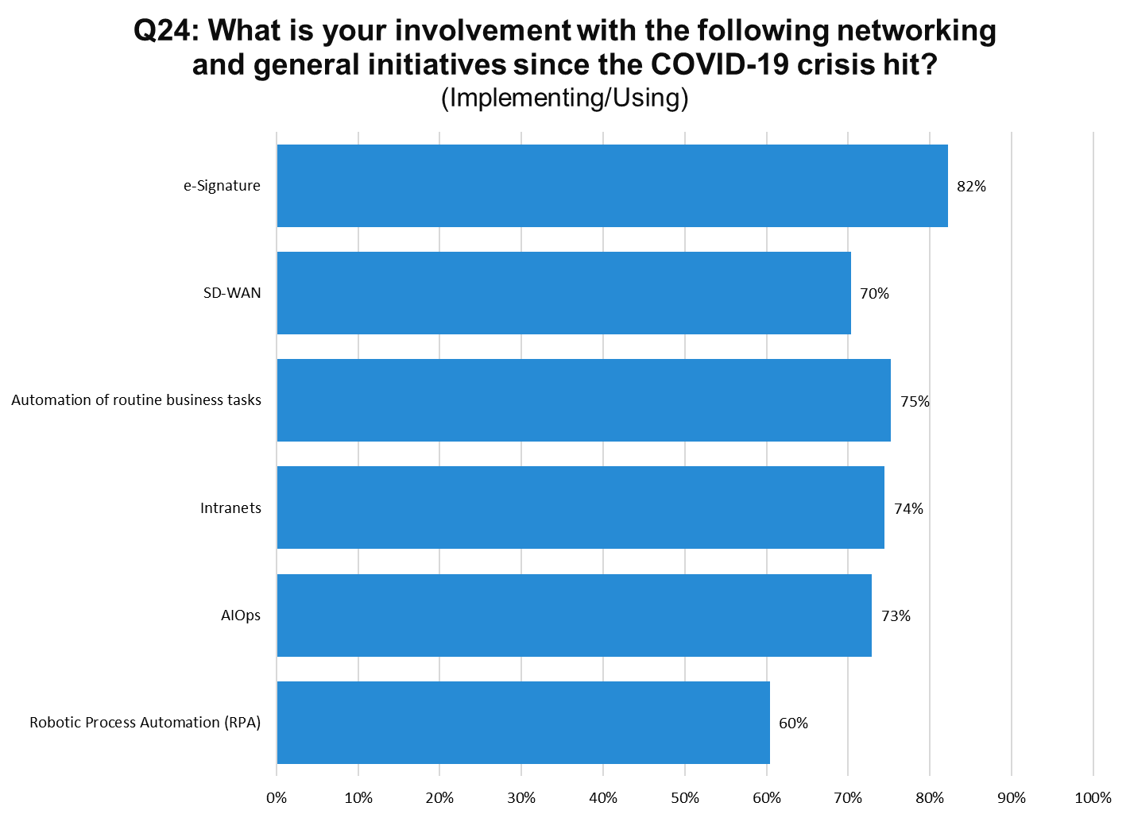
Notes:
N=200

Slide 42
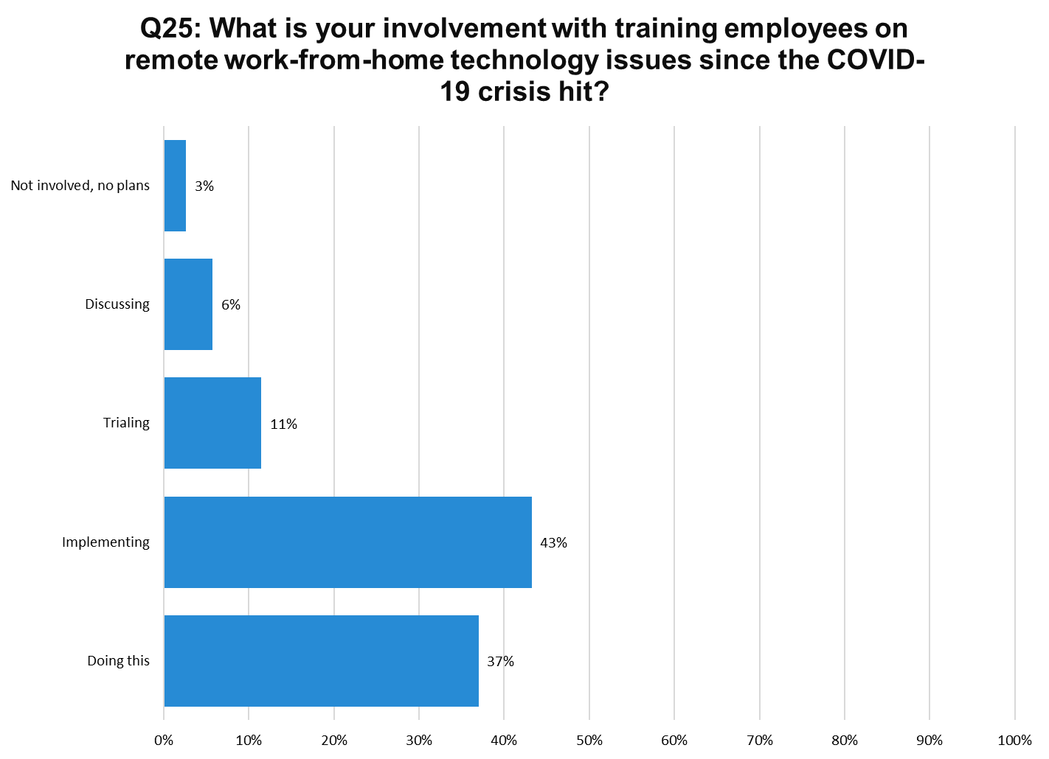
Notes:
N=200

Slide 43
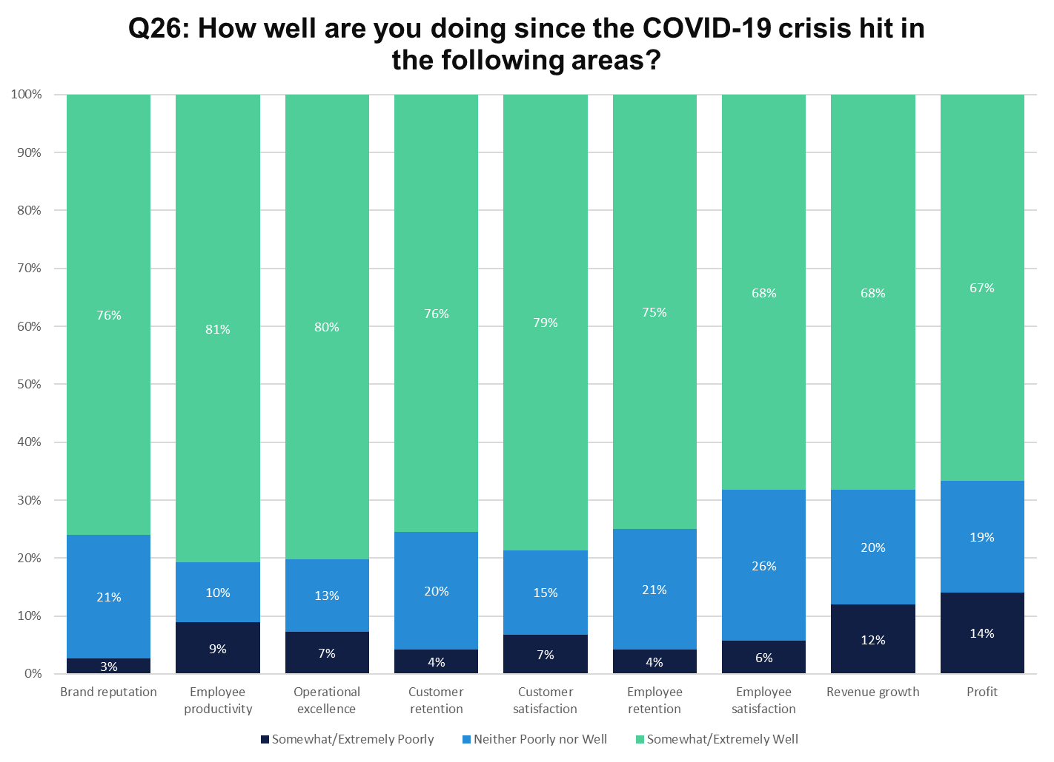
Notes:
N=200

Slide 44
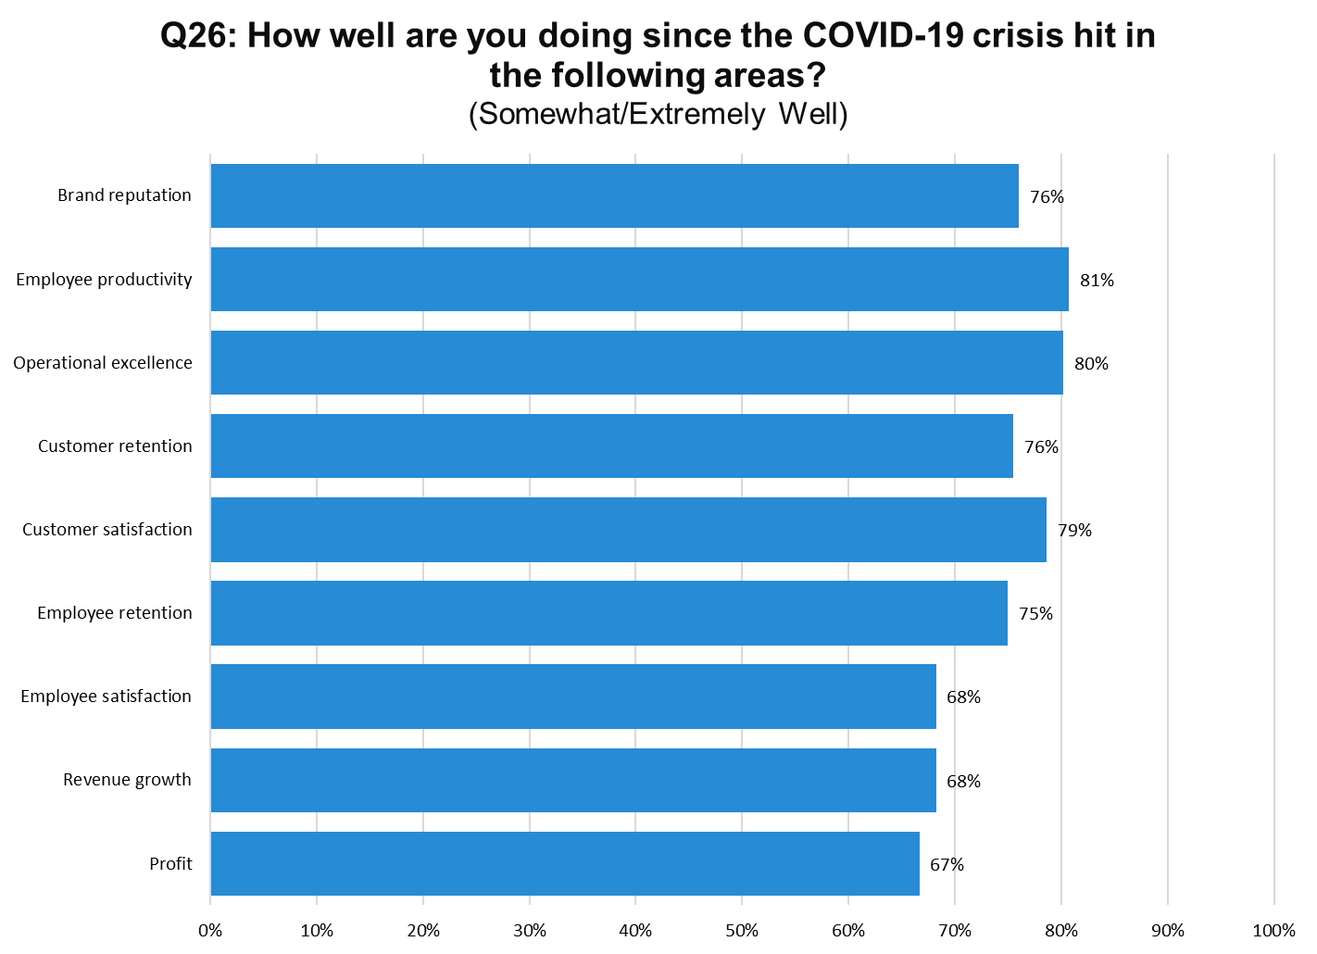
Notes:
N=200

Slide 45
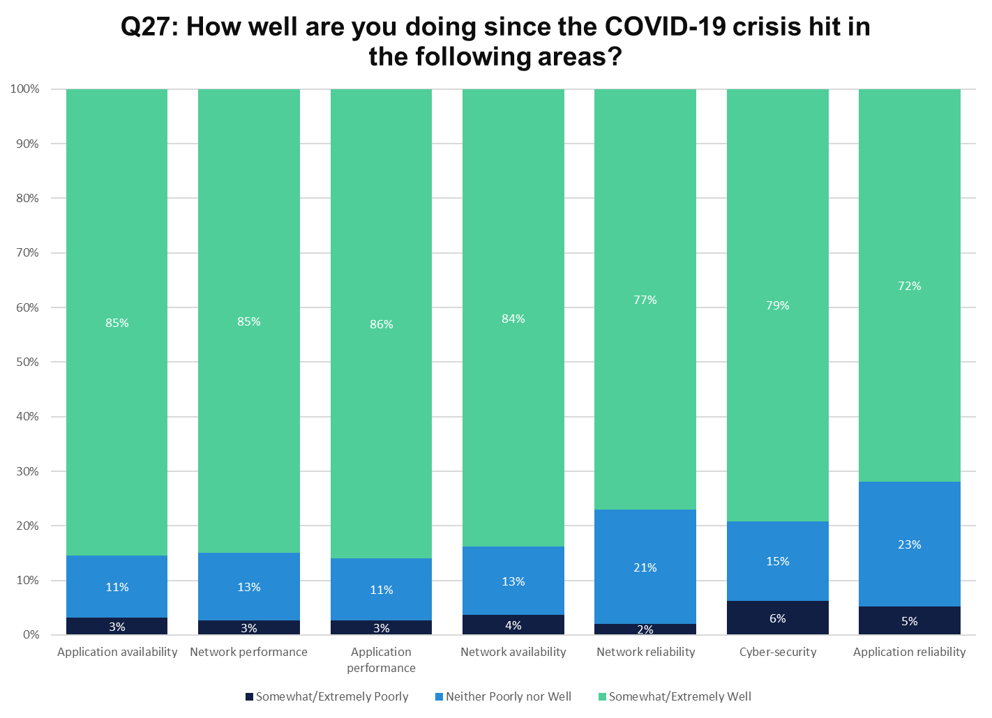
Notes:
N=200

Slide 46
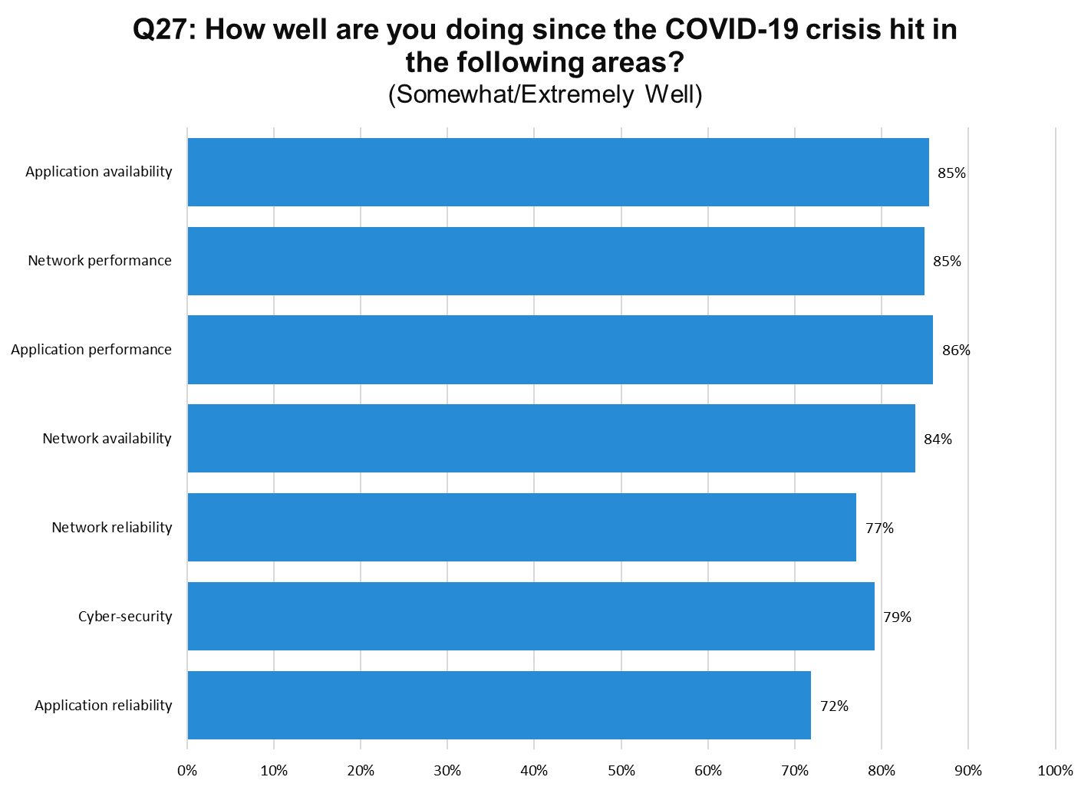
Notes:
N=200

Slide 47
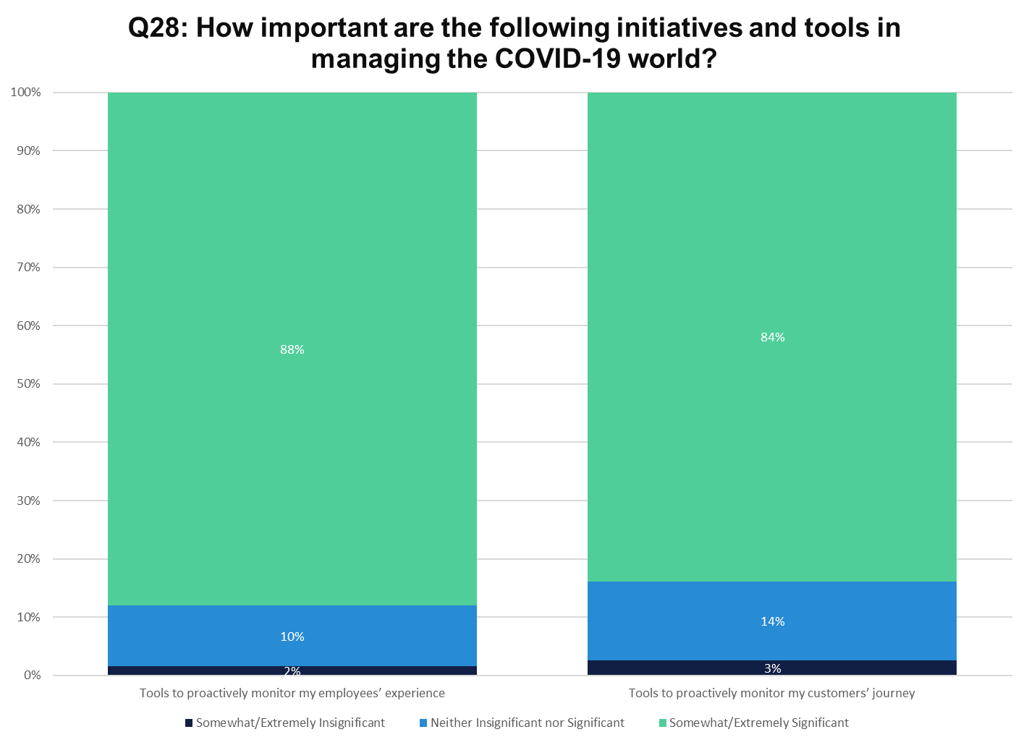
Notes:
N=200

Slide 48
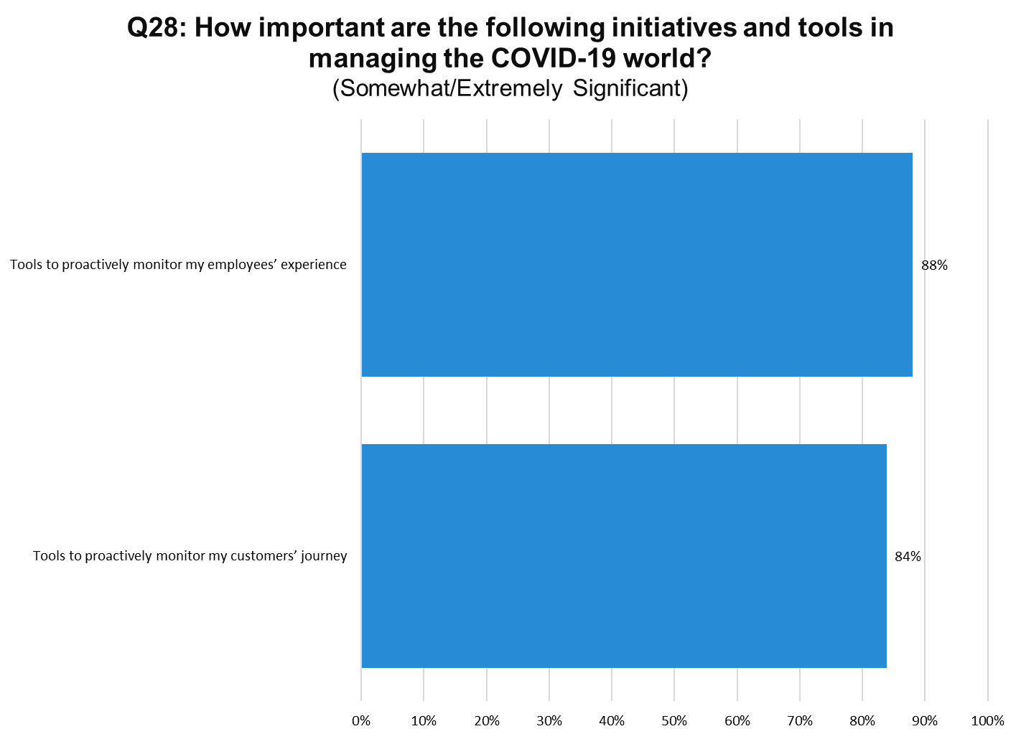
Notes:
N=200

