Slide 1
Instantly Understand Your Microservices
Epsagon Solution Overview

Slide 2







Business Modernization in the Cloud
The business world is transforming around cloud
“Own less, build more” means
Get closer to your customers
Make slow things fast
Make dumb things smart
Notes:
There is an amazing transformation going on in the Cloud.
Companies are getting closer to their customers - whether its apps to create services for their consumers or APIs to make services available to other companies
They’re adding AI to software and turnging hardware into IoT.
, or they’re t
Companies are streamlining their operations, rapidly adding features and services, and getting closer to their customers than ever before.
To get the most out of the cloud, to be the most scalable, the most cost optimized, the fastest to market - any dimension of competitiveness that you can think of - companies are adopting microservices architecture.

Slide 3







Business Modernization in the Cloud
The business world is transforming around cloud
“Own less, build more” means
Get closer to your customers
Make slow things fast
Make dumb things smart
Notes:
There is an amazing transformation going on in the Cloud.
Companies are getting closer to their customers - whether its apps to create services for their consumers or APIs to make services available to other companies
They’re adding AI to software and turnging hardware into IoT.
, or they’re t
Companies are streamlining their operations, rapidly adding features and services, and getting closer to their customers than ever before.
To get the most out of the cloud, to be the most scalable, the most cost optimized, the fastest to market - any dimension of competitiveness that you can think of - companies are adopting microservices architecture.

Slide 4
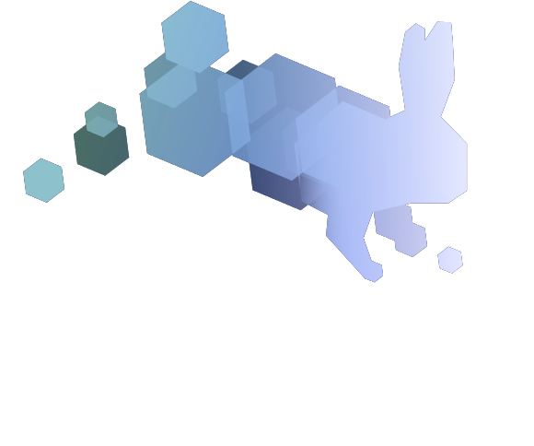




Companies are Already Winning
Needs stories, headlines for 2 enterprise examples
*Releases features “Twice as Fast with Half the Effort”
Notes:
We see it happening in every industry, coming from the top and the bottom. In some cases it is established players seizing the advantage in their market. On the other end of the spectrum, almost every startup launching today is using microservices for cost management at launch and unlimited scale once they find traction in the market.
Adobe
Vonage reported releasing features twice as fast after their move to microservices.
Via
Volta
...

Slide 5
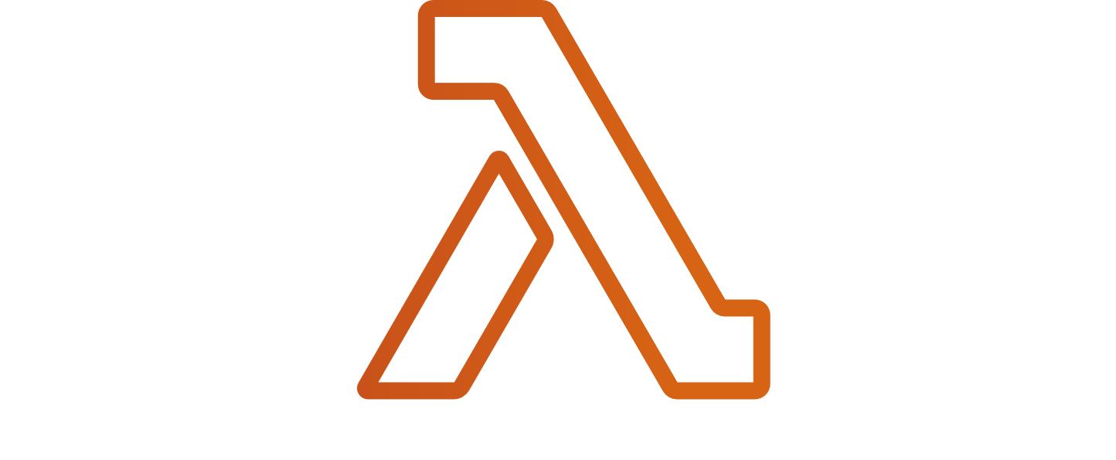


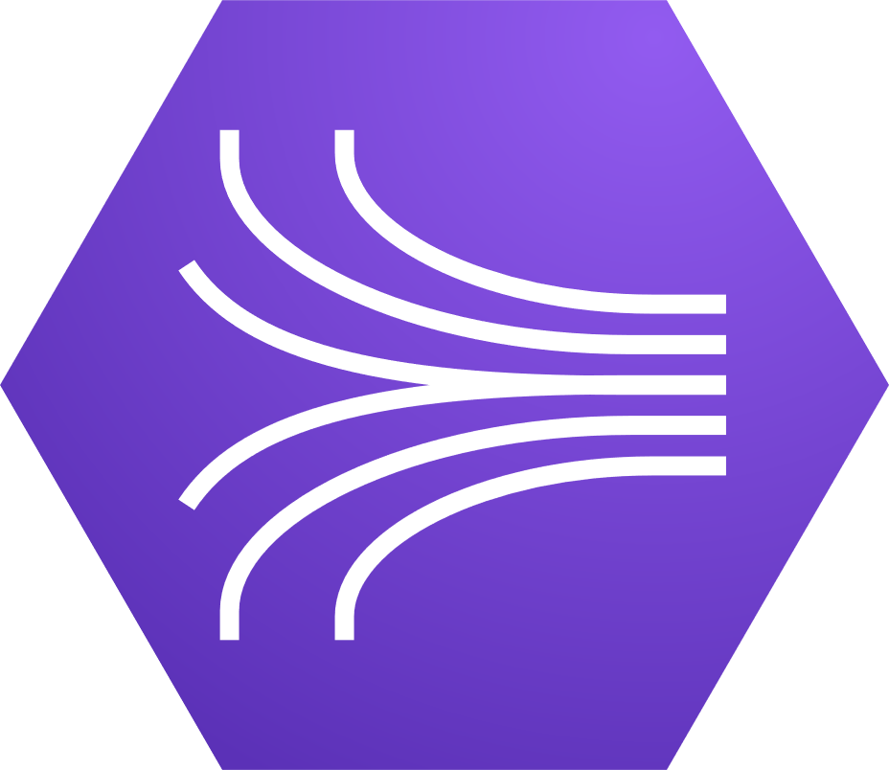
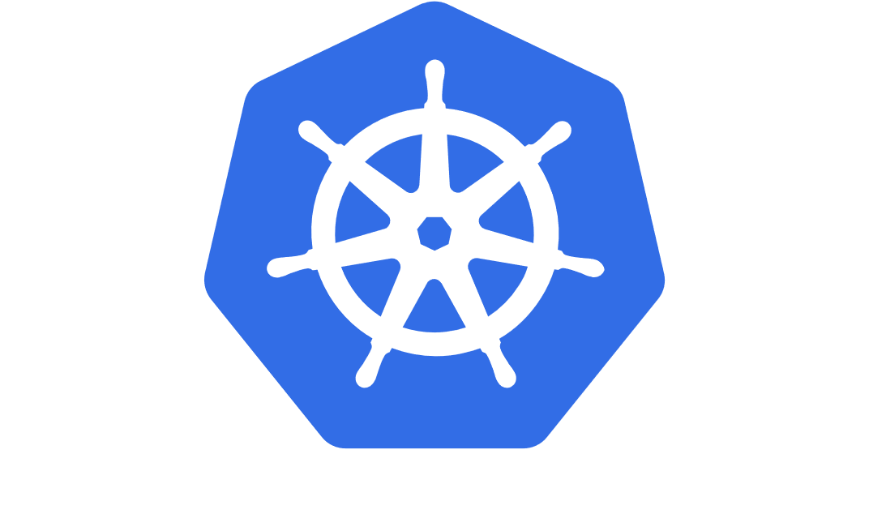
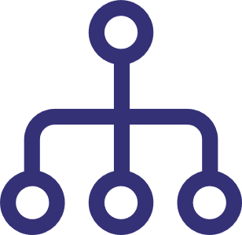

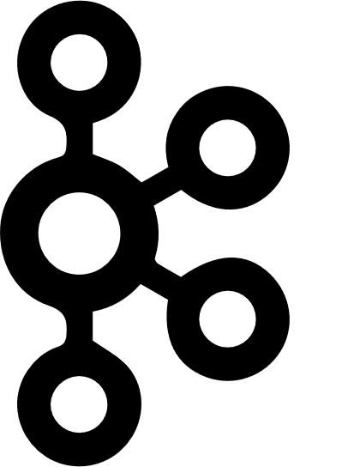





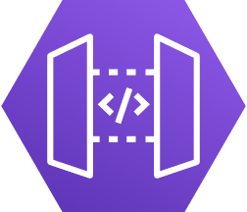
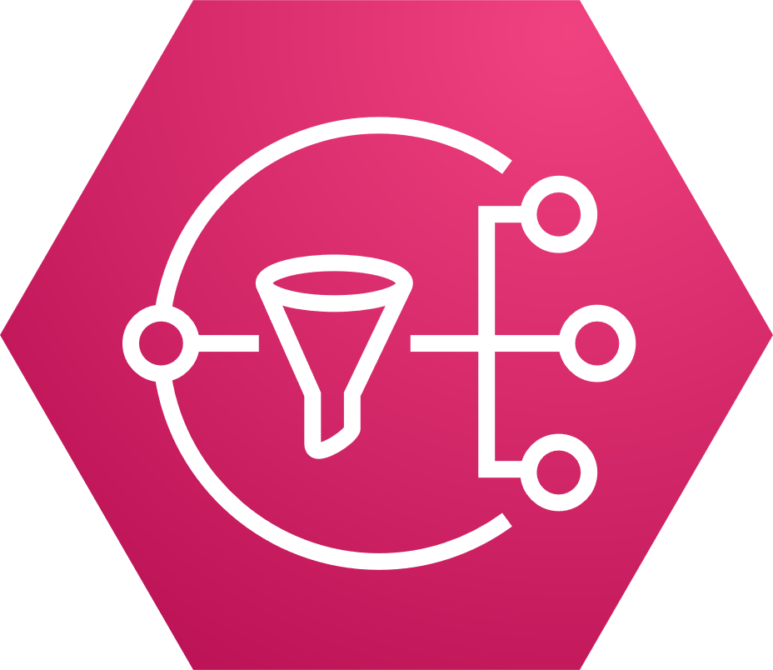
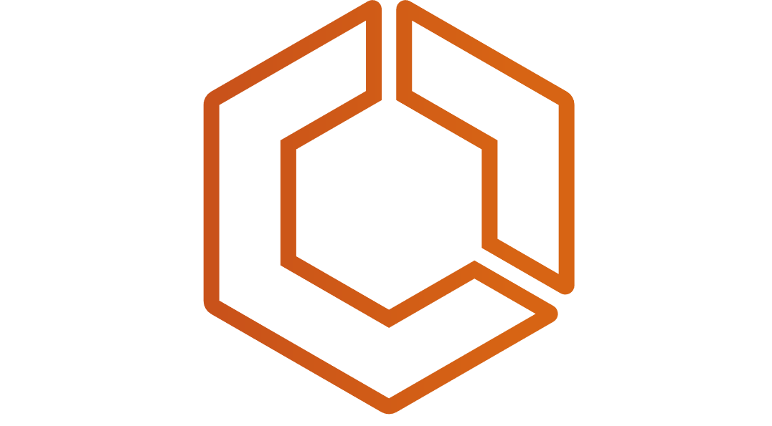

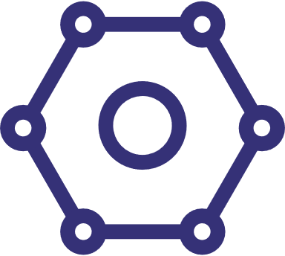
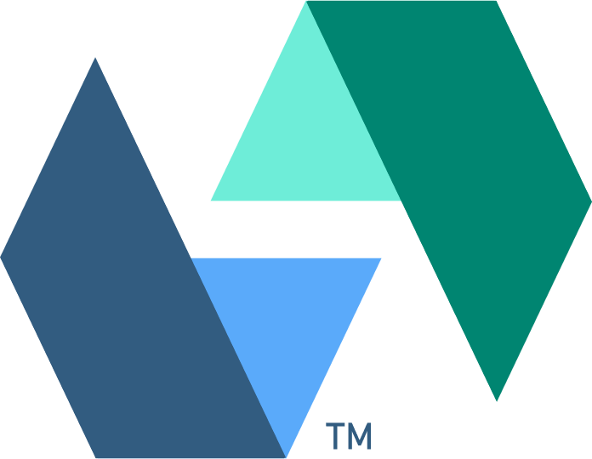


But There’s a Catch
Cloud service APIs are difficult to troubleshoot
Thousands of containers, functions, and services with a wide variety of behaviors
Logic shifts from the code within a service to the calls between microservices
Notes:
But there is a catch - complexity
Infrastructure is no longer the blocker. If you had their templates, you could spin up Vonage’s AWS infrastructure right now. But, your engineers wouldn’t understand what what they have on their hands.
Without the right help, the cloud can move faster and create more complexity than DevOps teams can manage.

Slide 6
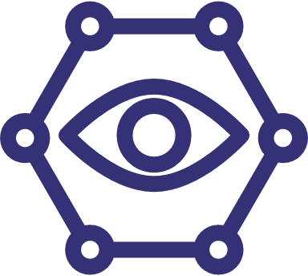

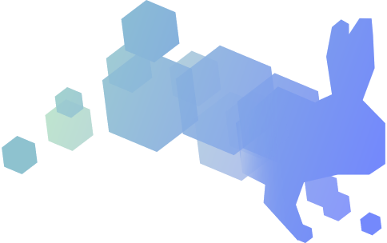
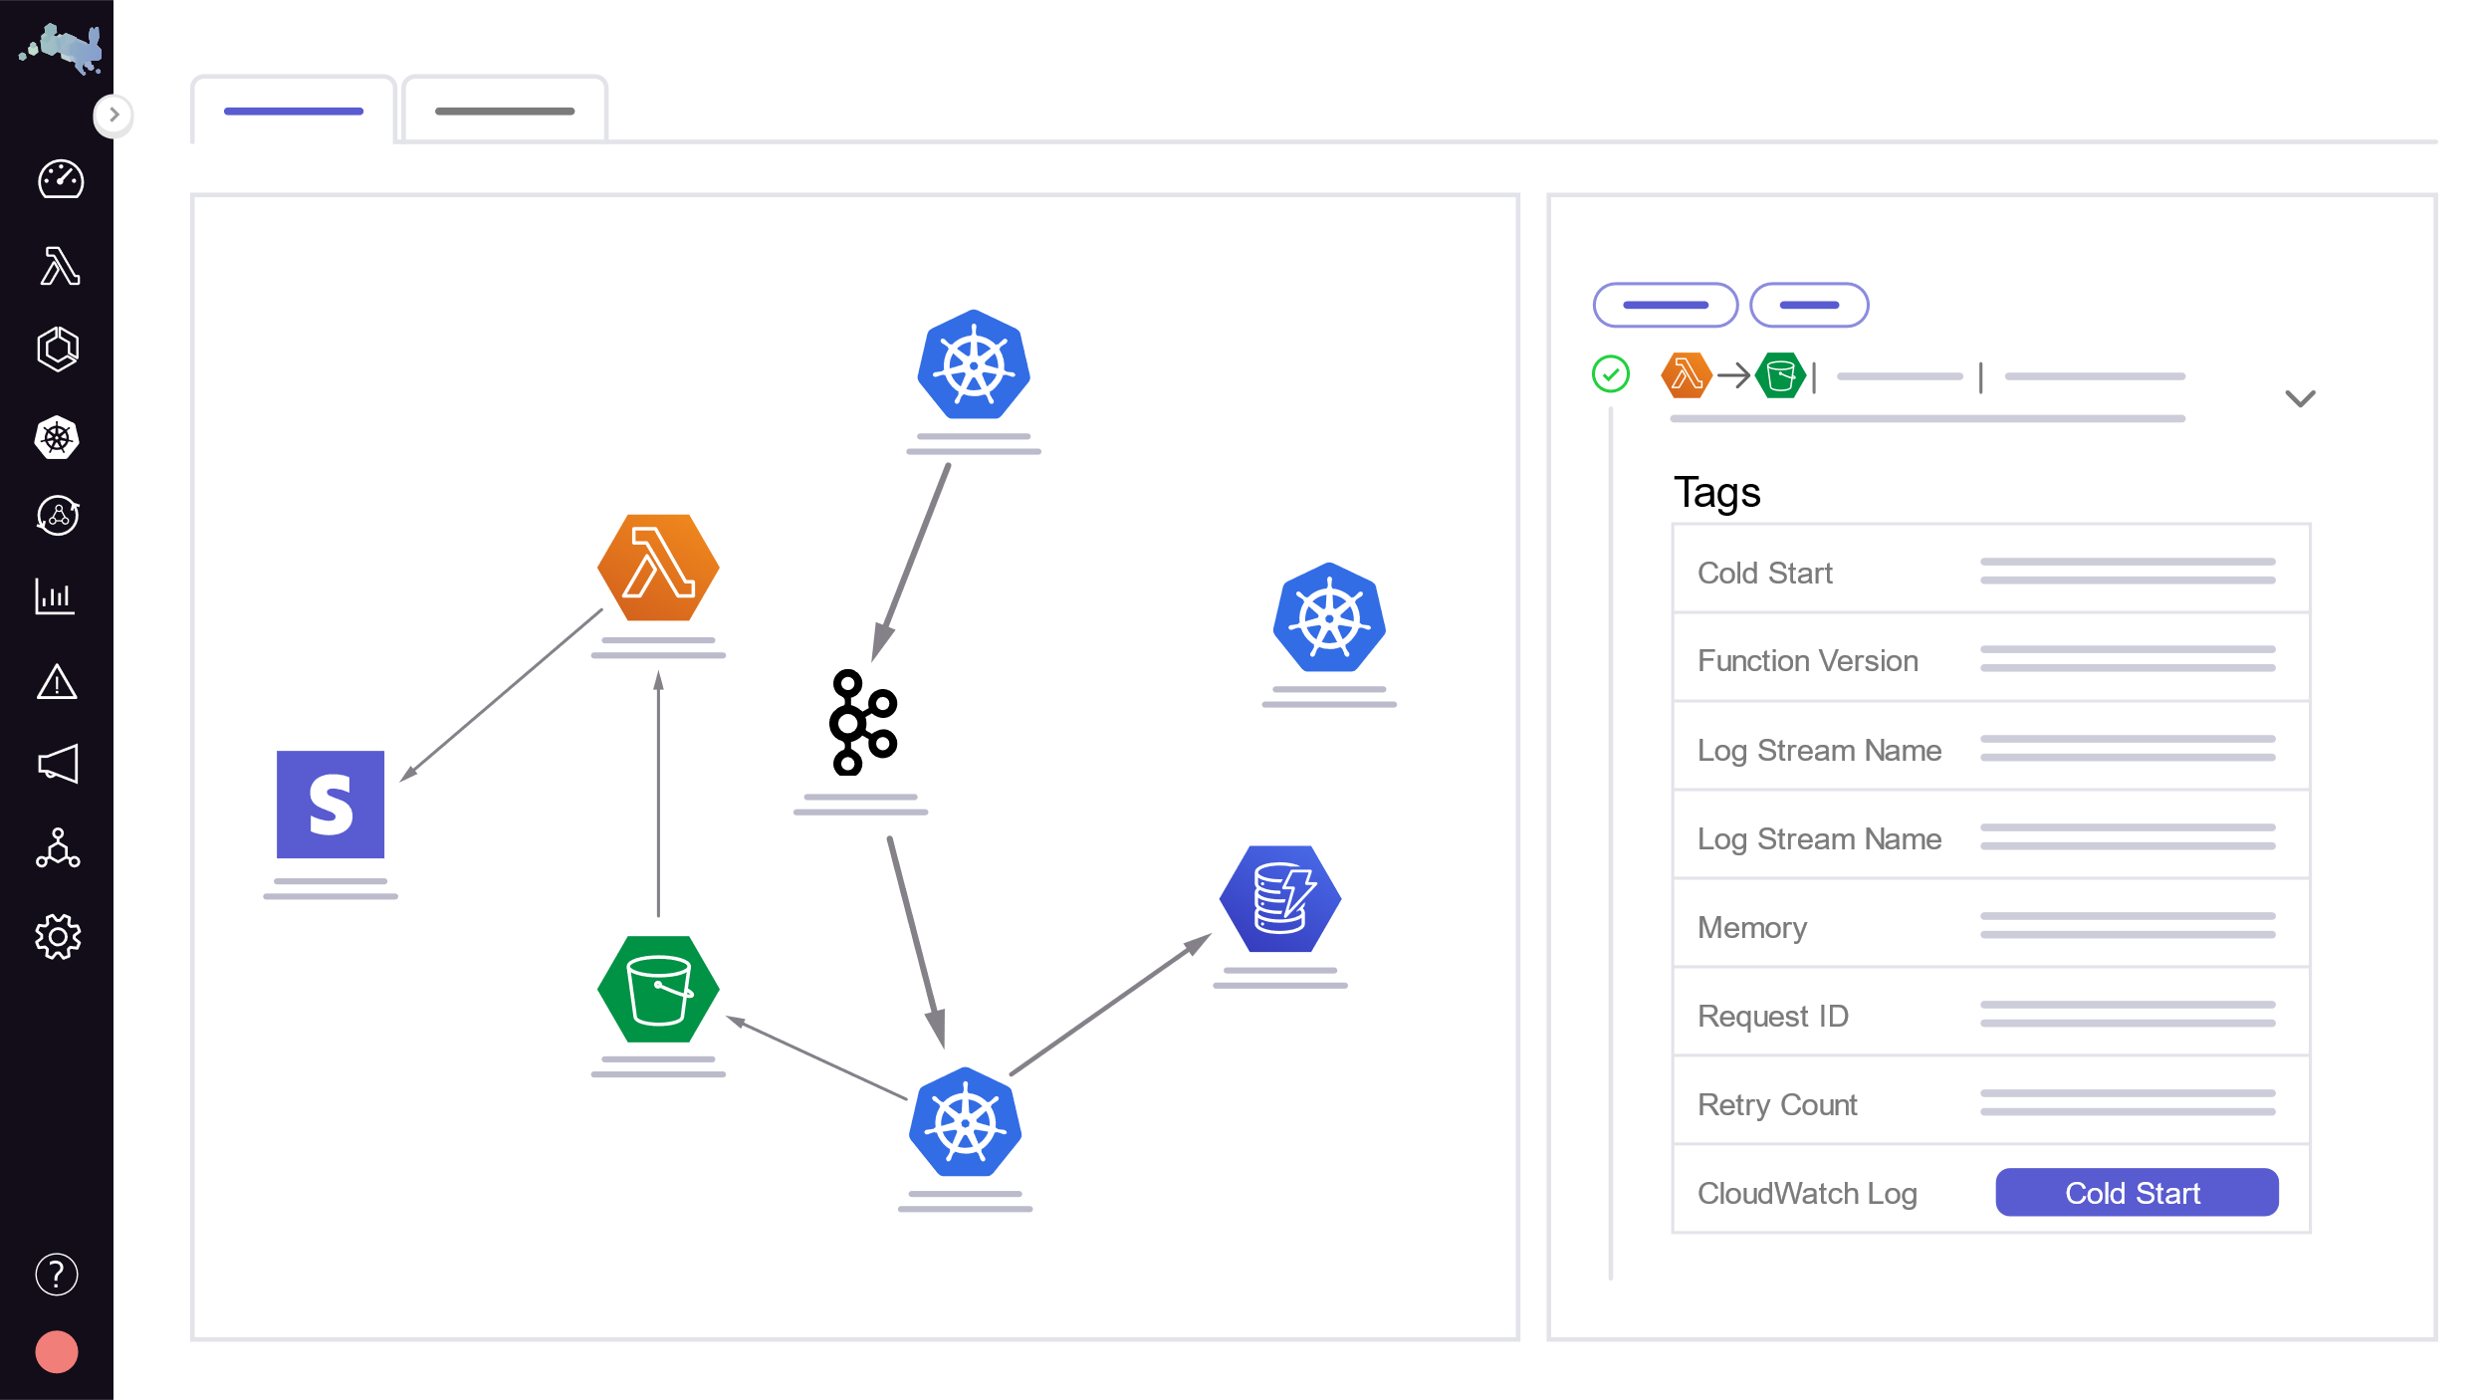
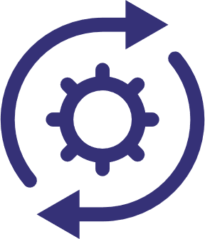
Understand Your Architecture
Epsagon simplifies microservices development so engineers can focus on building features.
Context-rich analysis for faster troubleshooting
Intuitive visualizations of Container and Serverless applications
Streamlined Solution with low-code setup that make it easy to onboard new users
Notes:
Epsagon was founded to solve these problems.
This is what we do better than anybody else:
We provide automated and intuitive visualizations of your environment. That includes topologies of individual requests traced through message queues and other cloud services. We repeatedly hear from customers that, before Epsagon, engineers need to make changes to the application to understand it. With Epsagon, even new hires can build a visual understanding before they ever make a change.
We provide tools for developers to drill down from the big picture of an application, to a specific request, and then even to the payload data that was passed along between two services in that request. All with correlated logs and metrics. We make it much easier for customers to troubleshoot issues related to Cloud Services/ SaaS APIs.
All of this is provided in no-code/low-code setup, depending on the language you use, without the need for manual instrumentation.

Slide 7

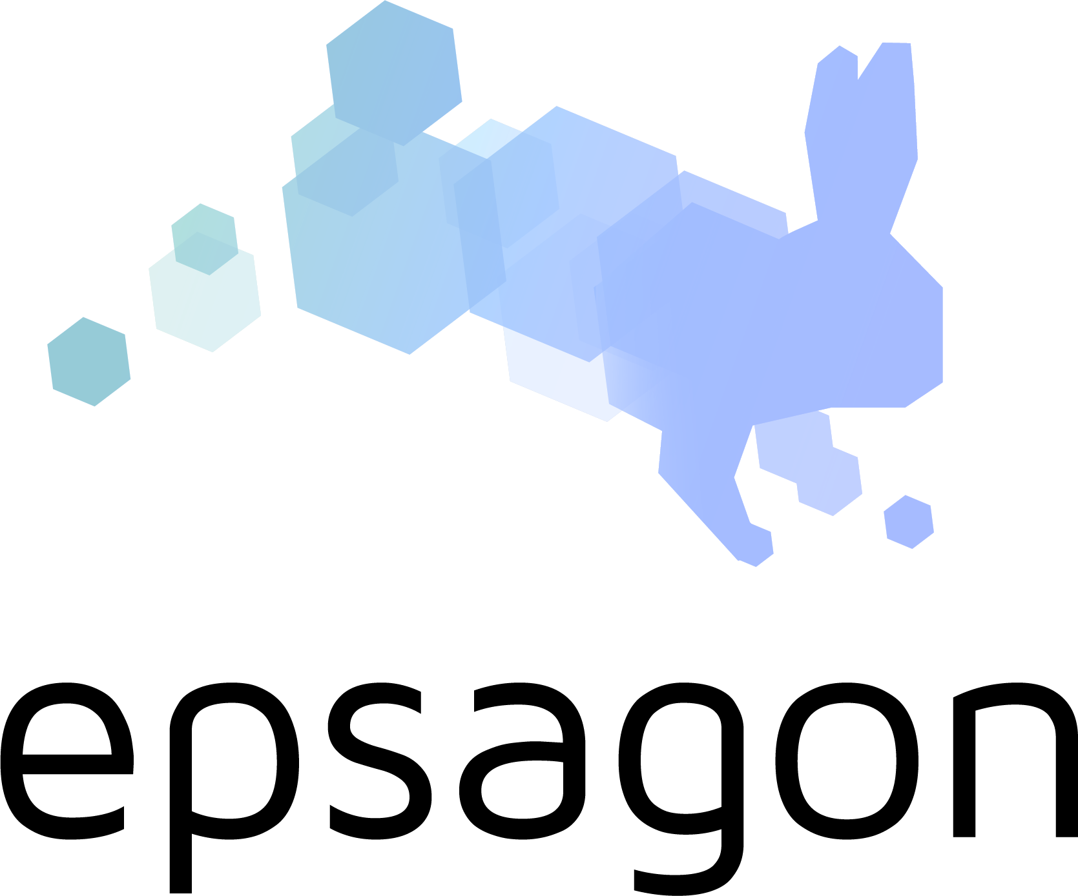


The Epsagon “Engineering Flywheel”
Quickly troubleshoot API issues during Production
Accurately predict end user experiences during Design
Easily catch business logic issues during Test
Confidently make changes to code during implementation
Notes:
With Epsagon in place, engineering teams can see what they are doing and communicate more effectively. Your team will achieve the “flywheel” effect as they better understand your applications in development, troubleshoot it more efficiently in test, and monitoring it in production.
Epsagon helps your engineers see what they are building in the cloud. It helps your managers trust what their teams are building. It is how you onboard new engineers so they can be productive right away.
It is how you build faster.

Slide 8











Observability Workarounds
Traditional APM
sees within services, but not between services
Manually Instrumented Distributed tracing
Requires heavy investment in time and FTE to setup, maintain and manage edge cases
Infrastructure Monitoring
alerts DevOps to issues, but does not give Devs context to remediate
APM with Microservice Add-ons
premium price to have partial workarounds on one platform
Log Aggregators
hours of manually correlation that bottlenecks team knowledge in one SME
Notes:
Bryson
These are all only partial measures. Traditional APM vendors have rolled out modules to evolve with the cloud the way you would use duct tape to patch a bucket. But at this point their entire bucket is made of duct tape.

Slide 9
The Epsagon Solution
Lets teams see more, share more, build more with microservices
Improve productivity, Onboard engineers more quickly
Drill-down from architectural views to individual requests
Trace requests through queues, databases, and APIs
Import and share traces to improve communications and illustrate postmortems
Monitor more, Troubleshoot faster
See infrastructure and orchestration metrics in context of microservices architecture
View logs automatically correlated with services
Search, create metrics, and set alerts on payload data passed between microservices
Reduce observability costs
Deploy automated monitoring with low-code, lightweight agents
Drive adoption with intuitive, self-serve design for new users
Manage a single product for microservices observability with use-based pricing
Epsagon Trace View of an individual request
Notes:
This looks like a brag sheet, but I have it here because I want to show you where Epsagon has been going, and is still going. I would like you to see it as a sign of our proven commitment to solving the challenges of microservices development.
(if competition needs to be addressed) -
There are other vendors in this space with a lot of money, as in “capital markets” money. They weren’t first to develop serverless auto instrumentation. They rolled it out just last year, after the open source community came up with an agent. We had it over two years before that, and with better functionality.
They weren’t the first to show you the payload data in the calls that your services send to each other. They still can’t do that.

Slide 10



“Twice as Fast, Half the Effort”
with Epsagon
“Getting to see everything on Epsagon, and easily understanding where we have issues, and what needs to be fixed before pushing to production, means we can get new features out faster”
-Engineering Manager
aws.amazon.com/solutions/case-studies
Notes:
Bryson
If you remember, at the beginning, I mentioned Vonage as a winner in microservices. Their quote was “Twice as fast with half the effort.”
That “half the effort” part was because they were using Epsagon. They got the scalability and efficiency from cloud services, while we removed the complexity and helped them understand their microservices. That’s what I want to do for you.

Slide 11

















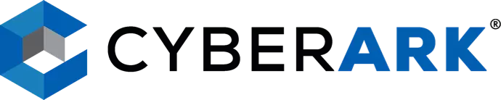
















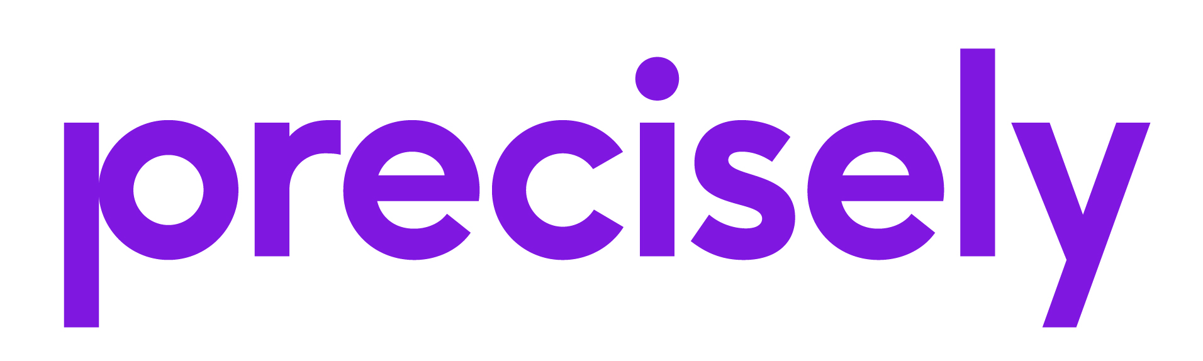







Trusted by Engineering Teams Customers

Slide 12


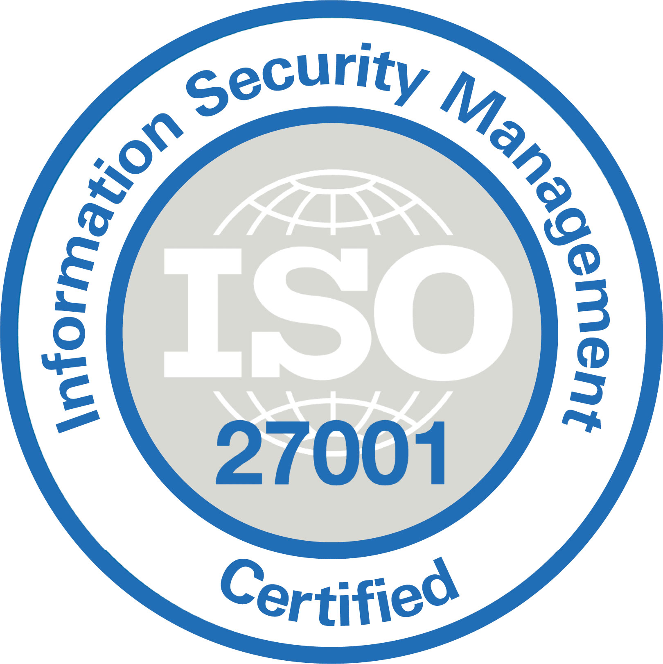

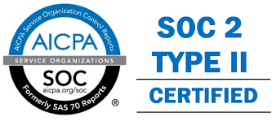



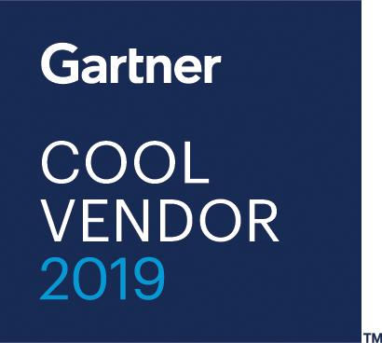
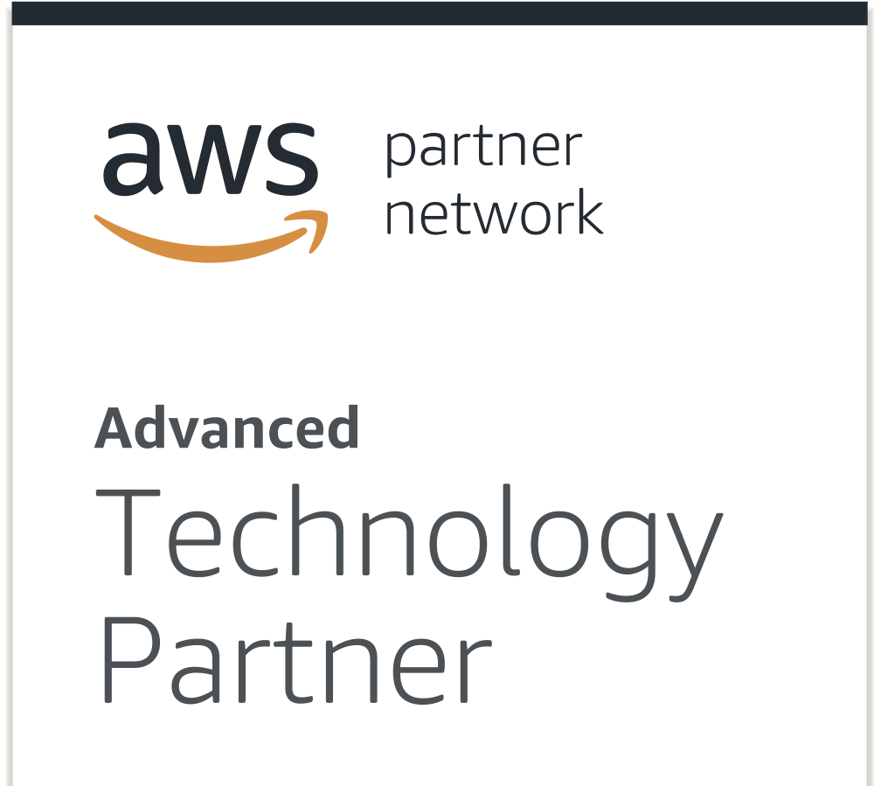
The Epsagon Solution
Simplify complex microservices architectures, eliminate manual work and fix problems faster
1st Solution
to automate microservices architecture maps
1st Solution
to auto-instrument serverless functions
Only Solution
to trace through all AWS managed services (and common 3rd party services) used in application architecture
Only Solution
to automatically make payload data extensible for search, metrics, and alerting
Notes:
This looks like a brag sheet, but I have it here because I want to show you where Epsagon has been going, and is still going. I would like you to see it as a sign of our proven commitment to solving the challenges of microservices development.
(if competition needs to be addressed) -
There are other vendors in this space with a lot of money, as in “capital markets” money. They weren’t first to develop serverless auto instrumentation. They rolled it out just last year, after the open source community came up with an agent. We had it over two years before that, and with better functionality.
They weren’t the first to show you the payload data in the calls that your services send to each other. They still can’t do that.

Slide 13

Next Steps
Your goals with Microservices
A tour of the product

Slide 14
Thank you!

Slide 15
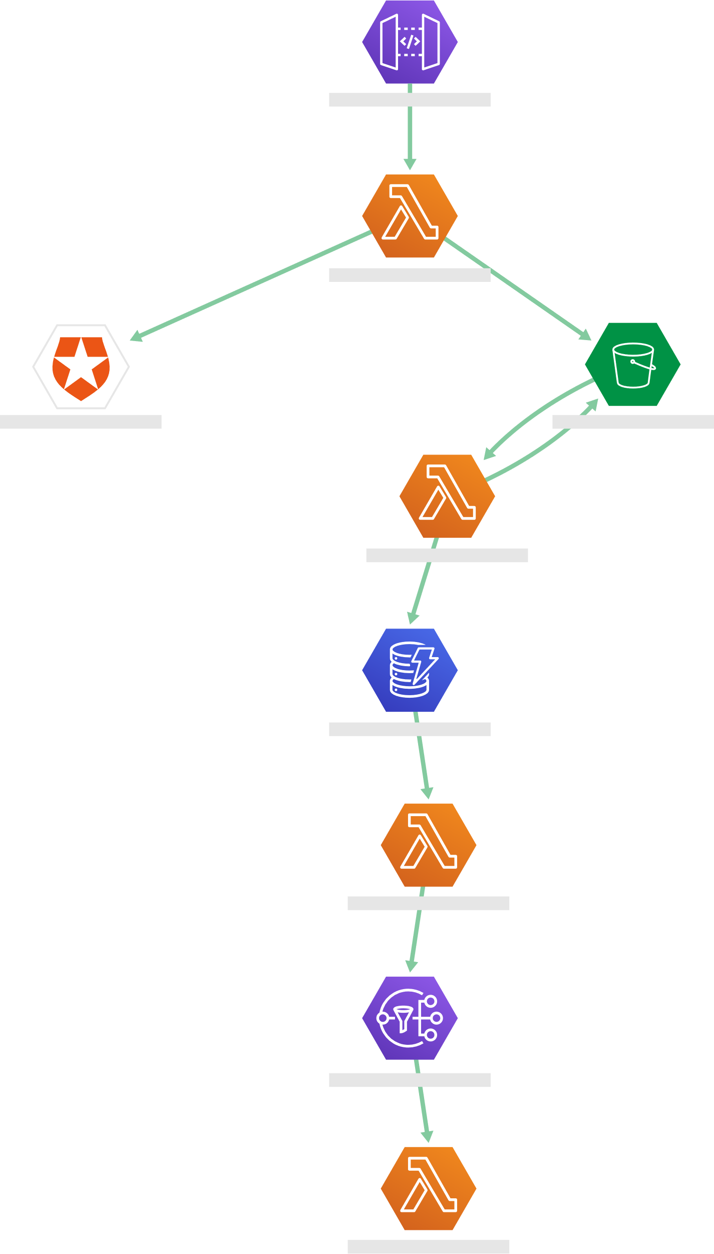
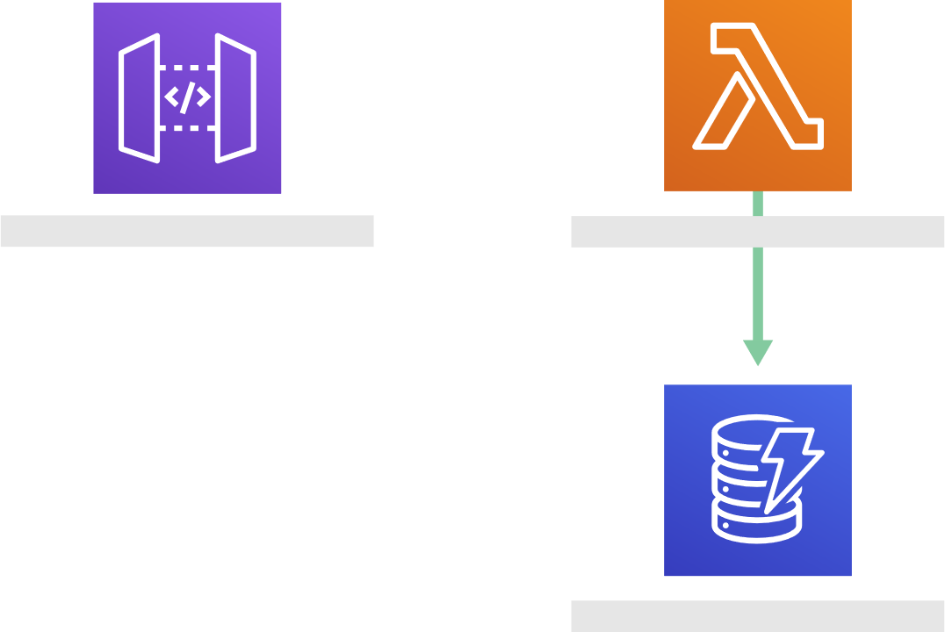
Partial Efforts
Request As Seen in “Serverless as Infrastructure”
Request As Seen in Epsagon
Needs new example
Notes:
Rod
This is an example of what happens when you combine partial solutions and why you want a purpose-built solution.
As we saw on the previous slide, I can no longer say we are the “only” vendor with service maps. And you might have seen other vendors show off complex maps with branching paths. If you have tried any of them then like many people I speak to, you will know that their automation and insight come apart when faced with the common inclusion of a managed service.
The example I have here is taken from a real case. On the left is a simple topology starting with an API gateway, flowing through two lambdas and DynamoDB before ending at SNS. In the middle is the topology we will show you automatically, OOTB. On the right is what you will see in Datadog. A complete breakdown on a very simple architecture. Apparently that meets Datadog’s standards for a service map.

Slide 16
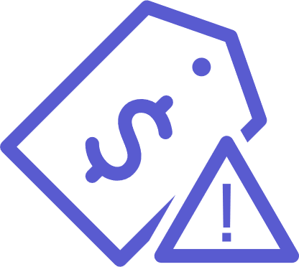



Testing Epsagon
Reduce License Costs
Reduce Open Source Costs
Improve Productivity
Total
Savings
$0.0
M
$0.0
M
$4.7
M
$4.7
M
One time cost of migrating microservices
$150
K
Cost of not acting (per month)
$131
K

Slide 17
Evaluating Epsagon is Easy
The evaluation process is simple and thorough
Product Demo
(30 minute call)
Epsagon implemented into pre-pod environment
Epsagon implemented into prod environment (optional)
POC Outline & Tech Support
(45 minute call)
Best practices session
(60 minute call)
Product Sebrief
(60 minute call)

Slide 18


Dedicated Resources
Devon Lawler
Head of Sales Engineering
Hen Peretz
Solutions Architect
Ran Ribenzaft
CTO
Slack Channel
With 24/7 support
Patrick Clement
Account Executive

Slide 19

Evaluating Epsagon is Easy
Product Demo
(30 minute call)
Epsagon implemented into pre-pod environment
Epsagon implemented into prod environment (optional)
POC Outline & Tech Support
(45 minute call)
Best practices session
(60 minute call)
Product Sebrief
(60 minute call)
Dedicated Resources
Devon Lawler
Head of Sales Engineering
Hen Peretz
Solutions Architect
Ran Ribenzaft
CTO
Slack Channel
With 24/7 support
Patrick Clement
Account Executive

Slide 20











Customers

Slide 21
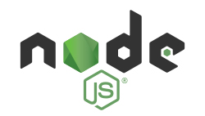

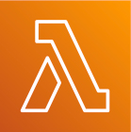
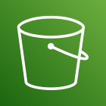
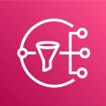



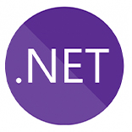
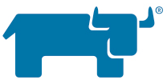
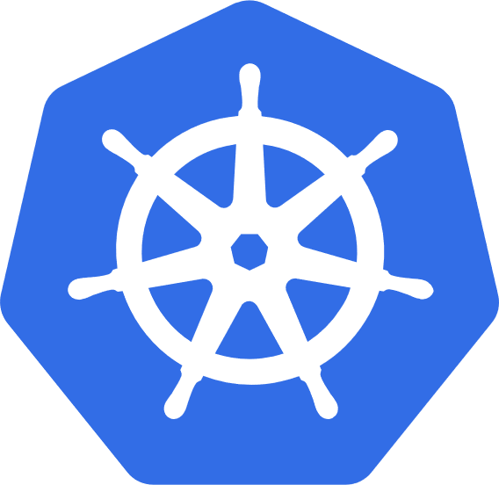
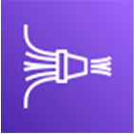
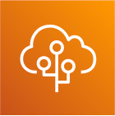
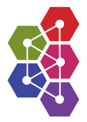

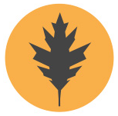

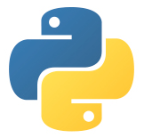

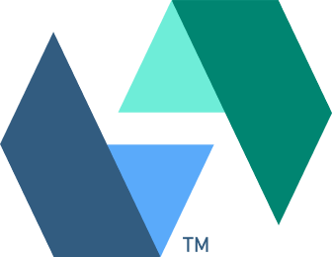
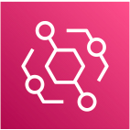
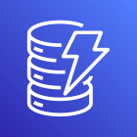


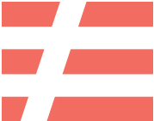

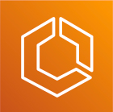
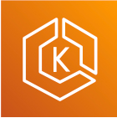
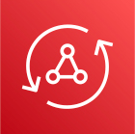
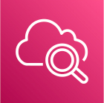

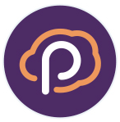




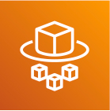
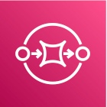
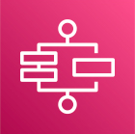
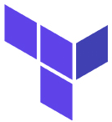



100+ Integrations
Frameworks
Environment
AWS-specific
Third-party
Alerts

