Slide 1


CLOUD DATA MANAGEMENT AT SCALE as-a-Service
Exabyte scale visibility, control & protection of cloud and on-premises data

Slide 2
Where we are today
Enterprises continue to amass billions to trillions of files comprising petabytes to exabytes of data that is growing 30% CAGR.
At this scale, data management tools fail and using the cloud becomes impossible.
By providing visibility, control and protection, Igneous is the only way to truly manage multi-petabyte scale data in the cloud and on-premise.
Notes:
Start by acknowledging the noisy market and emphasize as to why we solve a broader problem in a unique and differentiated way
I am going to make a bold claim!!

Slide 3
Modern data management requirements
CRITERIA | IGNEOUS | OTHERS
SAAS offering
Built for Multi-cloud/hybrid cloud ere
Ready for exabytes of unstructured data
Data visibility across all platforms
Make data mobility a reality
Delivers on the promise of automation
Enterprise ready & proven
✓
✓
✓
?
✓
❌
✓
?
✓
?
✓
❌
✓
✓

Slide 4
Igneous snapshot
Founded | 2013
Headquarters | Seattle, WA
Team | Founded by leaders in cloud and data storage with deep domain expertise gained at EMC-Isilon, NetApp, AWS and Azure; 74 employees
Technology Differentiation | Unique and defensible, with 15 patents granted and 3 patents pending
Customer Traction | 25 customers (including 5 with bookings > $1M); Average net retention rate of 200% Trusted by F500; 76+ PB data under management; clouds & on-prem
Financial Momentum | FY’20 (a) – 80%+ YoY growth in ARR FY’21 (e) – 120%+ YoY growth in ARR
World Class Investors | New Enterprise Associates Madrona
IDC Innovator:
Unstructured (File and Object) Content Management, 2019
Notes:
Emphasize: Team and patent portfolio
We could add what we do: DataProtection, etc. or tag line

Slide 5
Data growth is creating a crisis in the enterprise
Dataset size:
File count:
Storage:
MBs to GBs
100s to thousands
Local drives
100GB – 100s of TB
Millions
NAS
100s of TBs to PBs
100s of millions to billions
Cloud, Clustered NAS
10s of PBs to EBs
billions to trillions
Multi-site, Multi-site, Multi-NAS
2020
2010s
2000s
1990s
Notes:
Keep it short
In the 1990’s we went from: GB’s of data on our local hard drives to TB’s of data on commercial NAS
Starting in the 2000’s, with the web 1.0 revolution, we started to see 100’s of TB’s of data on multiple NAS systems
The 2010’s, with mobile + cloud, we were in the era of PB’s of data in the Cloud and on Clustered NAS (Isilon)
Today, businesses are staring at 100’s of PBs of data and trillions of files that span many systems, from many vendors and multiple cloud

Slide 6
The crisis is widespread and ubiquitous
On-premises NAS footprint > 70EB and growing!
25K+ companies; $10B+ spent on data management
INDUSTRIES | # OF COMPANIES | ESTIMATED ANNUAL SPEND ($M) | UNIQUE DATA CHALLENGES
Financial Services | 1,000 | $3,800 | Securities trading datasets
High Tech Design & Mfg | 3,500 | $1,400 | Project design and simulation data
Health Care | 10,000 | $500 | Patient medical imaging data
Life Sciences & Pharma | 2,000 | $200 | Genomics, Proteomics, Microscopy, Comp. Chemistry
Media & Entertainment | 7,800 | $3,500 | High resolution localized content
Energy | 1,200 | $865 | Discovery and seismic data
Geospatial | 500 | $96 | Multi-spectral geospatial imaging data
Telcos | 800 | $2,000 | Network log and intrusion data
Sources: crunchbase-pro, WSJ, Deloitte, csimarket, spiceworks
Notes:
This is a every industry problem

Slide 7








Vast majority of rapidly growing data is unstructured
Enterprise Storage Systems Capacity Forecast*
Data creation has changed in the last decade
  MBs / person / year ➔ TBs / machine / week
Explosion in number of devices
  50 billion internet connected devices
  15,000+ NextGen sequencers
Data is a strategic asset ➔ Long retention period
Exabytes
Unstructured CAGR: 29.8%
Structured CAGR: 19.6%
*Source: IDC’s Worldwide File- and Object-based Storage Forecast 2016-2021 (published, September 2017)
** Reported by Gartner Research
Notes:
What’s causing this rapid and continuous growth in data, especially unstructured data:
It’s the change from people generating GB’s of data per year to machines generating 100’s of TB’s of data per week
It’s the rapid growth in the number of such machines.
It’s the fact that data is now a strategic asset and kept around for long periods of time, if not forever.

Slide 8
The cloud is the future; hybrid is a reality
Why is the Cloud the future?
Cloud data is growing faster
Greater agility & flexibility
Economies of scale
350
300
250
200
150
100
50
0
Cloud data CAGR
33.9%
Phases of Cloud Adoption
Exabytes of Data
On-premises data CAGR
20%
Greenfield Apps
Lift and Shift of legacy Apps
Re-write of legacy Apps
Data heavy workflows
2016
2021
Notes:
Hybrid is a reality. On-premises data infrastructure is still growing, but data in the cloud is growing faster
Data heavy workflows is the connector from here to the next slide

Slide 9



Enterprise data is unmanageable…
Primary Storage
Catalog Servers
Media Servers
Tape Libraries
Notes:
Back in the day, an enterprise needed some storage for home directories and project files
There was one storage admin! Data Management pretty much meant Backup and it was as simply as buying a couple of servers, some tape library and installing Veritas or Commvault

Slide 10
…companies are responding by adding more boxes and more people…
Primary Storage
Catalog Servers
Media Servers
Tape Libraries
Notes:
As data grew, he likely added another NAS device and expanded his backup infrastructure. A bit more complex, but manageable

Slide 11

…increasing complexity…
Primary Storage
Catalog Servers
Media Servers
Tape Libraries
Notes:
Then his users wanted to and added NAS from a different vendor for a new use case.
His “Data Management”, still just backup, got more complicated and the team expanded! More people!

Slide 12







…which exacerbates the problem…
DR Site
Primary Storage
Media Servers
Catalog Servers
Disk Targets
Tape Libraries
Off-site Storage
Notes:
That second use case increased in size and they added more NAS
Oh, by now, backups to tape were failing so they added disk storage for backups.
The users needed 24x7 availability and “Data Management” expanded to supporting a DR site with more storage from his NAS vendors since replication is proprietary to a storage vendor
Inspite of all of this, many times, they don’t backup unstructured data because THEY CANT!!
UNSTRUCTURED DATA IS HANDLED DIFFERENLY, and replication as a backup strategy becomes the crutch

Slide 13




…creating environments that are unmanageable and prone to failure
DR Site
Primary Storage
Backup Storage
Backup storage
Vendor Specific Replication Software
Backup storage
Vendor Specific Replication Software
Media Servers
Catalog Servers
Disk Targets
Tape Libraries
Off-site Storage
Notes:
The dawn of machine generated datasets, saw his environment get really complex
More NAS vendors, more storage
Backups simply don’t work and the now, much larger team has to reply on replication to Tier-2 NAS as a backup strategy!
And it’s not like any of the old environment got retired!
Last but not the least, all this complex environment does not work with or leverage the cloud, the new cool, hot thing!

Slide 14

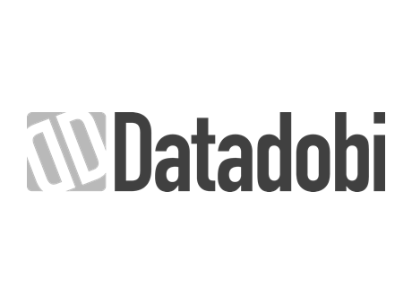


…and yet, unstructured data still can’t be managed
Ludicrously Expensive
Completely Inflexible
Data Still Unmanaged
Complex infrastructure
Manual, people intensive processes
Inability to leverage cloud economics
Many point solutions from many vendors
No visibility into data spread across systems
Cannot protect large and dense datasets
Data mobility is complex, cumbersome and manual
“You don’t know what you have or where it is! You cannot get it from where it is to where it is needed in a timely manner.”
Data Visibility
Data Protection
Vendor specific
Replication
Data Mobility
C:\>robocopy
Notes:
Great complexity and cost and yet the team is managing infrastructure as opposed to data
There is no visibility into data across all these systems from many vendors in many locations
How can one manage something that they cannot see in real-time??
How can amazon manage their inventory if they could not see what they have, how much of it they have and where they have it?
How can data that is invisible and immobile be managed?

Slide 15
Igneous reimagined the entire approach to data management
Visibility, Protection & Mobility
Modern & Cloud-Friendly
Empower data owners to see and understand all their data, no matter where it lives
Enable IT to protect data, no matter where it lives and at scale, using simple policies
Deliver data agility by automating data movement, at scale
Liberate data and modern data services (protection, visibility & mobility) from storage by supporting all data platform and clouds
Create a user-friendly SaaS platform and take advantage of cloud economics
Automate and simplify the entire data management process

Slide 16
Complex, manually-managed enterprise data infrastructure
Many systems from many vendors, each providing a legacy point solution
DR Site
Primary Storage
Backup Storage
Data Visibility
Vendor Specific Replication Software
Vendor Specific Replication Software
Data Protection
Media Servers
Catalog Servers
Vendor specific
Replication
Data Mobility
Disk Targets
Tape Libraries
Off-site Storage
C:\>robocopy
Notes:
Treat this as a bumper slide and don’t speak to it again!

Slide 17


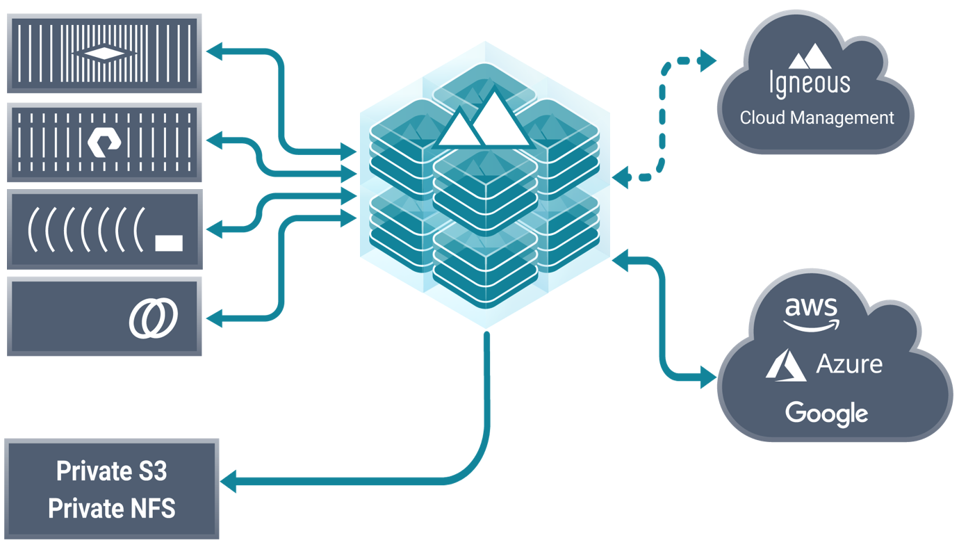




Igneous simplifies and automates…
Everywhere data lives
DATA VISIBILITY
Simple at any scale
100TB to 100PB
Millions to Billions of files
Unstructured
Data Management
as-a-Service
BACKUP & ARCHIVE
DATA MOBILITY
Notes:
DataDiscover – Delivers enterprise wide data visibility and data searchability. Core to our service offerings.
If you cannot see and understand what you have, you cannot make intelligent decisions, you cannot automate and simplify data management
DataProtect – This is the job customers hire us to do, Backup and Archive of unstructured data; billions of files and petabytes of data, to public and/or private clouds
DataFlow: Moving data from where it lives to where it is needed with a single API call / click

Slide 18
Igneous service offerings
DATA VISIBILITY
BACKUP & ARCHIVE
DATA MOBILITY
File analytics
Enterprise search
File data classification
Data security
Greater utilization
of data assets
Regulatory compliance
Backup
Archive
Disaster recovery
Infrastructure optimization
Regulatory compliance
Data migration
Data collaboration
Infrastructure flexibility
Data agility
Use Cases
Customer Value

Slide 19
Technology & Differentiation

Slide 20
Igneous reimagined the entire approach to data management
Visibility, Protection & Mobility
Modern & Cloud-Friendly
Empower data owners to see and understand all their data, no matter where it lives
Enable IT to protect data, no matter where it lives and at scale, using simple policies
Deliver data agility by automating data movement, at scale
Liberate data and modern data services (protection, visibility & mobility) from storage by supporting all data platform and clouds
Create a user-friendly SaaS platform and take advantage of cloud economics
Automate and simplify the entire data management process

Slide 21



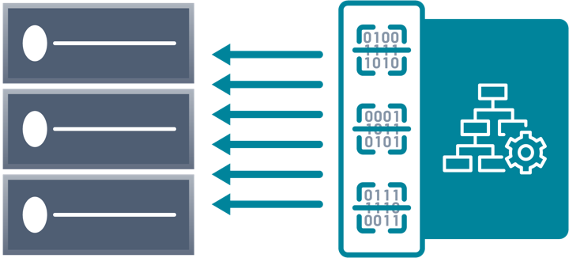
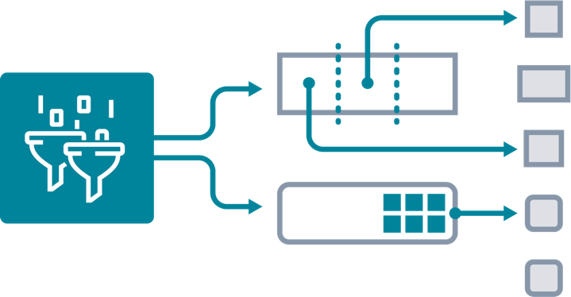
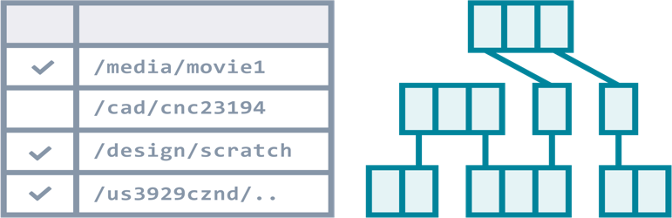
Our secret sauce: three key technologies
AdaptiveSCAN
faster than flash
IntelliMOVE
at line speed no matter what
InfiniteINDEX
at scale of enterprises
400K files / sec / instance vs.
20K files / sec
Only solution that can process
billions of files in near real-time
75TB / day / 10G
vs.
5TB / day
Only solution that can move PBs of data across a WAN
Trillion object index
vs
Billion row database
Search all enterprise data with no on-premises infrastructure
SUPPORT ALL FILE PROTOCOLS, NAS PLATFORMS & CLOUDS

Slide 22
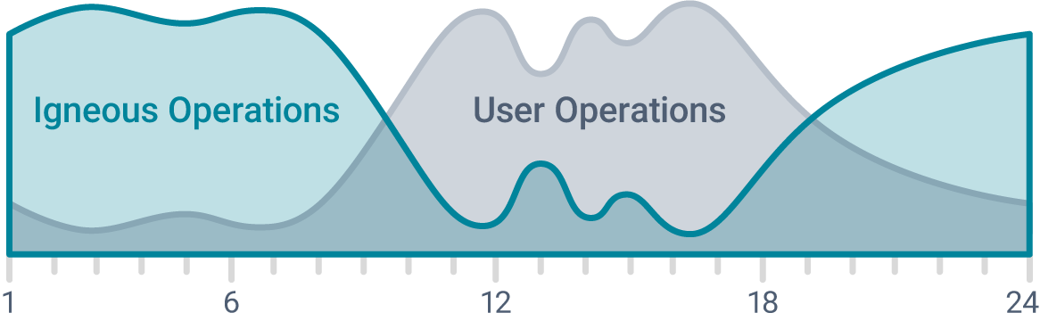
™
AdaptiveSCAN
Scans data stores quickly without impacting other production applications relying on the same storage
AdaptiveSCAN
faster than flash
Purpose built protocol clients (NFS, SMB, Object) that maximize scan performance
Horizontally scalable architecture that results in aggregate scan rates of millions of files per second
Distributed tree-walk algorithm to ensure constant scan rates independent of data characteristics
In-line latency monitoring drives dynamic scan rates that minimize impact to other applications
400K files / sec / instance
Only solution that can process
billions of files in near real-time

Slide 23
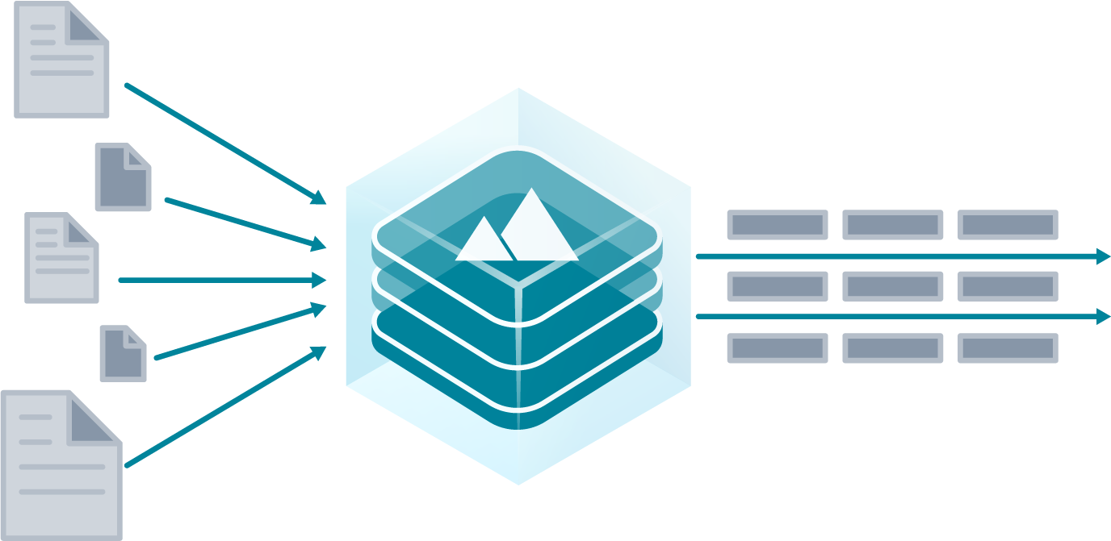
™
IntelliMOVE
Moves data at a constant rate that is independent of data and storage characteristics.
IntelliMOVE
at line speed no matter what
Proprietary pipelined data movement architecture that enables maximizing network throughput
  De-coupled reads and writes to ensure data movement is not constrained by transient external bottlenecks
  Patented “work stealing” algorithm results in constant rate of data movement even in the presence of highly varied and uneven data types and sizes
Horizontally scalable architecture resulting in the ability to move, across WANs, PBs of data in days
75TB / day / 10G
Only solution that can move PBs of data across a WAN

Slide 24
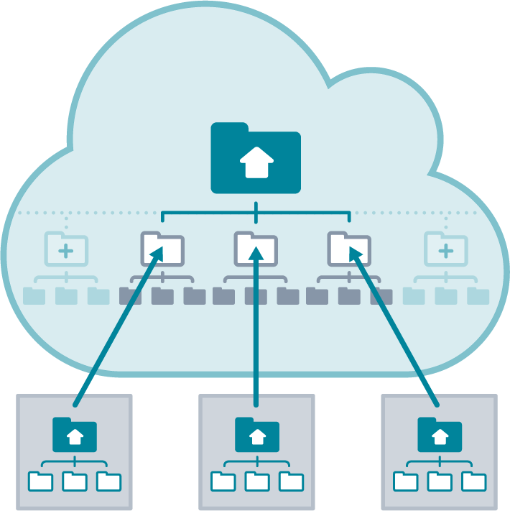
™
InfiniteINDEX
Cloud based purpose-built database optimized to index all enterprise data
InfiniteINDEX
at scale of enterprises
Sharded indexing architecture allows for the global indexing of trillions of objects
Support for multi-dimensional queries enabling rich search
De-coupled architecture (Inserts from queries, compute from storage) results in minimal resource consumption and less than 1% the cost of off-the-shelf alternatives
Flexible deployment capabilities means it can be hosted in any cloud, public or private
Trillion object index
Search all enterprise data with no on-premises infrastructure

Slide 25
Igneous reimagined the entire approach to data management
Visibility, Protection & Mobility
Modern & Cloud-Friendly
Empower data owners to see and understand all their data, no matter where it lives
Enable IT to protect data, no matter where it lives and at scale, using simple policies
Deliver data agility by automating data movement, at scale
Liberate data and modern data services (protection, visibility & mobility) from storage by supporting all data platform and clouds
Create a user-friendly SaaS platform and take advantage of cloud economics
Automate and simplify the entire data management process

Slide 26
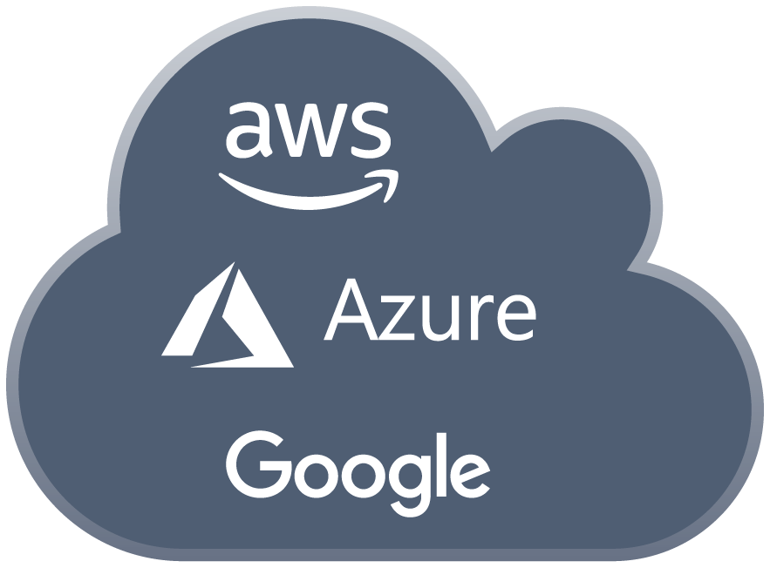

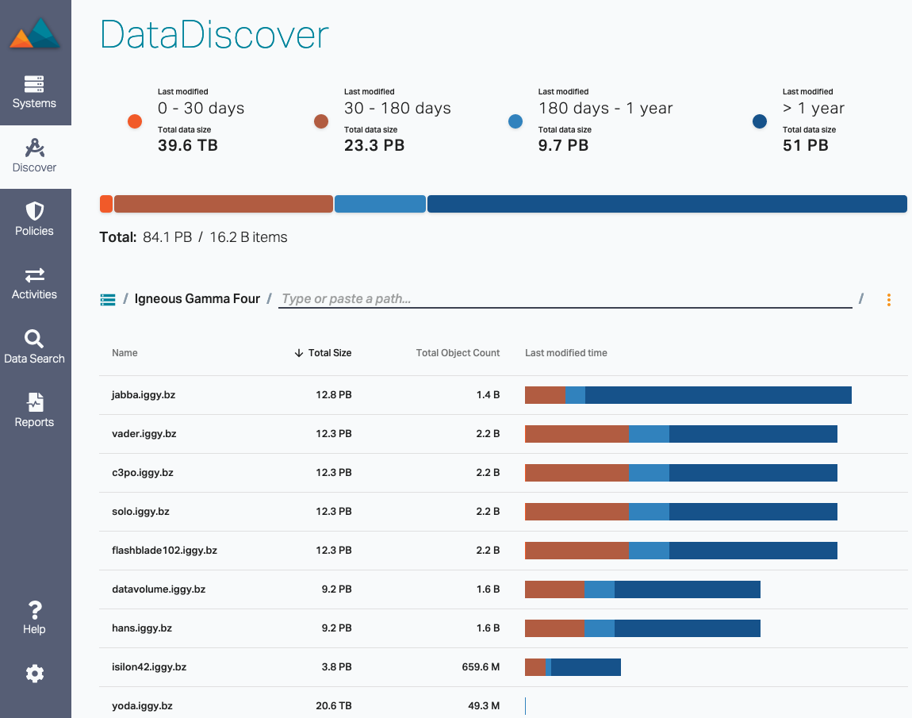



Letting machuines do work not fit for humans
Automation enabled by a simple and unified UT and API
Automated data namespace management
    Auto-import of all exports / shares / buckets
Intuitive search drives user actions
DATA VISIBILITY
BACKUP & ARCHIVE
DATA MOBILITY
Notes:
One interface and API to rule them all
This is unique! Most vendors cant even support the administration of multiple of their systems from a single interface, let alone managing data strewn across many platforms from many vendors from a single UI

Slide 27
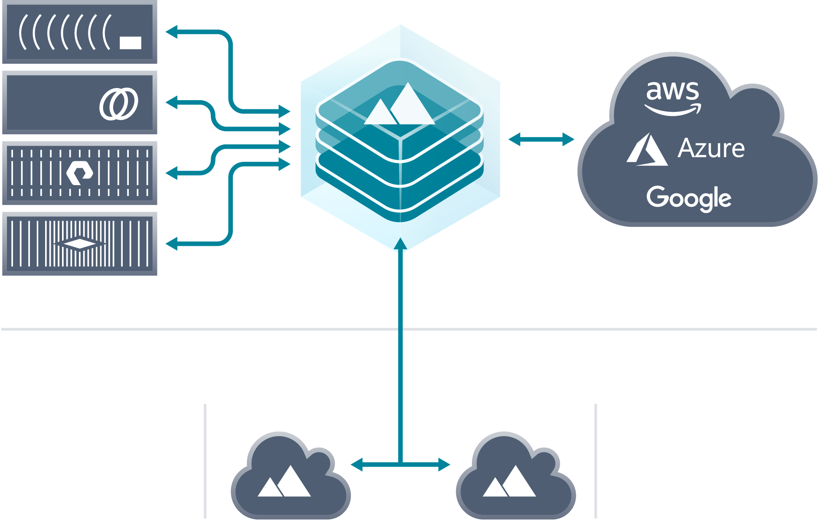


Always SaaS, run anywhere
Resilient Store
InfiniteINDEX
AdaptiveSCAN
IntelliMOVE
Protocol Engine
Search
Kubernetes .
Engineering
Operations
Managed Appliance
Public Cloud
Private Cloud
SaaS, with software on-prem
Nothing to deploy or manage
Always secure
Easy to trial
Powered by Kubernetes
On-premises
Hybrid
Public & private clouds
Notes:
SaaS for software that HAS to run within a customer’s data center, is unique
To date, no other vendor has been able to do this. The two exceptions are Druva and Clumio and their architecture is heavily biased towards structured data backups

Slide 28
Competitive Positioning

Slide 29







Igneous is the only solution for enterprise unstructured data
Unstructured
SMB
ENT
Structured

Slide 30






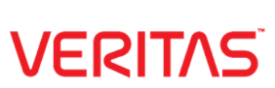

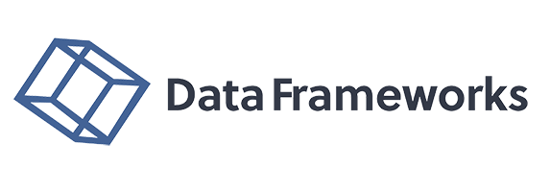




Igneous is the only solution for enterprise unstructured data
< 300TB
300TB – 1PB
1PB – 10PB
10PB+
DATA VISIBILITY
BACKUP & ARCHIVE
DATA MOBILITY
Vendor specific
Replication
Only Data Protection
Only Data Visibility
Only Data Mobility
C:\>robocopy

Slide 31
Enterprise structured data management is expansion oppt.
Current focus on unstructured data is a strategic choice
SaaS delivery model is independent of data types
Architectural flexibility allows for easy expansion to support structured data sets
  InfiniteINDEX can just as easily index content of virtual machines
  AdaptiveSCAN is very extensible; implementing support for VMs and DBs is a modest task

Slide 32

Why Igneous wins
Competitor
Limitations
Vendor specific replication as backup
Unable to leverage cloud for backup
Performance and scale limitations at the multi-PB scale
No support for data visibility or mobility
Optimized for structured data backup
Cannot handle unstructured data backup at the multi-PB scale
Always requires on-premises appliances
No support for data visibility or mobility
No support for data protection, primarily a visibility tool
Cannot handle billions of files and petabytes of data
Requires on-premises appliances
Optimized for structured data management
Unable to leverage cloud for unstructured data backup
At scale, requires complex on-premises infrastructure and management

Slide 33
GTM / Customers

Slide 34










GTM: SaaS business with an enterprise focus
Enterprise Data Customers
Expected LTV: $1M - $5M+
Large in size and/or large in data
Globally ~26K businesses
Subscription Pricing
Annual subscription based on data under management
Land & expand
Geo Focused
Boston, NY
PNW, NorCal, SoCal
Alliance Partners
Extends cloud
Co-exists with next gen data protection vendors
Channel Lead
100% channel fulfilled

Slide 35






















Data heavy businesses choose Igneous

Slide 36
Customer story: Apple
Customer Data Environment
Subscription Bookings
Quantum, StorNext, Qumulo, Dell, EMC, Isilon, NTAP, Pure Flash Blade, Cleversafe, AWS
10+ sites
1000PB+
Many applications & use cases
3 transactions
$3M in bookings
Current Igneous deployment
  2 sites, 2 countries
  10PB
Customer Challenge
Result of deploying Igneous
The small IT team (2 people) supporting the worldwide Marcom team managed 20+PB of data across 5 data centers
Consolidate multiple tier-1 solutions onto Qumulo and deploy one backup solution
Severely limited datacenter space
Single SaaS solution for backup and archive to the cloud (AWS)
Capped datacenter footprint by being able to leverage AWS for all future expansion

Slide 37
Customer story: Biogen
Customer Data Environment
Subscription Bookings
NexSAN+Avere, EMC Isilon, NTAP
6+ sites
20PB+ and growing
Regulatory need for backup
2 transactions
$1.8M in bookings
Current Igneous deployment
  4 sites, 2 countries
  10PB
Customer Challenge
Result of deploying Igneous
Backup all research data on NAS to meet compliance requirements
Inability to protect HPC data
Minimize complexity & overhead
Leverage (AWS) cloud for long-term archival
Single SaaS solution for all NAS backup and archive to the cloud (AWS)
Achieved regulatory compliance for research data

Slide 38
Customer story: Qualcomm
Customer Data Environment
Subscription Bookings
NTAP, Pure Flash Blade, DellEMC-Isilon, NetBackUp
17 sites, 6+ countries
~100PB worldwide
More than 300B files
5 transactions
$500K in bookings
Current Igneous deployment
  1 site, 1 country
  3PB
Customer Challenge
Result of deploying Igneous
Efficiently protect billions of files and meet business SLAs
Minimize complexity associated with Veritas NetBackup
Leverage public cloud for backup
Single pane of management across all sites
Backup of dense datasets well within business SLA commits
Single solution and interface for all services and sites
Enabling long-term retention in AWS Deep Glacier
Notes:
This is data management

Slide 39
Customer story: Broadcom
Customer Data Environment
Subscription Bookings
DellEMC Isilon, Pure Flash Blade, NTAP
21 sites, 6+ countries
70PB worldwide
More than 200B files
7 transactions
$1.4M in bookings
Current Igneous deployment
  5 sites, 4 countries
  7PB
Customer Challenge
Result of deploying Igneous
Efficiently protect billions of files and meet business SLAs
Minimize complexity
Enable end-user self service: Find, move and manage data
Single pane of management across all sites
Backup of dense datasets well within business SLA commits
Single solution and interface for all services and sites
Visibility to all NAS data
API Integration with end-user portal enables self-service
Notes:
This is data management

Slide 40

Customer story: QSI
Customer Data Environment
Subscription Bookings
EMC Isilon, Unity
6 sites
10PB, growing daily
Constant data movement
Small IT team of 2
5 transactions
$1.8M in bookings
Current Igneous deployment
  3 sites
  ~9PB
Customer Challenge
Result of deploying Igneous
Efficiently protect all NAS data
Minimize complexity & overhead
Enable end-user self service: Find, move and manage data
Leverage cloud for long-term archival
Single solution for visibility, backup and archive to Azure
Cap datacenter growth: On-premises storage where required, direct-to-cloud where feasible.
End-user data management is now possible due to DataDiscover

Slide 41
Customer story: NOA
Customer Data Environment
Subscription Bookings
DellEMC Isilon, NTAP
6+ sites, 3 countries
10PB worldwide
More than 200B files
7 transactions
$715K in bookings
Current Igneous deployment
  2 sites, 1 country
  1.5PB
Customer Challenge
Result of deploying Igneous
Retire complex Veritas Netbackup based backup infrastructure
Minimize complexity
Single pane of management across all sites
Veritas Netbackup replaced by Igneous + Rubrik (VMs)
Single solution and interface for all services and sites
API Integration with database admin workflow to enable more frequent Oracle RMAN snapshots
Notes:
This is data management

Slide 42
Financial Summary

Slide 43
Financial highlights
Clear & repeated success with enterprise customers
Best-in-class net retention rates, on average 200%
Accelerated interest in newly released products

Slide 44
Expansion potential within customers…
 |  | FY'19 |  |  |  |  | FY'20 |  |  |  |  | Current Data |  | Estimated Future Potential
Company |  | Q1'19 | Q2'19 | Q3'19 | Q4'19 |  | Q1'20 | Q2'20 | Q3'20 | Q4'20 |  | Under Management |  | Data Under Management
Financial Services |  | 3 | 3 | 3 | 3 |  | 3 | 3 | 2 | 2 |  | LT 500TB |  | 2PB - 5PB
Semiconductor design and manufacturing |  | 3 | 3 | 3 | 3 |  | 3 | 3 | 3 | 4 |  | 1PB - 3PB |  | 50PB - 100PB
Global game developer |  | 3 | 3 | 5 | 5 |  | 5 | 5 | 5 | 5 |  | 1PB - 3PB |  | 5PB - 10PB
Financial Services |  | 1 | 1 | 1 | 1 |  | 2 | 2 | 2 | 2 |  | < 500TB |  | 2PB - 5PB
Biosciences research institution |  | 2 | 4 | 4 | 4 |  | 4 | 4 | 4 | 5 |  | 5PB - 10PB |  | 30PB - 50PB
Brand and document security |  | 1 | 1 | 1 | 1 |  | 1 | 1 | 1 | 1 |  | < 500TB |  | < 500TB
Semiconductor design and manufacturing |  | 2 | 3 | 3 | 3 |  | 4 | 5 | 5 | 5 |  | 5PB - 10PB |  | 50PB - 100PB
Biotechnology development |  | 3 | 3 | 3 | 3 |  | 3 | 3 | 3 | 3 |  | 5PB - 10PB |  | 30PB - 50PB
Media and entertainment |  |  | 3 | 3 | 3 |  | 3 | 3 | 3 | 3 |  | < 1PB |  | 2PB - 5PB
Media and entertainment |  |  | 1 | 1 | 1 |  | 1 | 1 | 1 | 1 |  | < 500TB |  | < 1PB
Biomedical research |  |  |  | 4 | 4 |  | 4 | 4 | 4 | 4 |  | 3PB - 5PB |  | 5PB - 10PB
Media and entertainment |  |  |  | 2 | 2 |  | 2 | 2 | 2 | 2 |  | < 500TB |  | 30PB - 50PB
Technology |  |  |  | 4 | 4 |  | 4 | 4 | 4 | 5 |  | 5PB - 10PB |  | 200PB - 1000PB
Higher Ed (University) |  |  |  | 3 | 3 |  | 3 | 3 | 3 | 3 |  | 1PB - 3PB |  | 5PB - 10PB
Biopharmaceutical development |  |  |  |  | 3 |  | 3 | 3 | 3 | 3 |  | 1PB - 3PB |  | 5PB - 10PB
Biotechnology development |  |  |  |  | 5 |  | 5 | 5 | 5 | 5 |  | 5PB - 10PB |  | 30PB - 50PB
Biopharmaceutical development |  |  |  |  | 2 |  | 2 | 2 | 2 | 2 |  | < 500TB |  | 2PB - 5PB
Geospatial imaging |  |  |  |  | 5 |  | 5 | 5 | 5 | 5 |  | 3PB - 5PB |  | 5PB - 10PB
Games publisher |  |  |  |  |  |  |  |  | 2 | 2 |  | < 500TB |  | 2PB - 5PB
Electronic design automation |  |  |  |  |  |  |  |  |  | 3 |  | < 1PB |  | 30PB - 50PB
Biotechnology development |  |  |  |  |  |  |  |  |  | 3 |  | 1PB - 3PB |  | 2PB - 5PB
Advertising media |  |  |  |  |  |  |  |  |  | 1 |  | < 500TB |  | < 1PB
Customer’s Annualized Recurring Revenue in Period

Slide 45
Expansion potential within customers…
 |  | FY'19 |  |  |  |  | FY'20 |  |  |  |  | Current Data |  | Estimated Future Potential
Company |  | Q1'19 | Q2'19 | Q3'19 | Q4'19 |  | Q1'20 | Q2'20 | Q3'20 | Q4'20 |  | Under Management |  | Data Under Management
Hudson River Trading |  | 3 | 3 | 3 | 3 |  | 3 | 3 | 2 | 2 |  | LT 500TB |  | 2PB - 5PB
Qualcomm |  | 3 | 3 | 3 | 3 |  | 3 | 3 | 3 | 4 |  | 1PB - 3PB |  | 50PB - 100PB
Nintendo of America |  | 3 | 3 | 5 | 5 |  | 5 | 5 | 5 | 5 |  | 1PB - 3PB |  | 5PB - 10PB
Old Mission Capital |  | 1 | 1 | 1 | 1 |  | 2 | 2 | 2 | 2 |  | < 500TB |  | 2PB - 5PB
Allen Institute |  | 2 | 4 | 4 | 4 |  | 4 | 4 | 4 | 5 |  | 5PB - 10PB |  | 30PB - 50PB
Opsec Security |  | 1 | 1 | 1 | 1 |  | 1 | 1 | 1 | 1 |  | < 500TB |  | < 500TB
Broadcom |  | 2 | 3 | 3 | 3 |  | 4 | 5 | 5 | 5 |  | 5PB - 10PB |  | 50PB - 100PB
Paige.Ai |  | 3 | 3 | 3 | 3 |  | 3 | 3 | 3 | 3 |  | 5PB - 10PB |  | 30PB - 50PB
Tippett Studio |  |  | 3 | 3 | 3 |  | 3 | 3 | 3 | 3 |  | < 1PB |  | 2PB - 5PB
Bardel Entertainment |  |  | 1 | 1 | 1 |  | 1 | 1 | 1 | 1 |  | < 500TB |  | < 1PB
Altius |  |  |  | 4 | 4 |  | 4 | 4 | 4 | 4 |  | 3PB - 5PB |  | 5PB - 10PB
The Walt Disney Company |  |  |  | 2 | 2 |  | 2 | 2 | 2 | 2 |  | < 500TB |  | 30PB - 50PB
Apple |  |  |  | 4 | 4 |  | 4 | 4 | 4 | 5 |  | 5PB - 10PB |  | 200PB - 1000PB
Worcester Polytechnic Inst. |  |  |  | 3 | 3 |  | 3 | 3 | 3 | 3 |  | 1PB - 3PB |  | 5PB - 10PB
Syros Pharmaceuticals |  |  |  |  | 3 |  | 3 | 3 | 3 | 3 |  | 1PB - 3PB |  | 5PB - 10PB
Biogen |  |  |  |  | 5 |  | 5 | 5 | 5 | 5 |  | 5PB - 10PB |  | 30PB - 50PB
Alkermes |  |  |  |  | 2 |  | 2 | 2 | 2 | 2 |  | < 500TB |  | 2PB - 5PB
Quantum Spatial Inc. |  |  |  |  | 5 |  | 5 | 5 | 5 | 5 |  | 3PB - 5PB |  | 5PB - 10PB
Wizards of the Coast |  |  |  |  |  |  |  |  | 2 | 2 |  | < 500TB |  | 2PB - 5PB
Synopsys |  |  |  |  |  |  |  |  |  | 3 |  | < 1PB |  | 30PB - 50PB
New England BioLabs |  |  |  |  |  |  |  |  |  | 3 |  | 1PB - 3PB |  | 2PB - 5PB
Screenvision, Inc. |  |  |  |  |  |  |  |  |  | 1 |  | < 500TB |  | < 1PB
Customer’s Annualized Recurring Revenue in Period

Slide 46
…driving significant growth in ARR…
Ending ARR
$25M
$20M
$15M
$10M
$5M
$0M
Zero Customer Churn
On average, 200% Net Retention Rate
80% of new business includes a cloud component
121% ^{YoY}
$20.7M
132% ^{YoY}
$9.4M
83% ^{YoY}
778% ^{YoY}
$4.0M
$2.2M
FY’19 A
FY’20 A
FY’21 E
FY’22 E

Slide 47
…and providing strong visibility
Beginning ARR
Expansion ARR
Net New ARR
$20.7M
$25M
$20M
$15M
$10M
$5M
$0M
Zero customer churn
On average, 200% net retention rate
80% of new business includes a cloud component
$4.8M
$9.4M
$6.5M
$4.0M
$2.3M
$2.2M
$0.1M
$3.1M
$9.4M
$1.7M
$1.5M
$2.2M
$4.0M
FY’19 A
FY’20 A
FY’21 E
FY’22 E

Slide 48
Revenue trends
Subscription revenue
Hardware revenue
$14M
$12M
$10M
$8M
$6M
$4M
$2M
$0M
Revenue lags ending ARR
Minimal hardware revenue in FY’20, none after Q1
Subscription revenue shows strong growth
132% ^{YoY}
$12.6M
118% ^{YoY}
19.7% ^{YoY}
212% ^{YoY}
$5.3M
$0.3M
$3.0M
$2.4M
$0.8M
FY’19 A
FY’20 A
FY’21 E
FY’22 E

Slide 49
Profit & loss by year
($ in Millions) | FY’19 A | FY’20 A | FY’21 E | FY’22 E
Ending ARR | $2.2 | $4.0 | $9.4 | $20.7
Subscription Revenue | $0.8 | $2.4 | $5.3 | $12.6
Total Revenue | $3.8 | $2.7 | $5.3 | $12.6
Subscription GM% | 58% | 59% | 71% | 83%
GAAP Gross Margin% | 22% | 54% | 71% | 83%
Total Operating Expenses | $14.7 | $19.0 | $19.6 | $26.4
Operating Income/(Loss) | $(13.9) | $(17.6) | $(15.8) | $(16.0)
Total Headcount | 67 | 73 | 77 | 104
**
***
*
* Impact of hardware
** Hiring support staff ahead of revenue
*** Subscription margin at scale

Slide 50
Profit & loss by year
($ in Millions) | FY’19 A | FY’20 A | FY’21 E | FY’22 E
Ending ARR | $2.2 | $4.0 | $9.4 | $20.7
Subscription Revenue | $0.8 | $2.4 | $5.3 | $12.6
Total Revenue | $3.8 | $2.7 | $5.3 | $12.6
Subscription COGS | $0.3 | $1.0 | $1.5 | $2.2
Total COGS | $3.0 | $1.2 | $3.7 | $2.2
Total Gross Profit | $0.8 | $1.4 | $3.7 | $10.4
Subscription GM% | 58% | 59% | 71% | 83%
GAAP Gross Margin% | 22% | 54% | 71% | 83%
Operating Expenses
R&D | $5.3 | $7.2 | $7.1 | $8.8
S&M | $7.3 | $8.8 | $9.8 | $15.0
G&A | $2.1 | $2.9 | $2.6 | $2.7
Total Operating Expenses | $14.7 | $19.0 | $19.6 | $26.4
Operating Income/(Loss) | $(13.9) | $(17.6) | $(15.8) | $(16.0)
Net Loss | $(14.1) | $(17.4) | $(15.8) | $(16.2)
Net Income % | -373% | -652% | -302% | -128%
Total Headcount | 67 | 73 | 77 | 104
**
***
*
* Impact of hardware
** Hiring support staff ahead of revenue
*** Subscription margin at scale

Slide 51







Management team
Kiran Bhageshpur, CEO
Formerly VP-Engineering @EMC-Isilon
Jeff Hughes, CTO
Formerly Director of Engineering @EMC-Isilon
Byron Rakitzis, Architect
First engineer hired at NetApp
Mike O’Brien, CRO
Former CRO at K2 Software
Christian Smith,
VP of Product
Various leadership roles at EMC & NTAP
Anna Mowry,
VP of Finance
Various leadership roles at ExtraHop, Isilon & AWS
Jim Choumas,
VP of Sales
Various leadership roles at Qumulo, NetApp, Fusion-IO

Slide 52
Closer

Slide 53

For more information please contact:
Bill Hsieh
Managing Director
415.710.6953
bill@bridgestreetadvisors.com
Jon Curtis
Managing Director
415.710.6951
jon@bridgestreetadvisors.com

