Slide 1
2019 Outages Survey
North America Key Findings
Version 1.0
07/18/2019

Slide 2
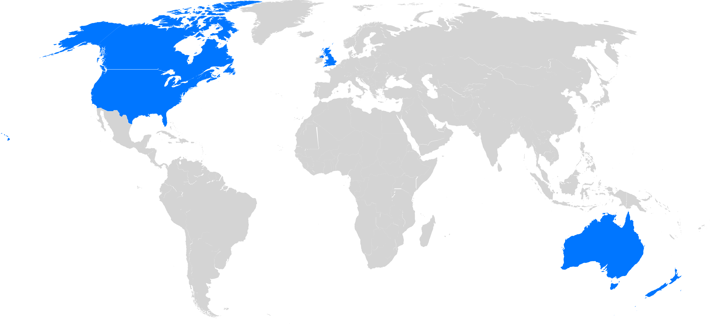
Methodology
  SURVEY CONDUCTED: JUNE 2019
100
  U.S. & CANADA
Company Size
2,500 to
4,999
10,000 or more
27%
44%
5,000 to
9,999
29%

Slide 3



Performance and Availability Rule
2
Availability
4
Security
1
3
Performance
Cost-effective

Slide 4
Yet Outages and Brownouts are Common
How many brownouts has your organization seen in the past three years?
How many outages has your organization seen in the past three years?
37%
48%
20%
18%
22%
9%
10%
16%
6%
6%
6%
3%
1-4
5-9
10-24
25-49
50+
0
1-4
5-9
10-24
25-49
50+
0
MEDIAN = 5
MEDIAN = 4

Slide 5
Yet Outages and Brownouts are Common
How many brownouts has your organization seen in the past three years?
How many outages has your organization seen in the past three years?
50+
0
50+
0
25-49
25-49
3%
6%
10%
6%
6%
9%
10-24
10-24
15%
18%
1-4
1-4
5-9
37%
48%
5-9
5-9
22%
20%
MEDIAN = 4
MEDIAN = 5

Slide 6


In Fact, IT is Pessimistic about Outages and Brownouts
50% say it is likely they will experience a brownout or outage so severe that it makes the major media
52% say it is likely they will experience a brownout or outage so severe that someone loses their job

Slide 7






Why?
How common are the following in terms of causing outages and brownouts?
2
Usage spikes/surges
4
Loss of electrical power
6
Software malfunction
1
Human Error
3
Infrastructure hardware
5
Network failure

Slide 8
Outages and Brownouts are Costly
Costs of outages in each of these areas over the past 3 years?
Costs of brownouts in each of these areas over the past 3 years?
$2,053
Mitigation costs
$2,493
Lowered stock price
$2,947
Business failed
Other
$30,620
$2,516
Career negatively impacted
Other
$38,341
Damage to brand /rep
$4,435
Career negatively impacted
Lost productivity
$46,665
$6,316
Business failed
$31,351
Costs to mitigate and recover from a brownout
Lost revenue
$132,548
$5,766
Costs to mitigate and recover from a brownout
$34,923
Lost revenue
$229,608
Compliance or legal costs
$71,546
$11,439
Compliance or legal costs
Lost productivity
$153,637
Lowered stock price
$109,866
$15,419
Damage to brand/rep
$15,577
Mitigation costs

Slide 9
More than Half of all Outages and Brownouts are Avoidable
What percent of brownouts were avoidable?
What are the most common causes?
What percent of outages were avoidable?
Passing a capacity threshold
Failure of hardware or software that comes after a period of deterioration
1
2
45%
55%
48%
52%
UNAVOIDABLE
AVOIDABLE
UNAVOIDABLE
AVOIDABLE

Slide 10



Wide Range of Outcomes
Top Tier | Middle Tier | Bottom Tier
These are the respondents performing the best with monitoring and managing brownouts | These are the respondents who scored in the middle in terms monitoring and managing brownouts | These are the respondents having the most problems with monitoring and managing brownouts

Slide 11



Bottom Tier Doing Much Worse
Top Tier
Bottom Tier
9x
5x
1.5x
Higher costs incurred due to brownouts
The number of people required to troubleshoot monitored infrastructure
The number of people required to troubleshoot unmonitored infrastructure

Slide 12


Bottom Tier Experiences More Outages and Brownouts
Top Tier
Bottom Tier
2x
1.5x
6x
1.2x
The total number of outages
The number of avoidable outages
The total number of brownouts
The number of avoidable brownouts

Slide 13



Bottom Tier Sees More Outages and Brownouts
Top Tier
Bottom Tier
16x
8.1x
2x
More likely to experience brownouts or outages so severe it makes the major media
More likely to experience brownouts or outages so severe someone is fired
More than twice as long to troubleshoot outages and brownouts

Slide 14





Recommendations
At LogicMonitor, we expand what’s possible for businesses by advancing the technology behind them. Through monitoring, our customers gain the ability to focus less on problem-solving and more on evolving and future-proofing their businesses. Want to do the same? Here are five tips to get you started.
Embrace comprehensive monitoring
Identify and address gaps in your systems
Act on trends in your monitoring data
Create an outage response plan
Scale
your monitoring
Find and implement a platform that comprehensively monitors infrastructures, allowing you to view your IT systems through a single pane of glass. Consider extensibility during the selection process to ensure the platform integrates with all of your technologies.
Build a high level of redundancy into your monitoring systems to prevent outages from occurring. Focus on eliminating single points of failure that might cause a system to go down.
Make sure you have a solution in place that gives you early visibility into trends that could signify trouble ahead. Use data forecasting to proactively identify future failures, and prevent an outage before it impacts the business.
Hopefully you’ll never have to use it, but it’s critical to have a defined process for handling outages, from escalation and remediation to communication and root cause analysis. Set a plan on who to involve--and when--to ensure you can respond quickly if an outage does occur.
Whether you’re adopting new technologies or moving your infrastructure to the cloud, make sure that your monitoring solution can keep up. Select a scalable platform that will help take your business to the next level while still maintaining visibility into your systems.

Slide 15
Appendix

Slide 16
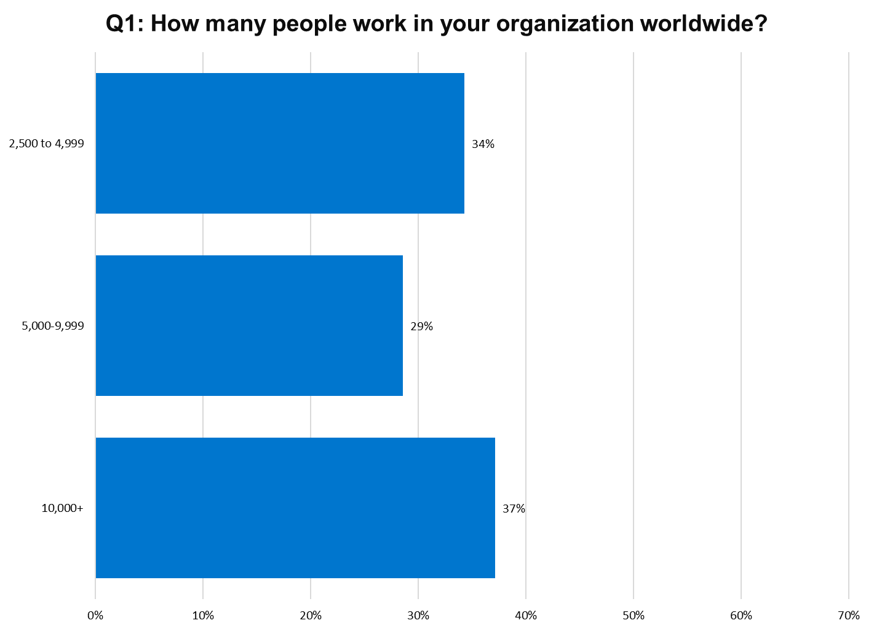
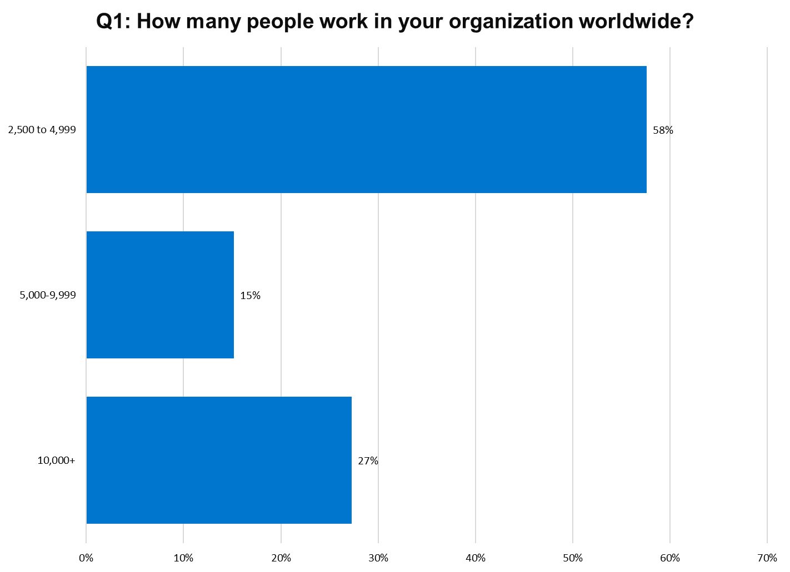
Top Tier Bottom Tier

Slide 17
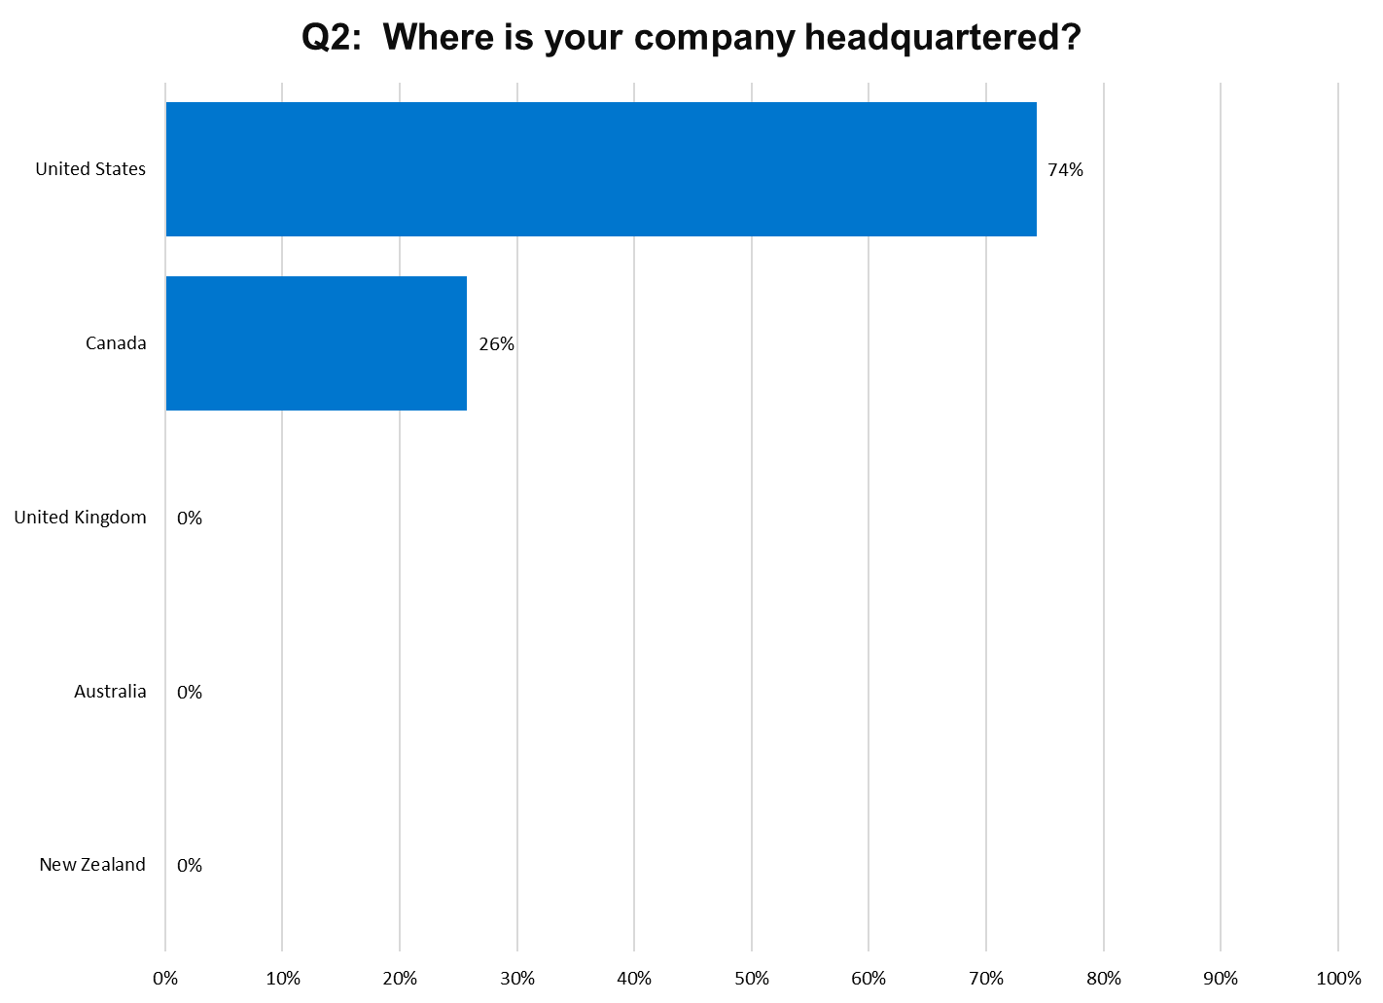
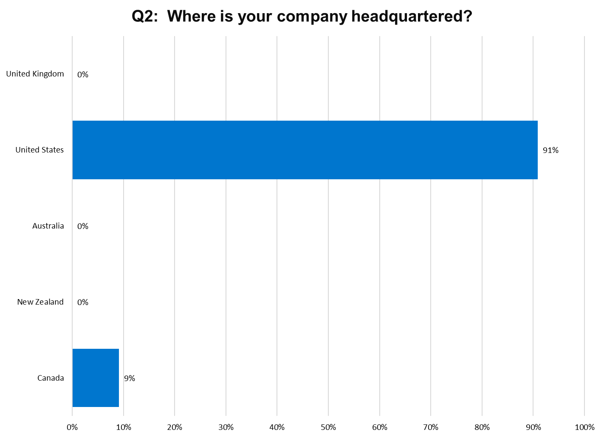
Top Tier Bottom Tier

Slide 18
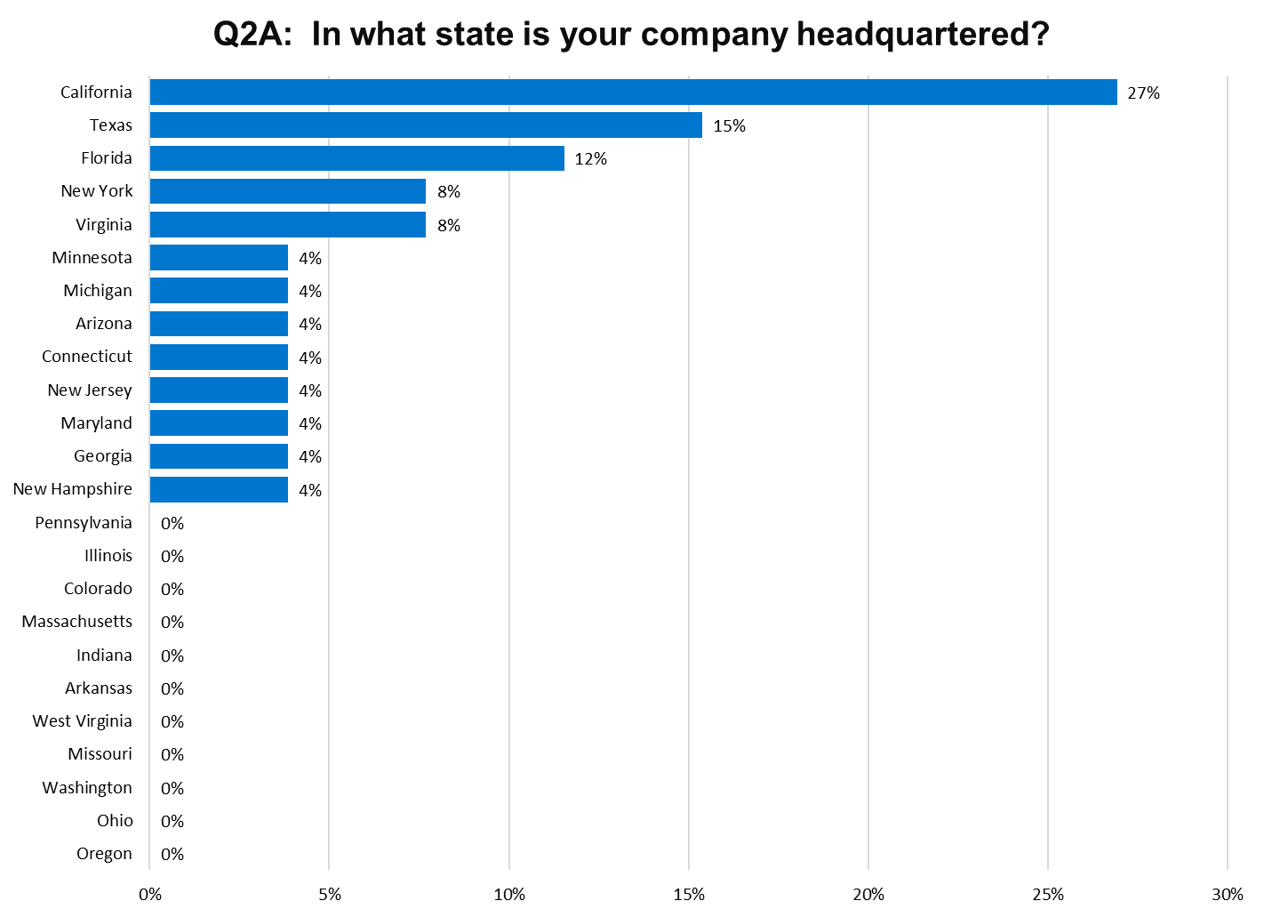
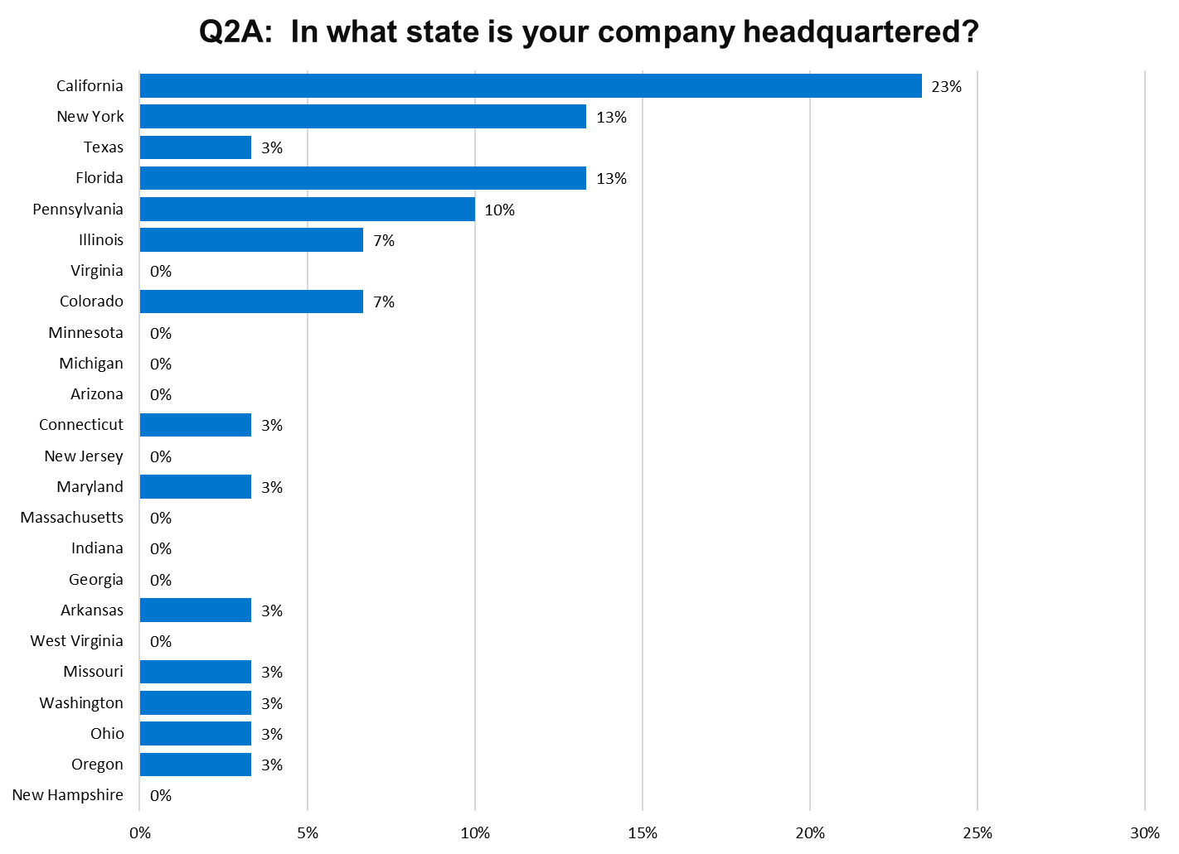
Top Tier Bottom Tier

Slide 19
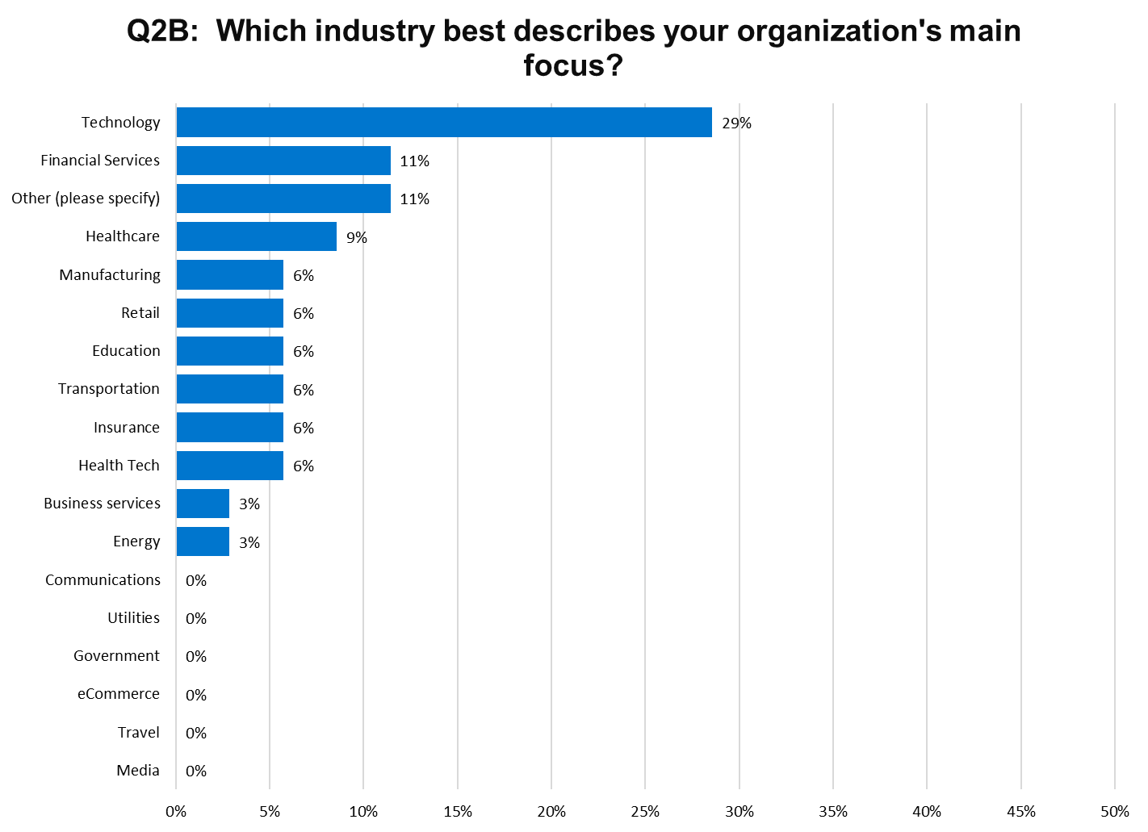
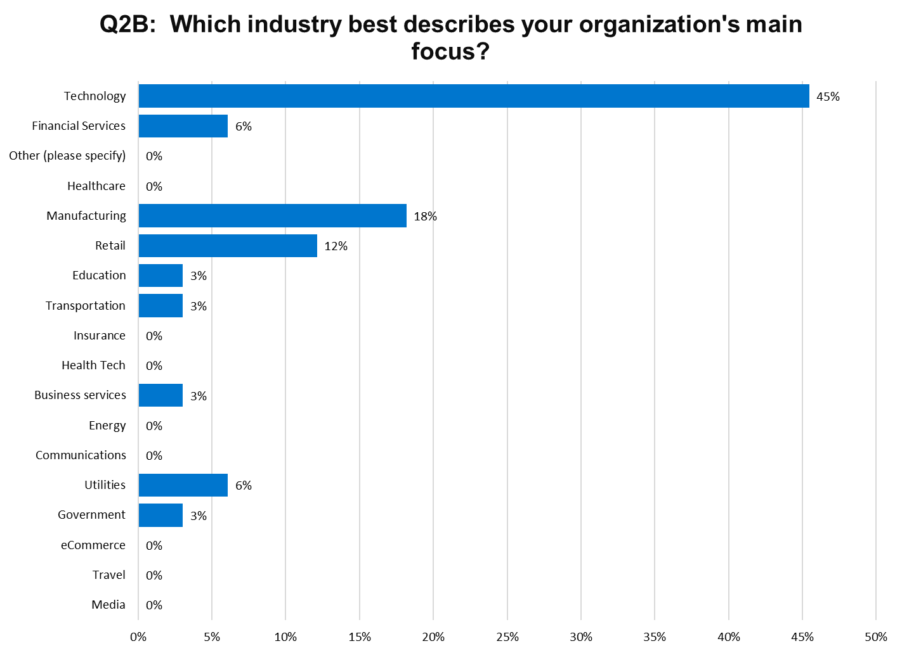
Top Tier Bottom Tier

Slide 20
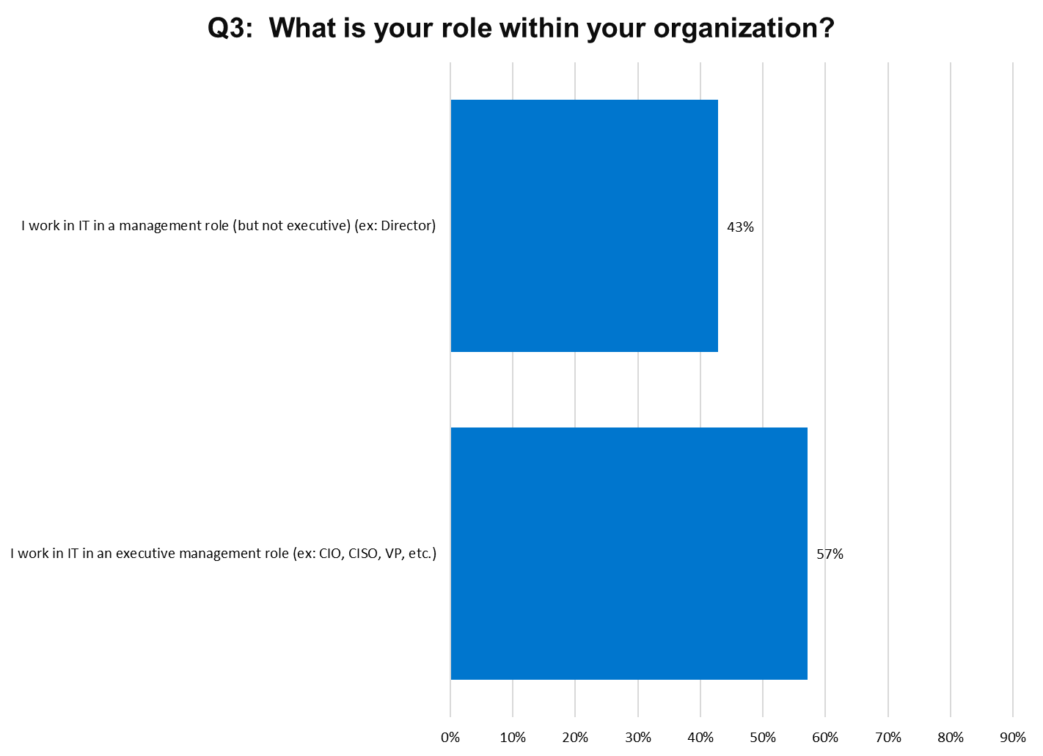
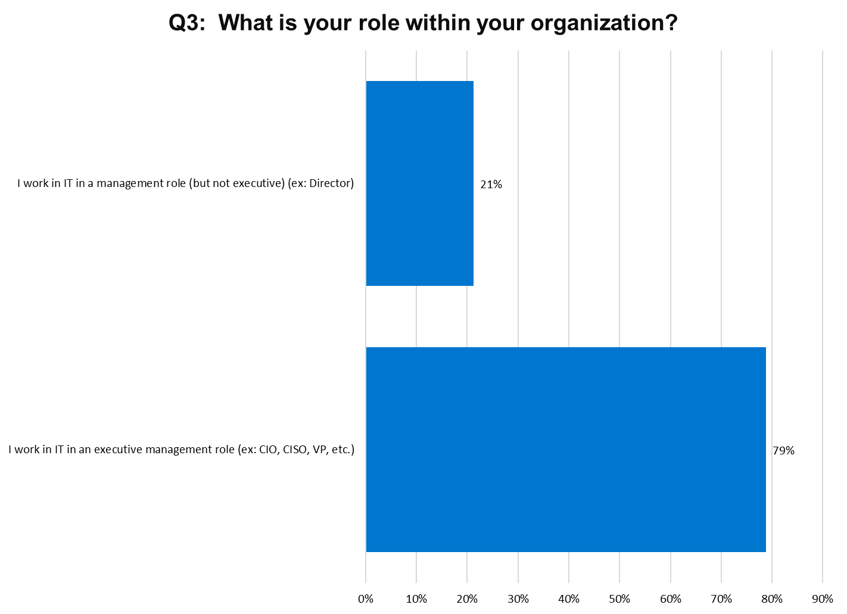
Top Tier Bottom Tier

Slide 21
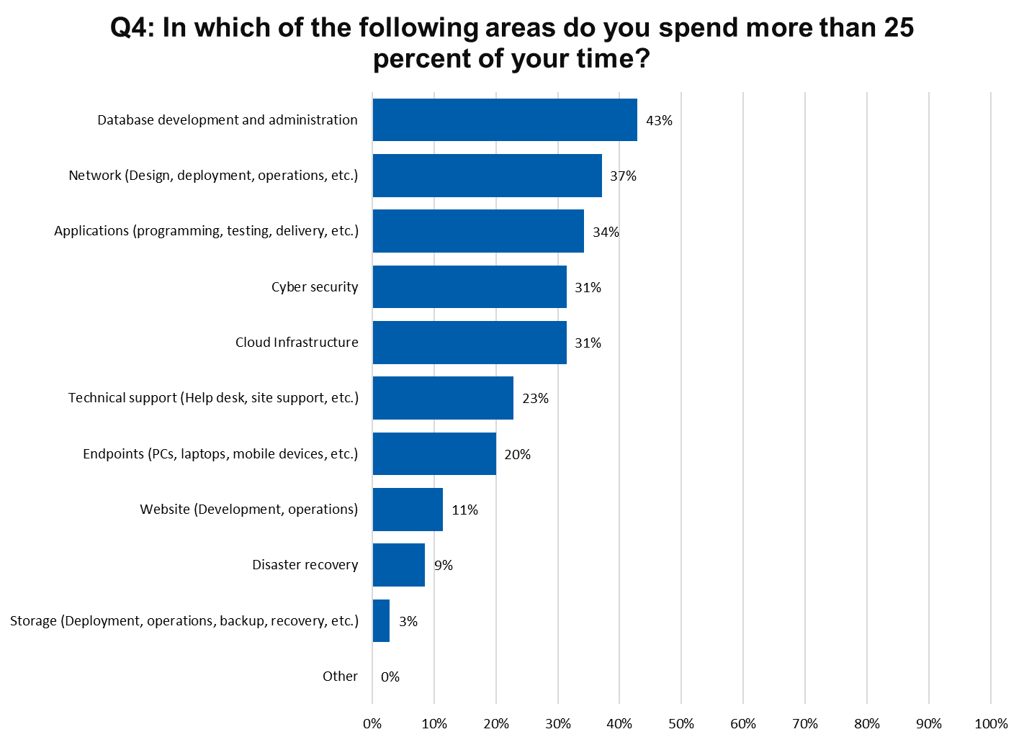
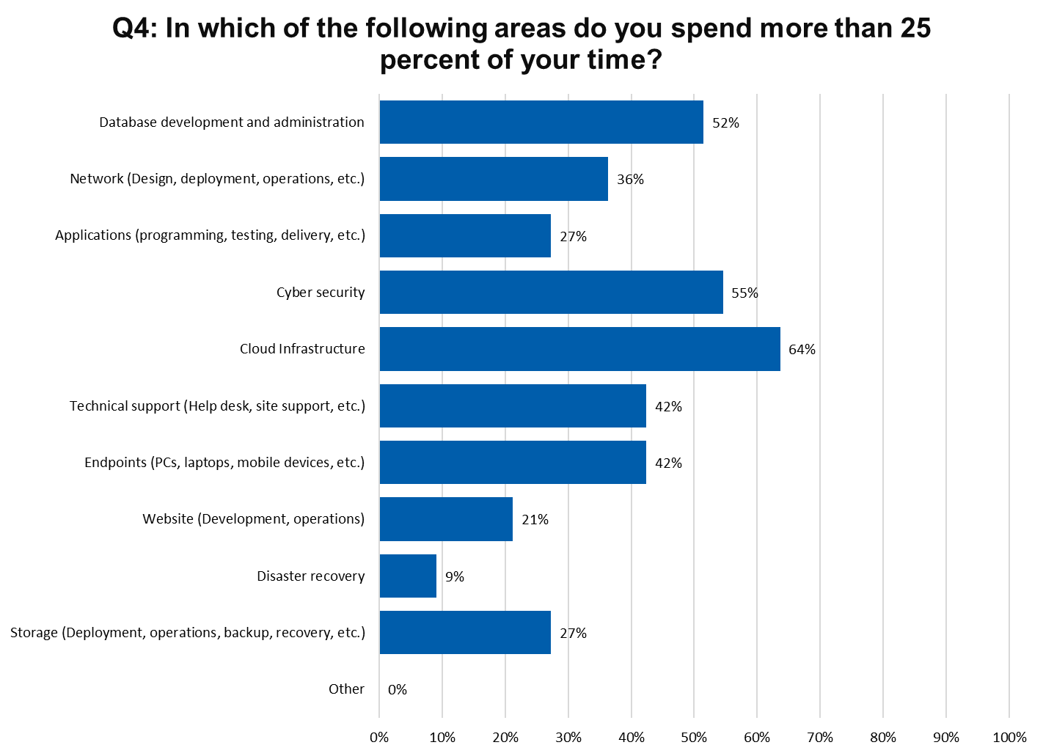
Top Tier Bottom Tier

Slide 22
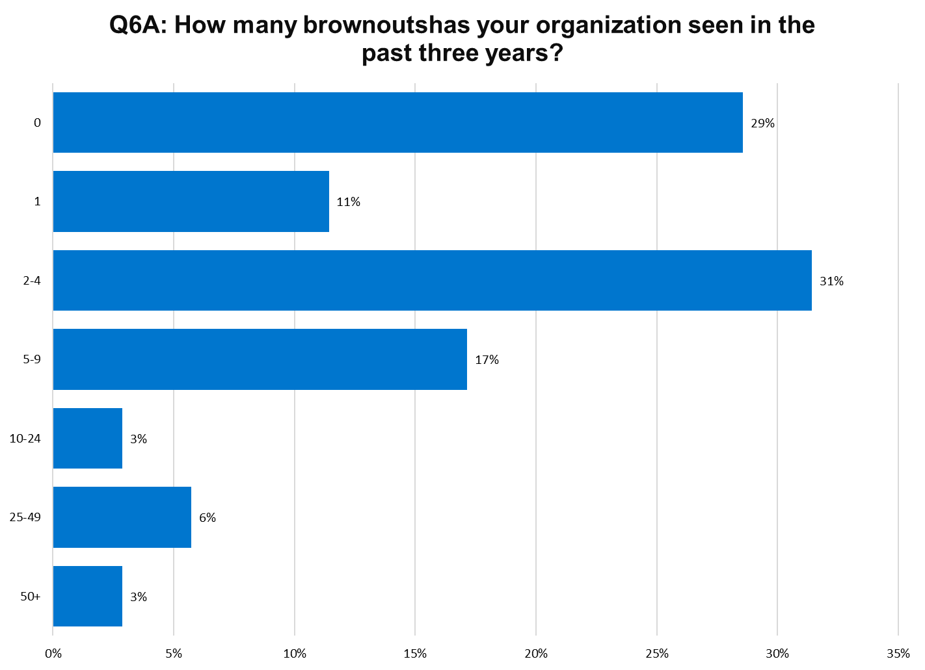
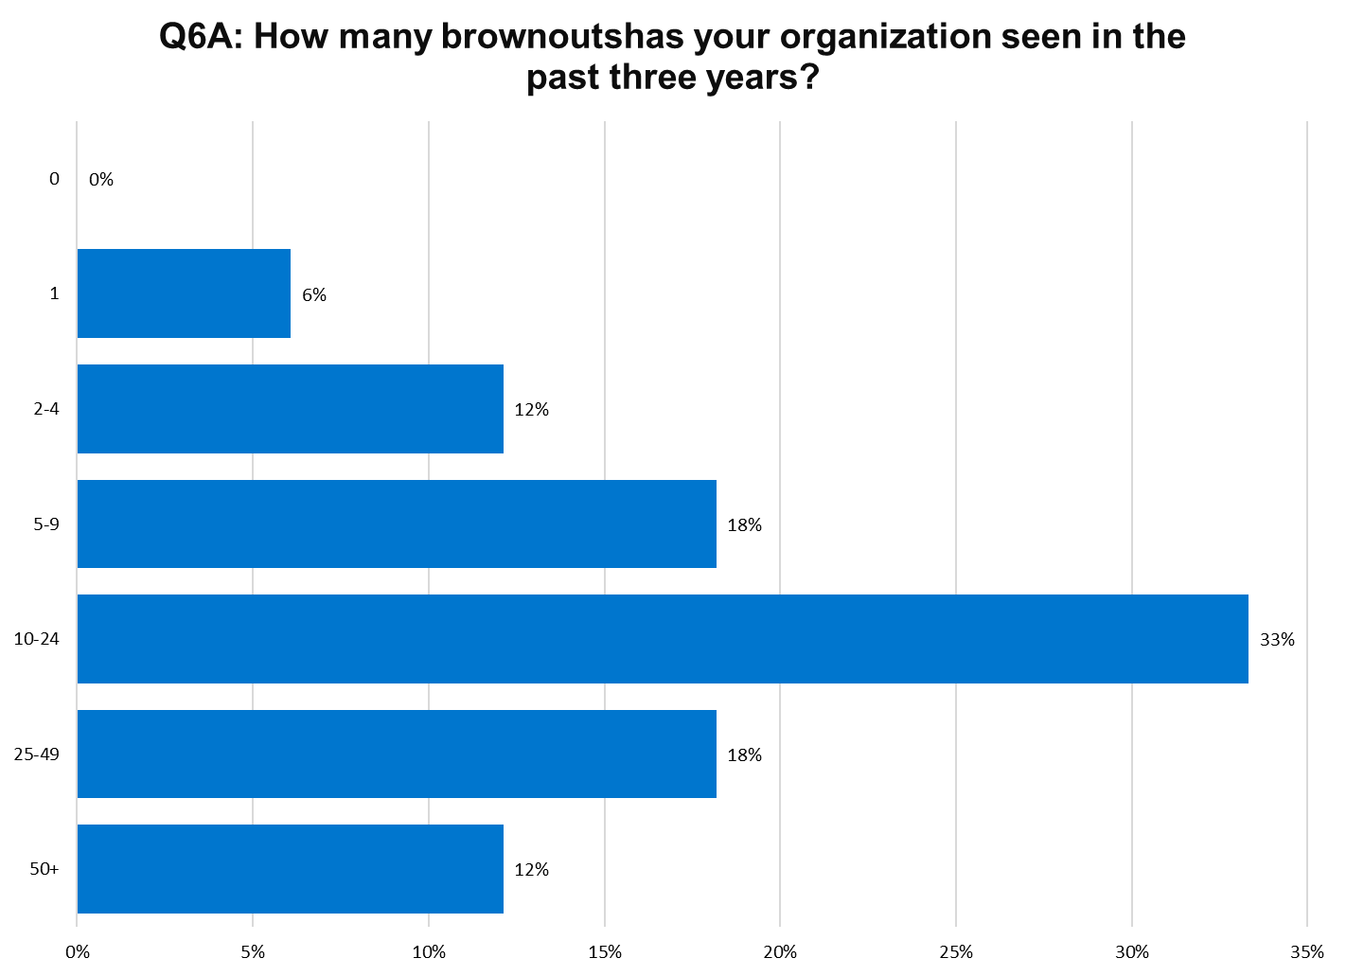
Top Tier Bottom Tier
Notes:
Median Top Tier - 2
Median Bottom Tier – 13.5
6.25 time more brownouts

Slide 23
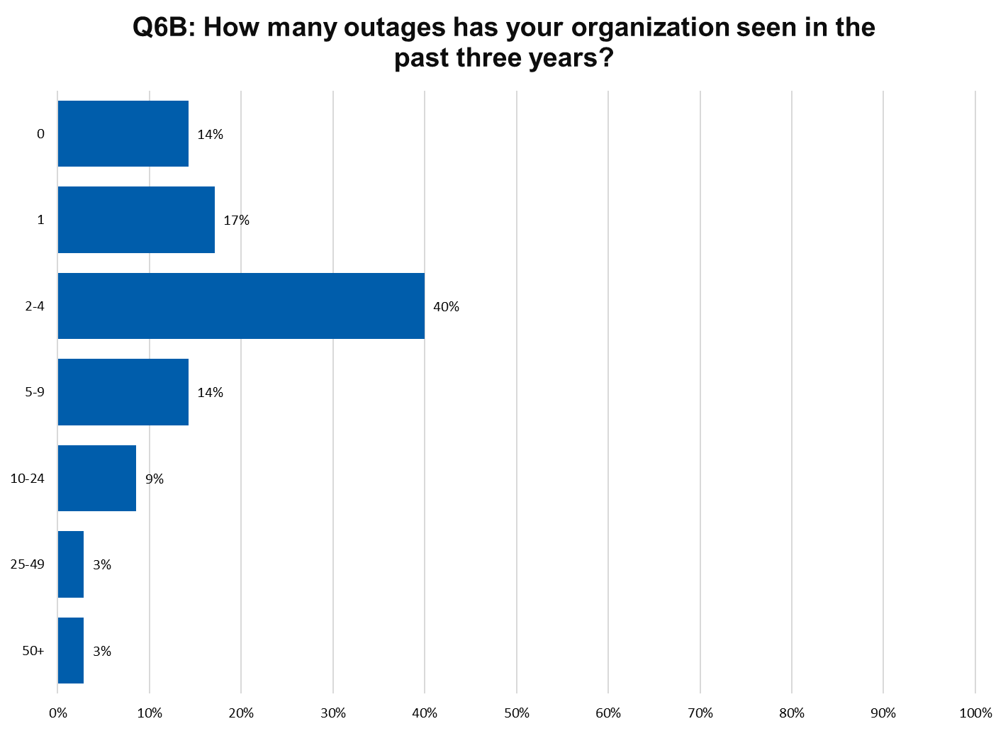
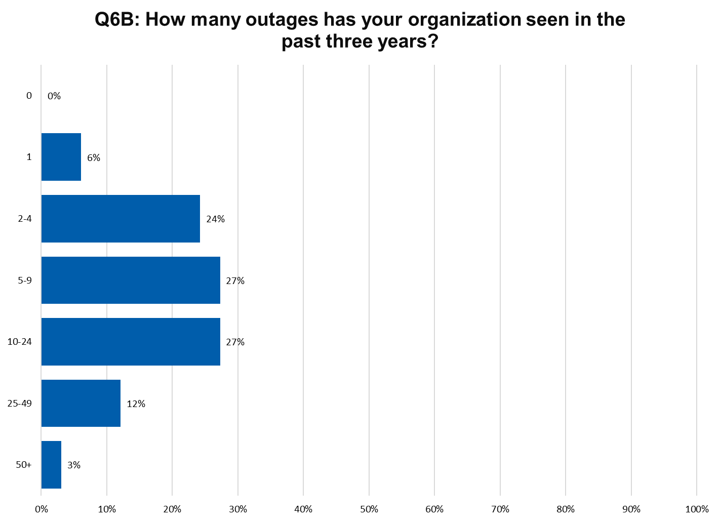
Top Tier Bottom Tier
Notes:
Median Top Tier – 2.5
Median Bottom Tier - 10
4.00 time more outages

Slide 24
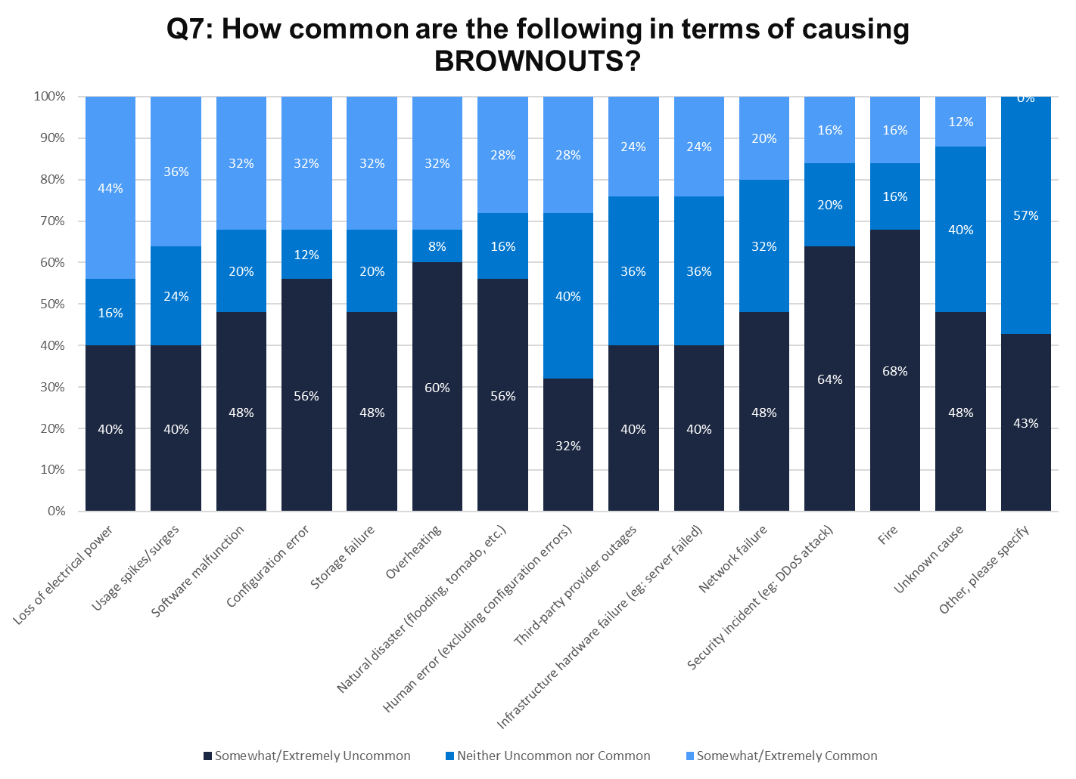
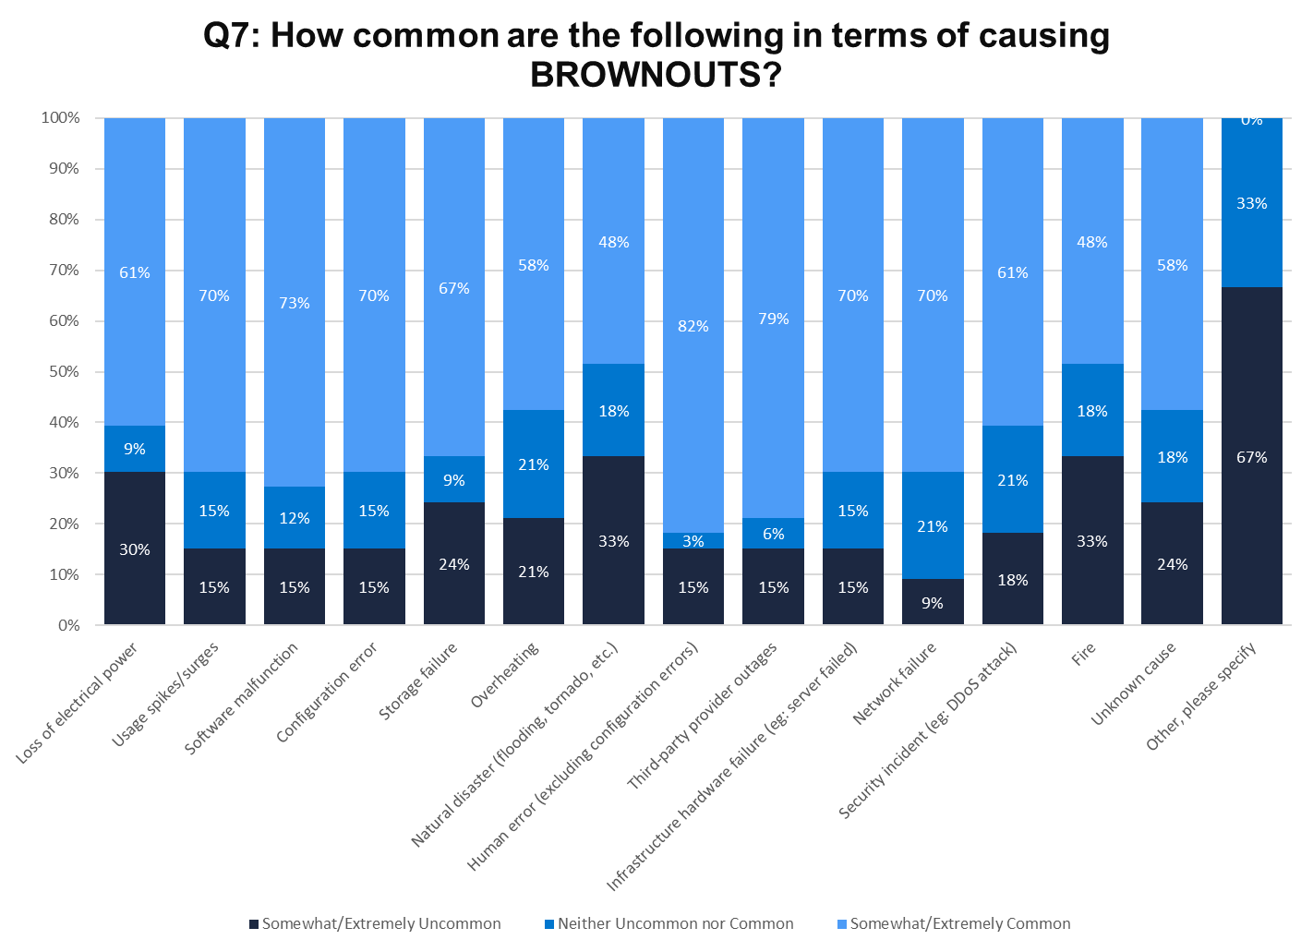
Top Tier Bottom Tier

Slide 25
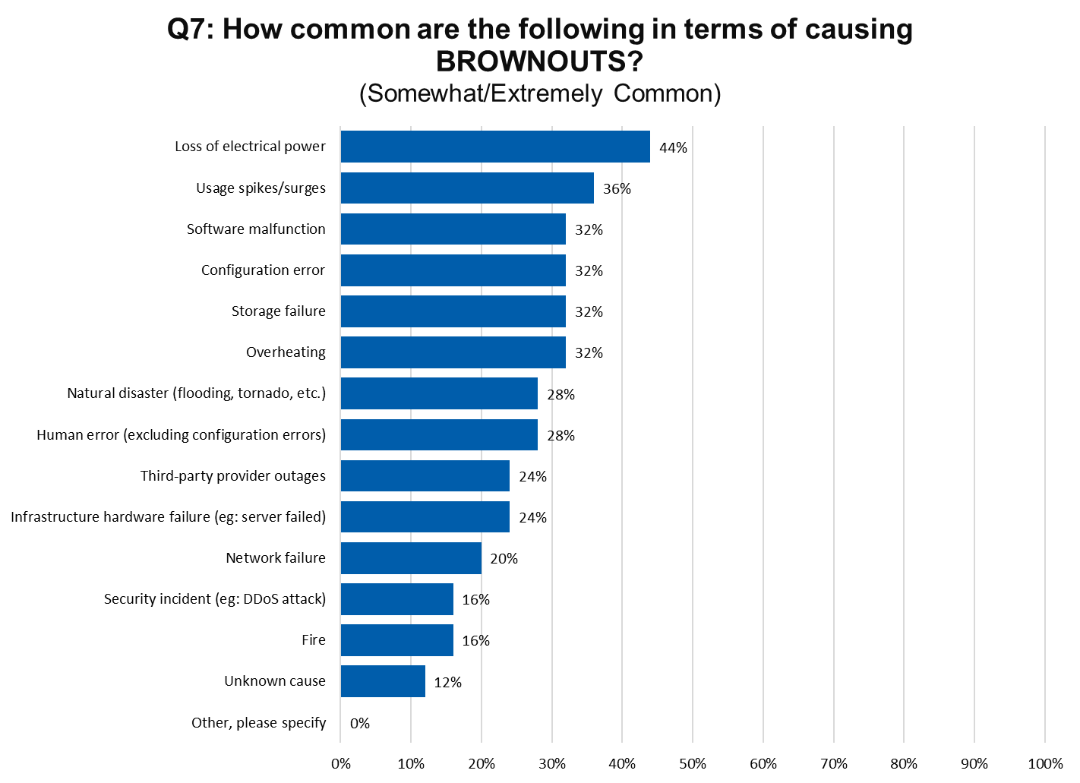
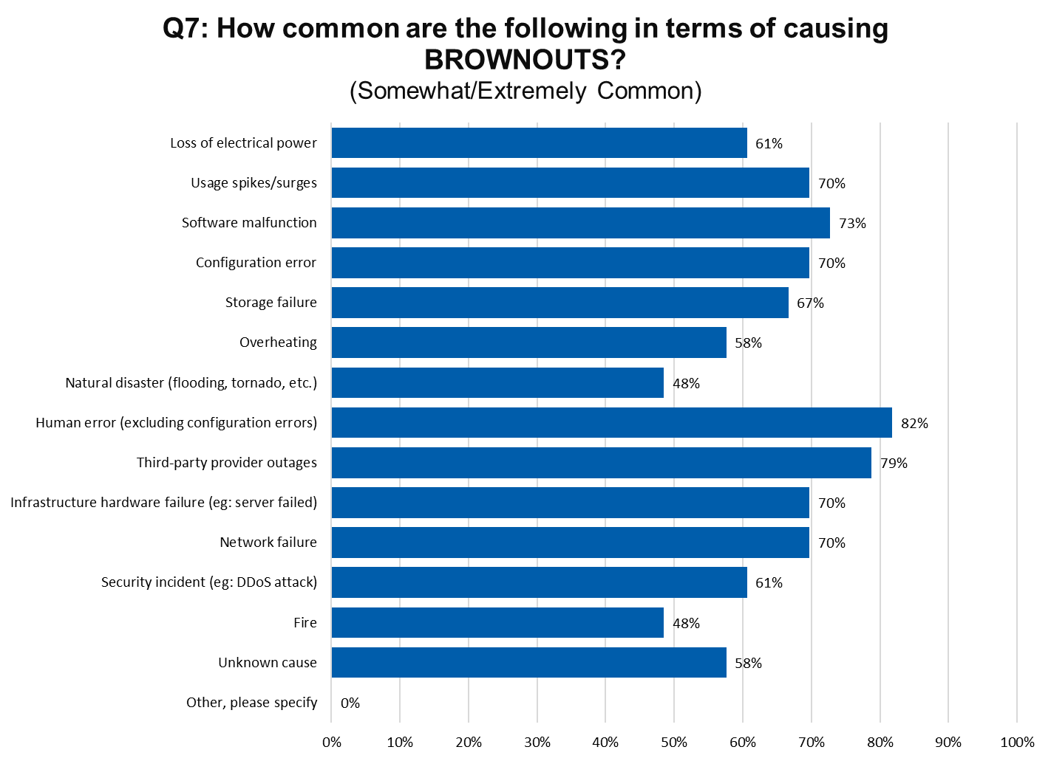
Top Tier Bottom Tier

Slide 26
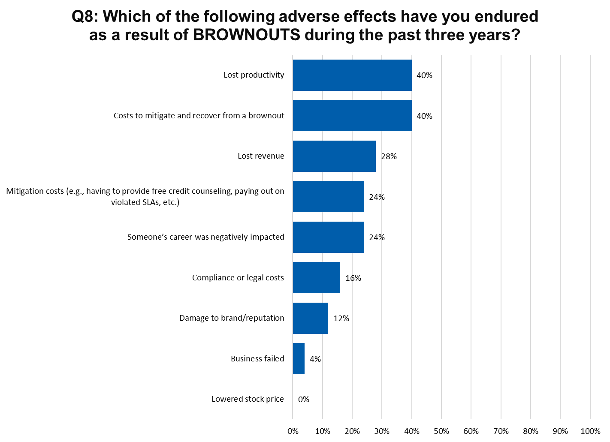
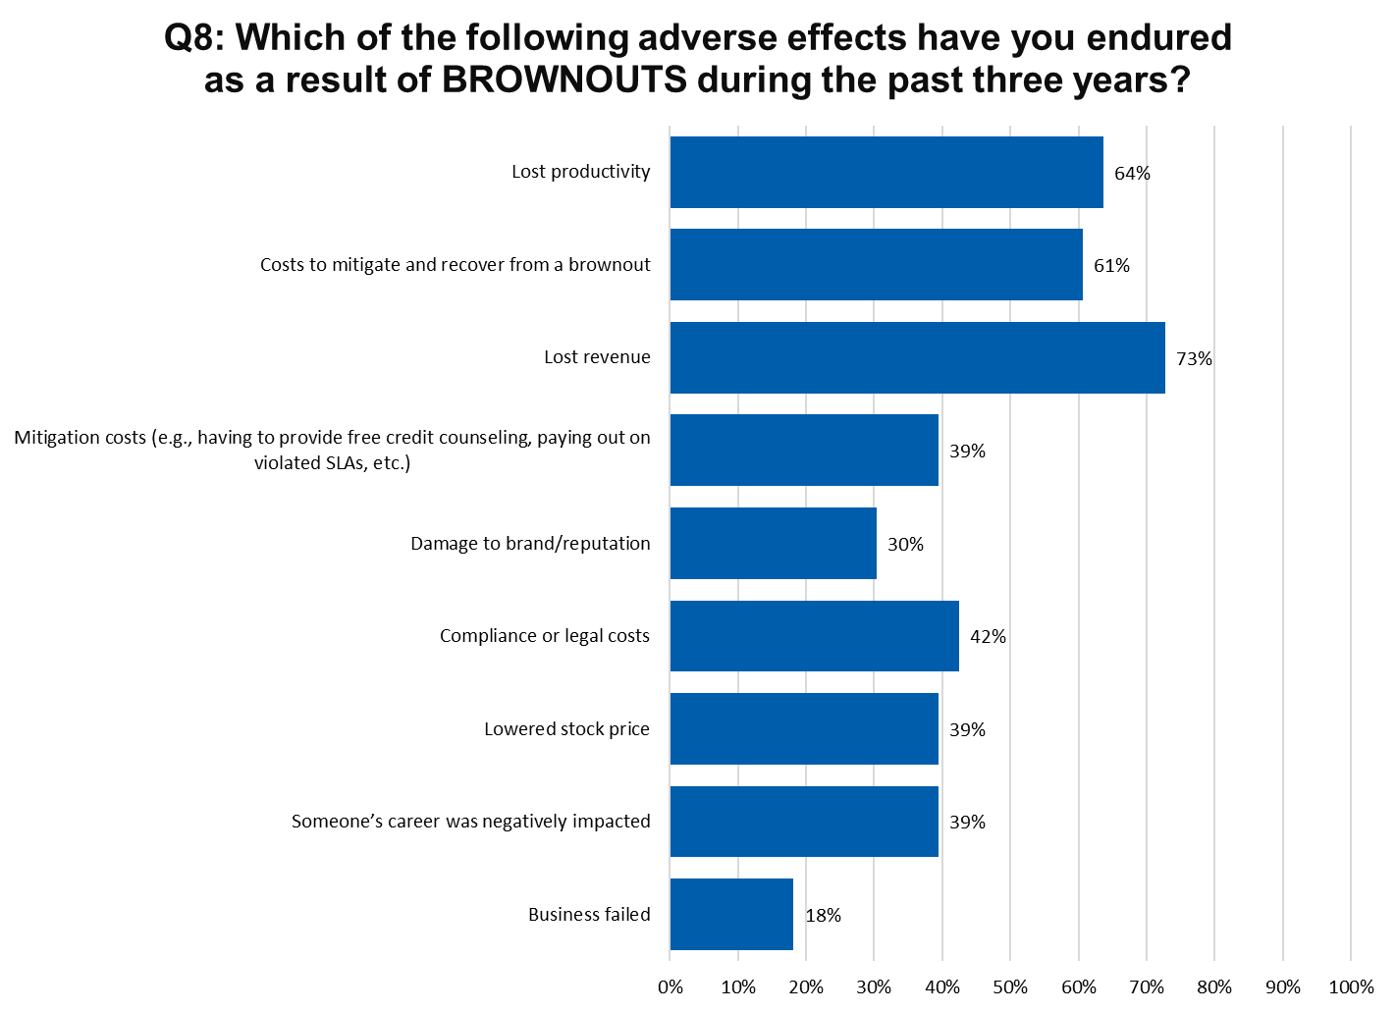
Top Tier Bottom Tier

Slide 27
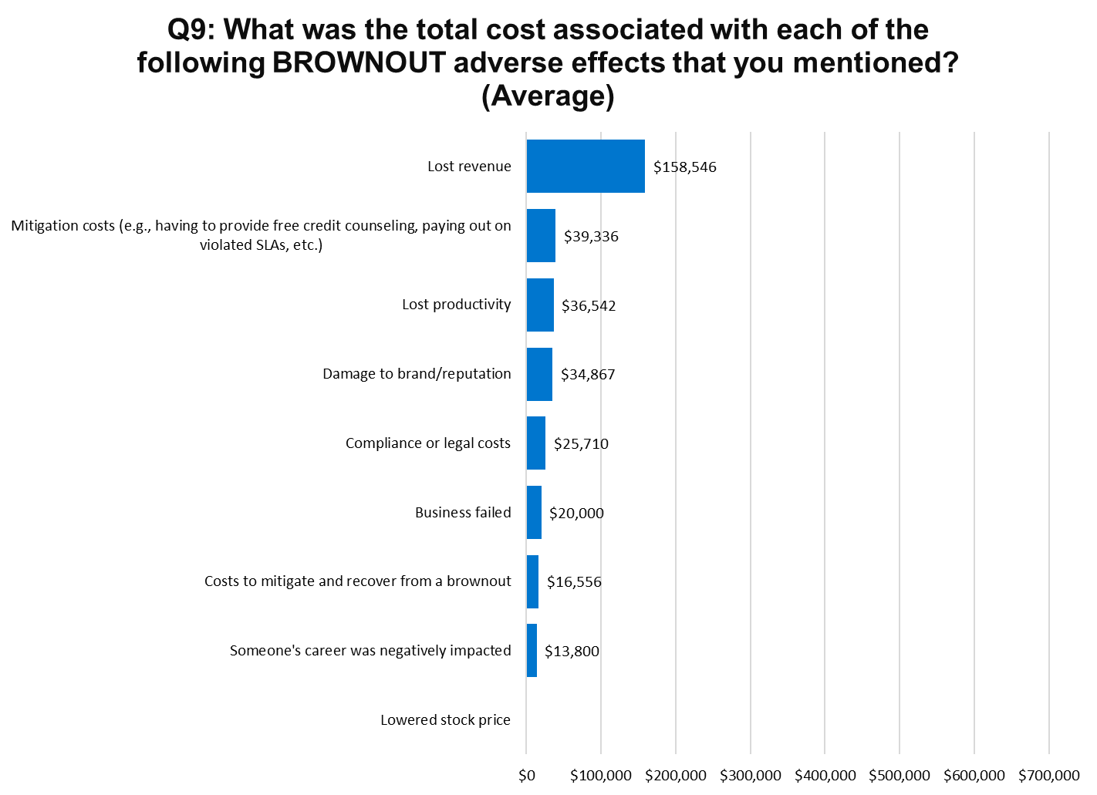
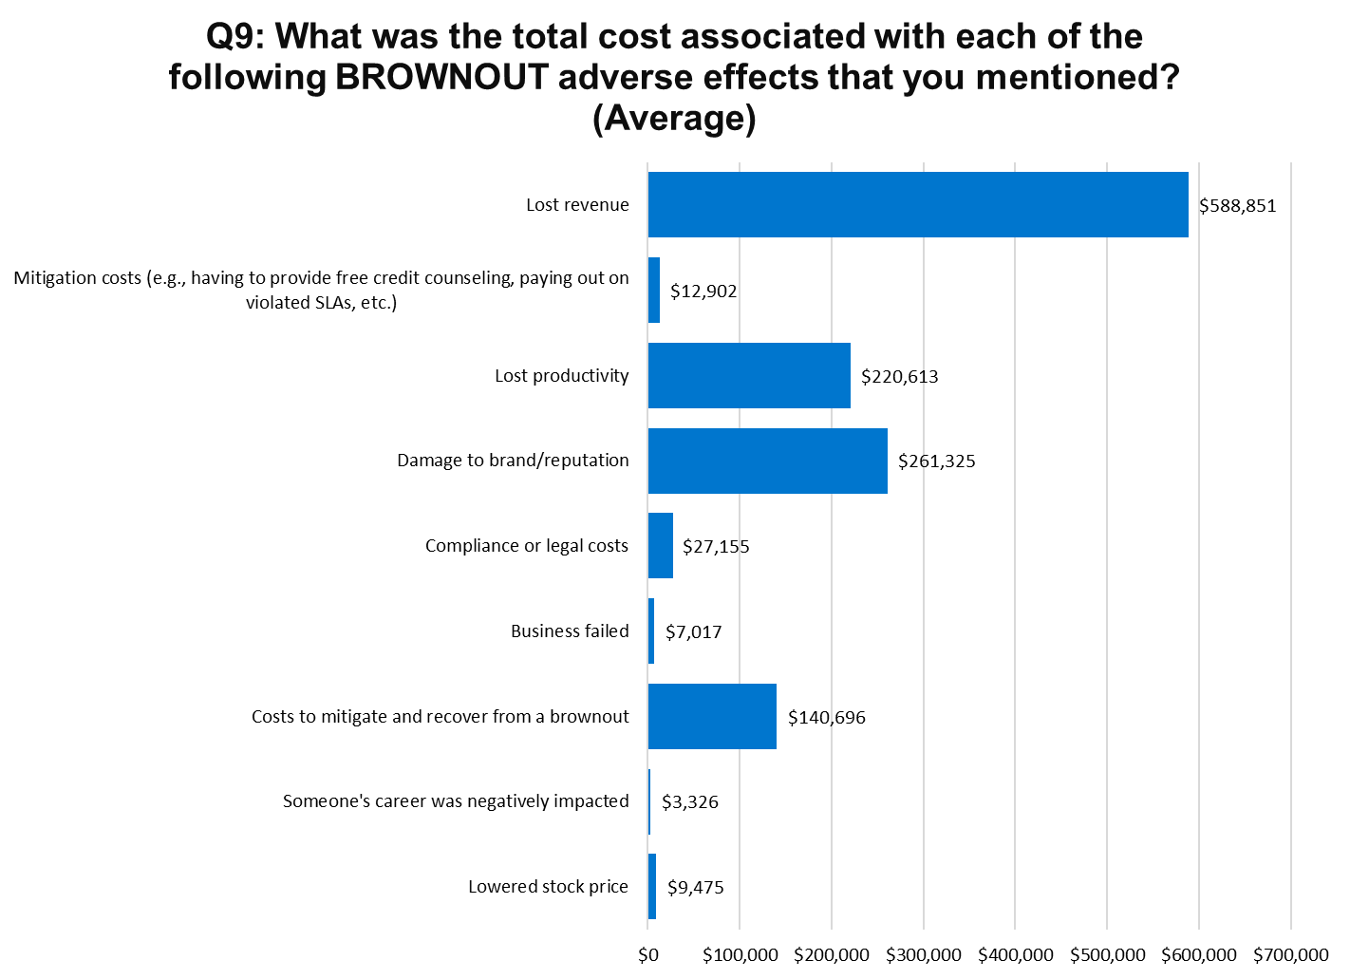
Top Tier Bottom Tier

Slide 28
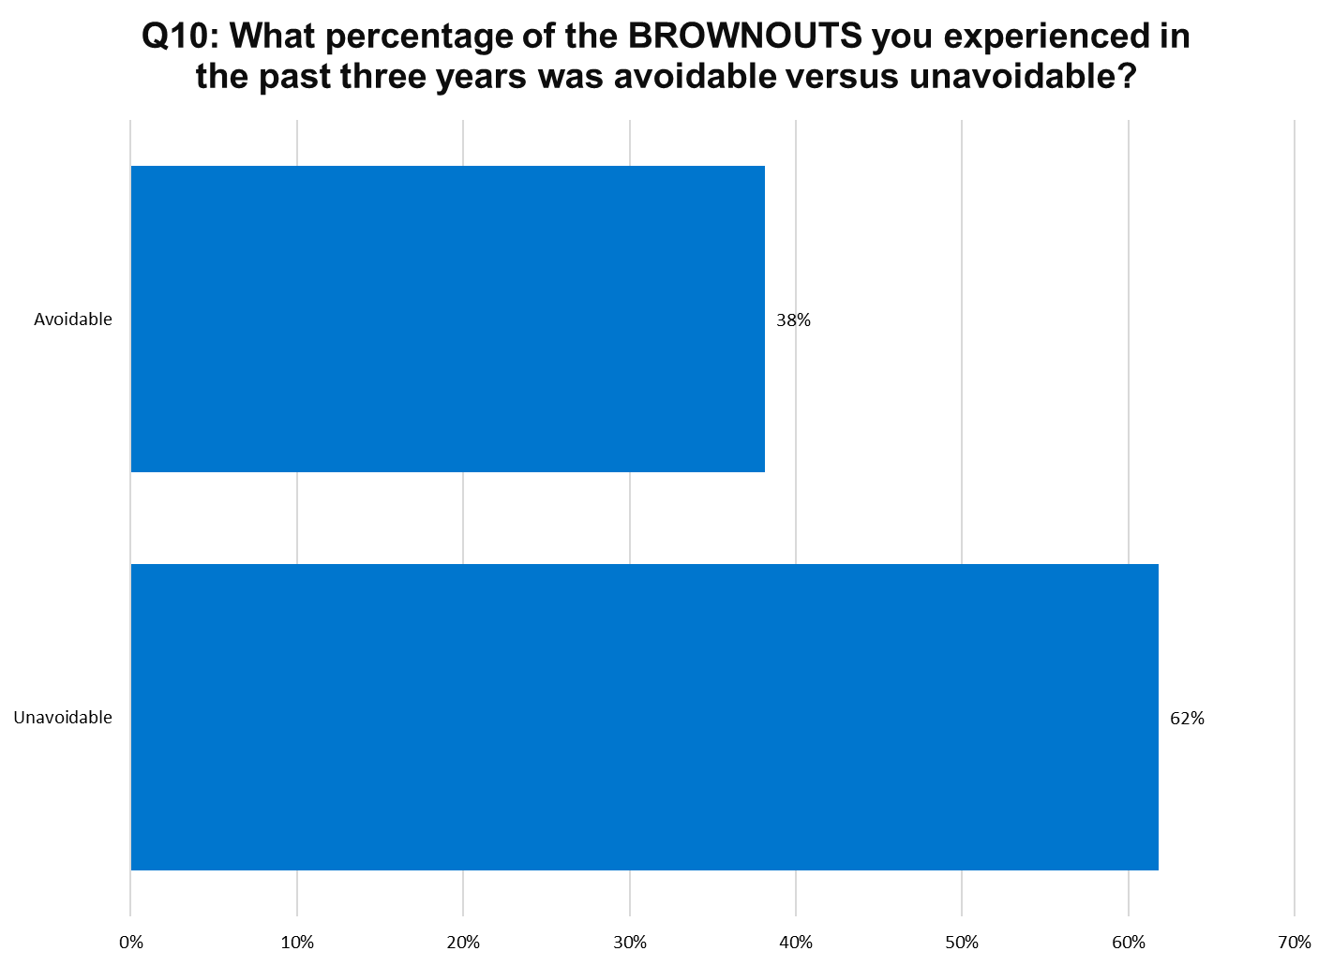
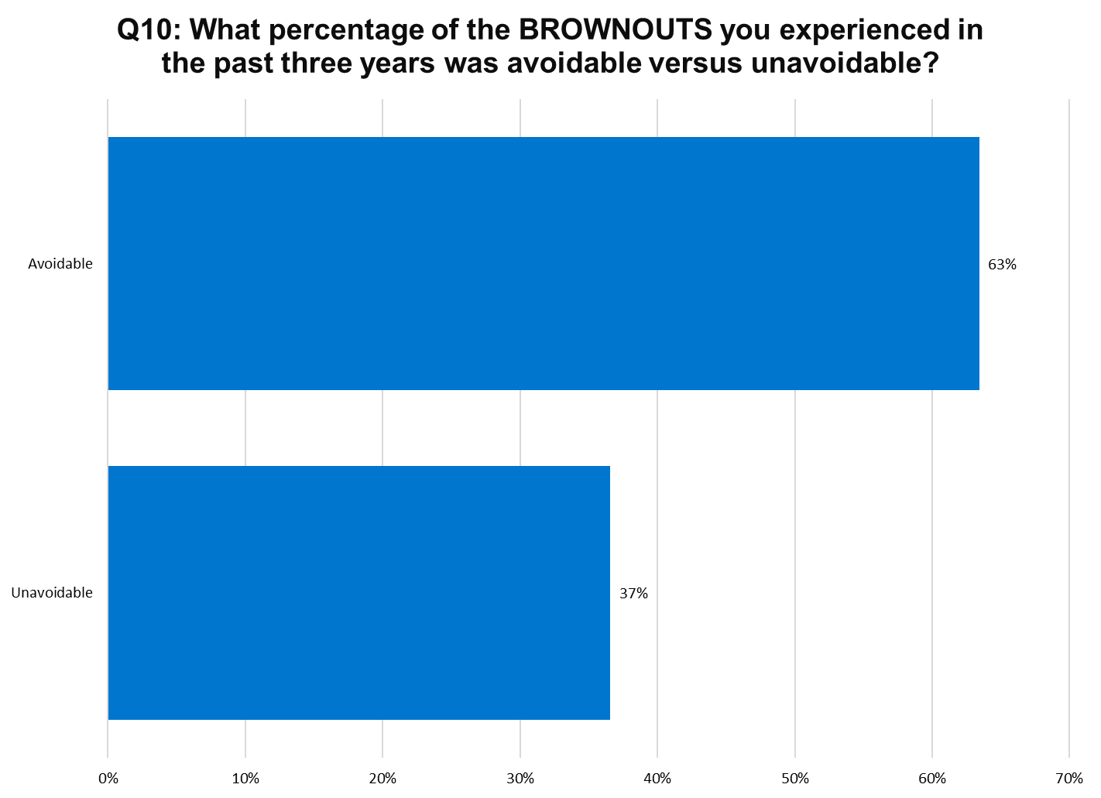
Top Tier Bottom Tier

Slide 29
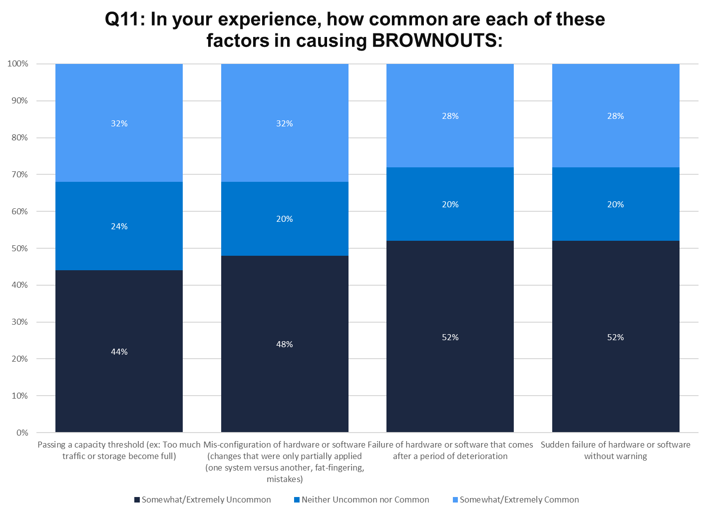
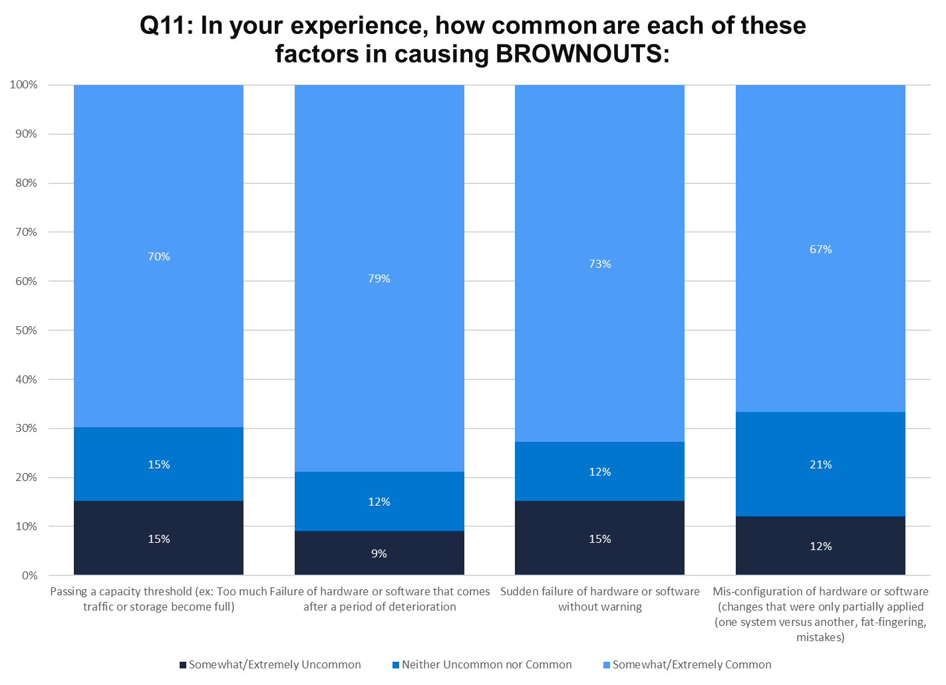
Top Tier Bottom Tier

Slide 30
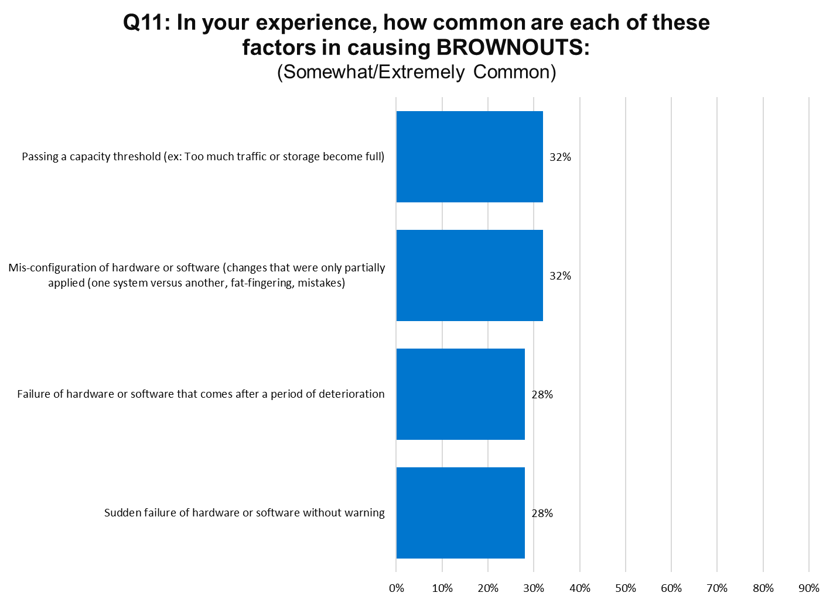
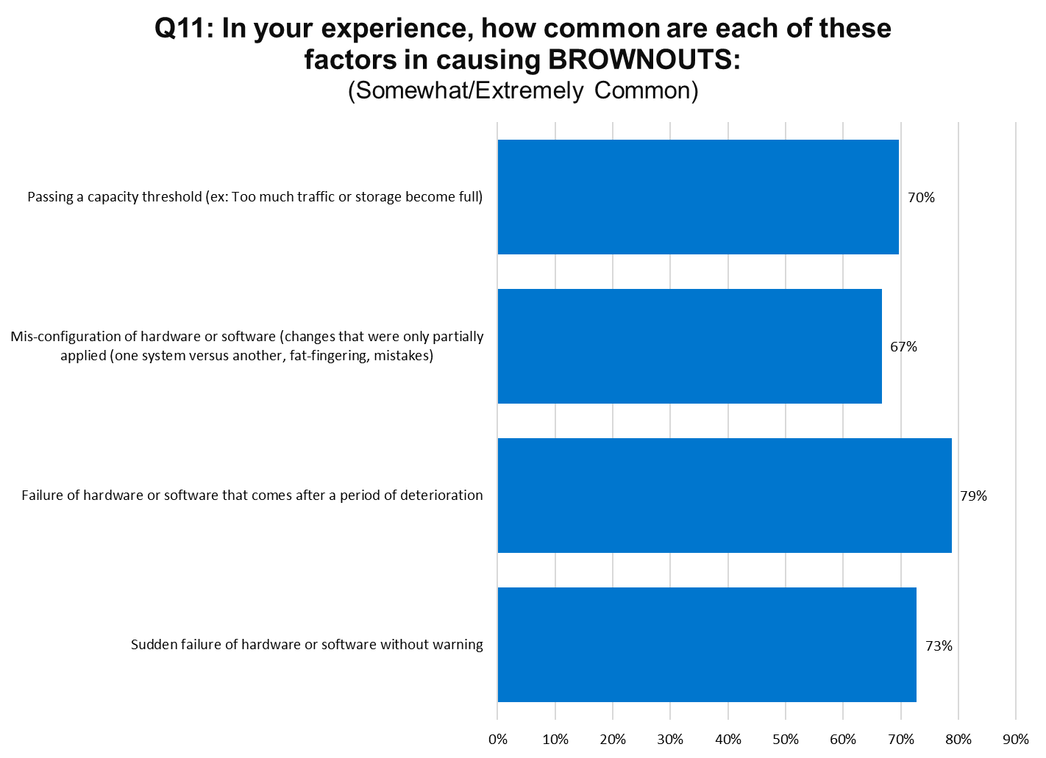
Top Tier Bottom Tier

Slide 31
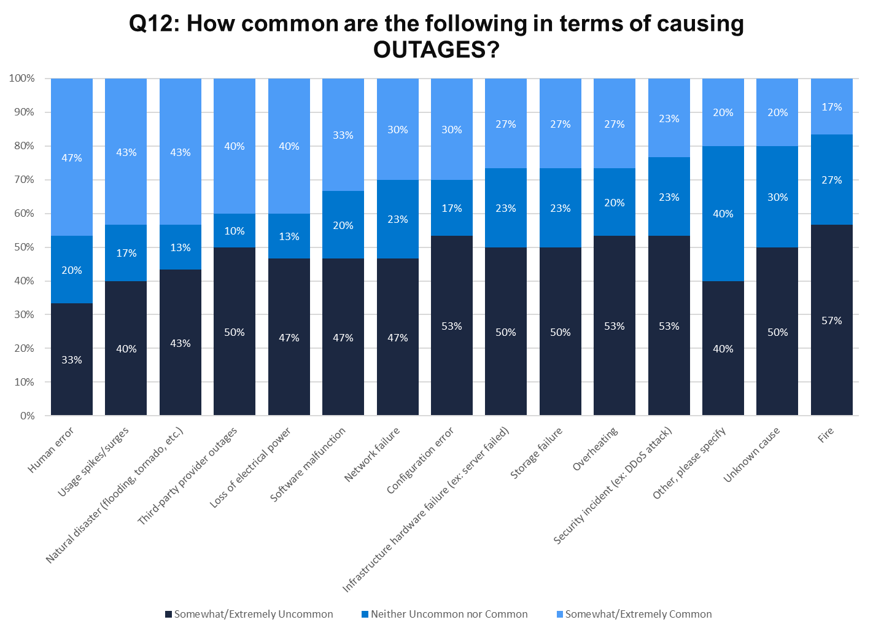
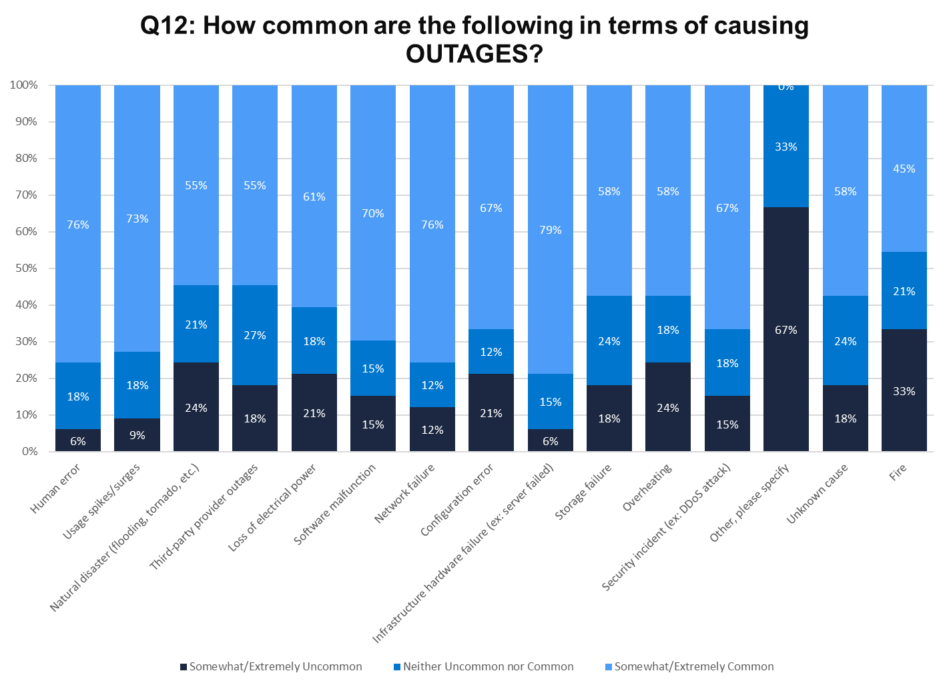
Top Tier Bottom Tier
Notes:
1.5 times more likely to experience avoidable browouts

Slide 32
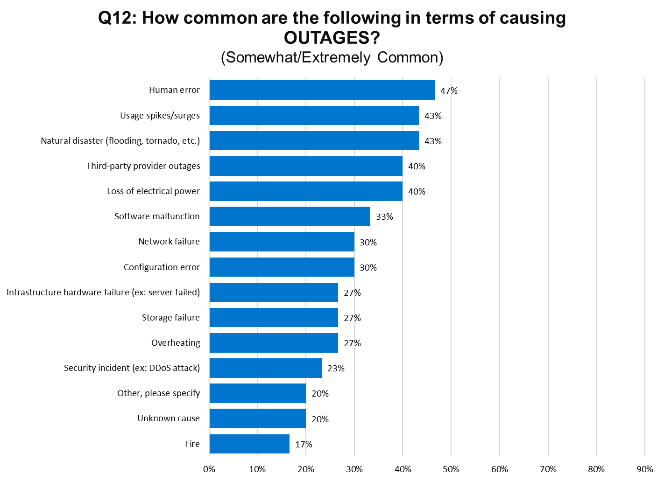
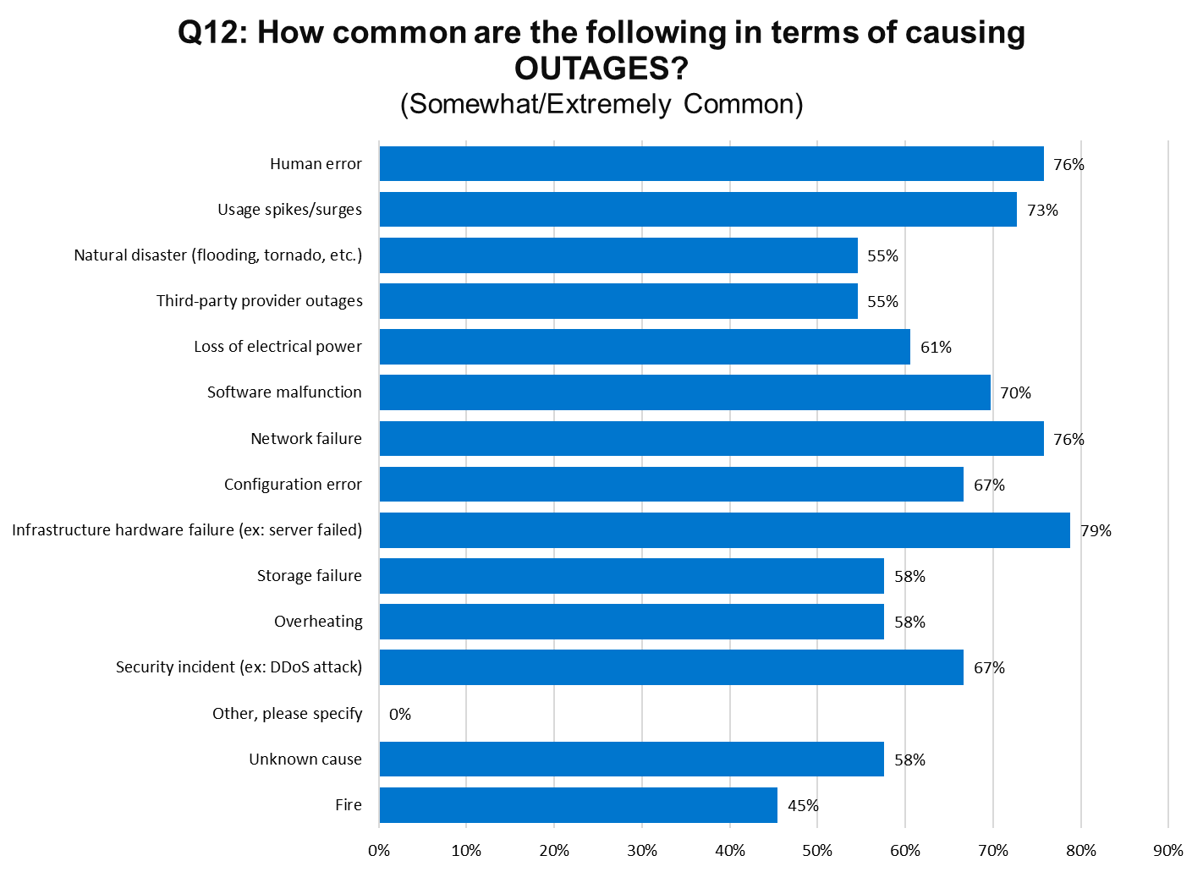
Top Tier Bottom Tier

Slide 33
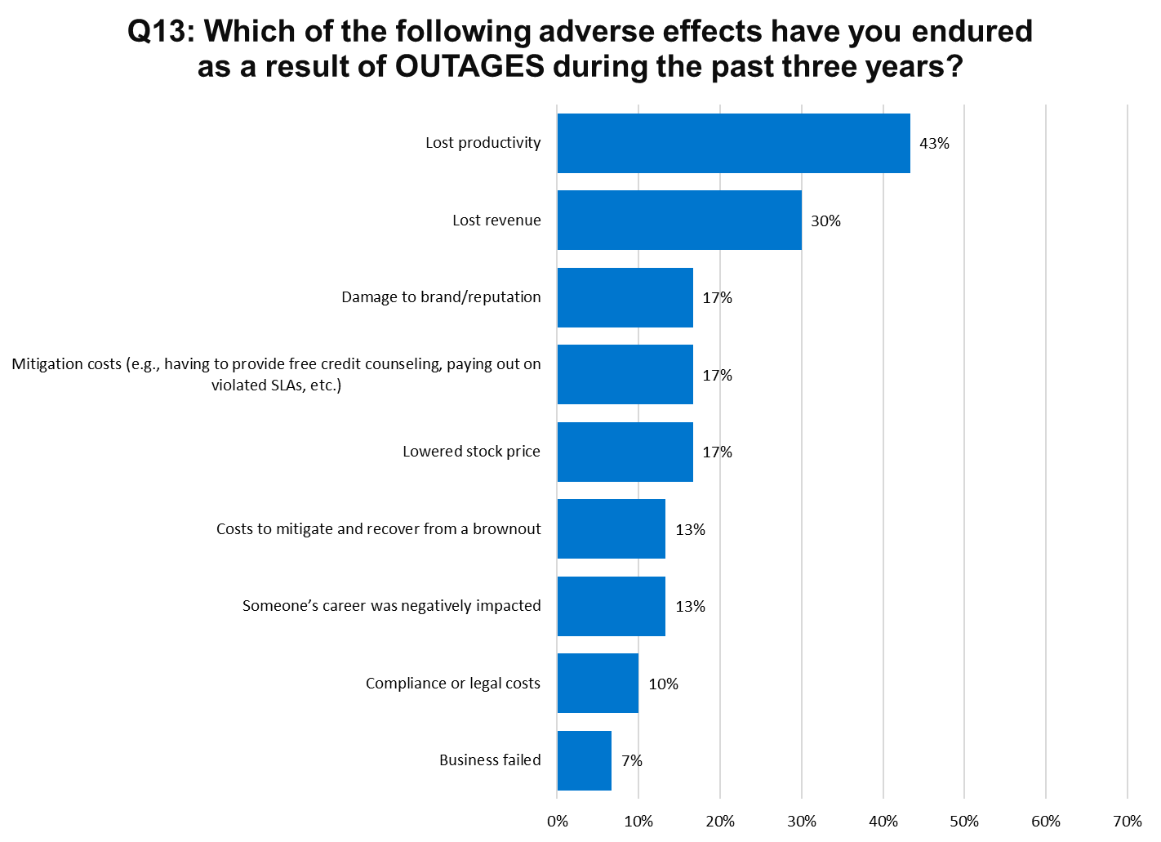
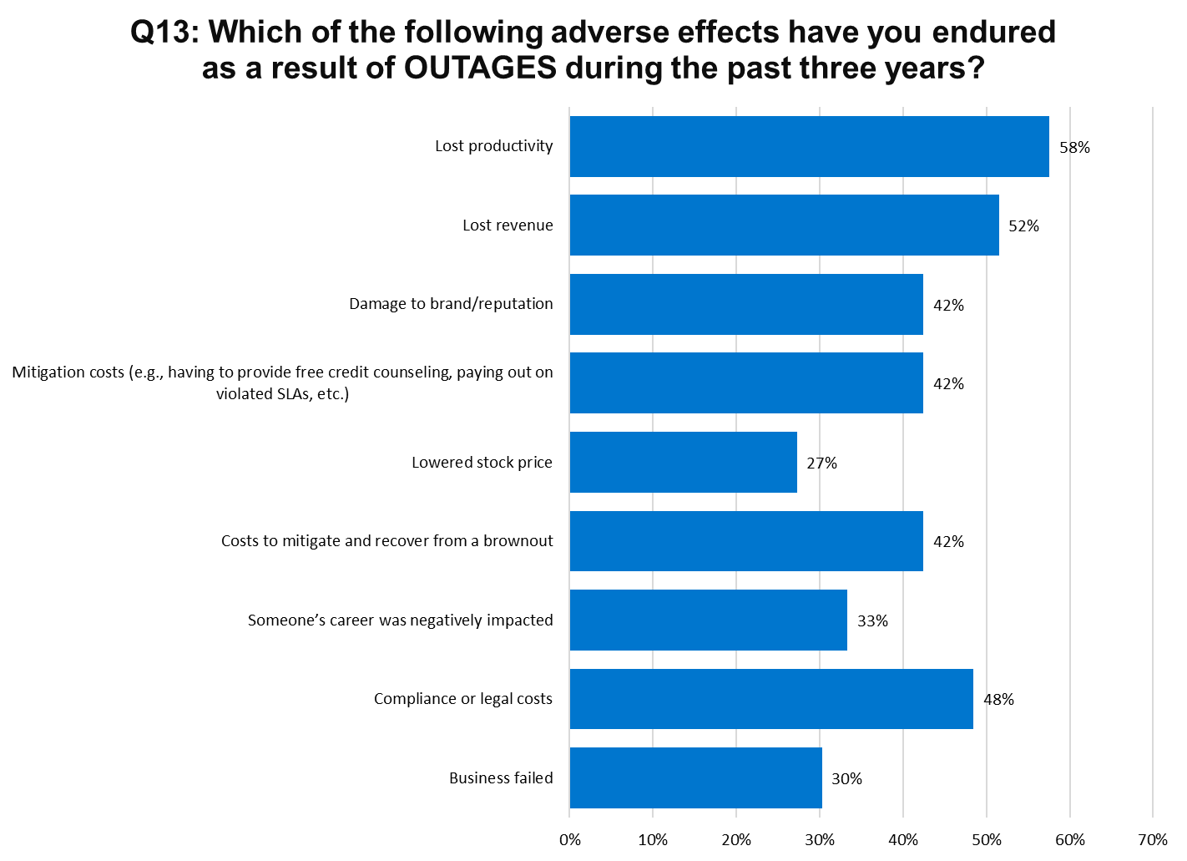
Top Tier Bottom Tier

Slide 34
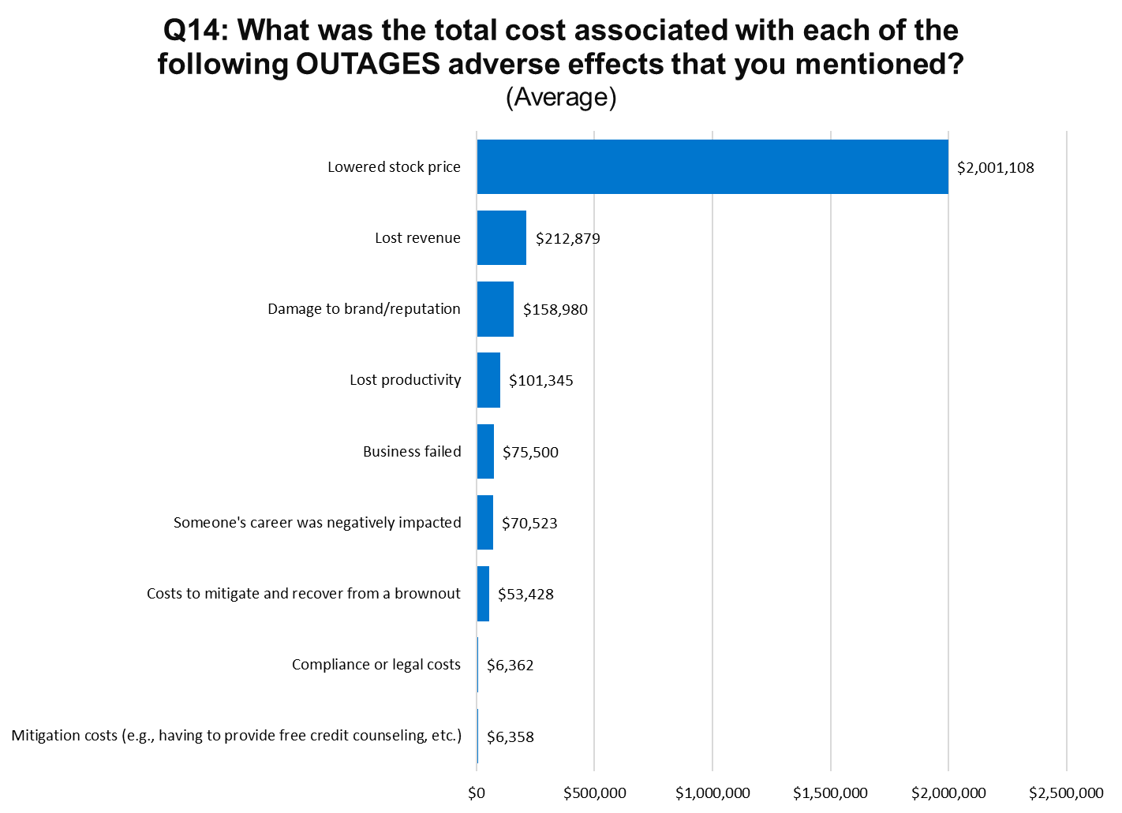
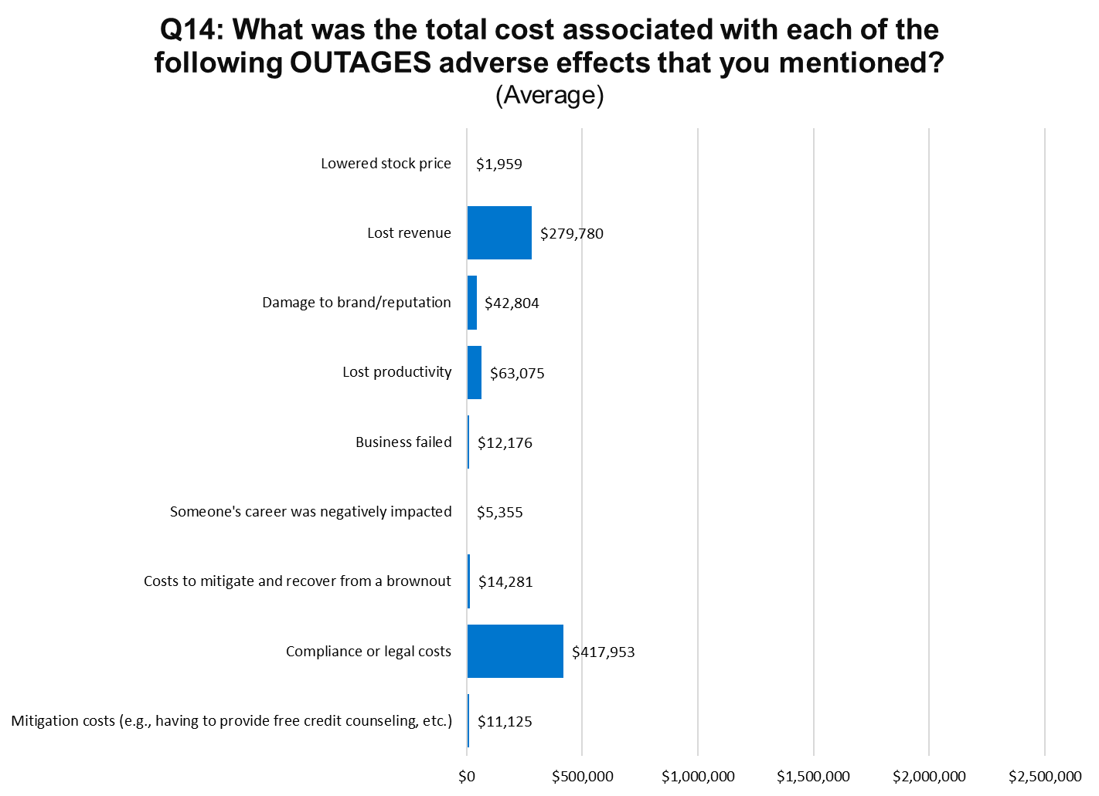
Top Tier Bottom Tier

Slide 35
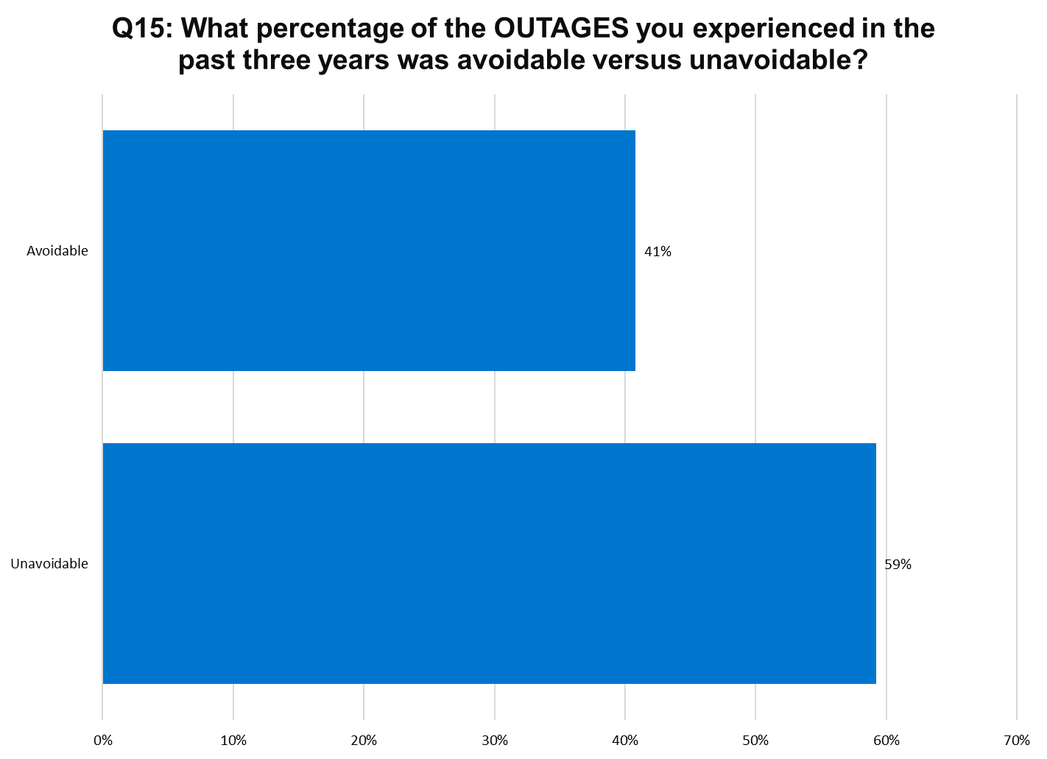
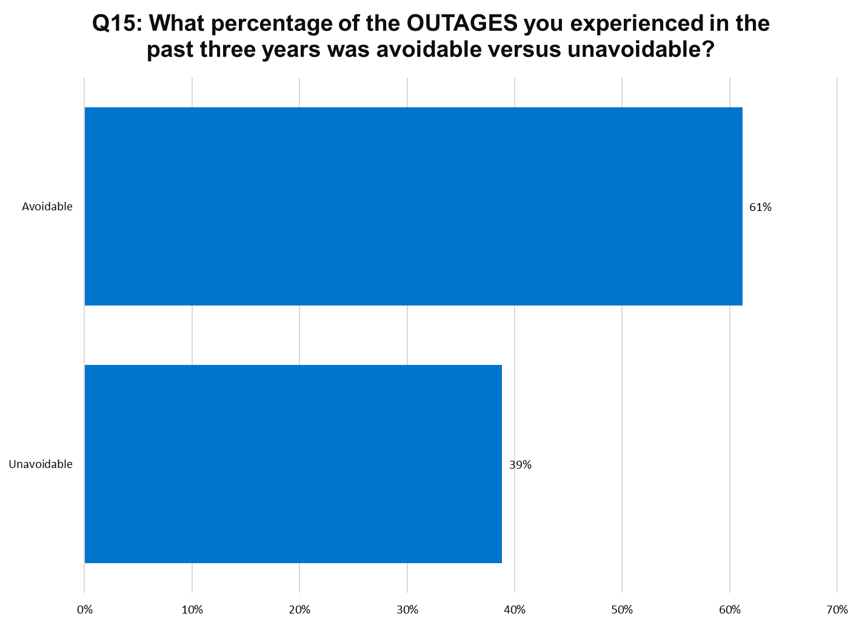
Top Tier Bottom Tier

Slide 36
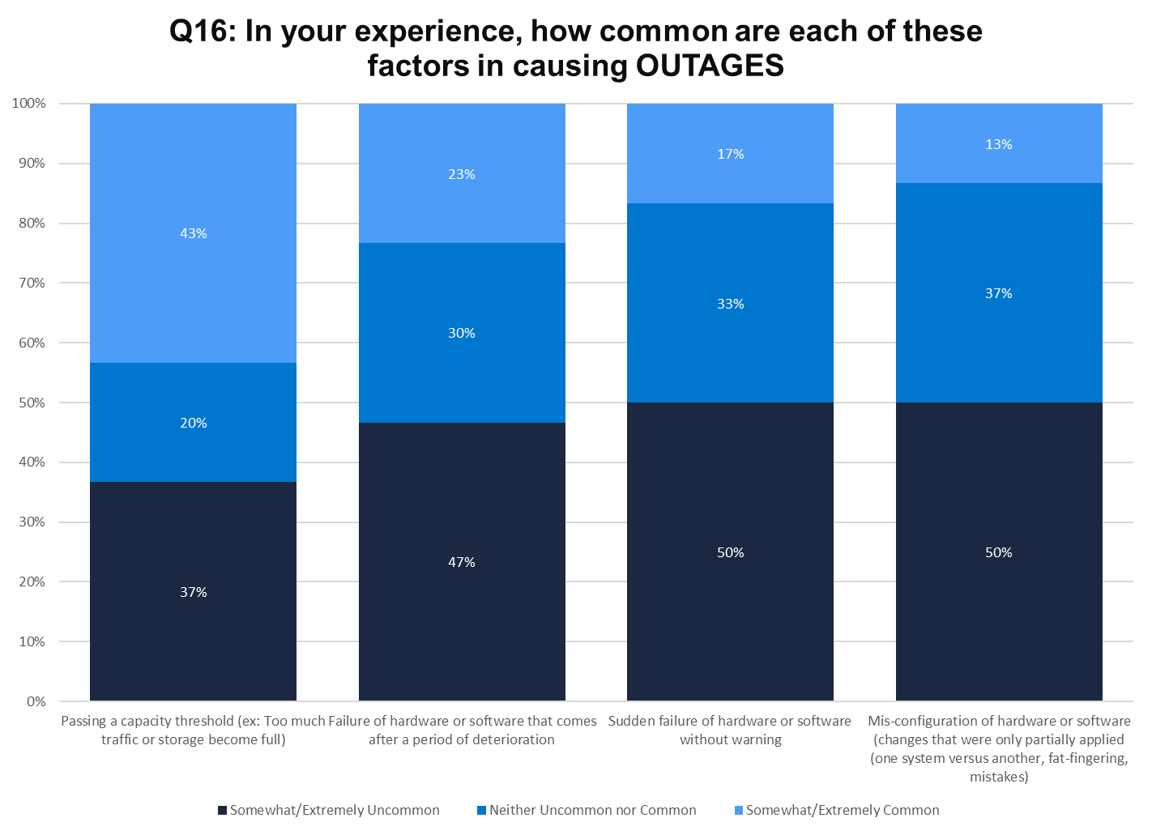
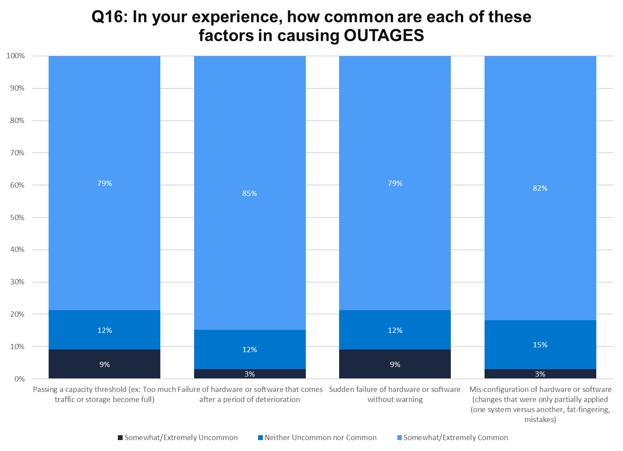
Top Tier Bottom Tier

Slide 37
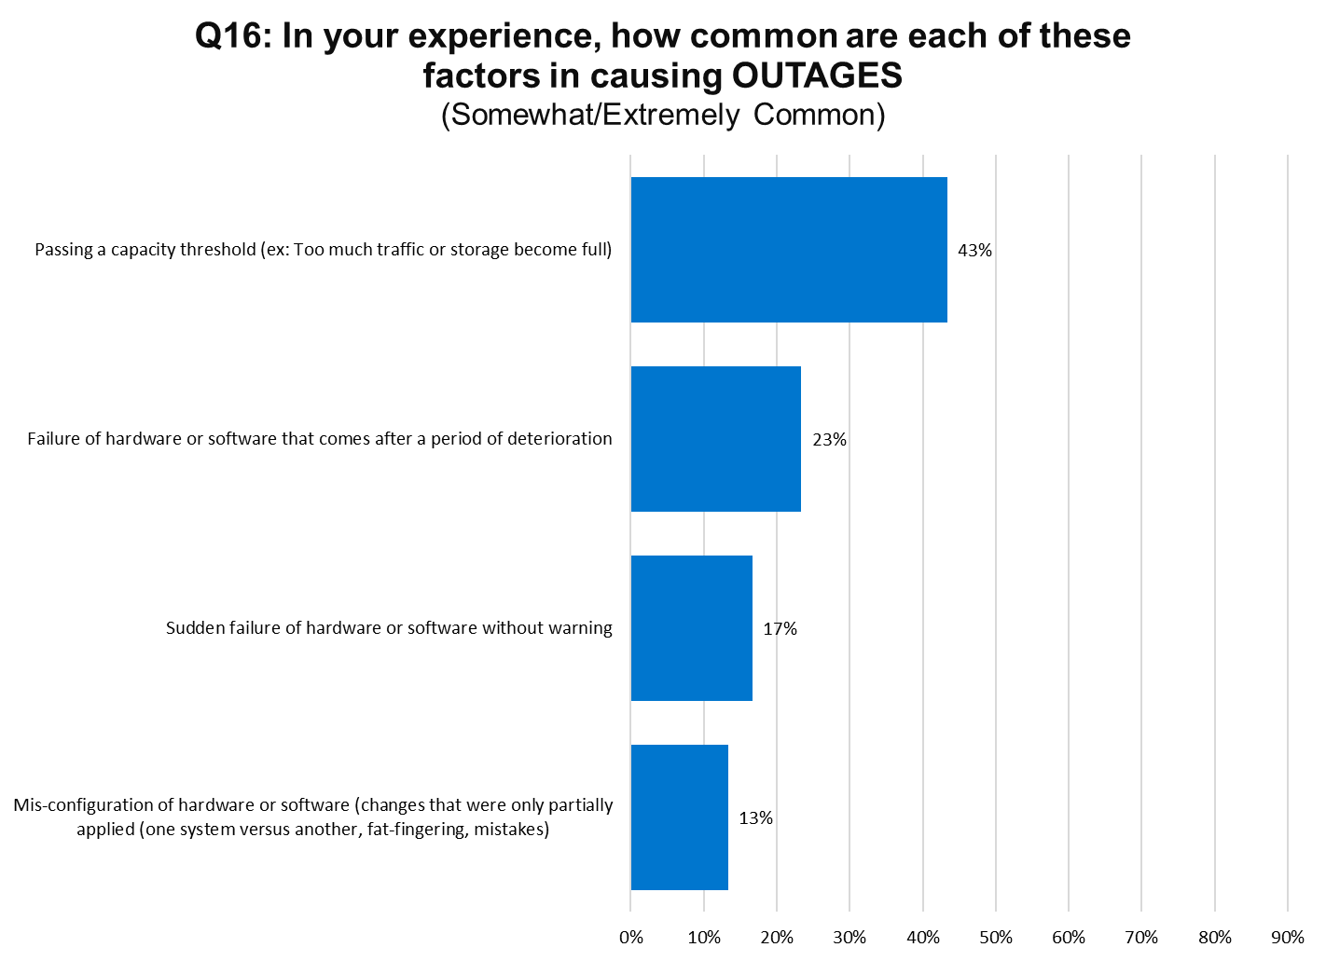
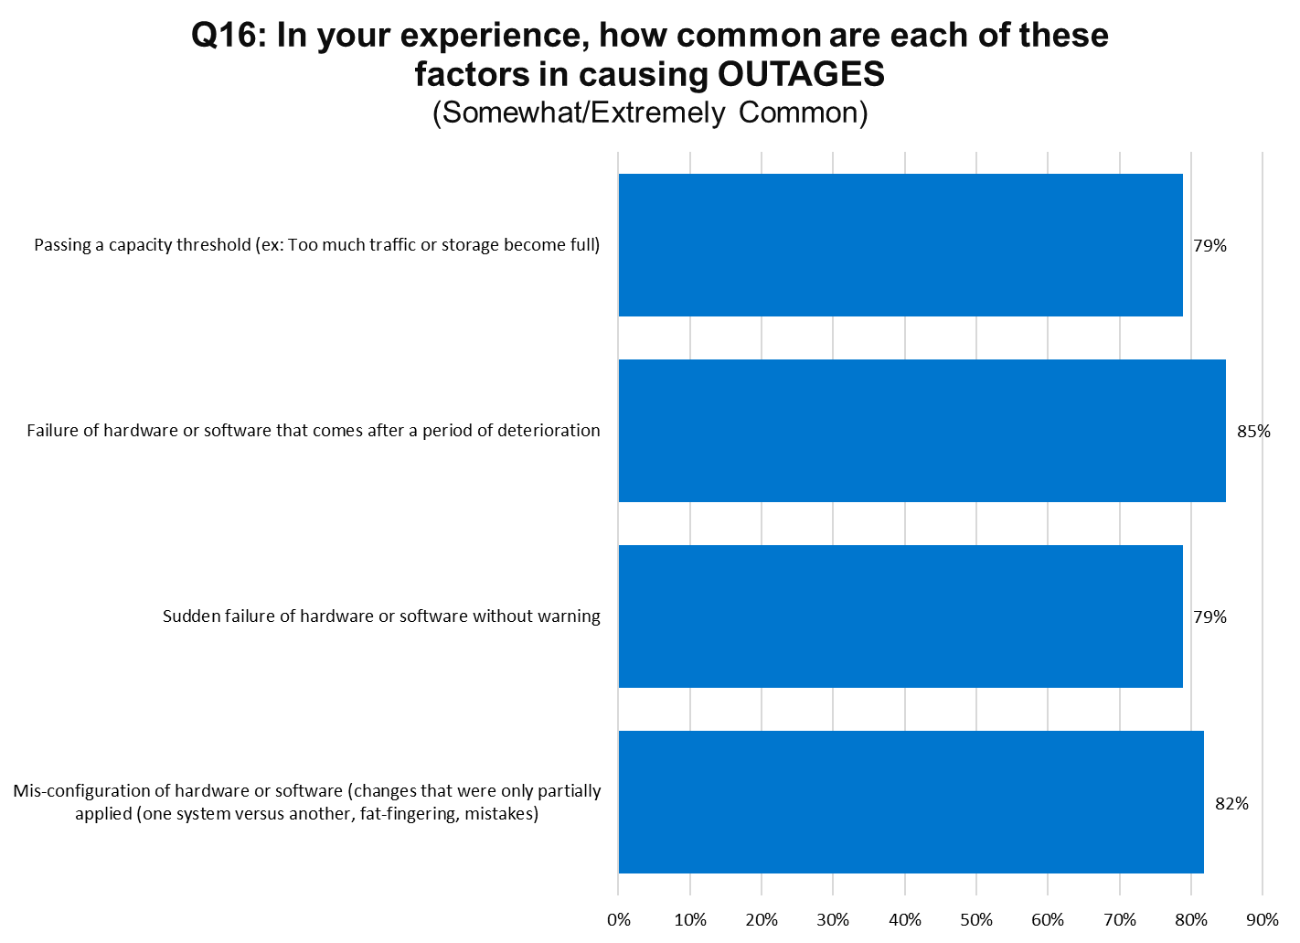
Top Tier Bottom Tier

Slide 38

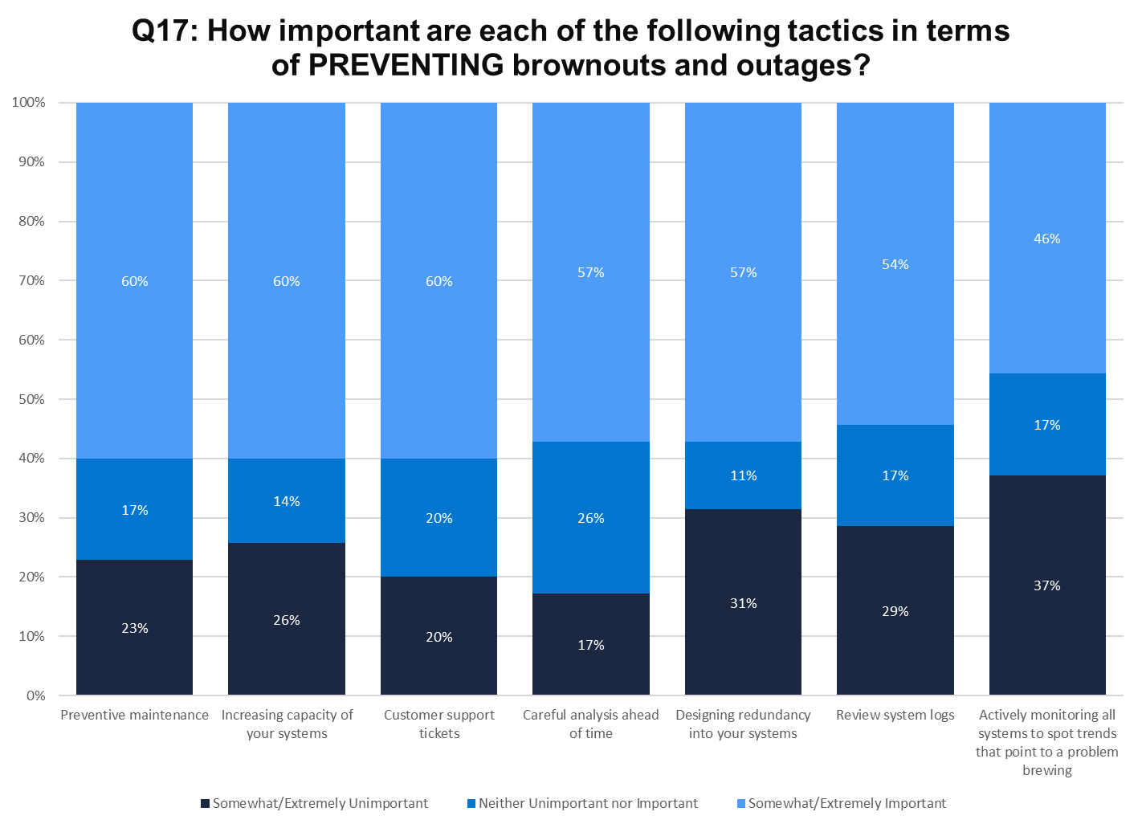
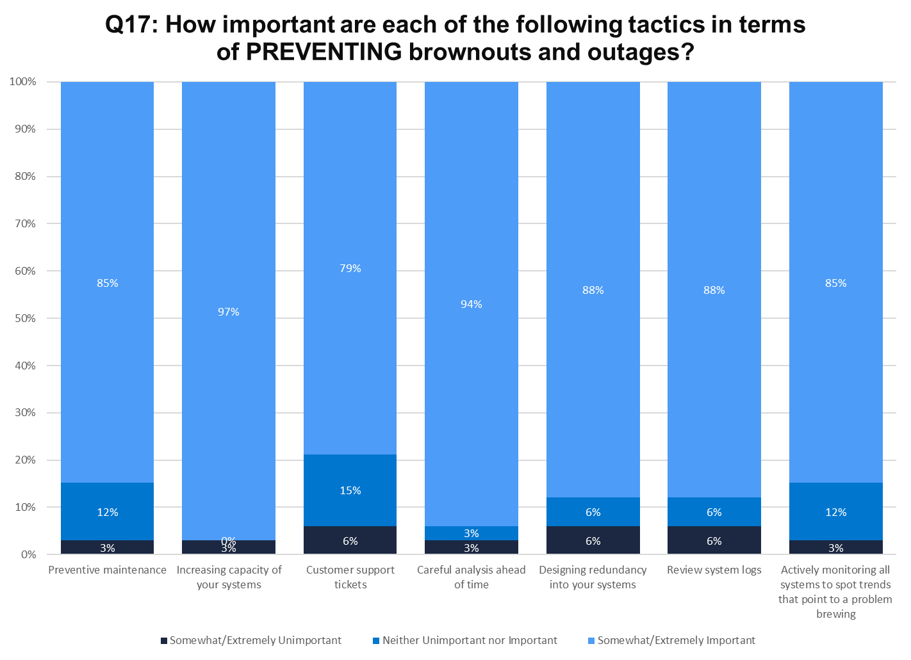
Top Tier Bottom Tier

Slide 39
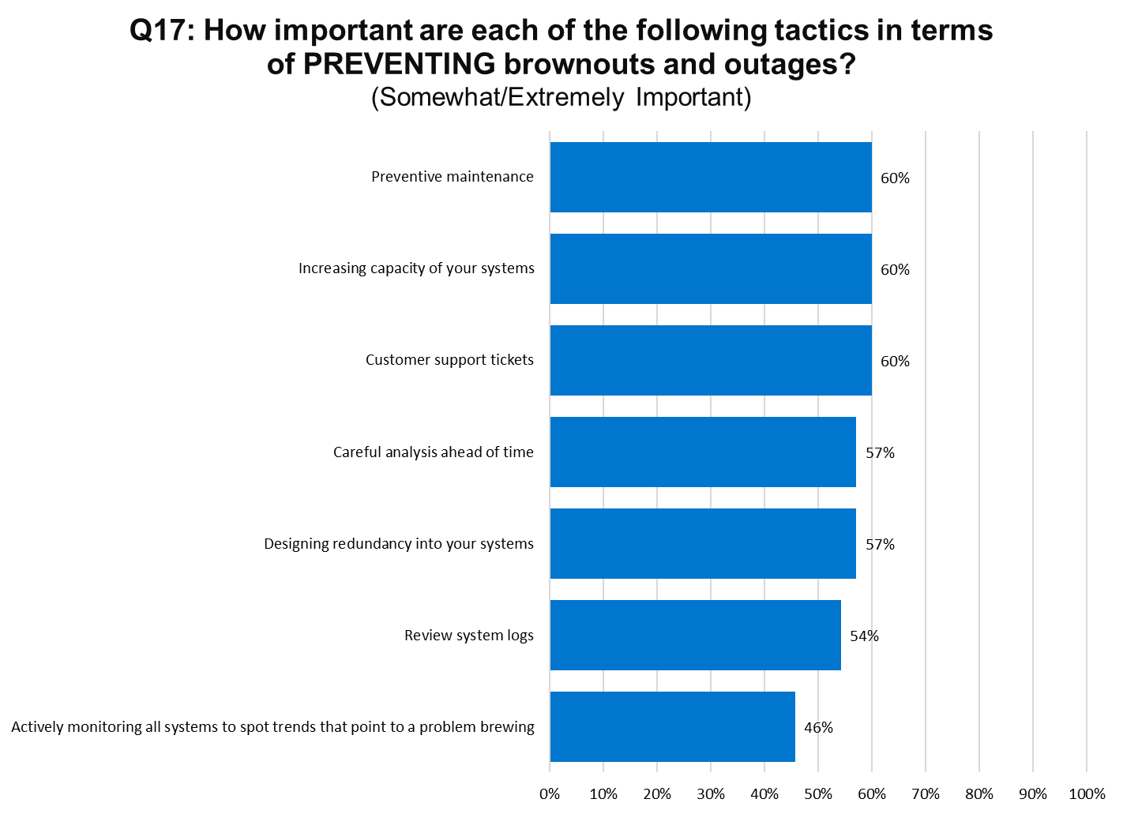
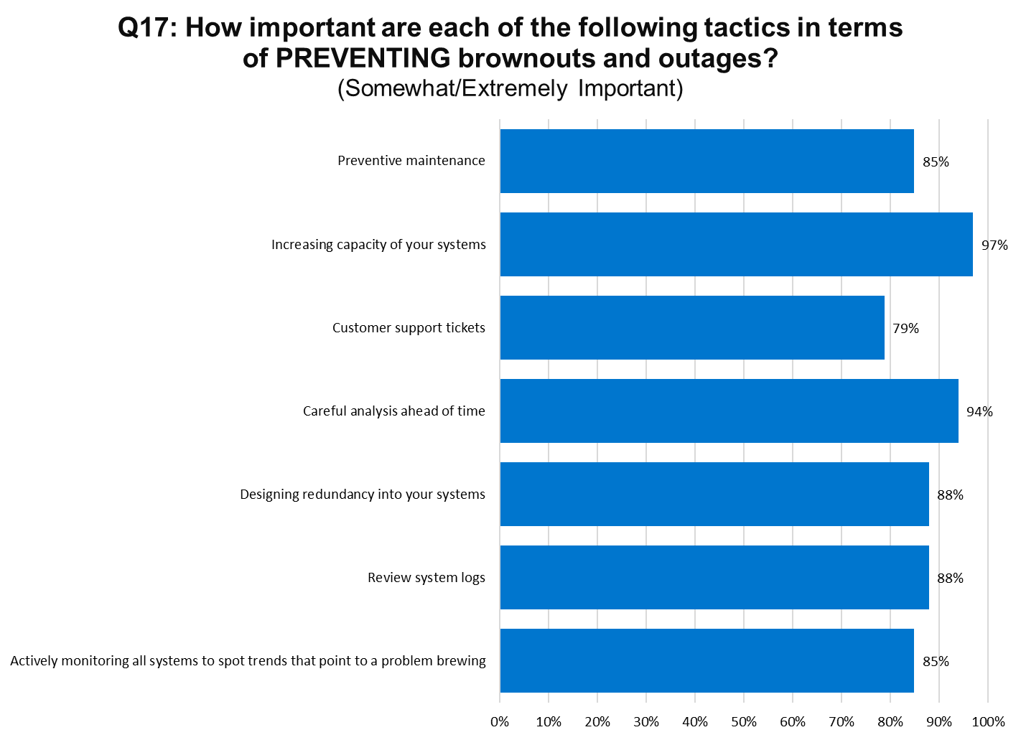
Top Tier Bottom Tier

Slide 40
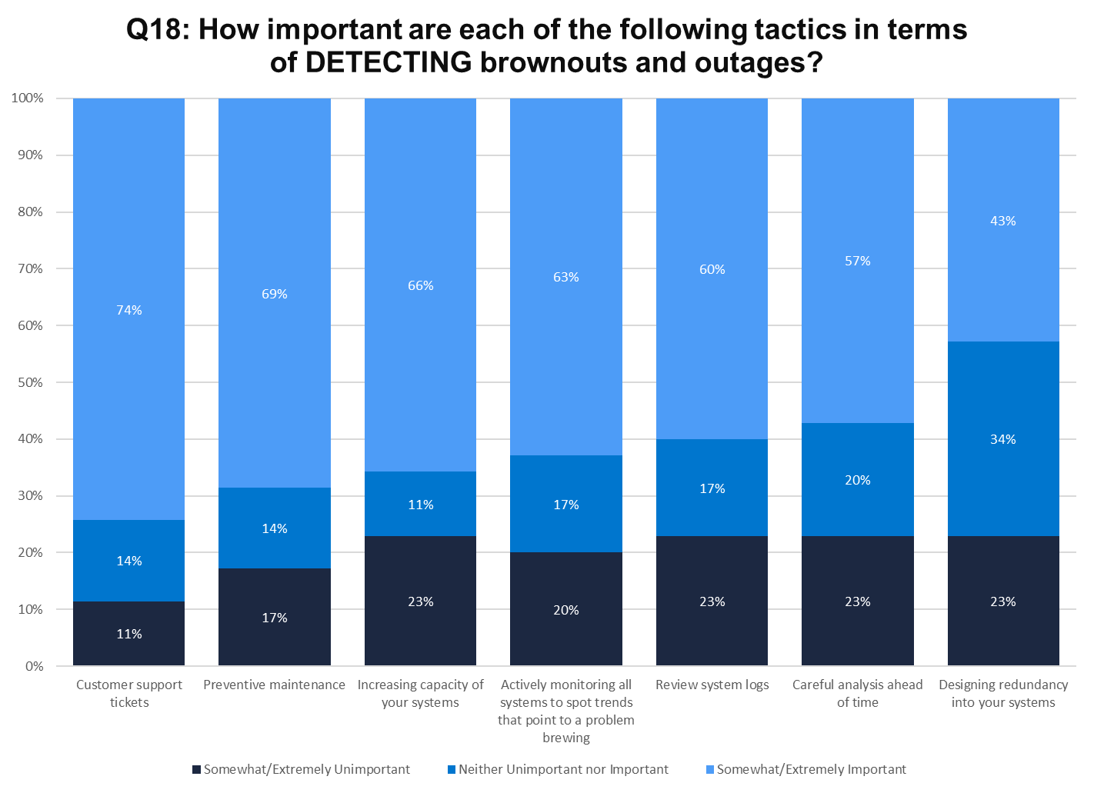

Top Tier Bottom Tier

Slide 41


Top Tier Bottom Tier
Notes:
1.5 times more likely to experience avoidable browouts

Slide 42


Top Tier Bottom Tier

Slide 43


Top Tier Bottom Tier

Slide 44


Top Tier Bottom Tier

Slide 45


Top Tier Bottom Tier

Slide 46


Top Tier Bottom Tier

Slide 47


Top Tier Bottom Tier

Slide 48


Top Tier Bottom Tier

Slide 49


Top Tier Bottom Tier

Slide 50


Top Tier Bottom Tier

Slide 51


Top Tier Bottom Tier

Slide 52


Top Tier Bottom Tier

Slide 53


Top Tier Bottom Tier

Slide 54


Top Tier Bottom Tier

Slide 55


Top Tier Bottom Tier

Slide 56


Top Tier Bottom Tier

Slide 57


Top Tier Bottom Tier

Slide 58


Top Tier Bottom Tier

Slide 59


Top Tier Bottom Tier

Slide 60


Top Tier Bottom Tier

Slide 61


Top Tier Bottom Tier

Slide 62


Top Tier Bottom Tier

Slide 63


Top Tier Bottom Tier
Notes:
3.2 times more likely to experience brownouts or outages so severe it makes the major media

Slide 64


Top Tier Bottom Tier
Notes:
9.0 times more likely to experience brownouts or outages so severe someone loses their job

Slide 65


Top Tier Bottom Tier
Notes:
Much less likely to monitor each type of device or service

