Slide 1
IT Automation Survey
Jeff Paine, SVP, Marketing
pica8.com info@pica8.com @pica8
Notes:
According to Gartner, “By 2023, 40 percent of I&O teams will use AI-augmented automation in large enterprises, resulting in higher IT productivity with greater agility and scalability.”
This is a big deal, and has the potential to change IT in fundamental ways. To learn more, Pica8 commissioned ReRez Research of Dallas, Texas to survey 200 Senior IT managers in the US and Canada to learn more about how IT is embracing automation in different areas.

Slide 2










Demographics
How many employees work at your organization worldwide?
7%
IT Staff
200 Senior IT managers in the US and Canada
40%
What is your role within your organization?
34%
IT Executive
59%
IT Management
24%
22%
Which industry best describes your organization’s primary focus?
Education
34%
Retail, Manufacturing & eCommerce
15%
8%
Financial & Business Services
6%
10%
State and Local Government
10%
Communications & Media
10%
<500
500-999
1,000-2,499
2,500-4,999
>4,999
Other
21%
Notes:
Respondents came from all areas of IT, but skewed senior with a third coming from IT executive roles and 59 percent coming from IT management.
ReRez surveyed all sized organizations from SMB to large enterprise. The survey comprised a wide range of industries.
The survey shows IT is laser-focused on IT automation …

Slide 3
Automation is IT’s Leading Initiative
Notes:
We found that IT automation is at the top of IT’s list of priorities, ahead of AI-Ops, Edge computing and RPA. In fact, 88 percent said IT automation was a somewhat to extremely important initiative in terms of reaching their organization’s goals. But how far along are organizations in automating IT?

Slide 4
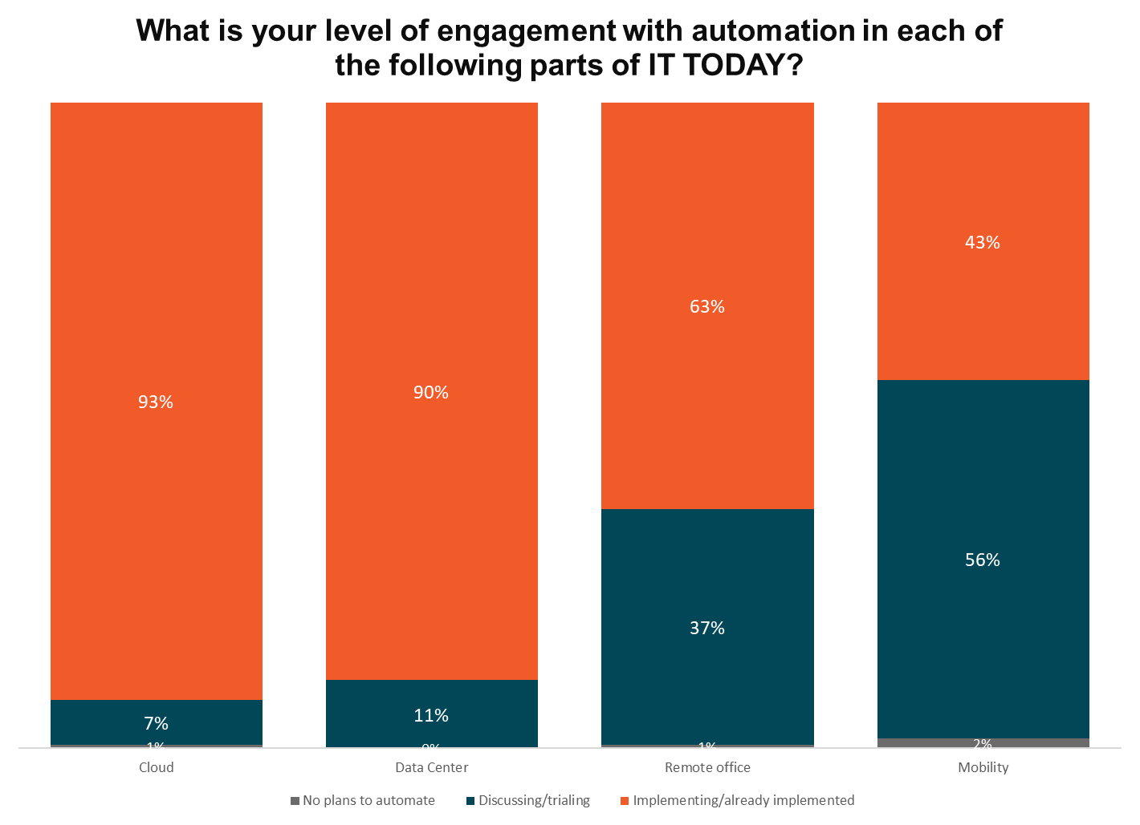
IT Automation Progress Varies by Focus
Notes:
Automation is well under-way, with cloud and data center being the most advanced (93 and 90 percent say they have completed automating these areas)
Remote office lags at 63 percent already automated. BUT … 37 percent are discussing or in trials.
What is driving this interest in IT Automation?

Slide 5
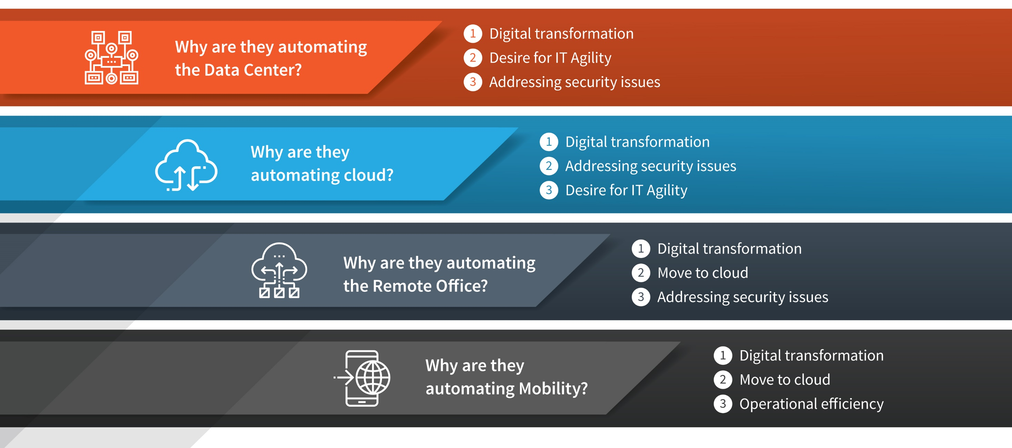
IT Automation Drivers by Area of Automation
Notes:
There are several common drivers of IT automation regardless of area – Digital Transformation tops the list in each area, in fact. Beyond that, there are subtle variations is just what is driving IT to automating different areas of IT. But why? What does IT hope to achieve with all of this IT automation?

Slide 6
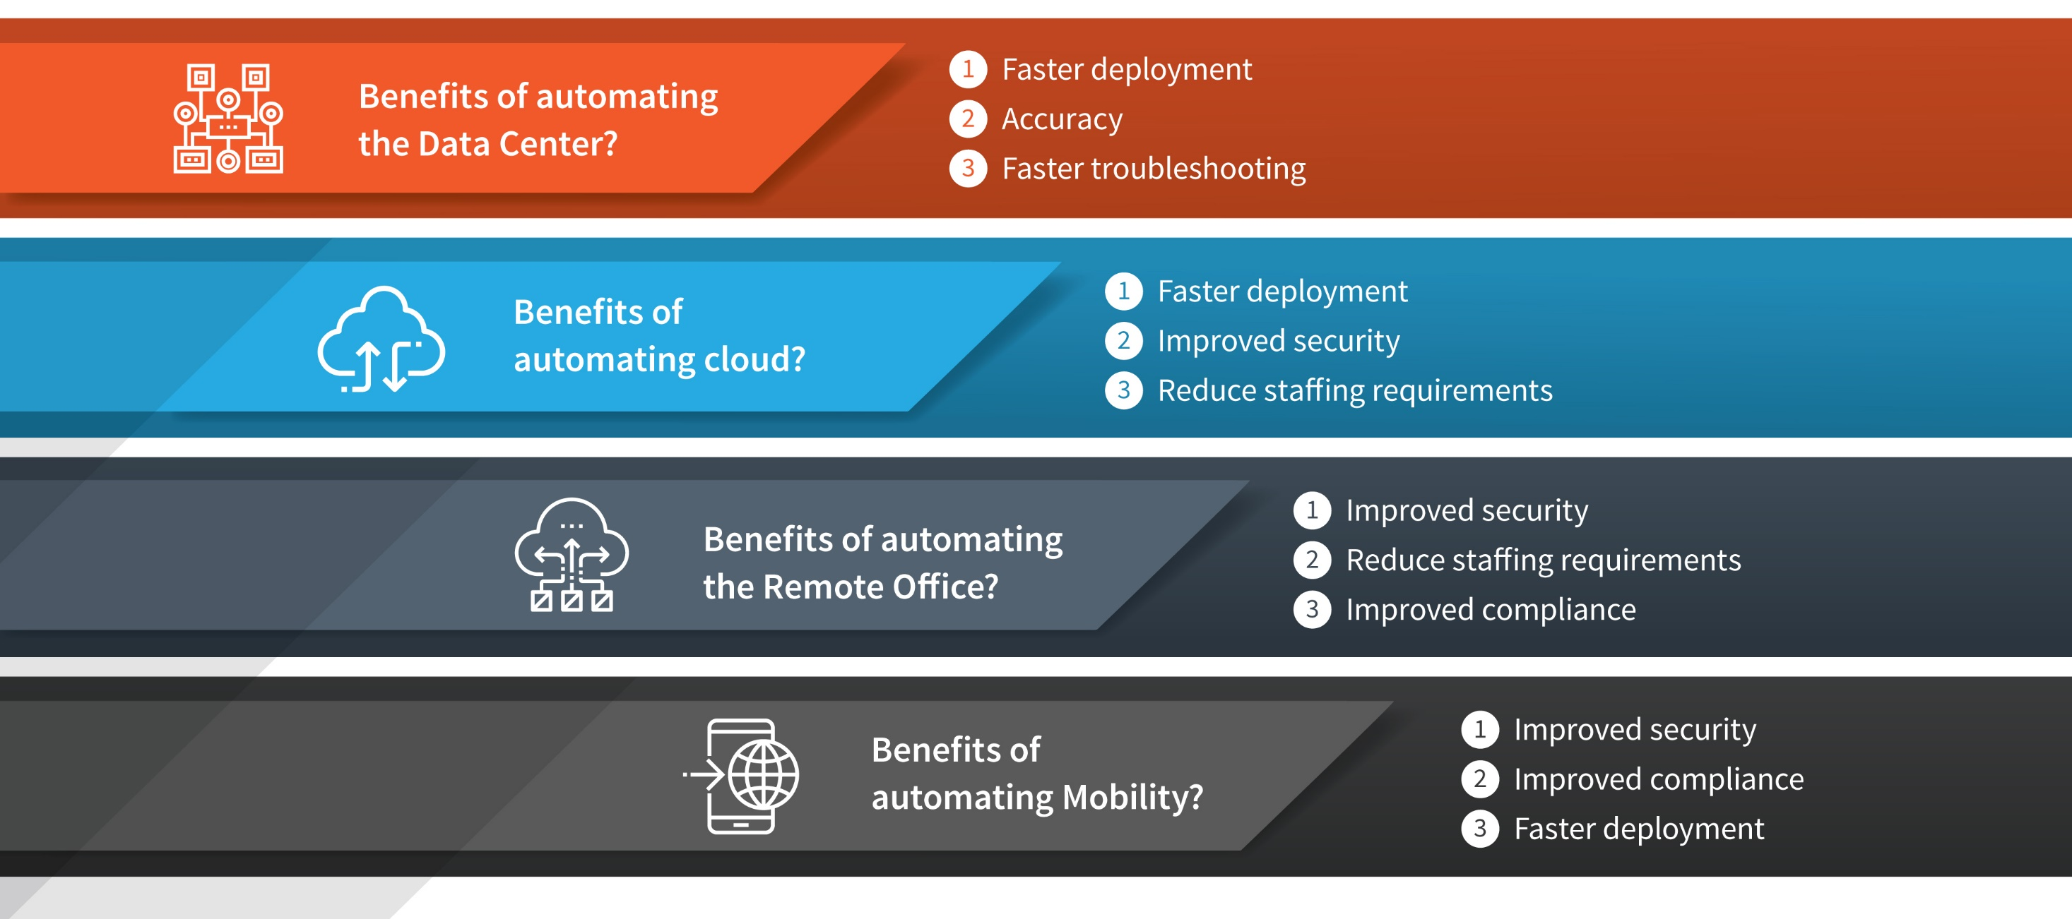
IT’s Automation Goals
Notes:
The expected benefits of automating various aspects of IT vary by the specific area being automated. Faster deployment, improved security, reducing staffing requirements and improved compliance are frequently mentioned, but each area has its own specific list.
But automation is not easy. What are the challenges IT is facing in their automation efforts?

Slide 7
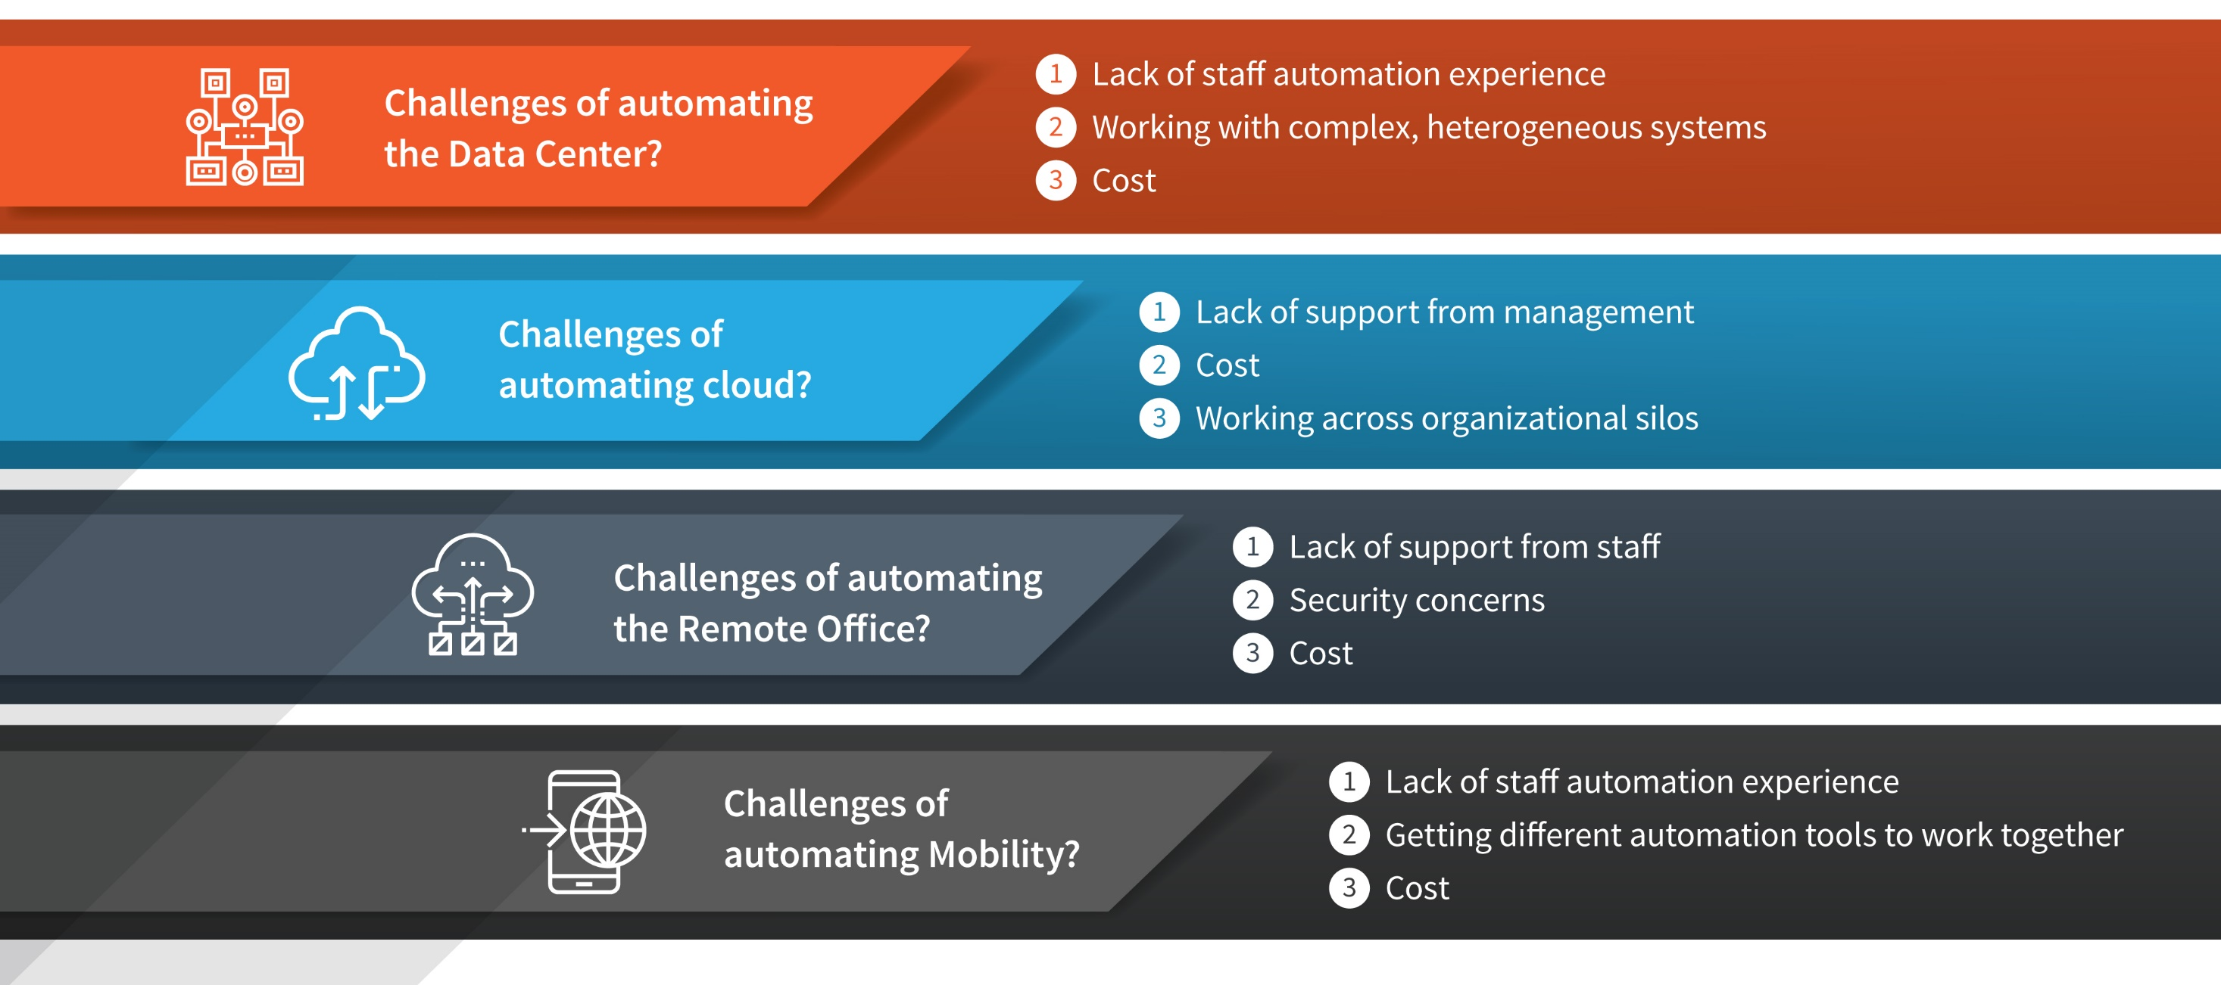
Automation Challenges
Notes:
In terms of automation challenges, cost is the most pervasive followed by lack of staff automation experience. There are a host of other specific challenges – each area has its own specific list.
With all of these challenges we were interested to find out how well organizations were doing with their IT automation initiatives …

Slide 8
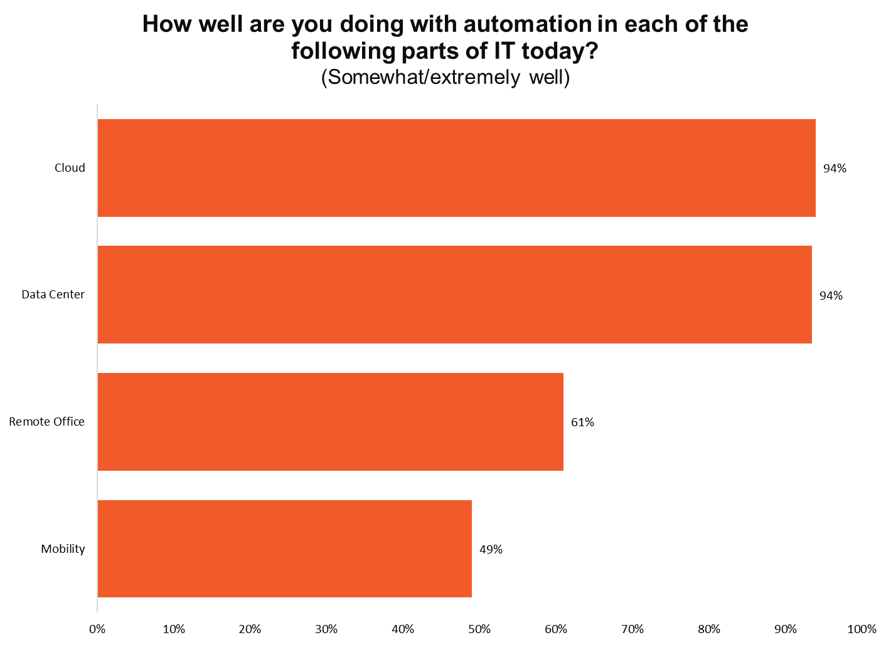
Mixed Report Card for IT Automation Progress
Notes:
It turns out to be highly variable. IT is doing well in some areas (Cloud and Data Center), poorly in Mobility and in-between in Remote Office automation.
With so much interest and activity into IT automation, we were interested to find out what kinds of features IT wanted to see in their IT automation platforms.

Slide 9
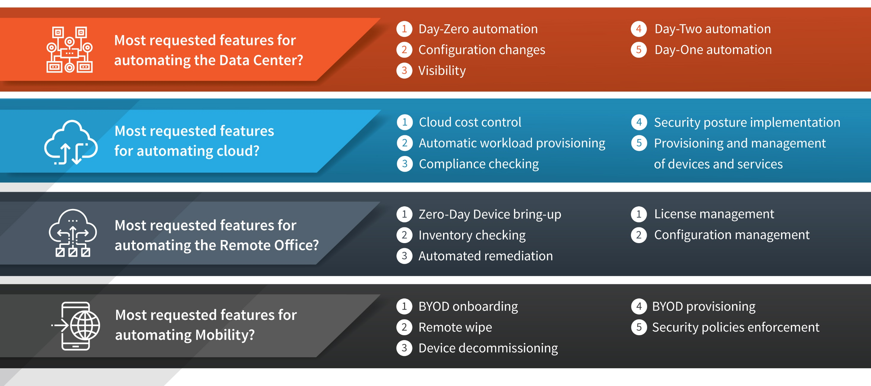
Most Commonly Requested IT Automation Features
Notes:
Once again, the specifics vary by area of automation. For example, automating the data center as well as remote offices spurs IT to ask for “Day Zero” capabilities. Automating cloud is about cost control. And mobility requires BYOD capabilities.
The lesson is that there is no silver bullet when it comes to IT automation. Tools that worked well for automating the data center may fall short for cloud or remote office automation.
So what can IT managers do to make their IT automation journey more successful?

Slide 10






Pica8 IT Automation Recommendations
The Pica8 IT Automation Survey points to five best practices for companies ready to make their IT automation journey more successful:
Focus on automation solutions designed for enterprise network deployments and workflows, not DevOps workflow-oriented data center tools. These are very much different worlds.
Start with inexpensive, open networking automation tools that simplify remote/campus switch deployment, configuration and maintenance, which is the lion’s share of what most enterprises need on a day-to-day basis. For very large enterprises, more complex/expensive tools can always be added later (if needed).
Deploy simpler, GUI-based open networking campus automation tools to allow non-programmers to supplement your scarce and expensive top-tier network engineers, who are in short supply at most companies and organizations.
Challenge your existing networking vendor as to why you are paying – both in terms of cost and complexity – for a one-size-fits-all proprietary automation solution packed with hundreds of advanced features that you will likely never use.
Adopt Linux-based open networking for easy integration with the ever-growing catalog of open source campus automation and management tools on the market
Notes:
Pica8 to write

Slide 11
Appendix Slides

Slide 12
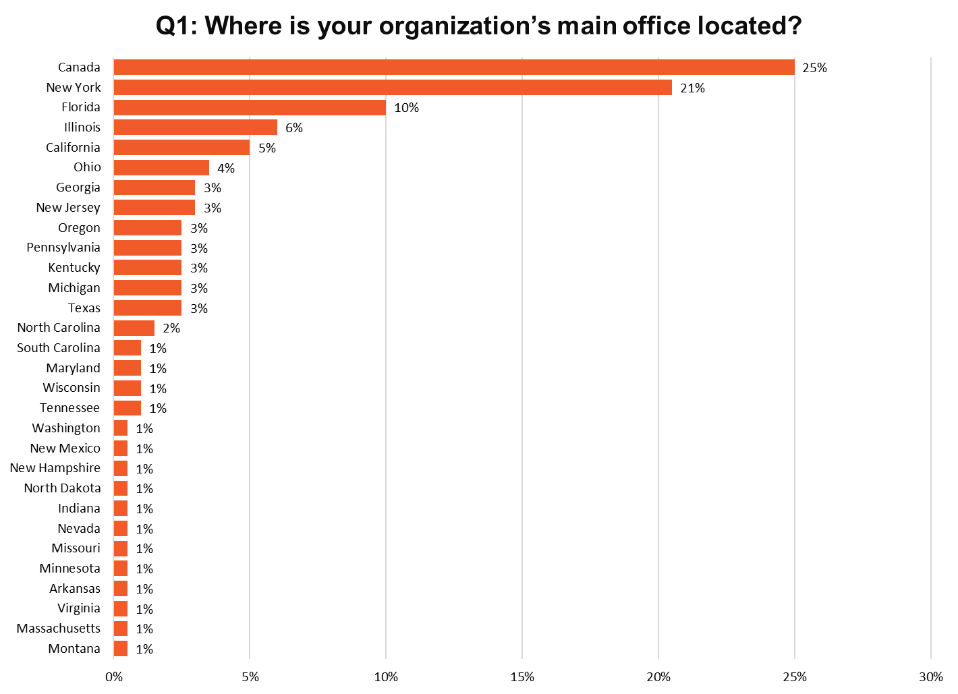
Notes:
N=200

Slide 13
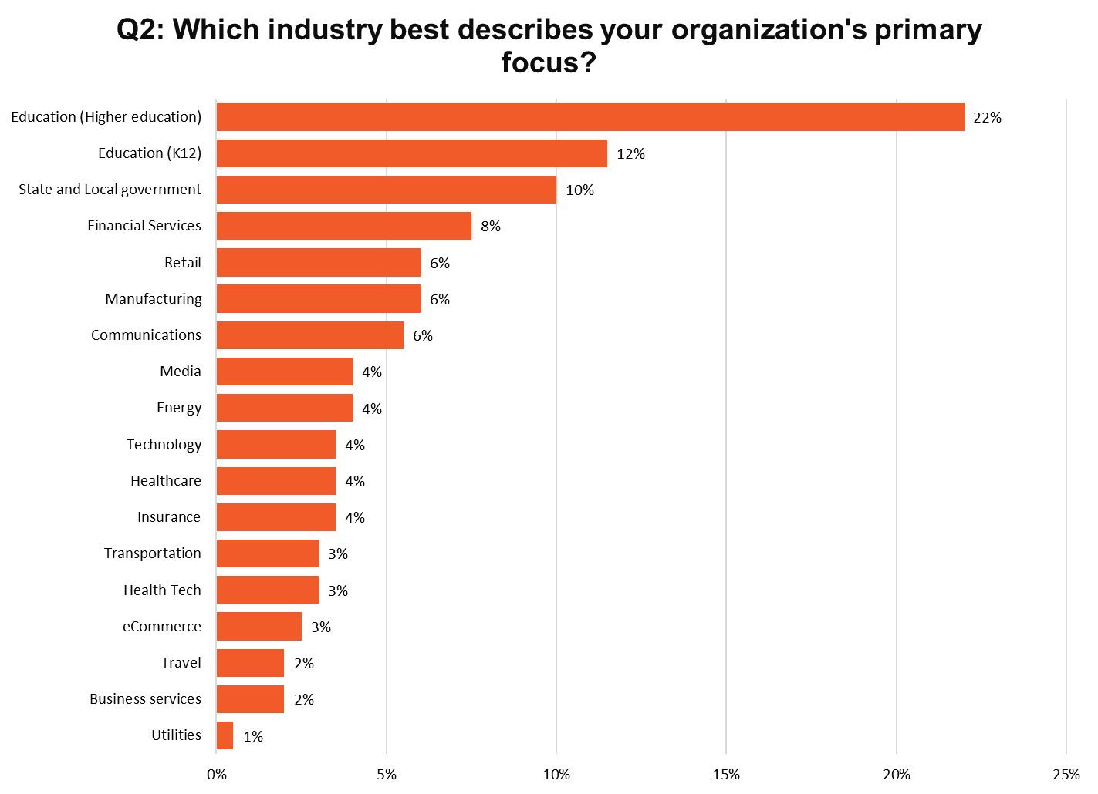
Notes:
N=200

Slide 14
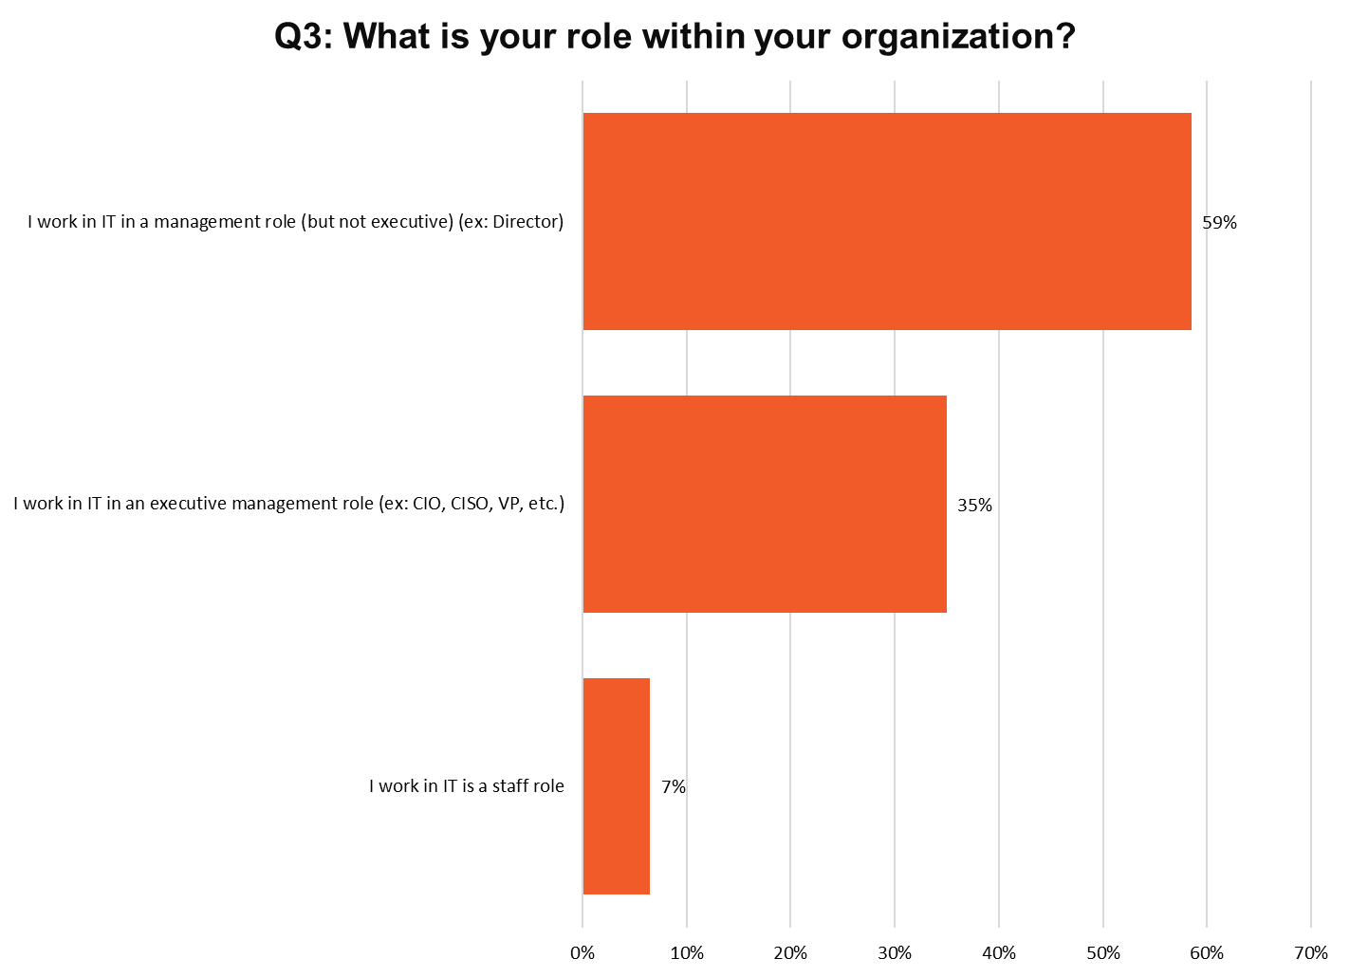
Notes:
N=200

Slide 15
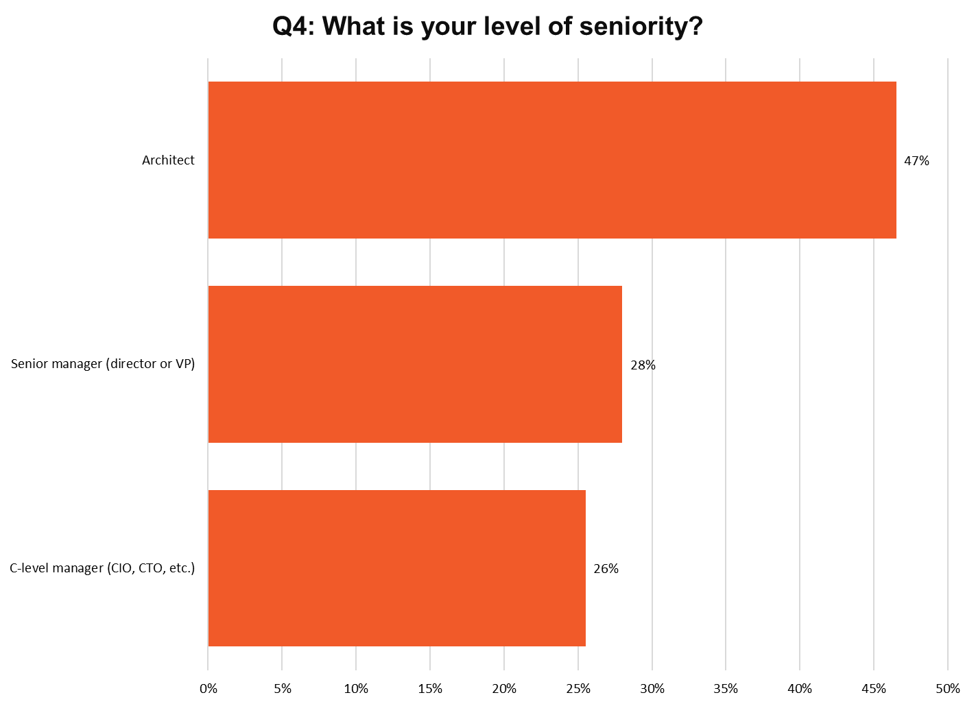
Notes:
N=200

Slide 16
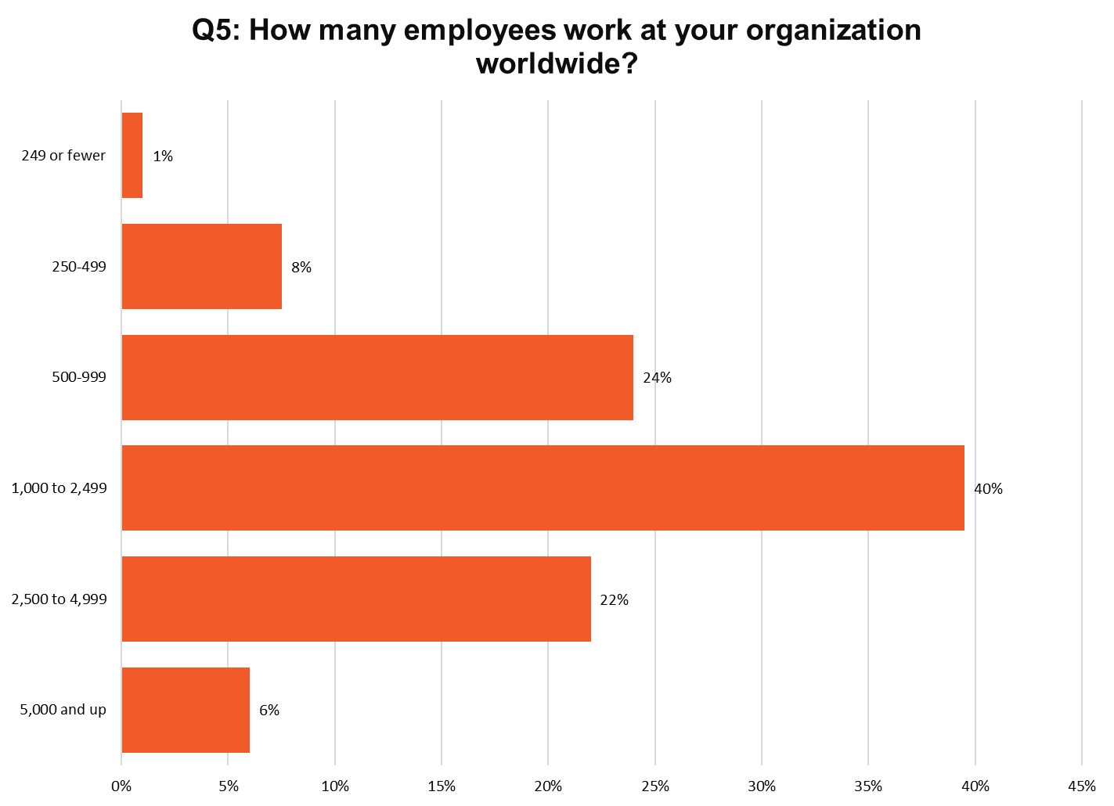
Notes:
N=200
Median - 1500

Slide 17
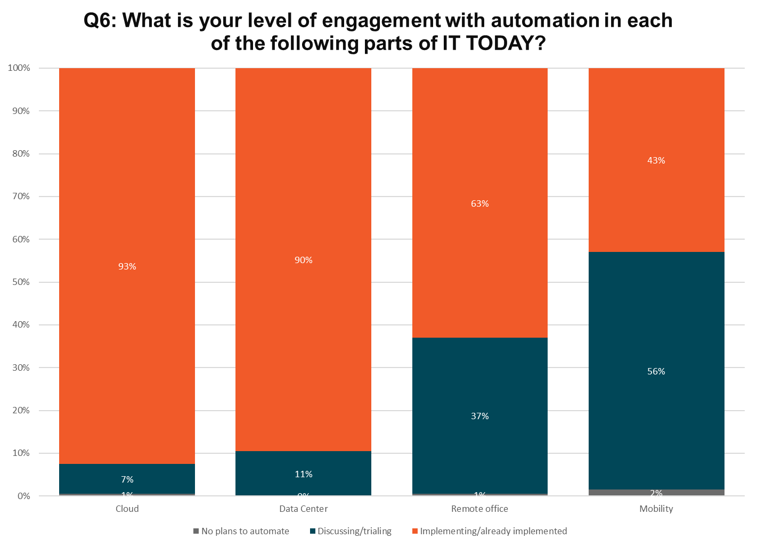
Notes:
N=200

Slide 18
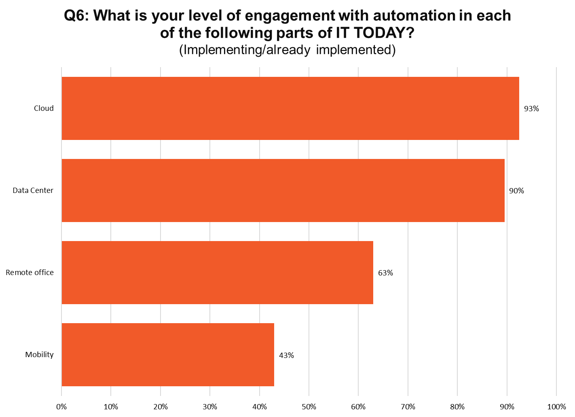
Notes:
N=200

Slide 19
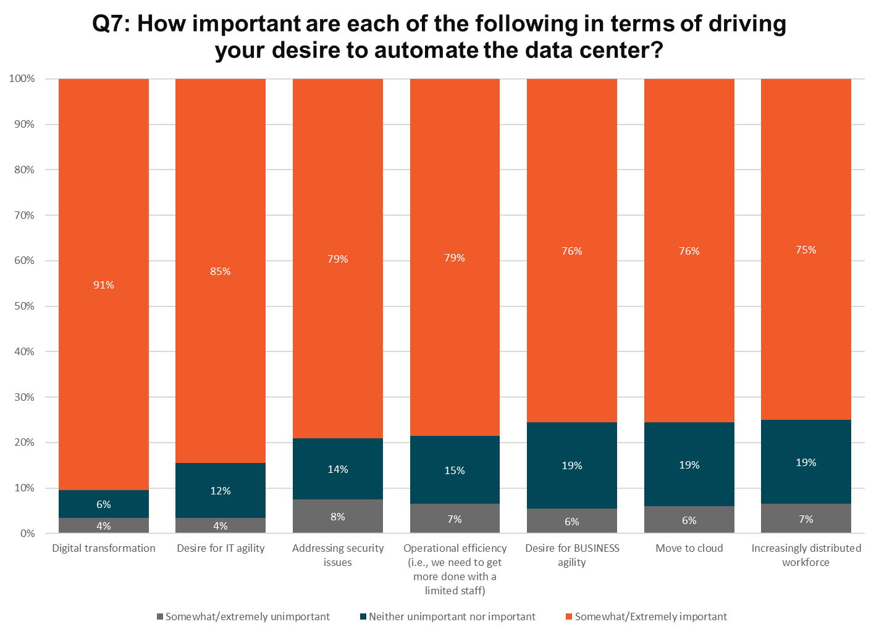
Notes:
N=196

Slide 20
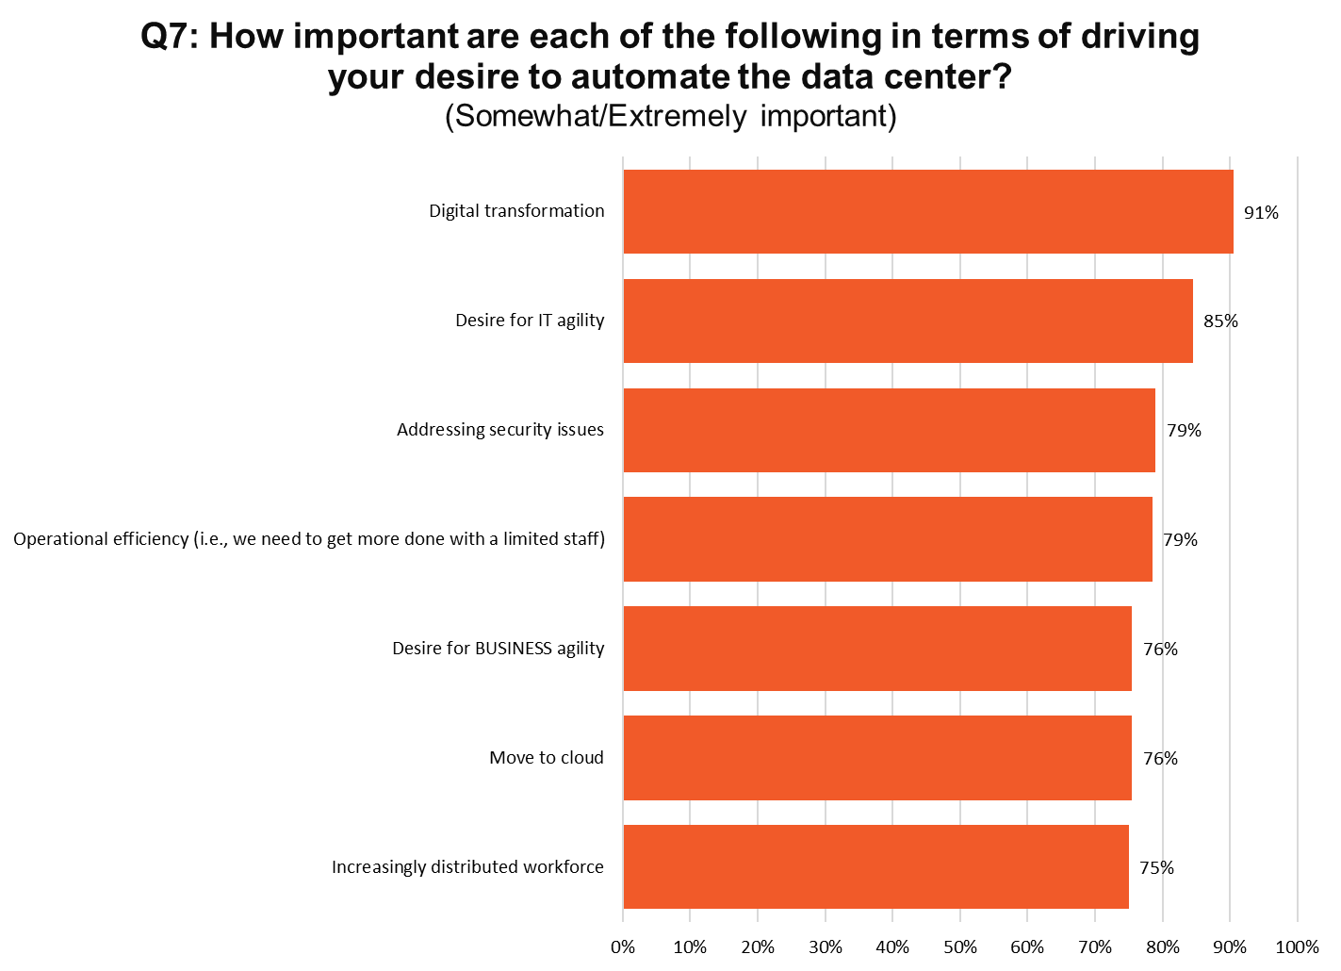
Notes:
N=196

Slide 21
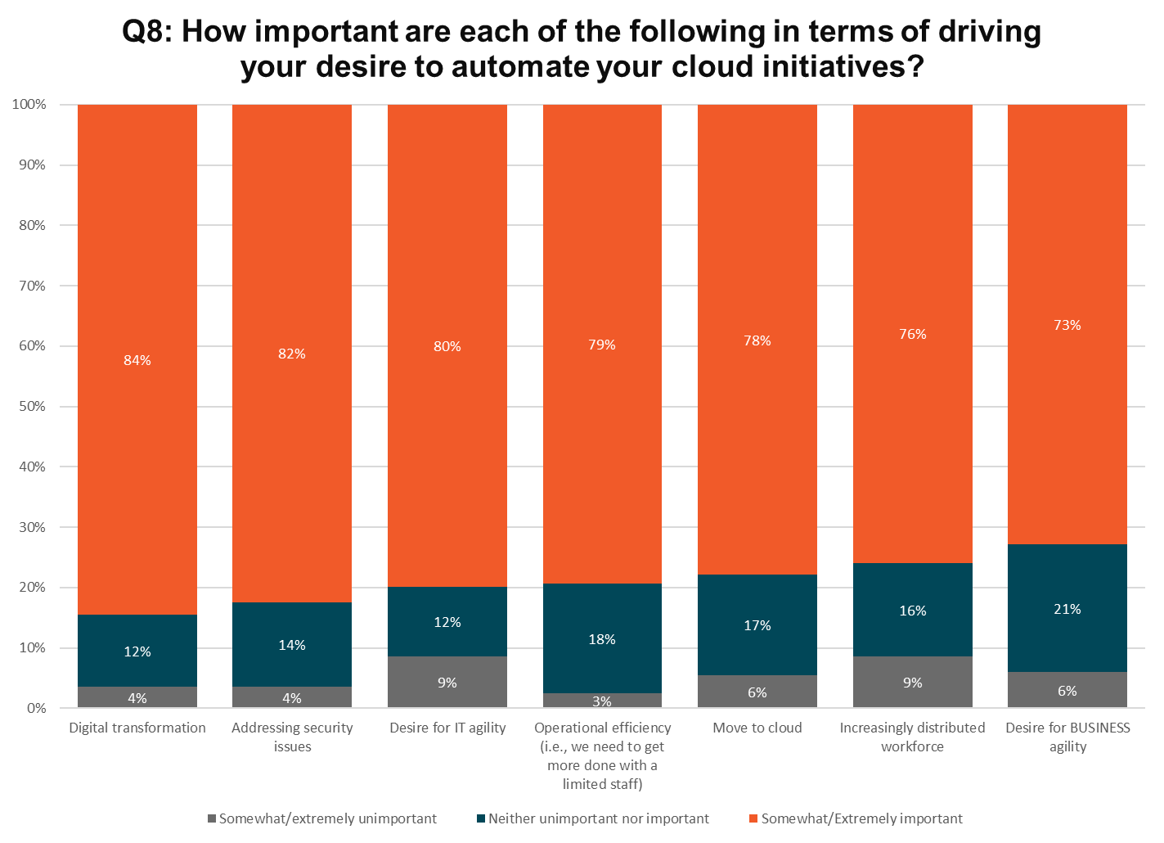
Notes:
N=194

Slide 22
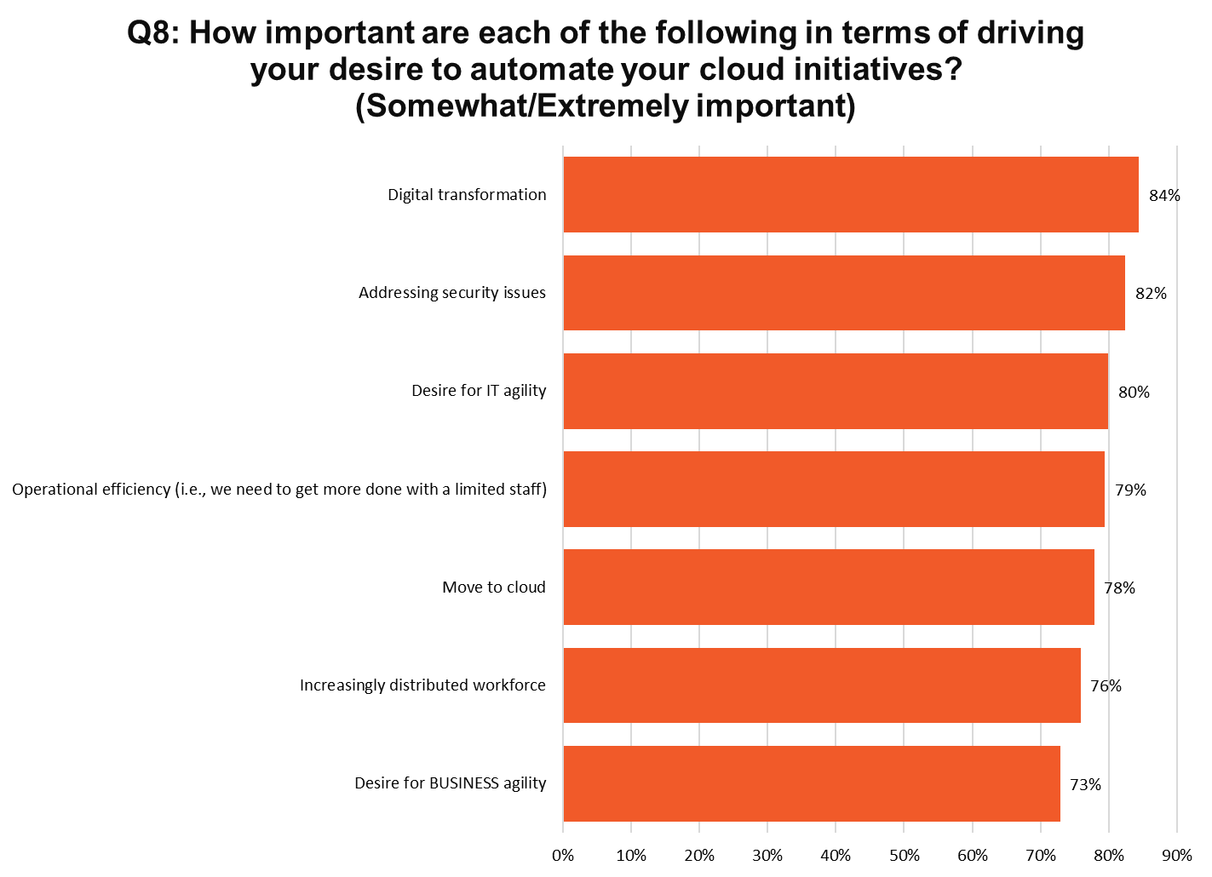
Notes:
N=194

Slide 23
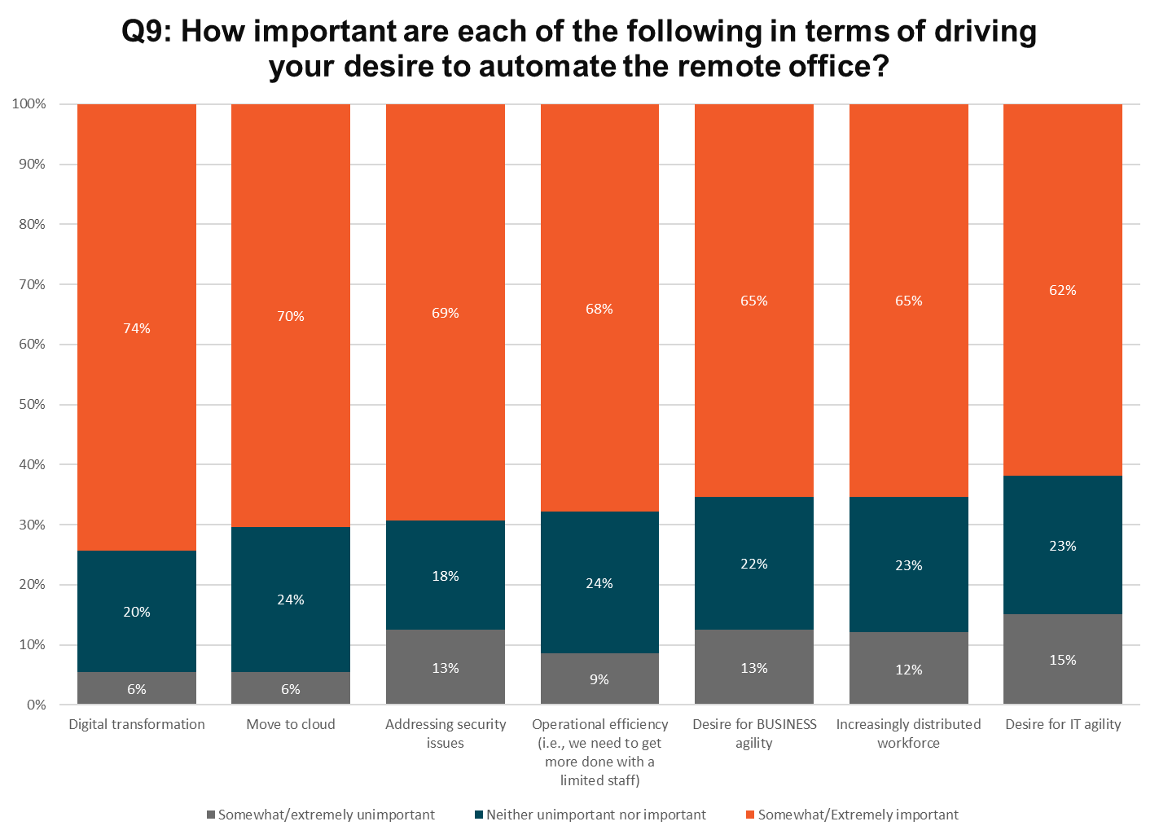
Notes:
N=176

Slide 24
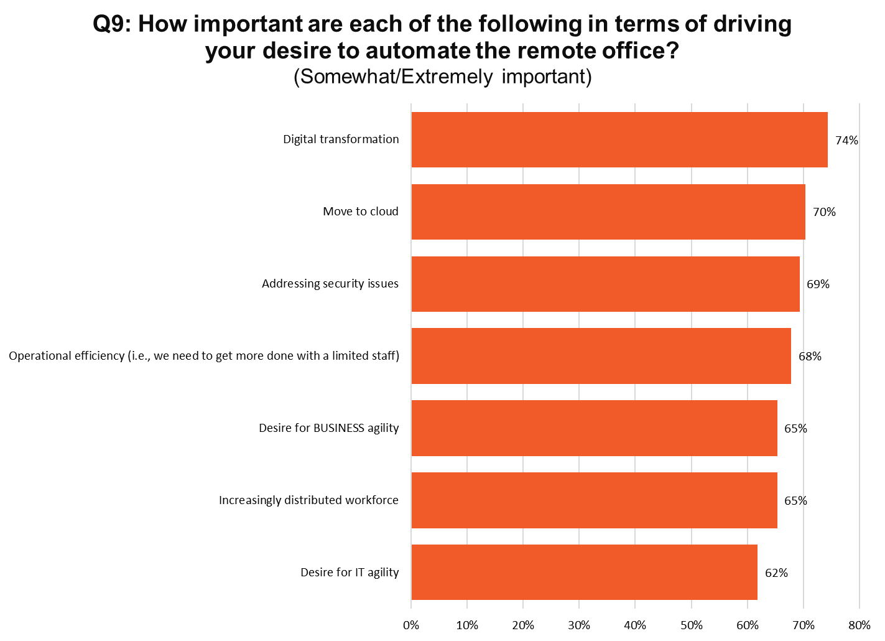
Notes:
N=176

Slide 25
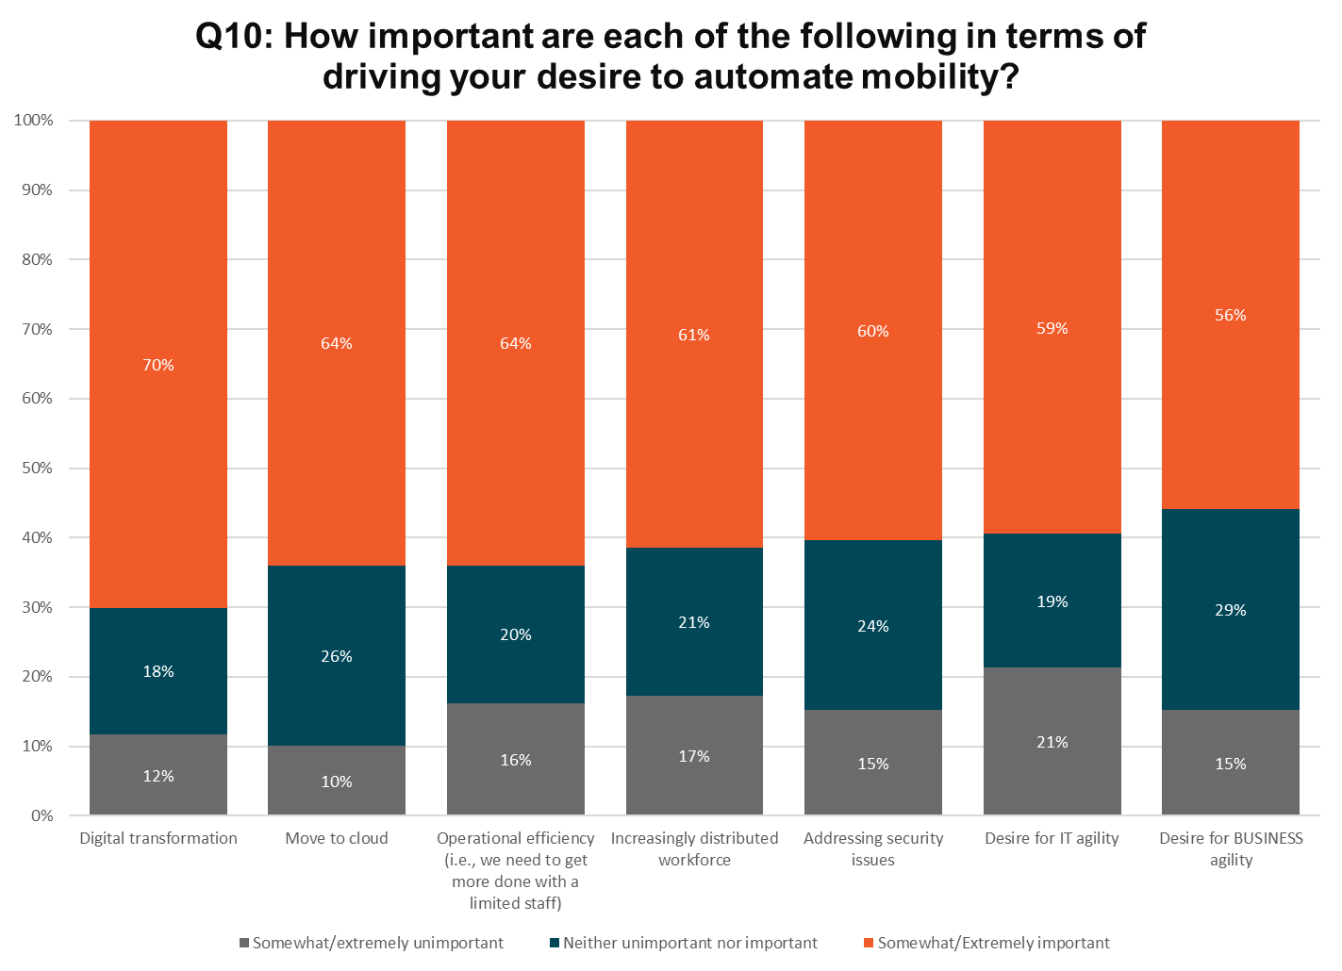
Notes:
N=145

Slide 26
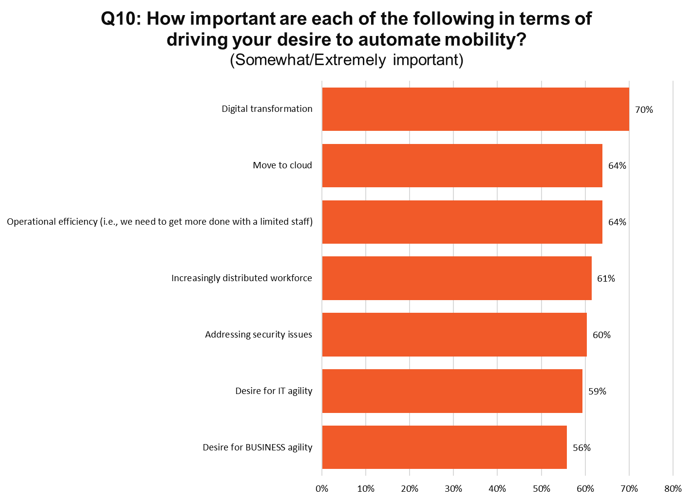
Notes:
N=145

Slide 27
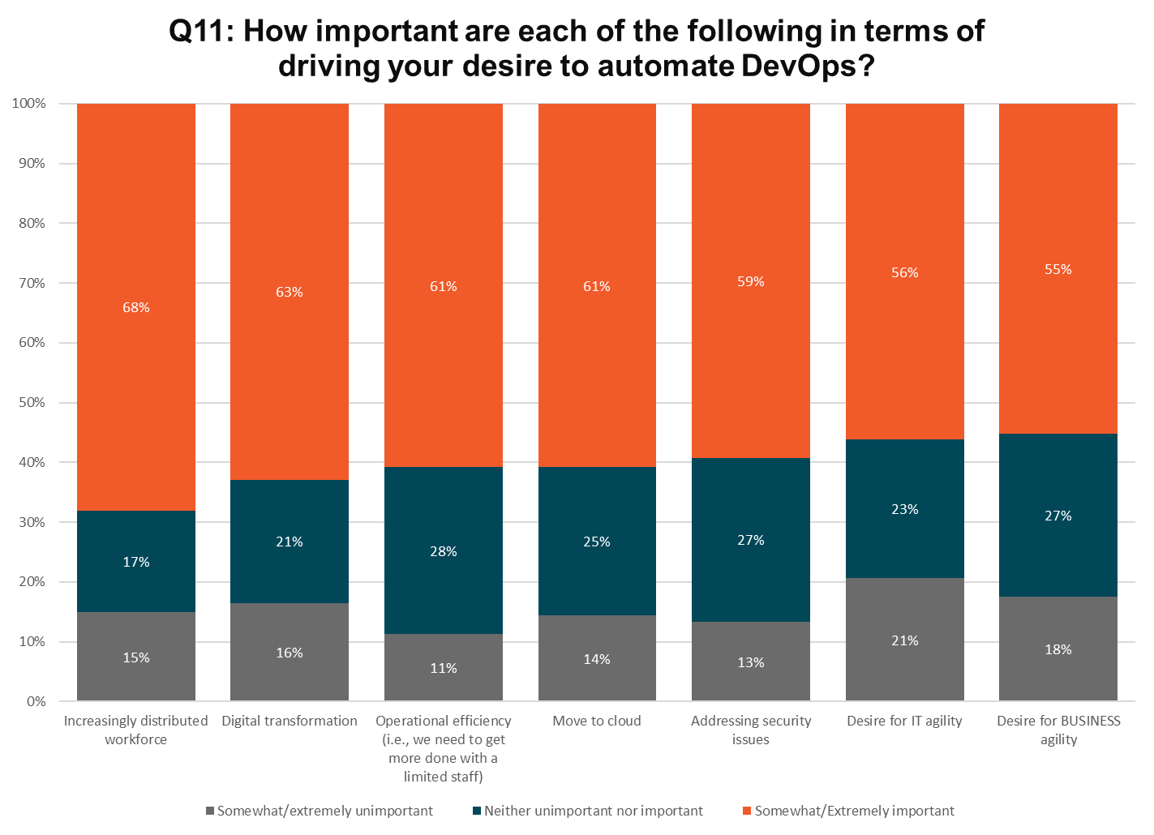
Notes:
N=123

Slide 28
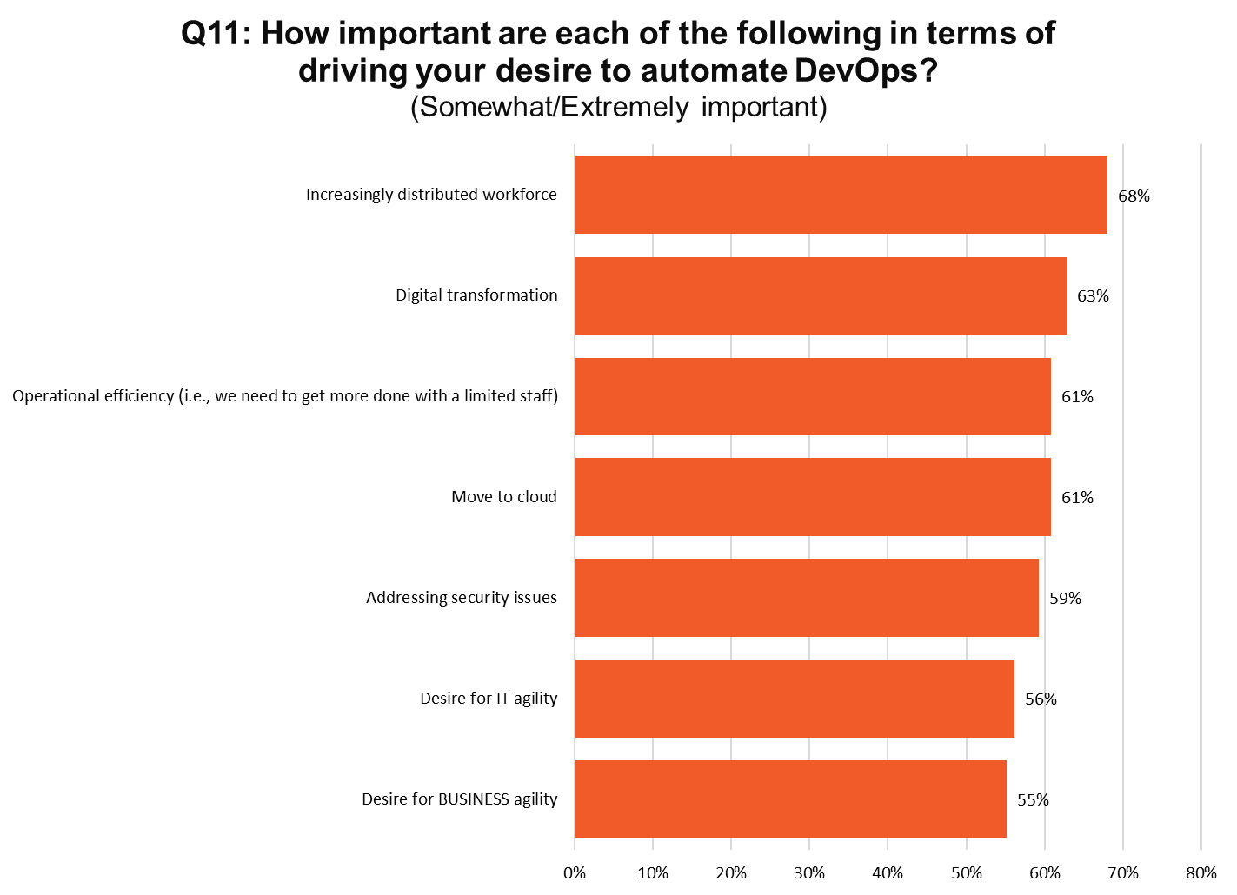
Notes:
N=123

Slide 29
Q12: Rate your engagement with the following types of automation for each area
Notes:
N=200

Slide 30
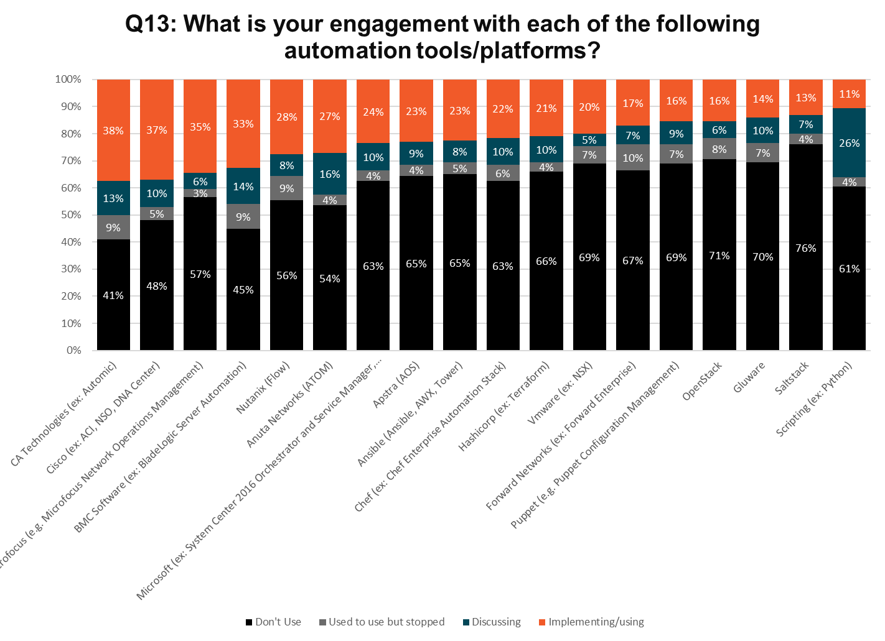
Notes:
N=200

Slide 31
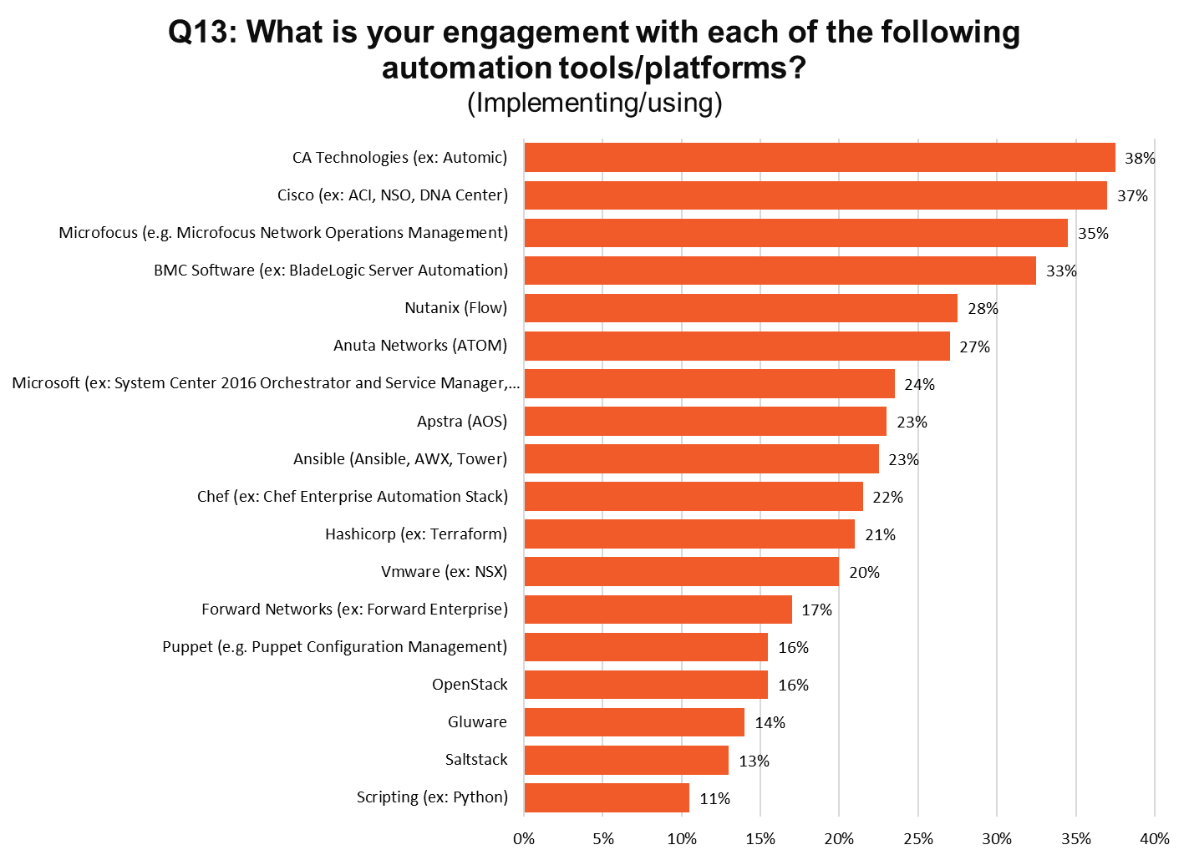
Notes:
N=200

Slide 32
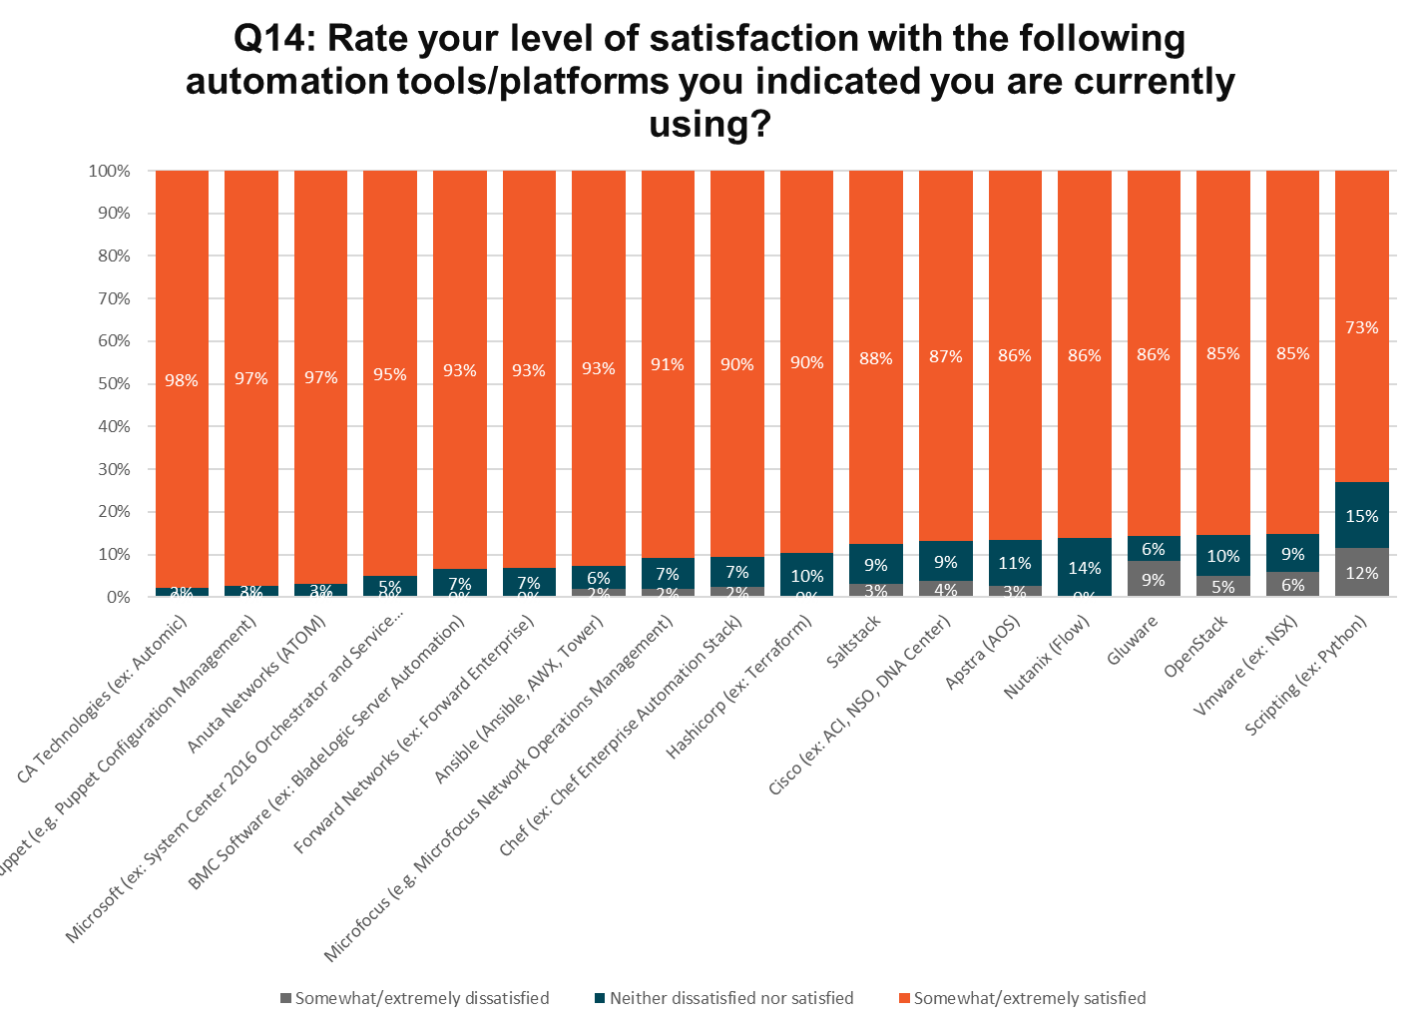
Notes:
N=62

Slide 33
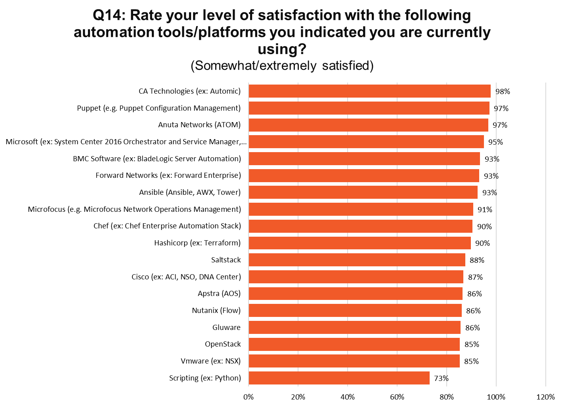
Notes:
N=62

Slide 34
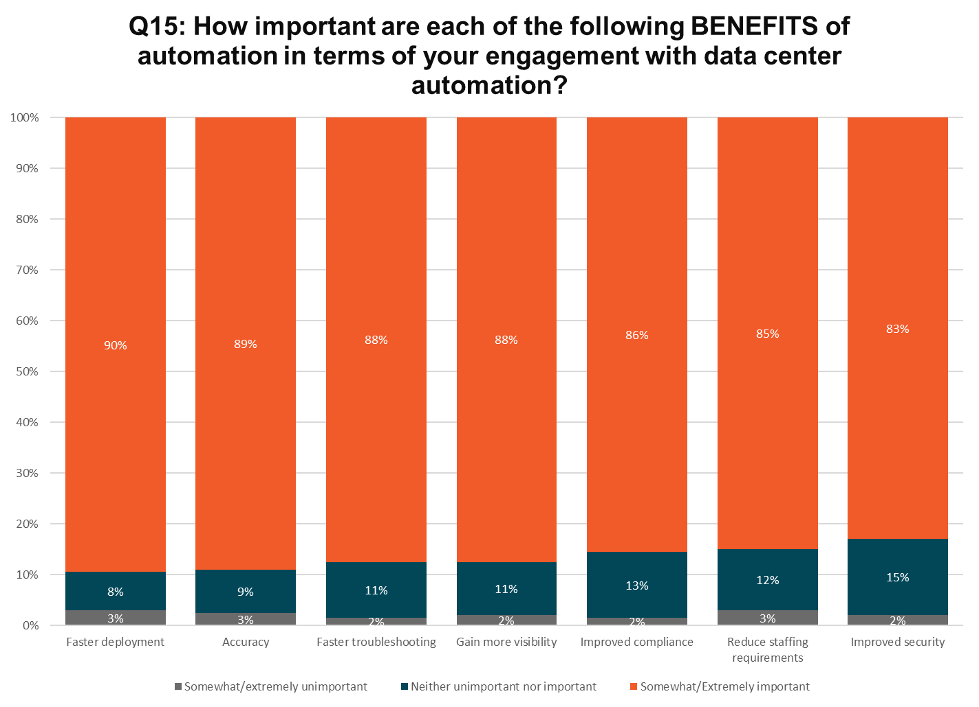
Notes:
N=196

Slide 35
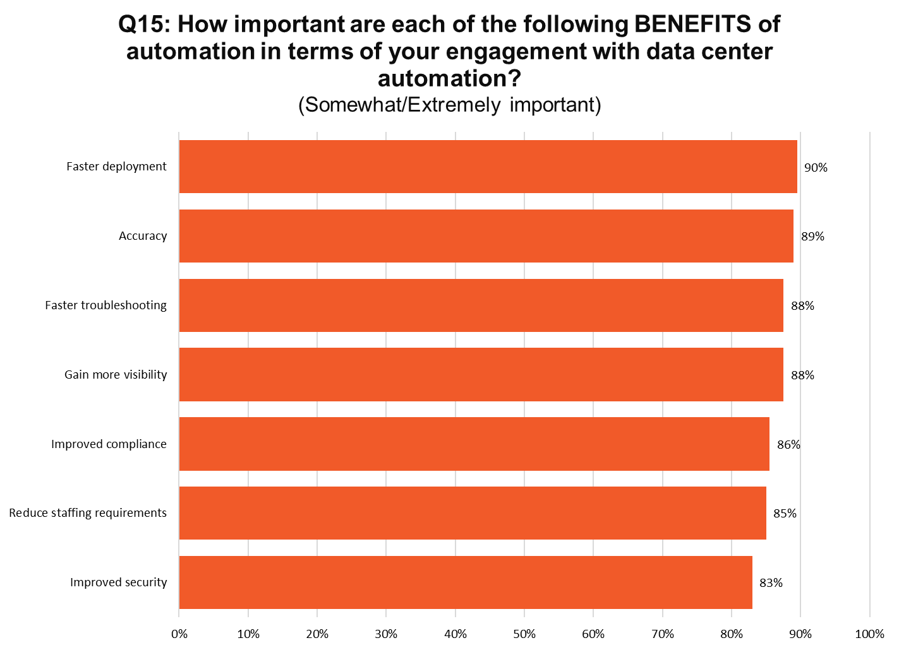
Notes:
N=196

Slide 36
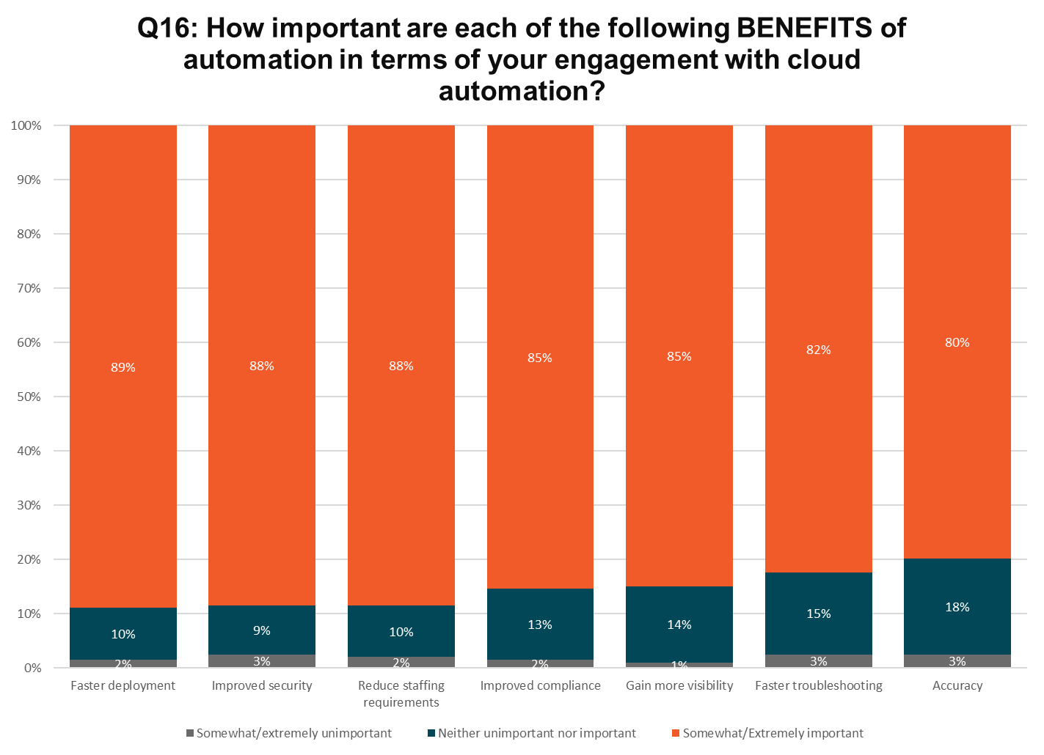
Notes:
N=194

Slide 37
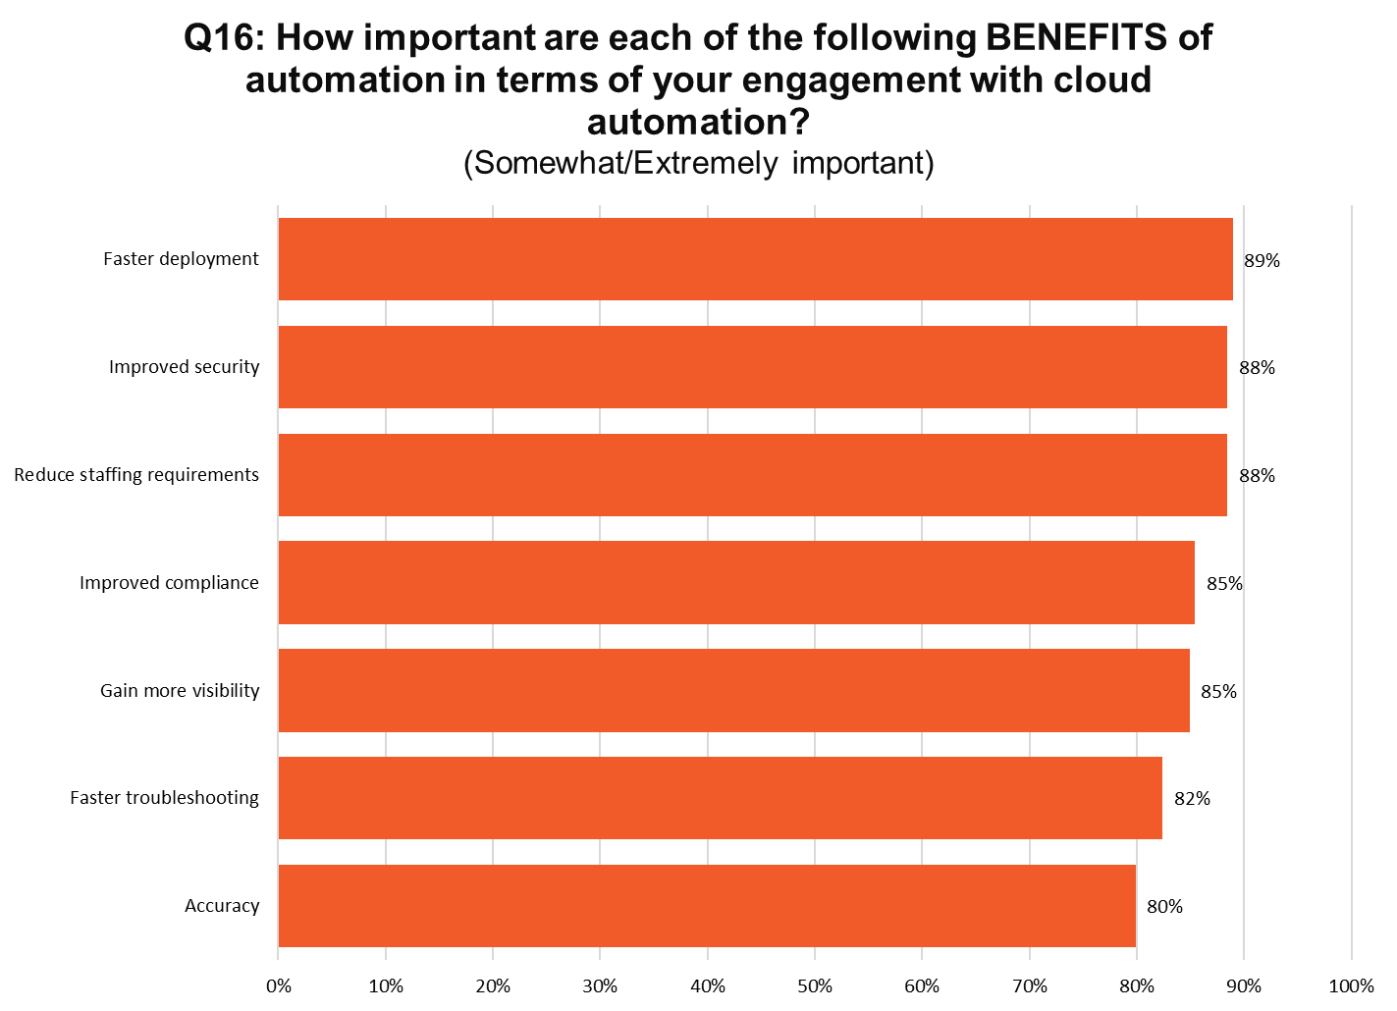
Notes:
N=194

Slide 38
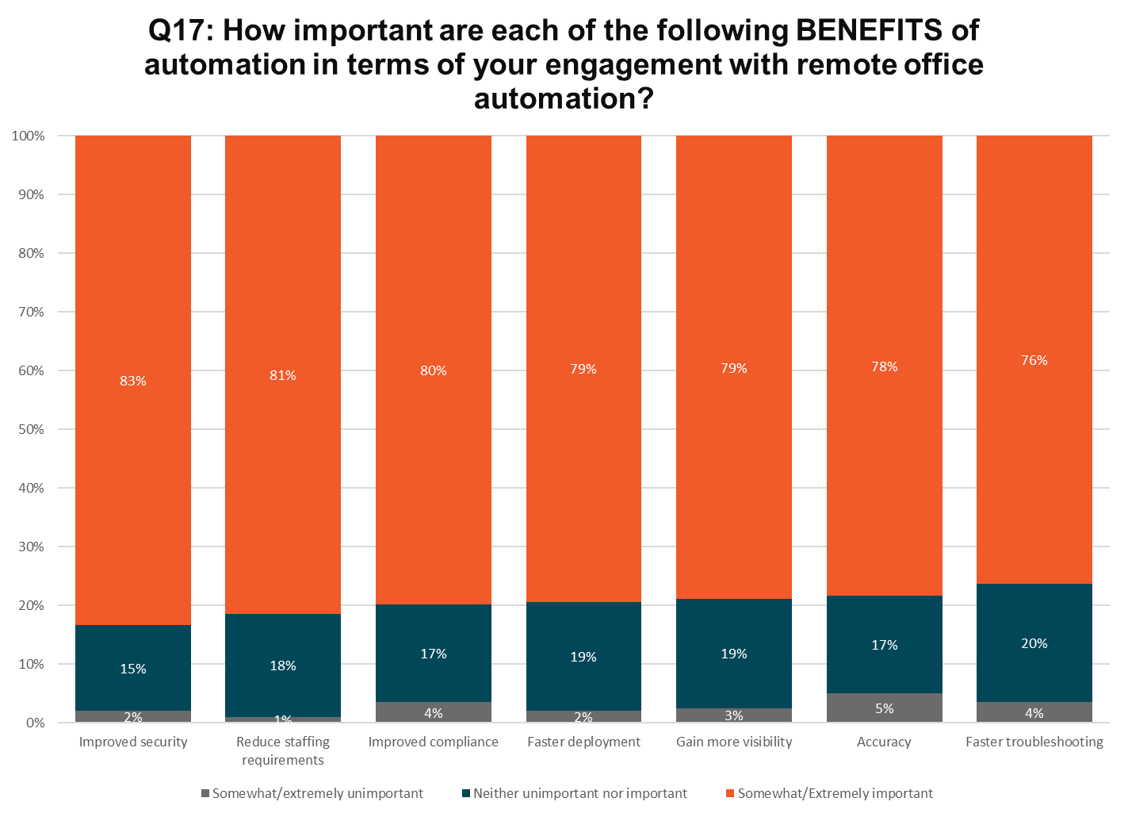
Notes:
N=176

Slide 39
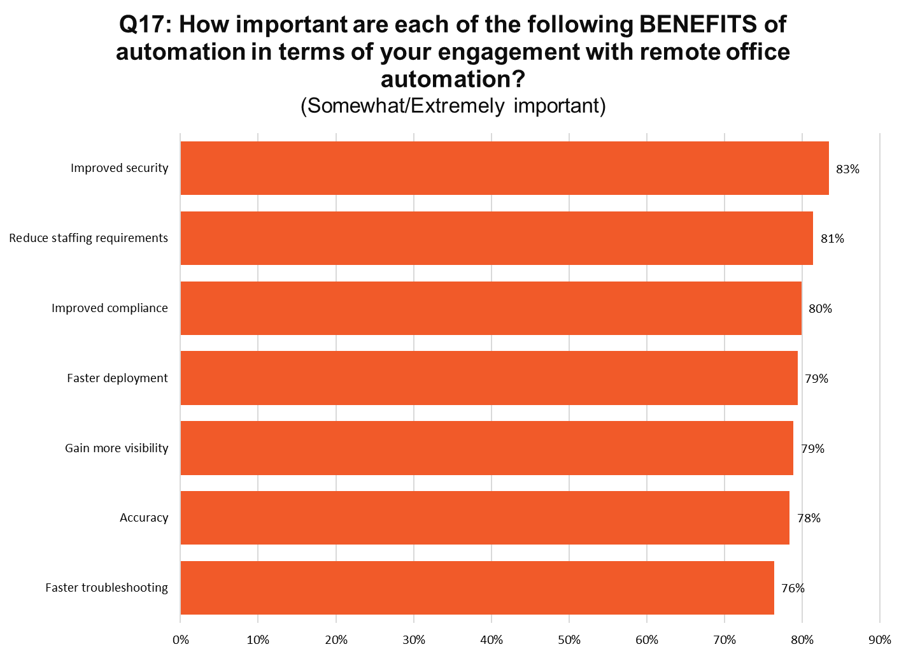
Notes:
N=176

Slide 40
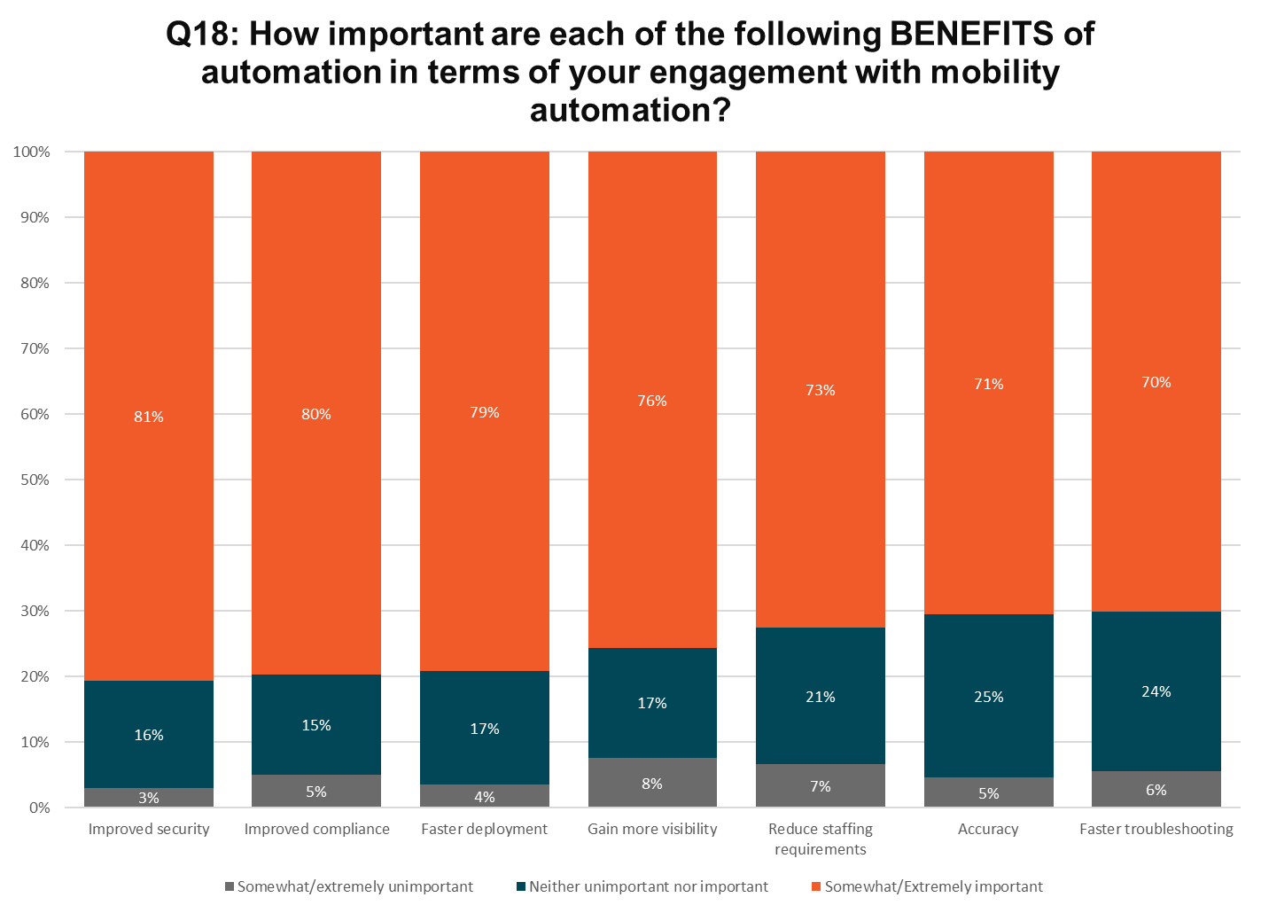
Notes:
N=145

Slide 41
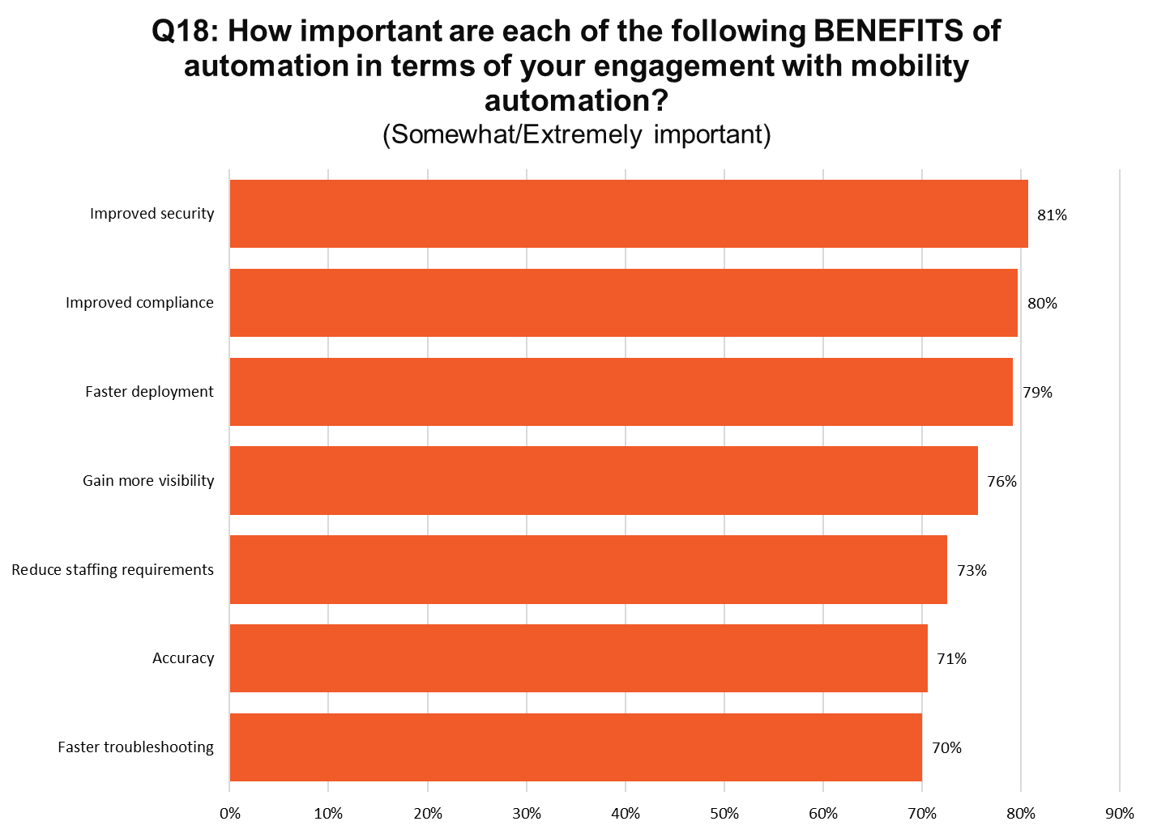
Notes:
N=145

Slide 42
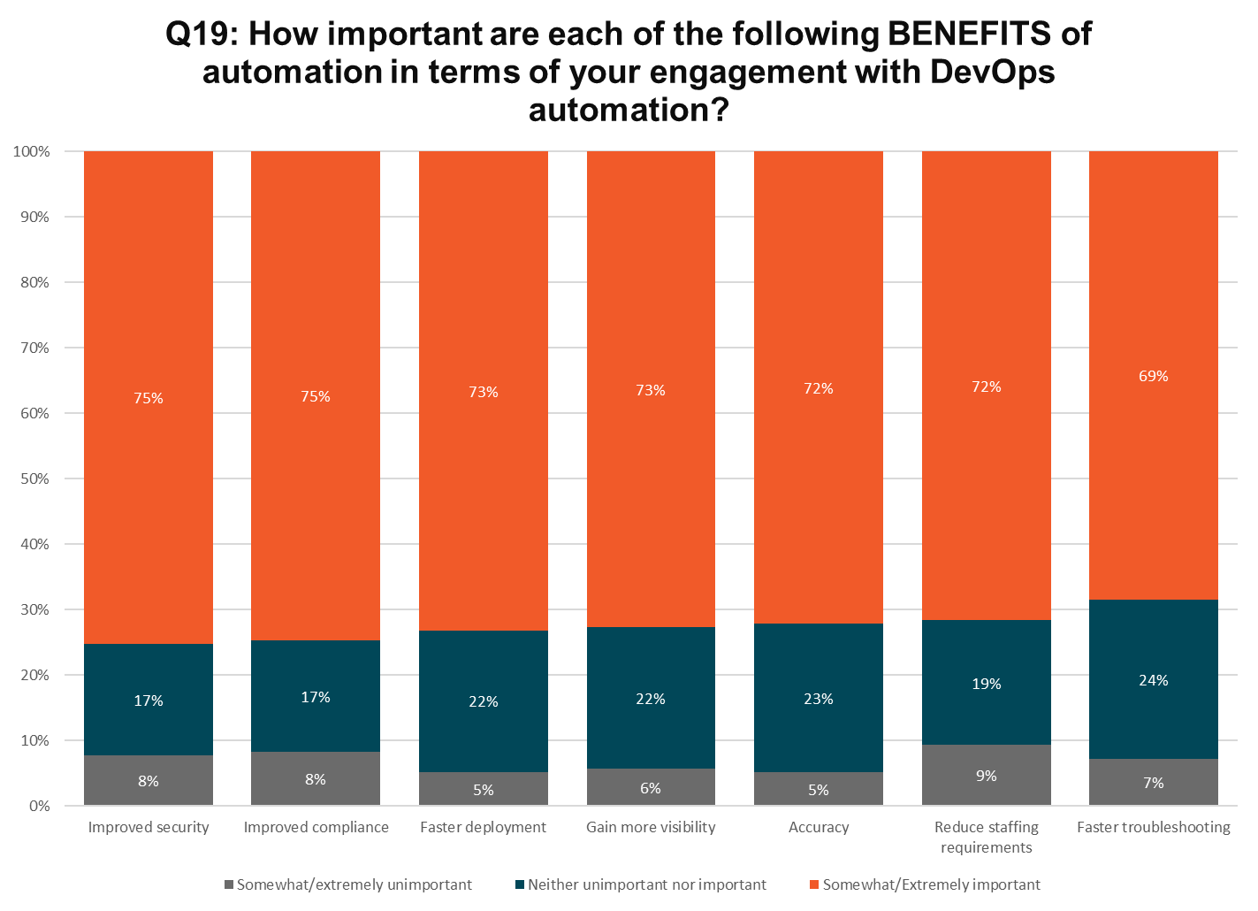
Notes:
N=123

Slide 43
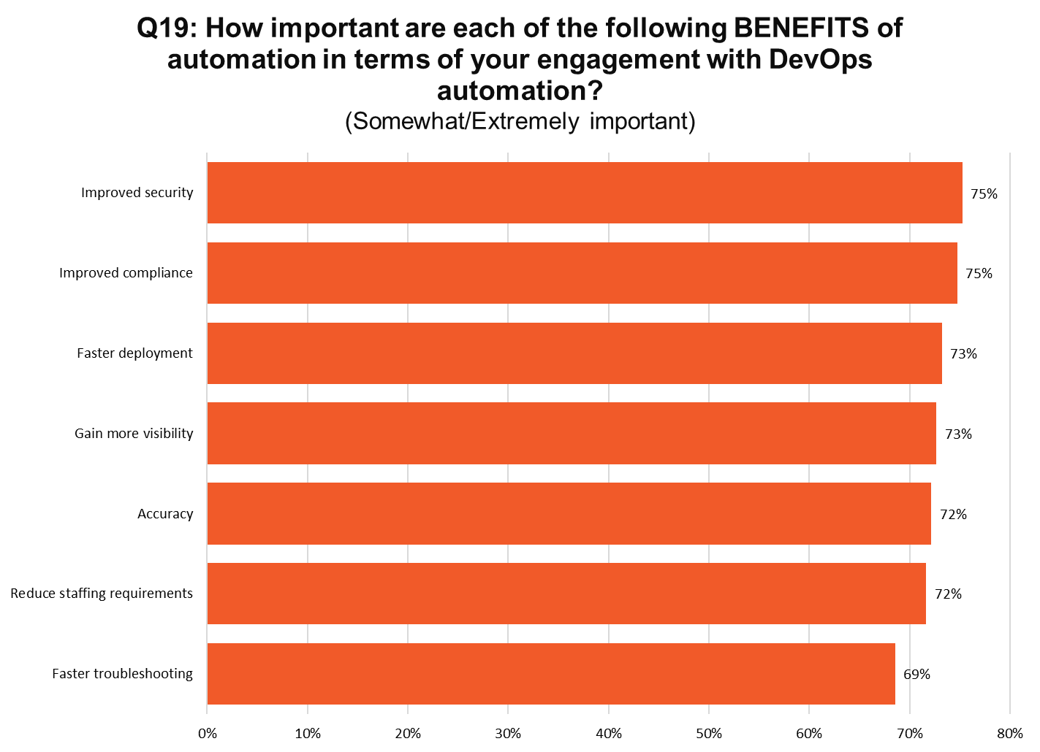
Notes:
N=123

Slide 44
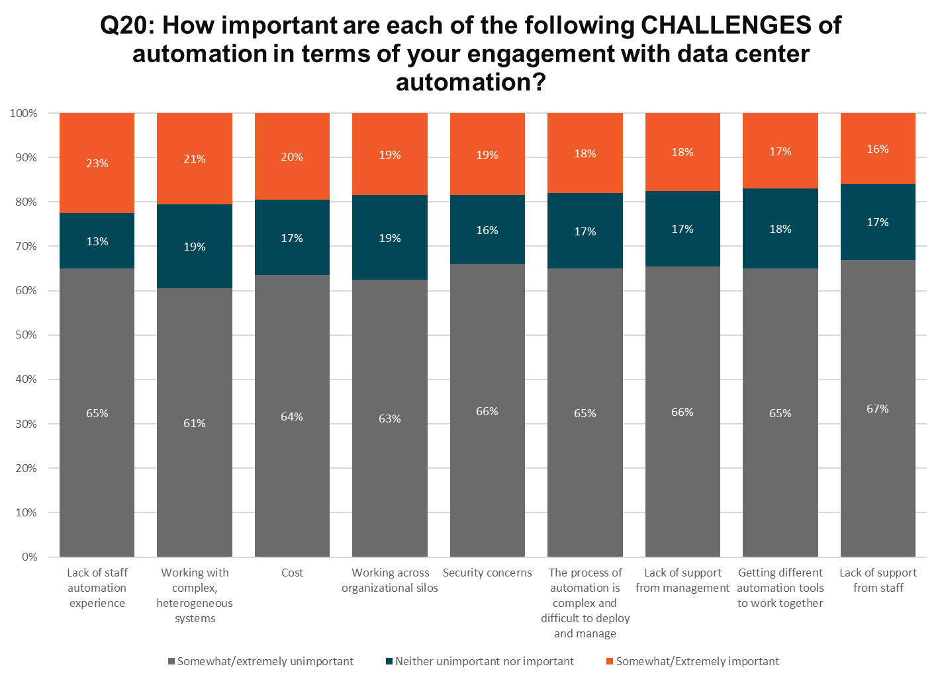
Notes:
N=196

Slide 45
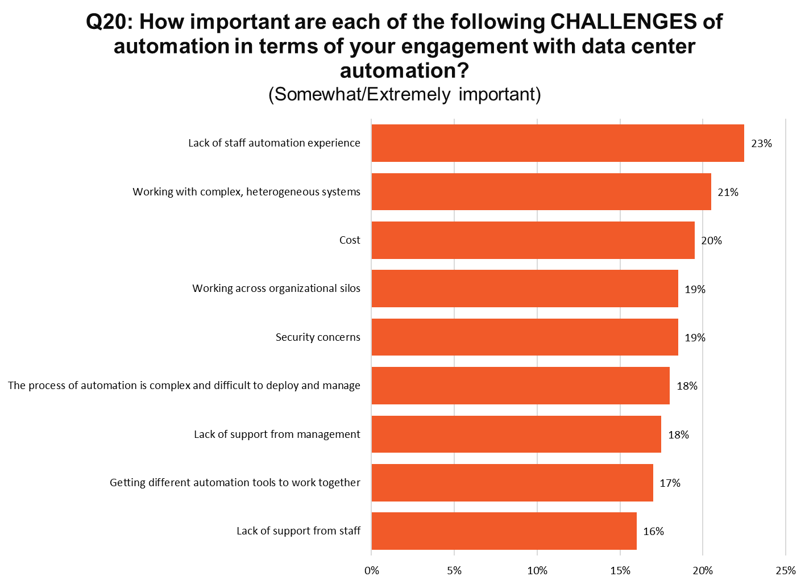
Notes:
N=196

Slide 46
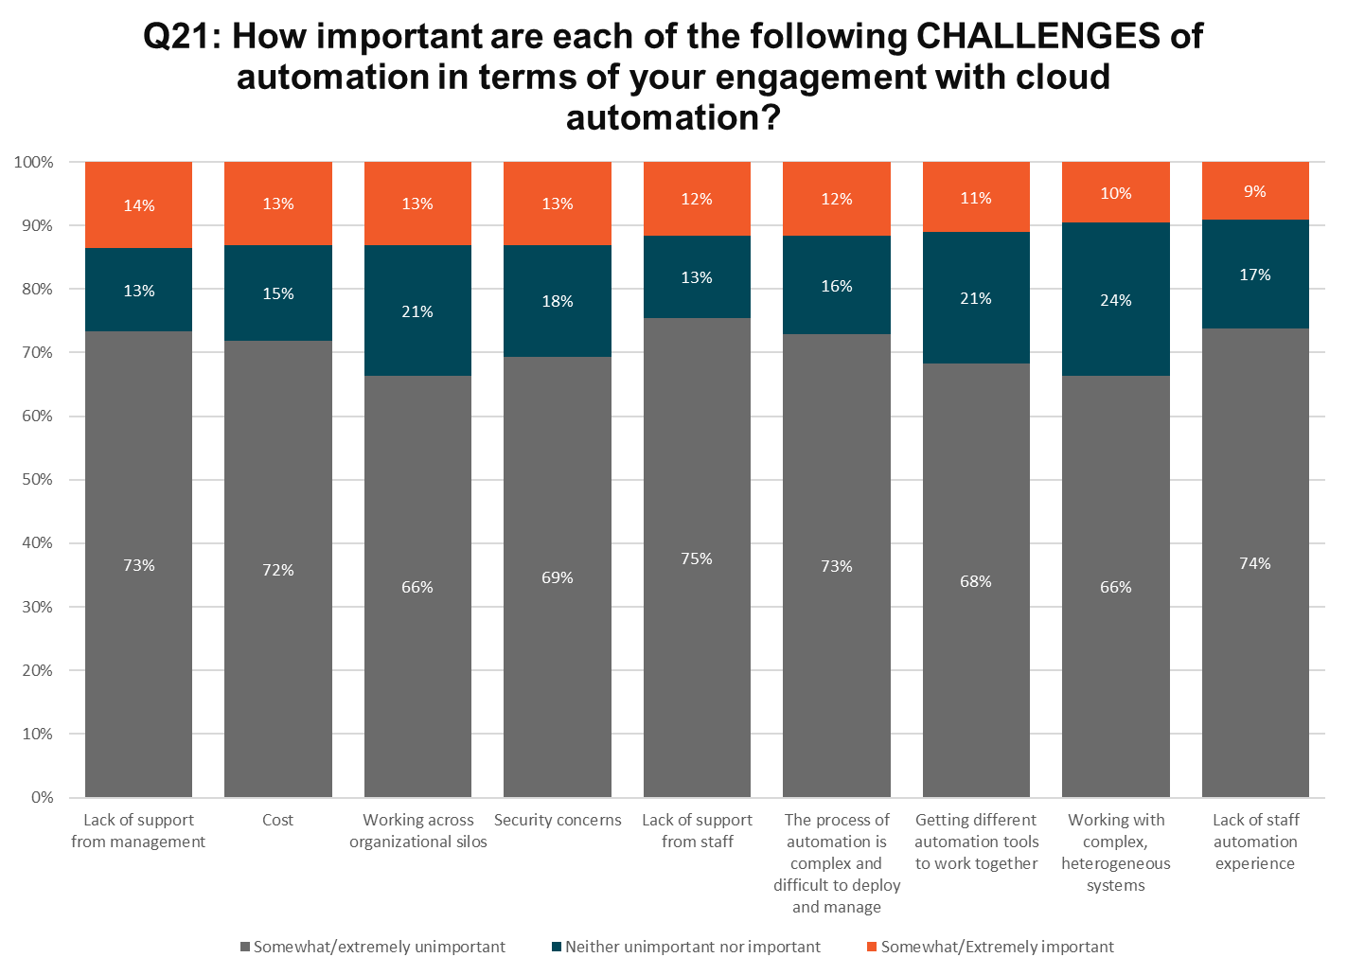
Notes:
N=194

Slide 47
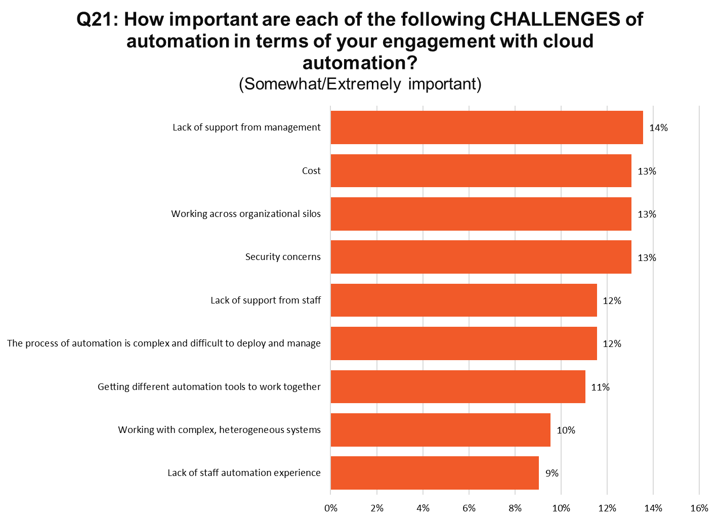
Notes:
N=194

Slide 48
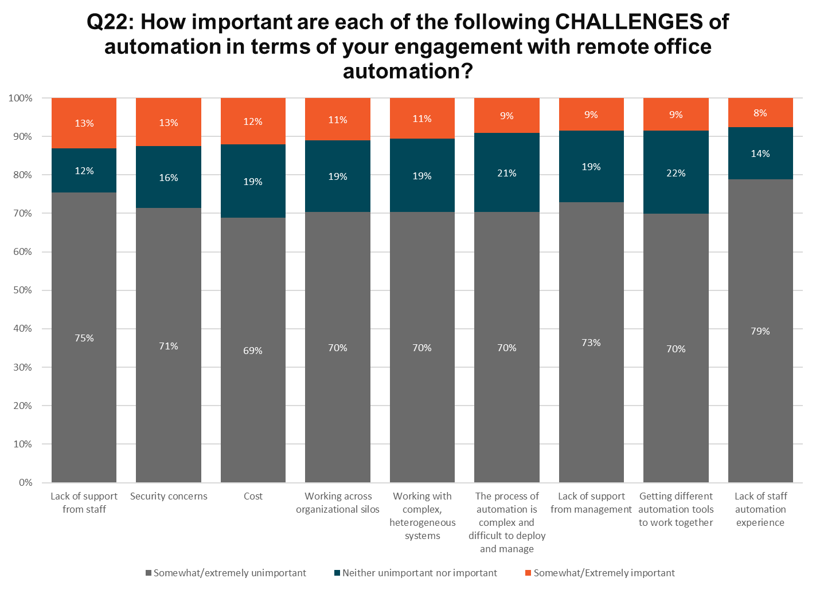
Notes:
N=176

Slide 49
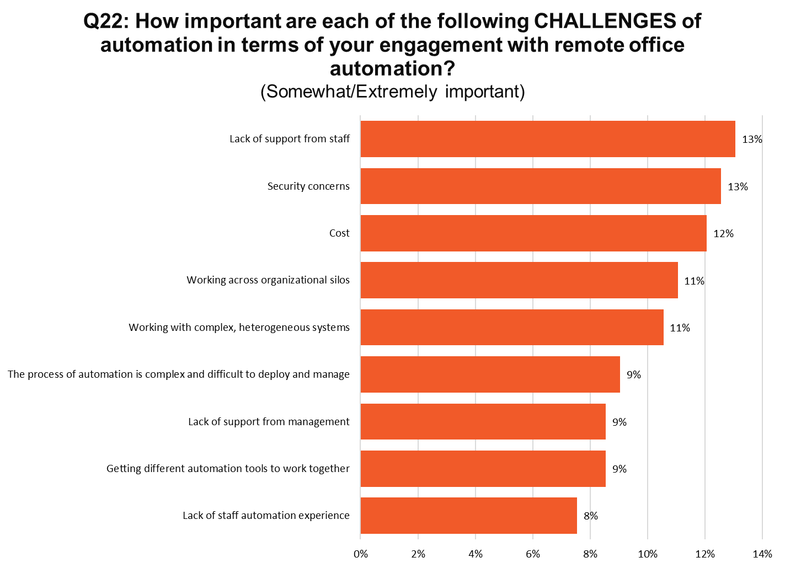
Notes:
N=176

Slide 50
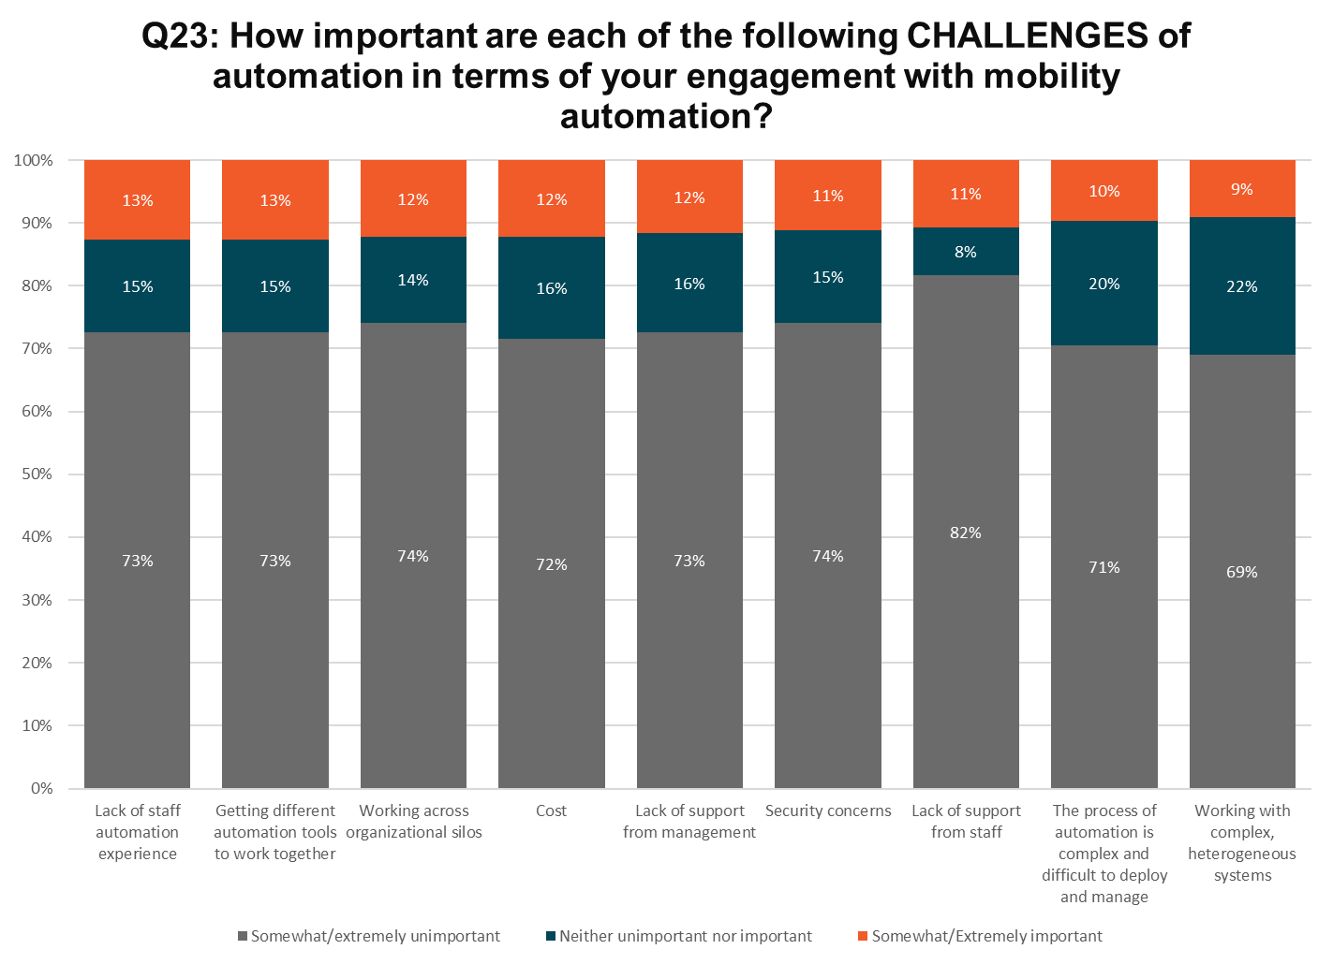
Notes:
N=145

Slide 51
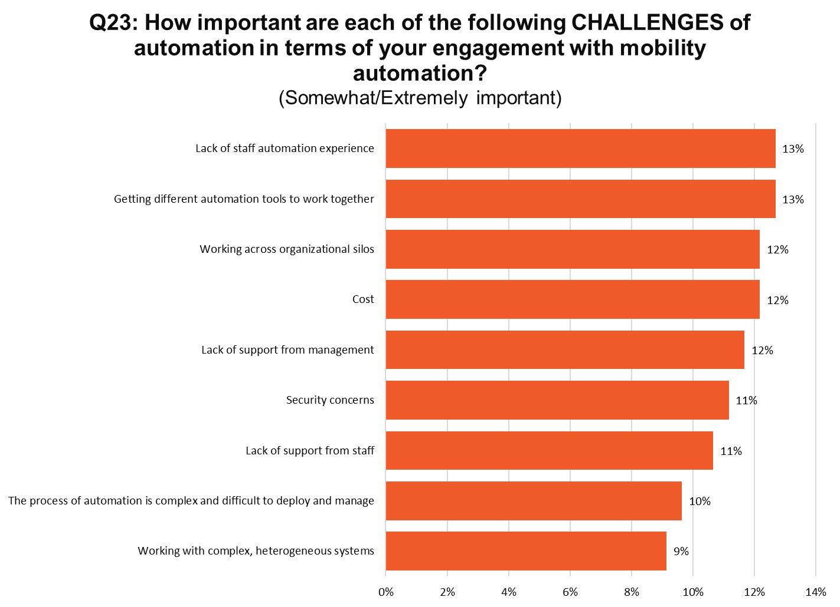
Notes:
N=145

Slide 52
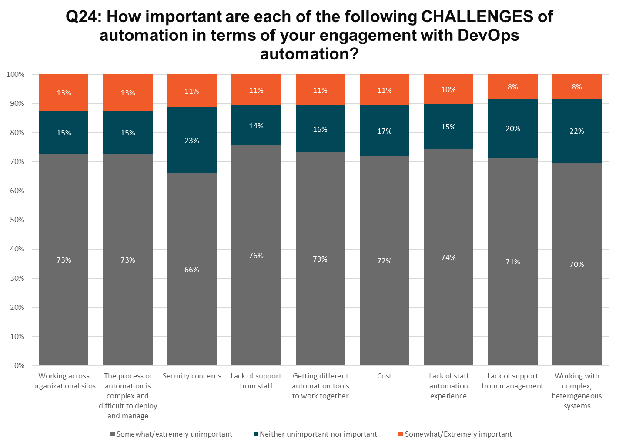
Notes:
N=123

Slide 53
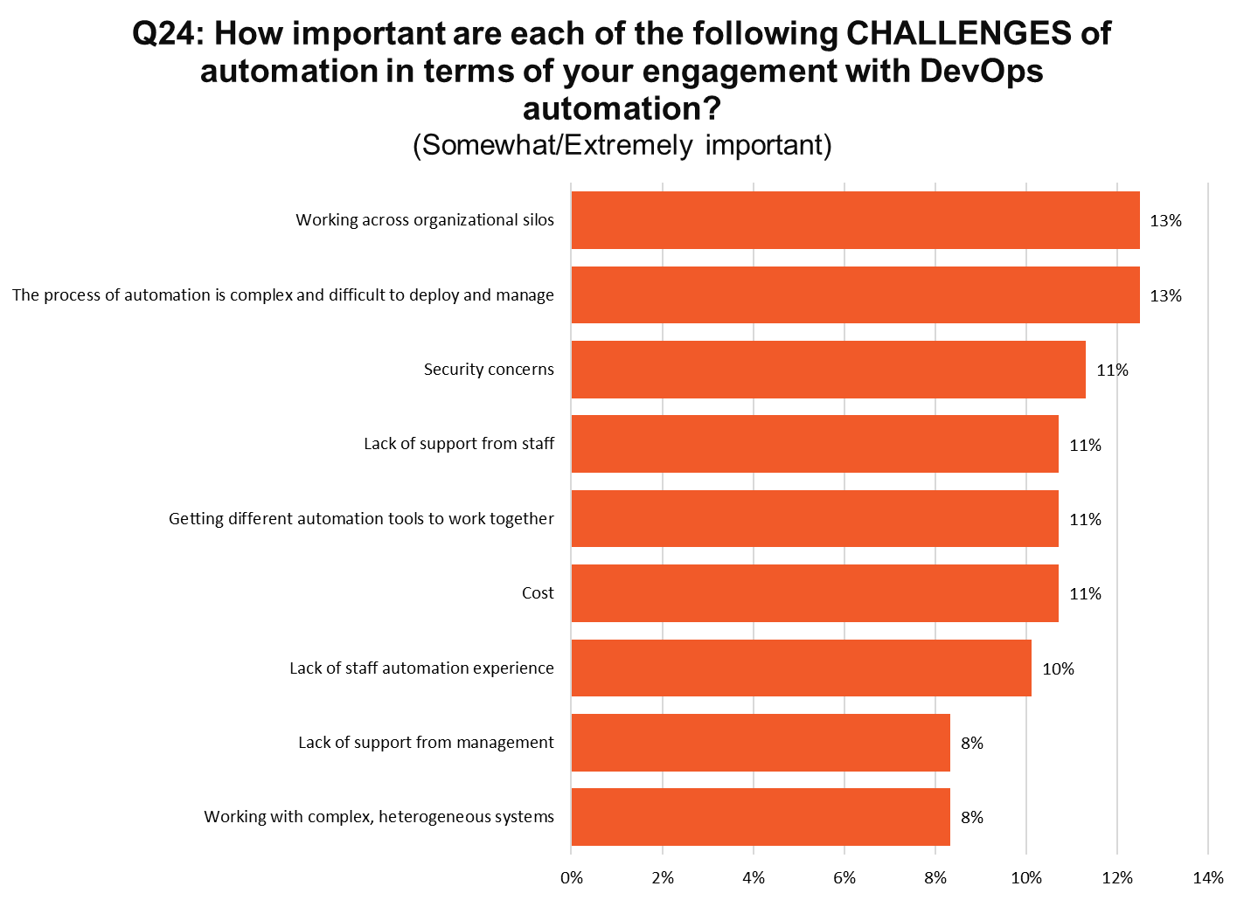
Notes:
N=123

Slide 54
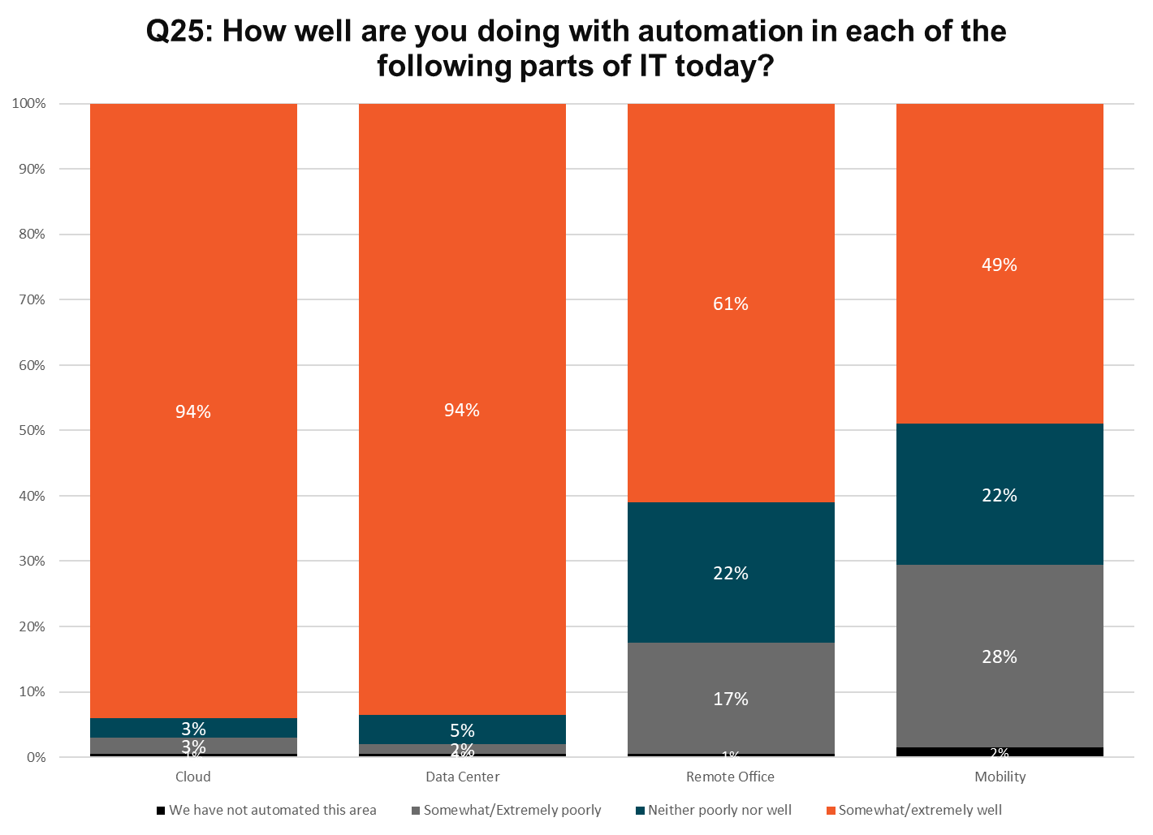
Notes:
N=200

Slide 55
Notes:
N=200

Slide 56
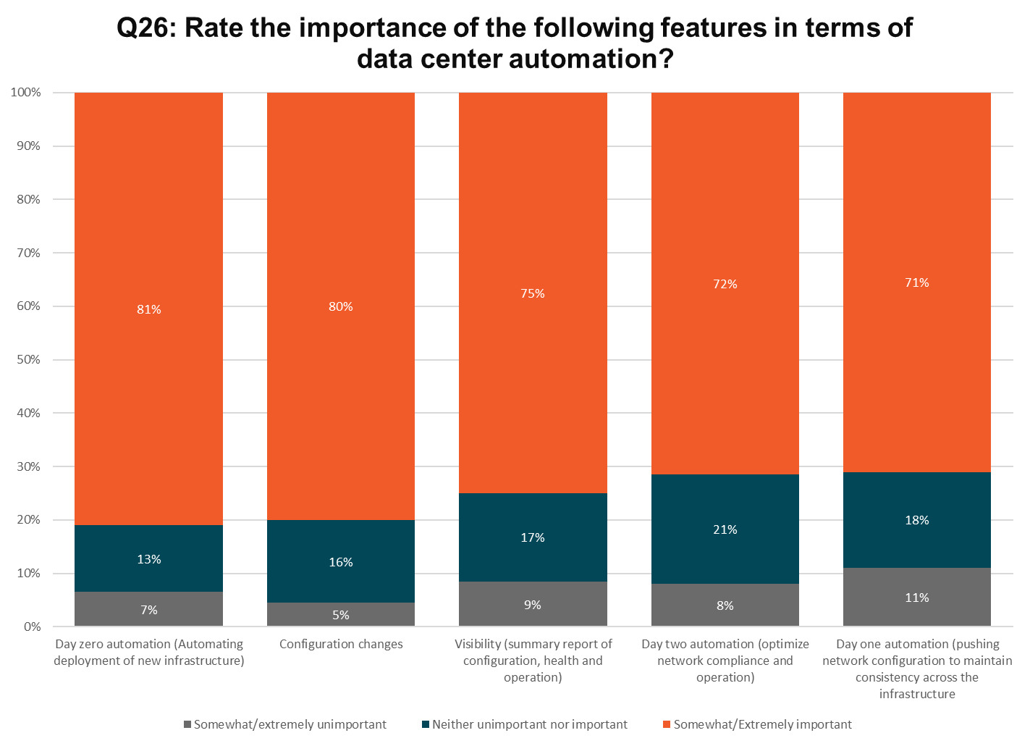
Notes:
N=200

Slide 57
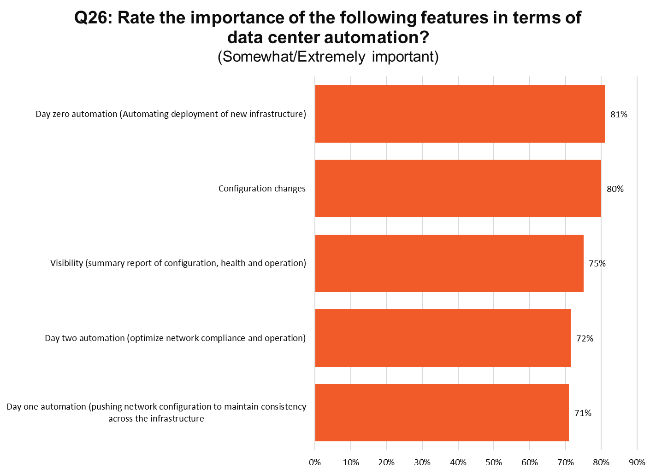
Notes:
N=200

Slide 58

Notes:
N=200

Slide 59

Notes:
N=200

Slide 60

Notes:
N=200

Slide 61

Notes:
N=200

Slide 62

Notes:
N=200

Slide 63

Notes:
N=200

Slide 64

Notes:
N=200

Slide 65

Notes:
N=200

Slide 66

Notes:
N=200

Slide 67

Notes:
N=200

Slide 68
Thank You
Jeff Paine, SVP, Marketing jeff.paine@pica8.com

