Slide 1


Rent Better
2020 Effects of the COVID-19 Pandemic on Residential Rentals Survey
Daniel Berlind, CEO
daniel@snappt.com
www.snappt.com
818. 331. 8031
Notes:
In 2019 Snappt published a study which showed application fraud was costing the property manager of a typical residential building millions of dollars annually. Since that study, the COVID-19 pandemic has turned the world upside down. We wanted to see how this has impacted the prevalence and impact of application fraud, so we commissioned the 2020 Eviction and Fraud in the Rental Industry Survey.

Slide 2







Demographics
Snappt commissioned a study of property managers and renters across the United States
100
120
Property managers
Property renters
Involvement with rental application evaluation
Renters’ Age
I manage the evaluation team
66%
Millennials (20-40)
35%
I am involved with evaluation
37%
Gen X (41-55)
27%
Baby Boomer (56-74)
36%
57%
(75+)
2%
12%
12%
10%
6%
Business or Property Mgr.
Regional Manager
Leasing
Manager
Leasing Agent
Regional VP
Notes:
ReRez Research, of Dallas, surveyed both property managers as well as renters. The 100 property managers either manage or are involved directly with evaluating rental applications. They had a variety of titles and roles, but were most commonly business or property managers.
The 120 renters were split between Millennials, Gen-X, Boomers and the Silent Generation. They were geographically distributed across the US. They were all renting apartments or townhouses. We did not survey renters of single family homes.

Slide 3
The Problem
Notes:
So, what’s going on in this age of COVID-19?

Slide 4
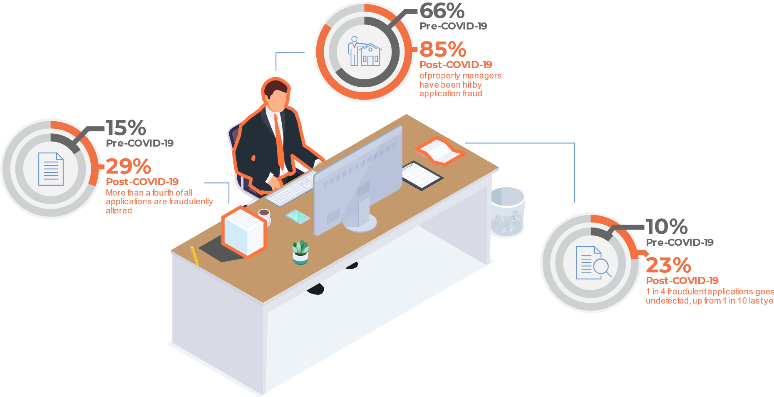
Application Fraud is Rising
Notes:
In a nutshell, application fraud has risen dramatically because of COVID-19. Property managers say 29 percent of rental applications now exhibit application fraud … nearly double the 15 percent we found in our survey from the end of 2019. 85 percent of all landlords now report being a victim of application fraud, up from 66 percent last year.
And, whereas last year property managers felt just one in ten fraudulently altered application went through undetected, they now say one in FOUR is undetected.
Clearly, application fraud is up, but what does that mean for landlords?

Slide 5
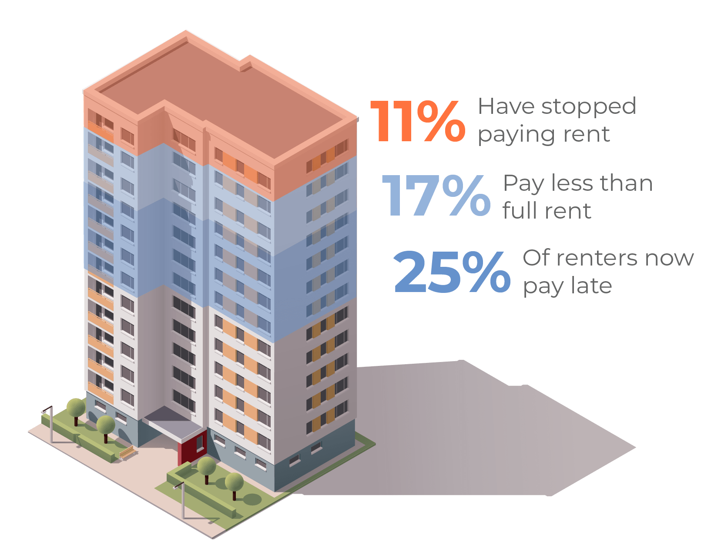
COVID-19 Causes Problems with Rent Payments
Notes:
The most direct effect is problems with rent payments. Landlords report more than HALF of tenants are having trouble making rent. A quarter are paying late, one in six (17 percent) now pay less than full rent and one in nine (11%) have stopping paying at all.
What’s that driving?

Slide 6
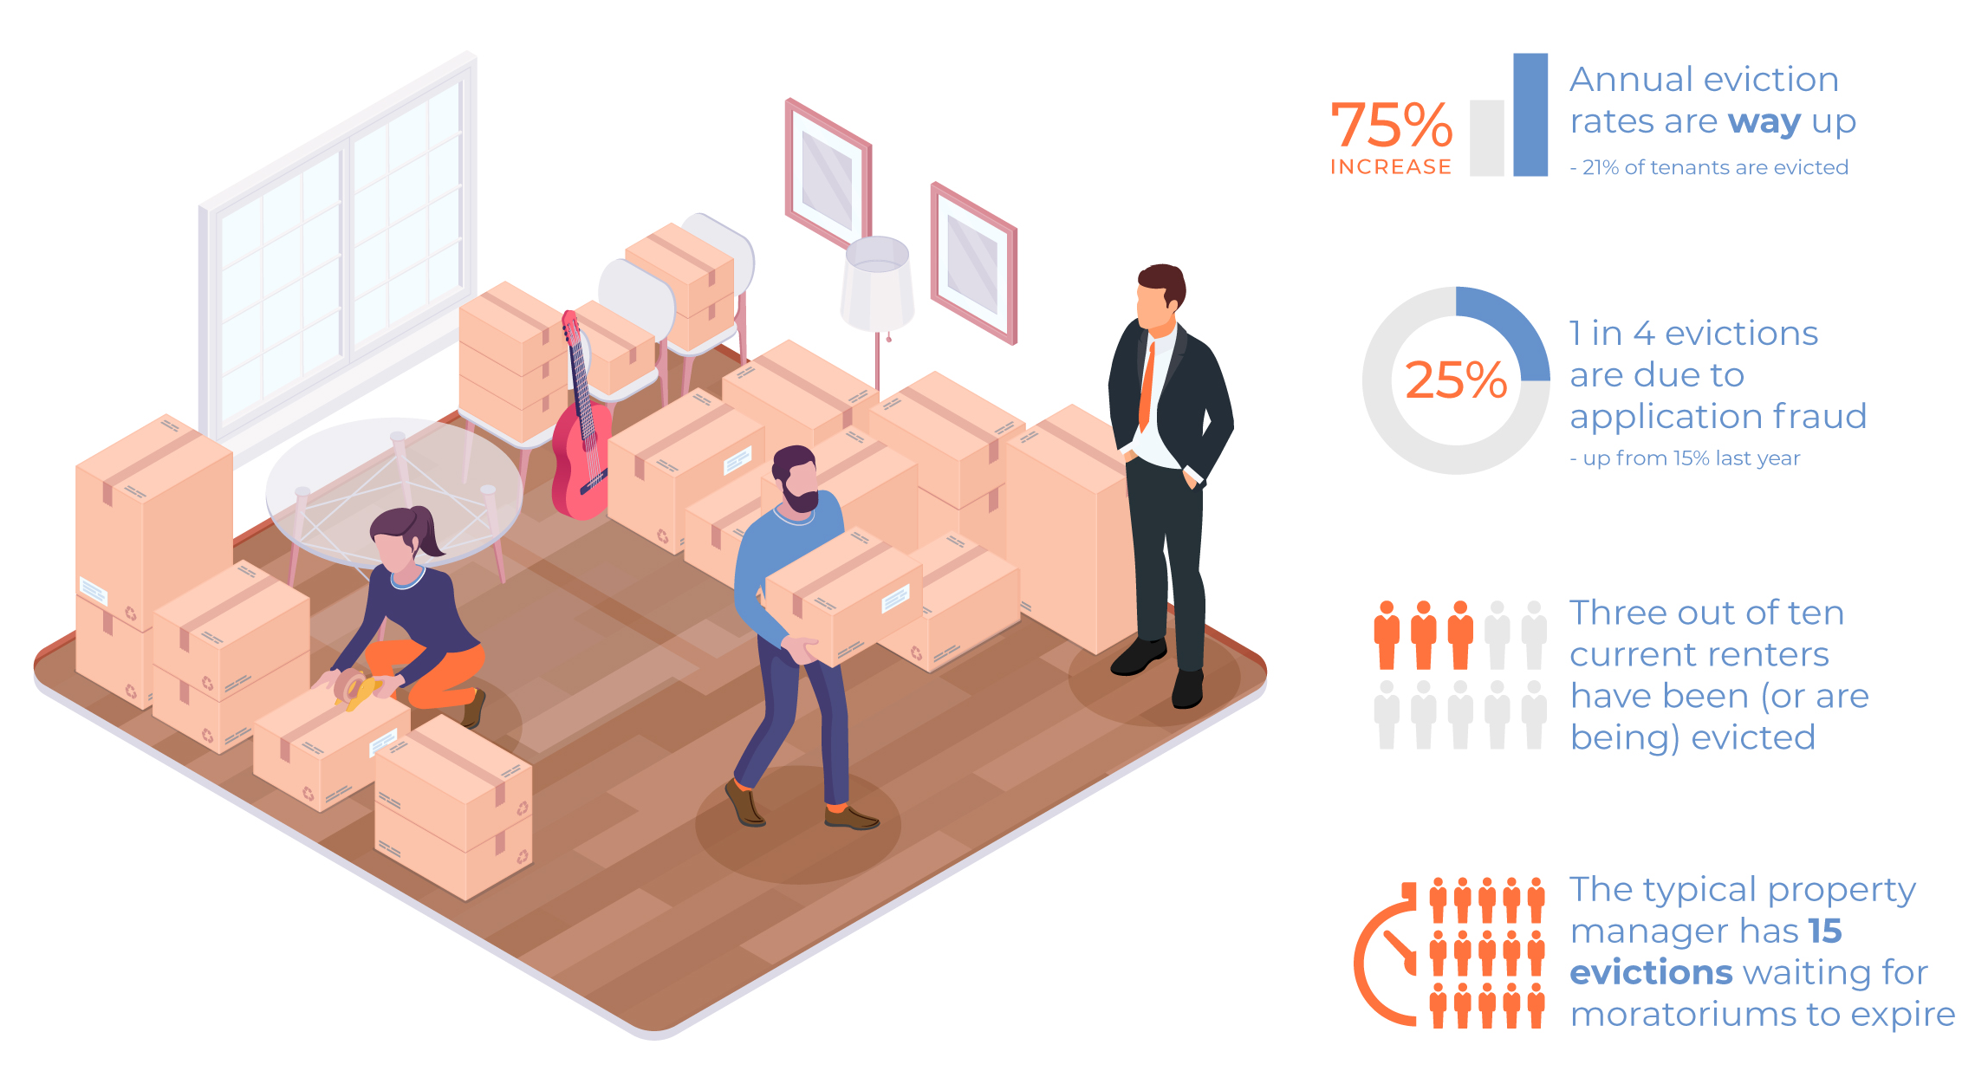
Evictions in a COVID-19 World
Notes:
Evictions. Landlords report an astounding 21 percent eviction rate today, a 75 percent increase from last year. One in four of these are tied to application fraud.
Three of ten renters have been, or will be evicted after moratoriums expire. In fact, the typical property manager has 15 evictions stacked-up awaiting for moratoriums to expire.

Slide 7
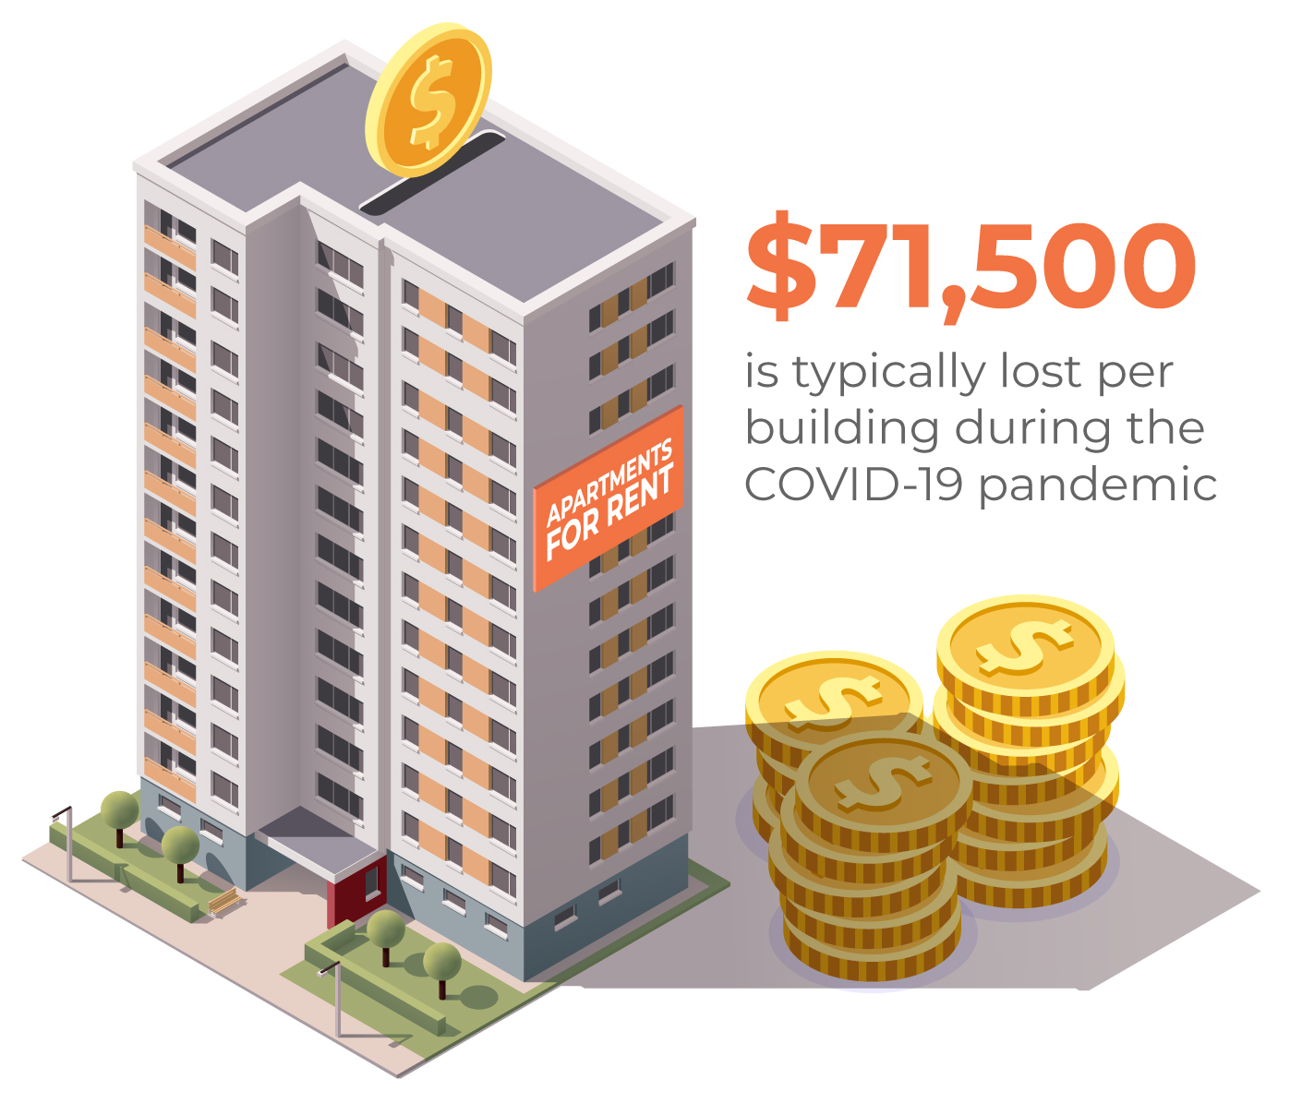
Typical COVID-19 Loss: $71,500 per Building
Notes:
If this sounds expensive, it is. The typical building has lost more than $70,000 from COVID-19.

Slide 8
Recommendations
TBD

Slide 9
Appendix

Slide 10
Renters

Slide 11
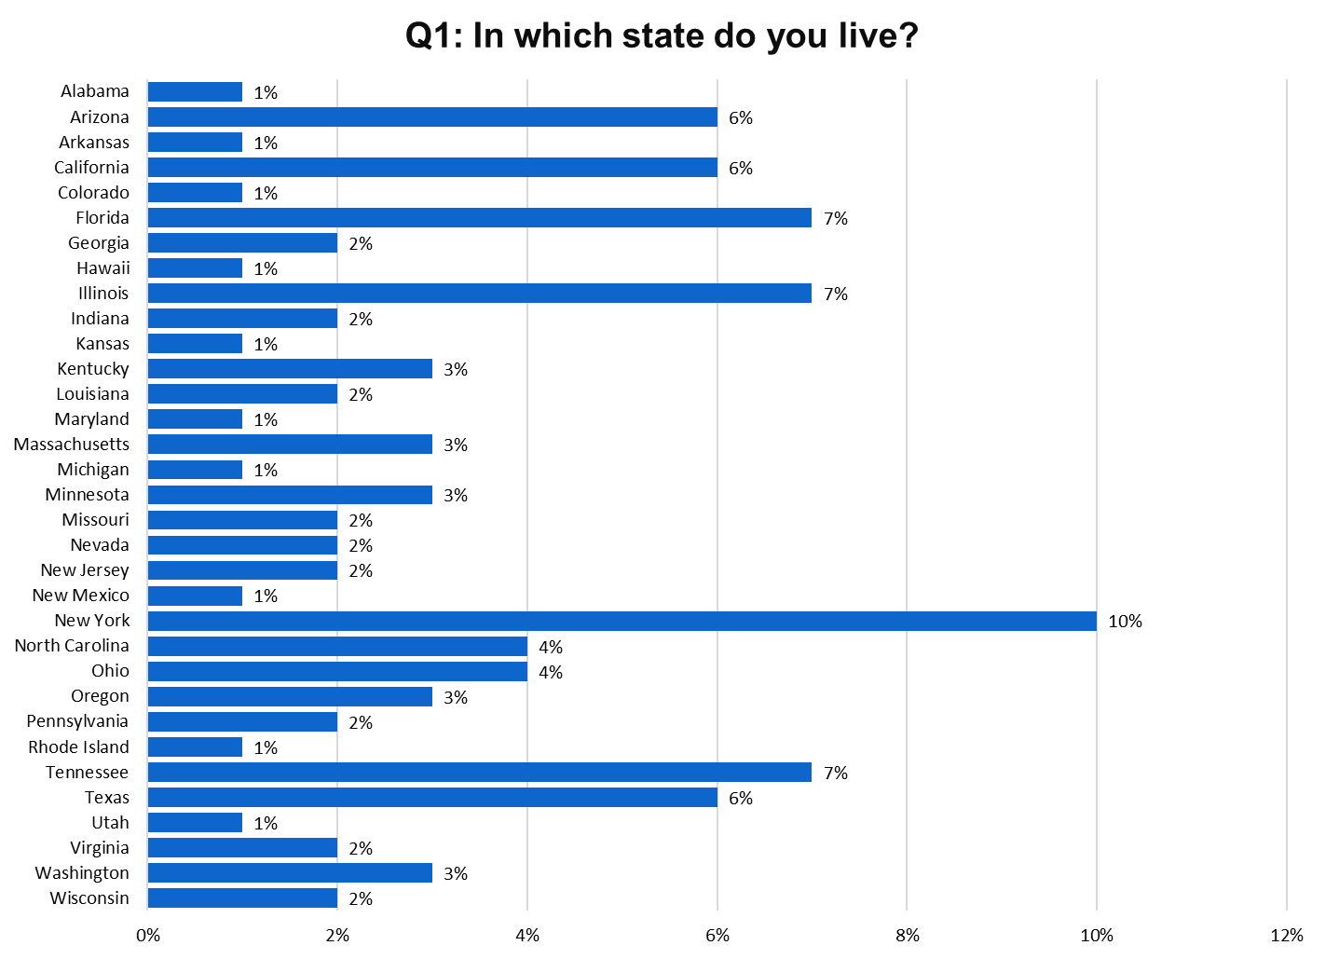
Notes:
N=120

Slide 12
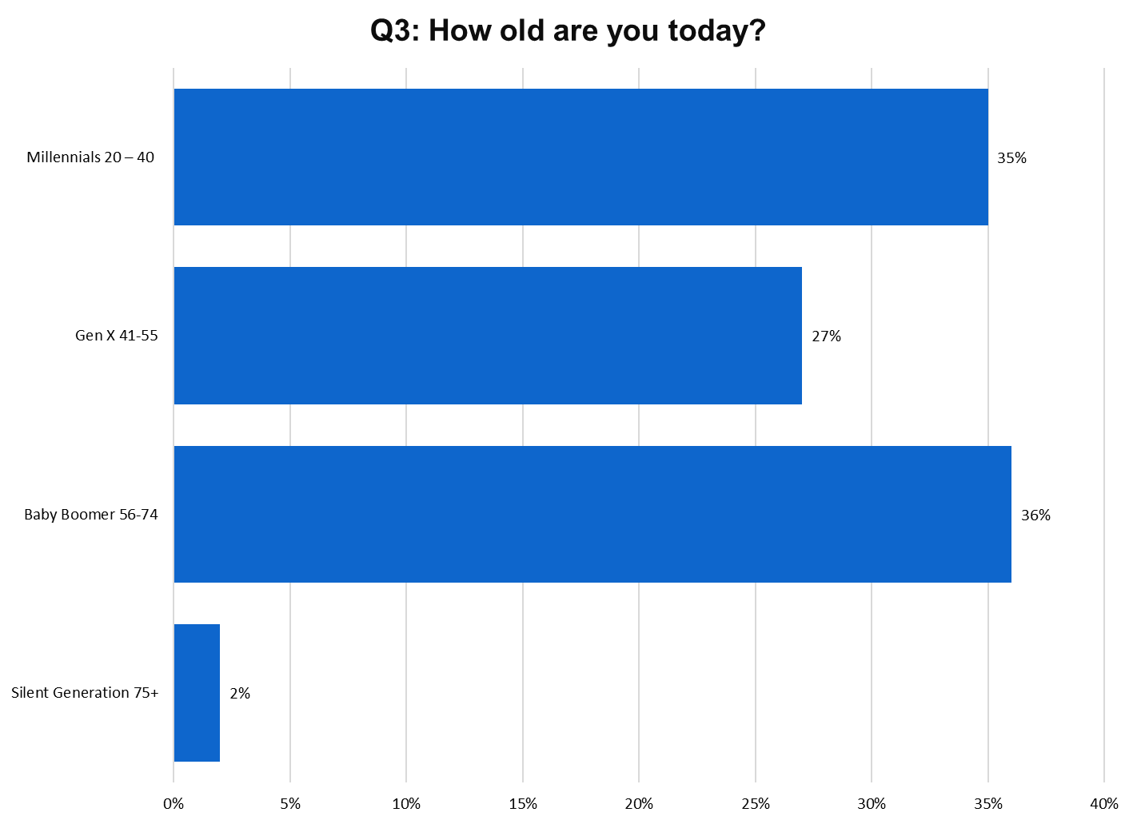
Notes:
N=120
Median: 50.5

Slide 13
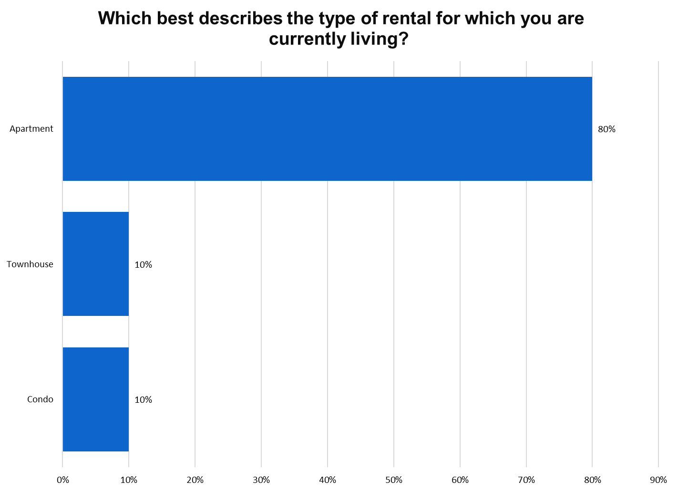
Notes:
N=120

Slide 14
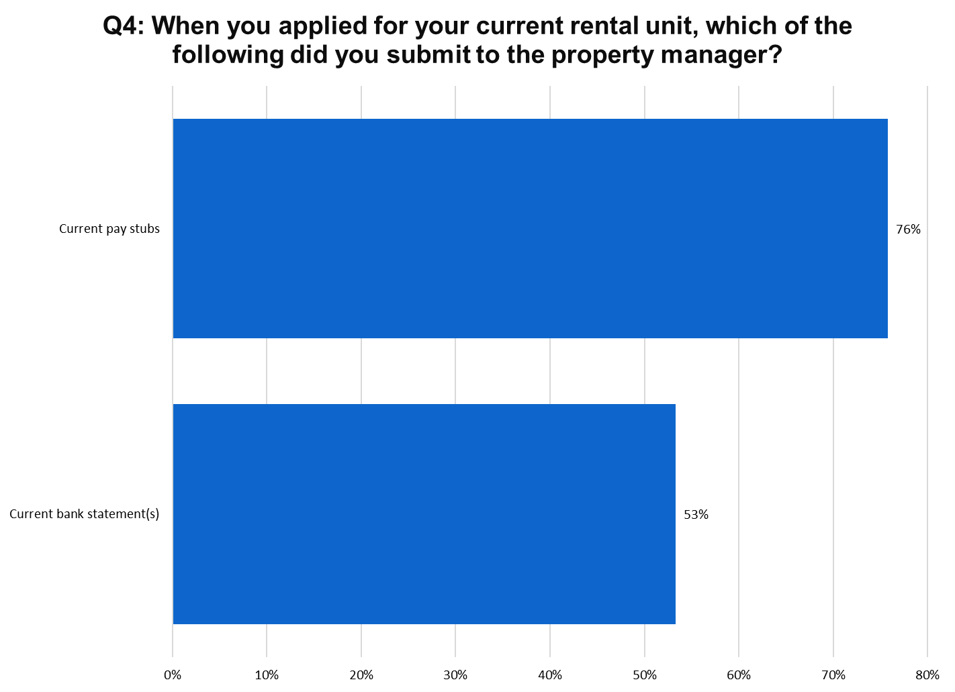
Notes:
N=120

Slide 15
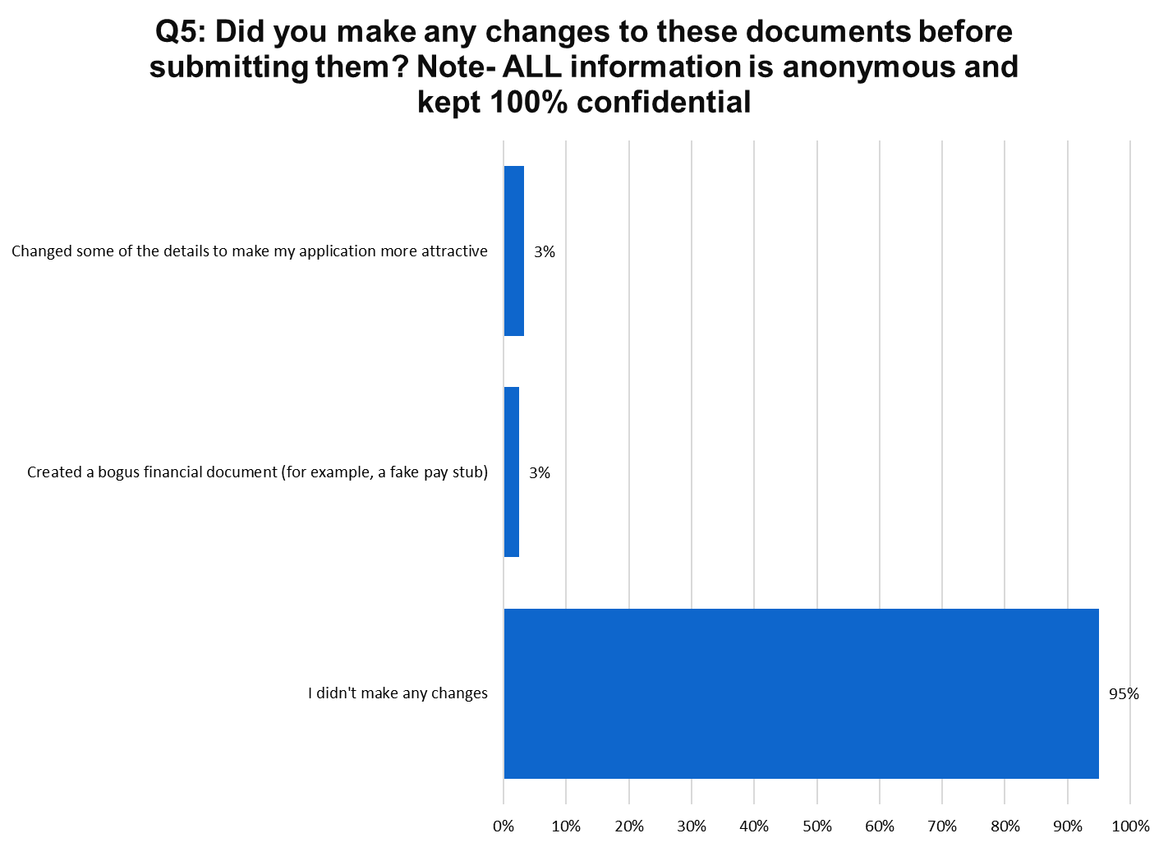
Notes:
N=120

Slide 16
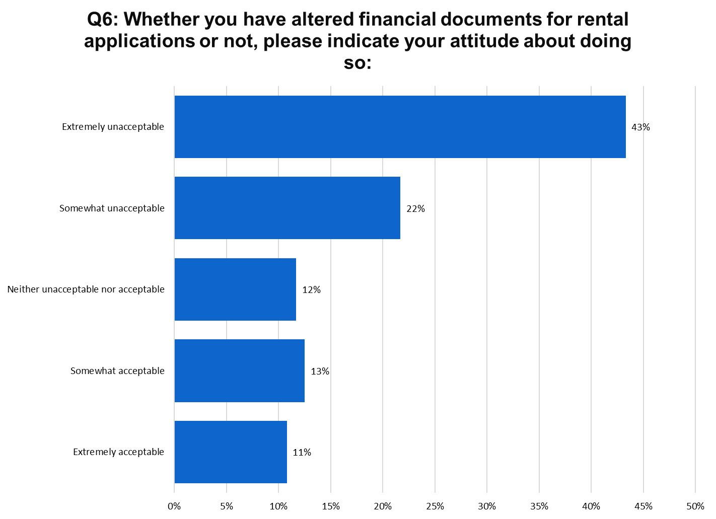
Notes:
N=120

Slide 17
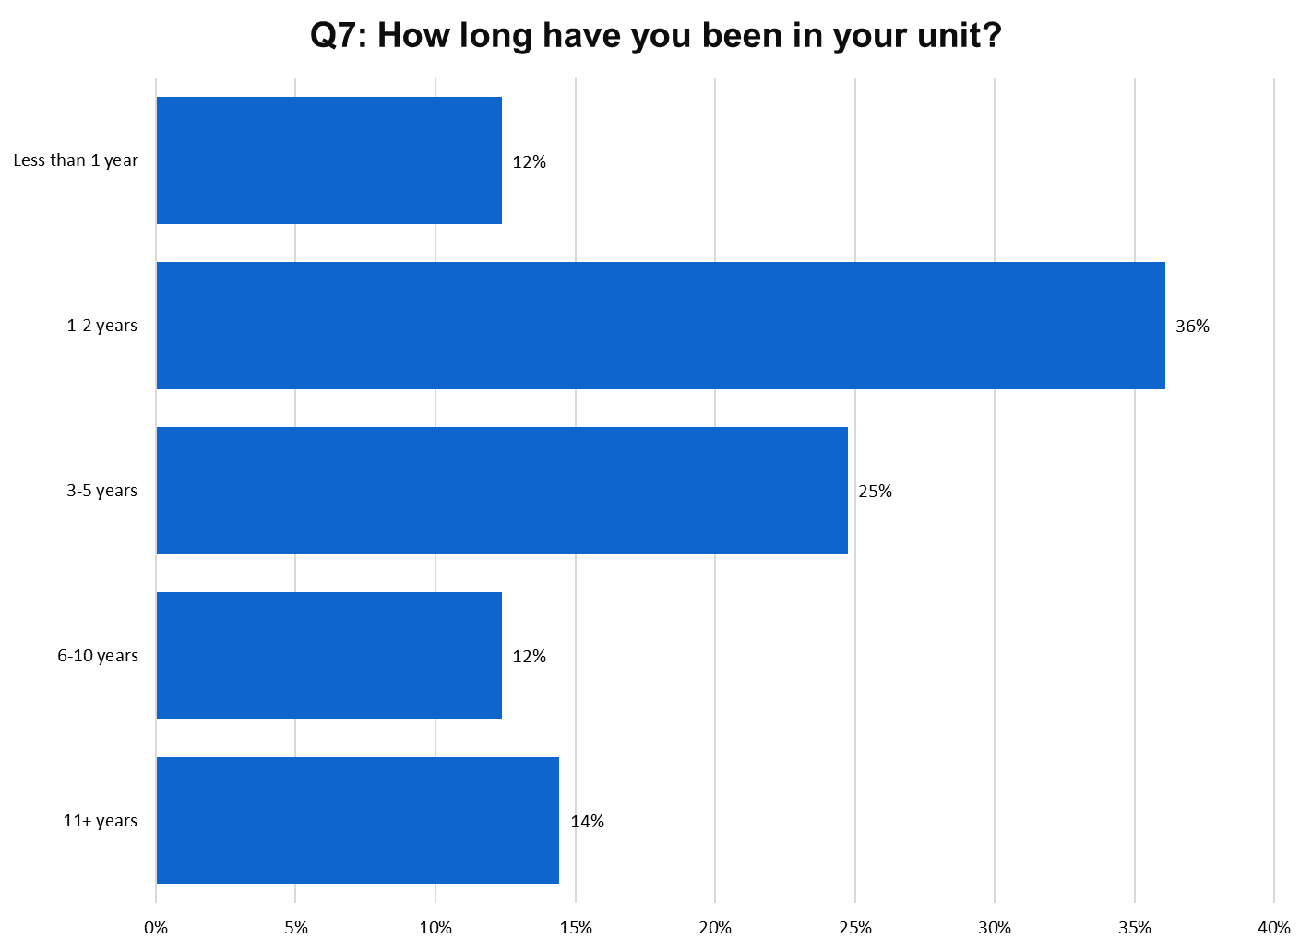
Notes:
N=120
Median = 3 years

Slide 18
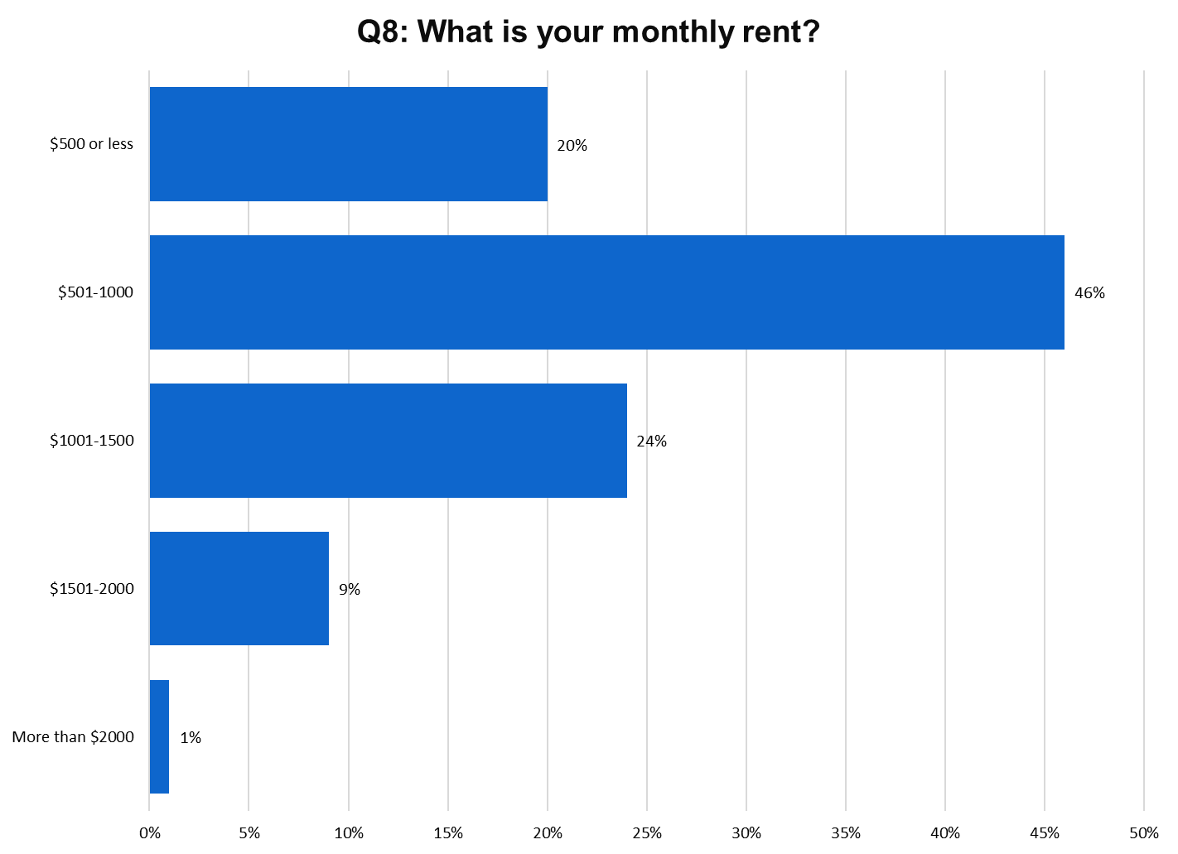
Notes:
N=120
Median = $873

Slide 19
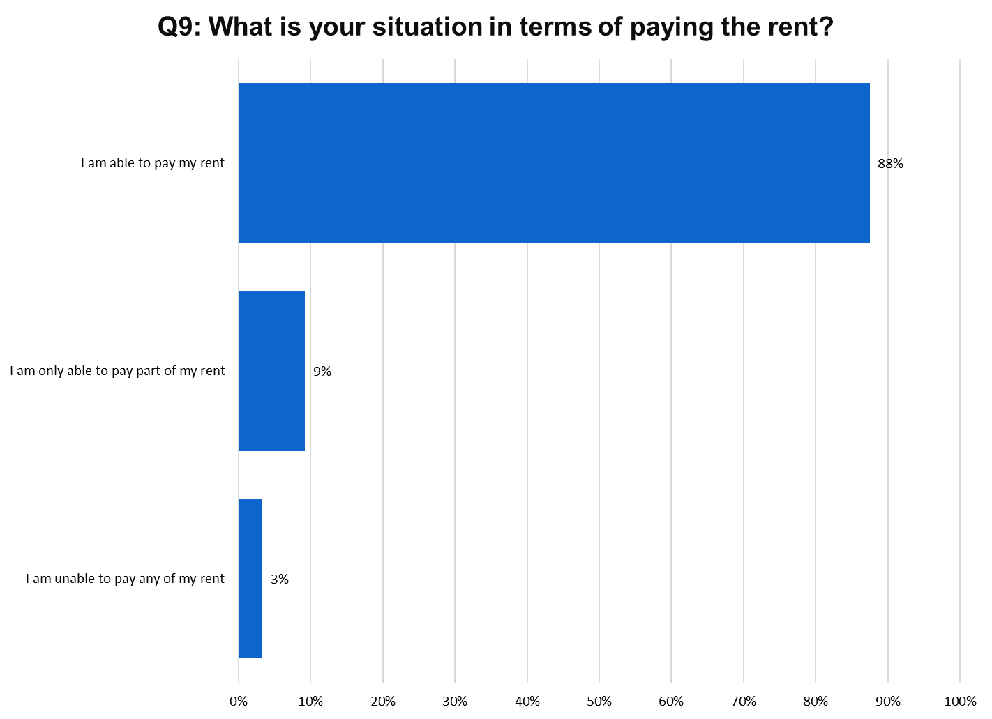
Notes:
N=120

Slide 20
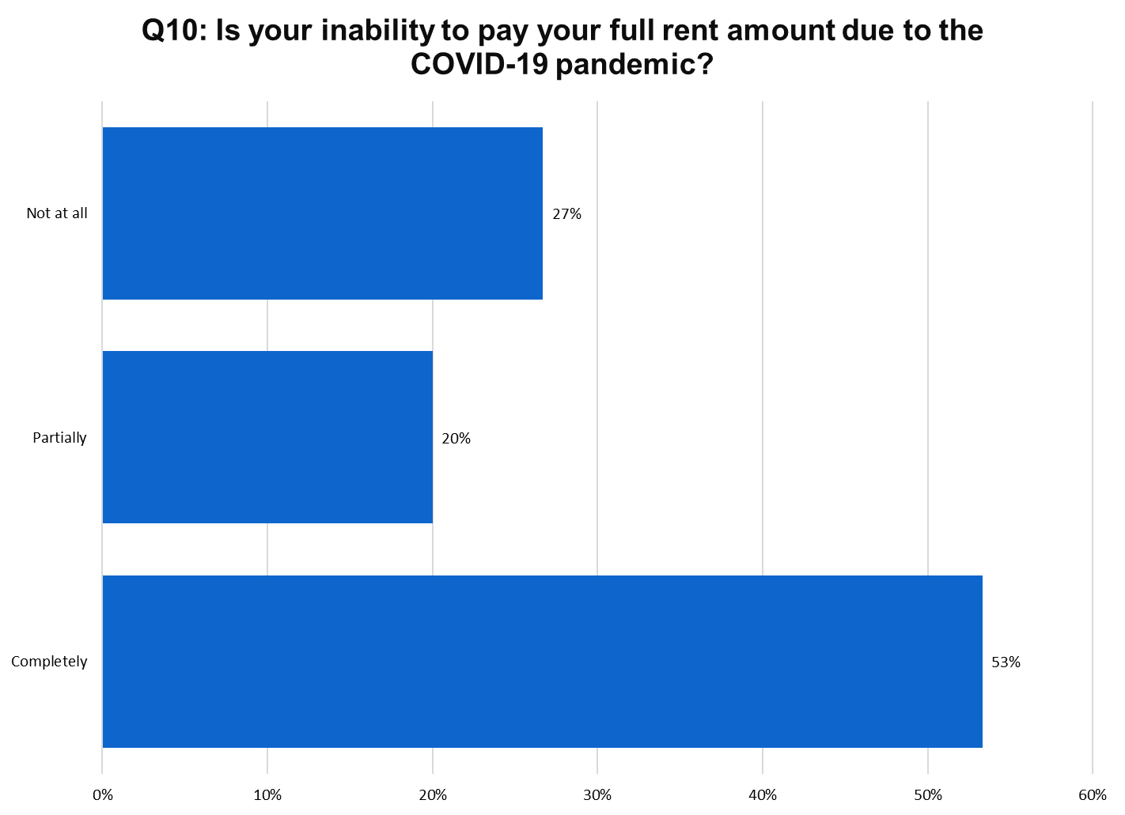
Notes:
N=15

Slide 21
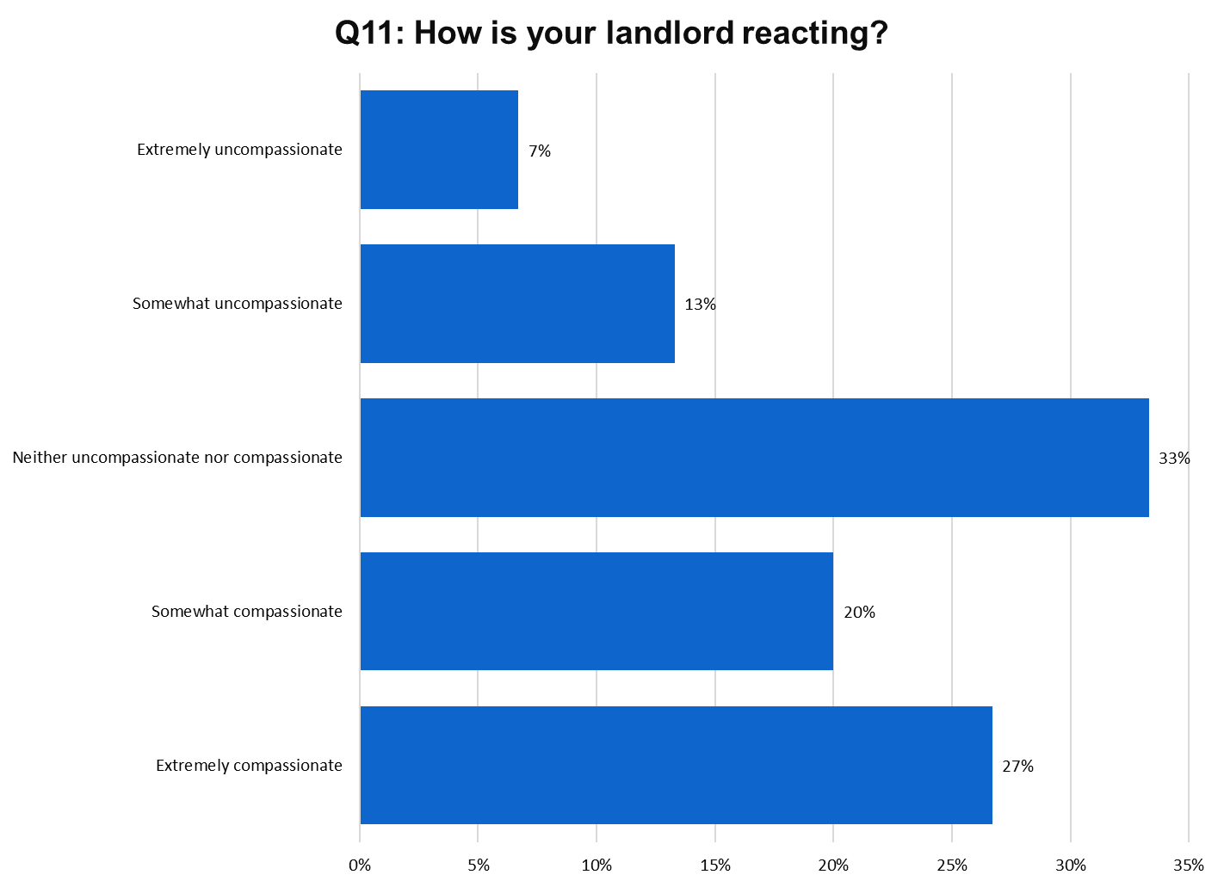
Notes:
N=15

Slide 22
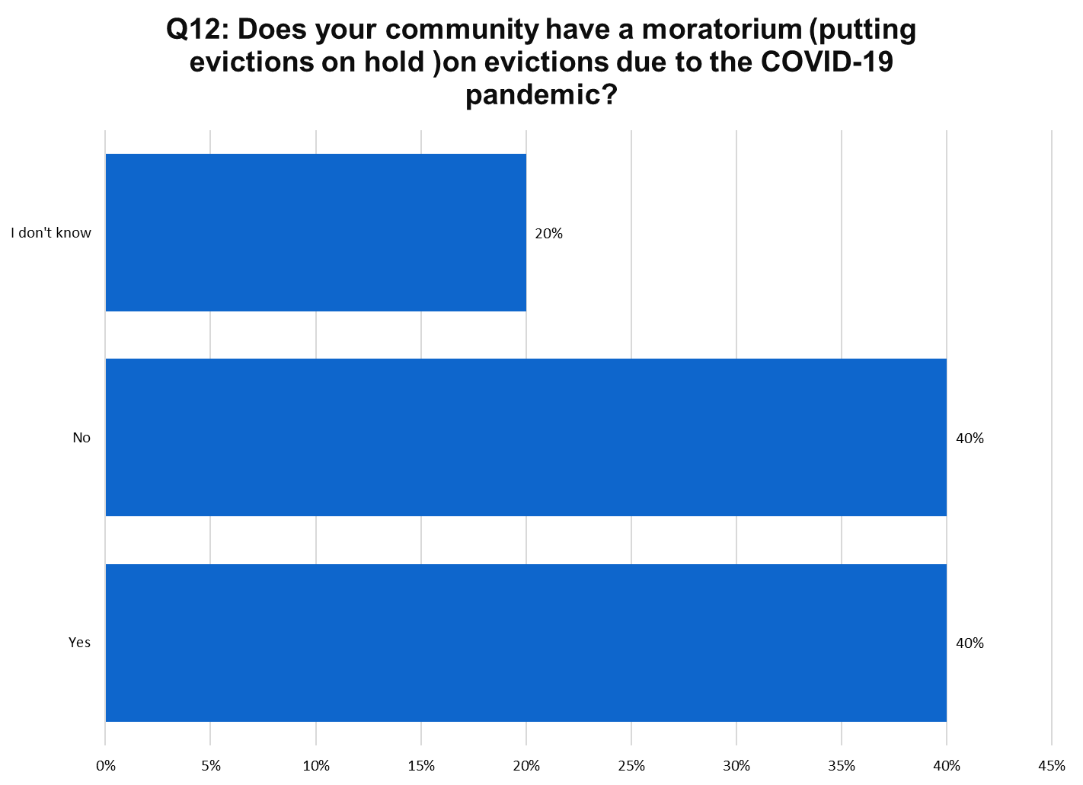
Notes:
N=15

Slide 23
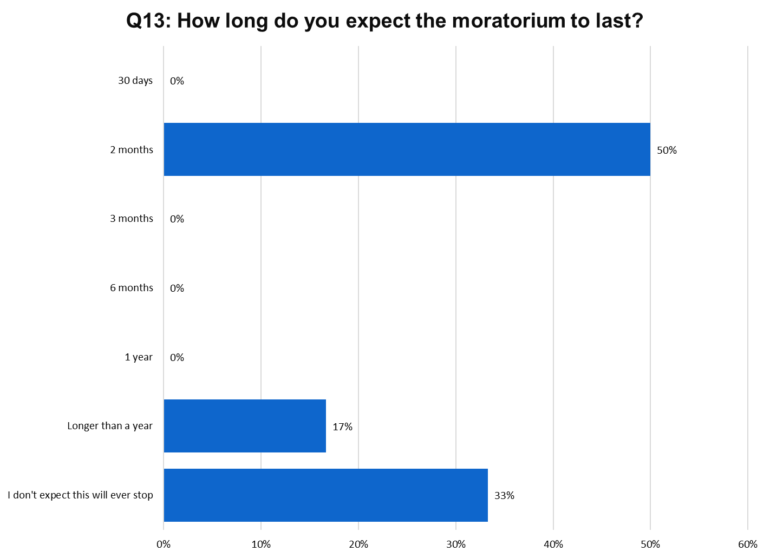
Notes:
N=6

Slide 24
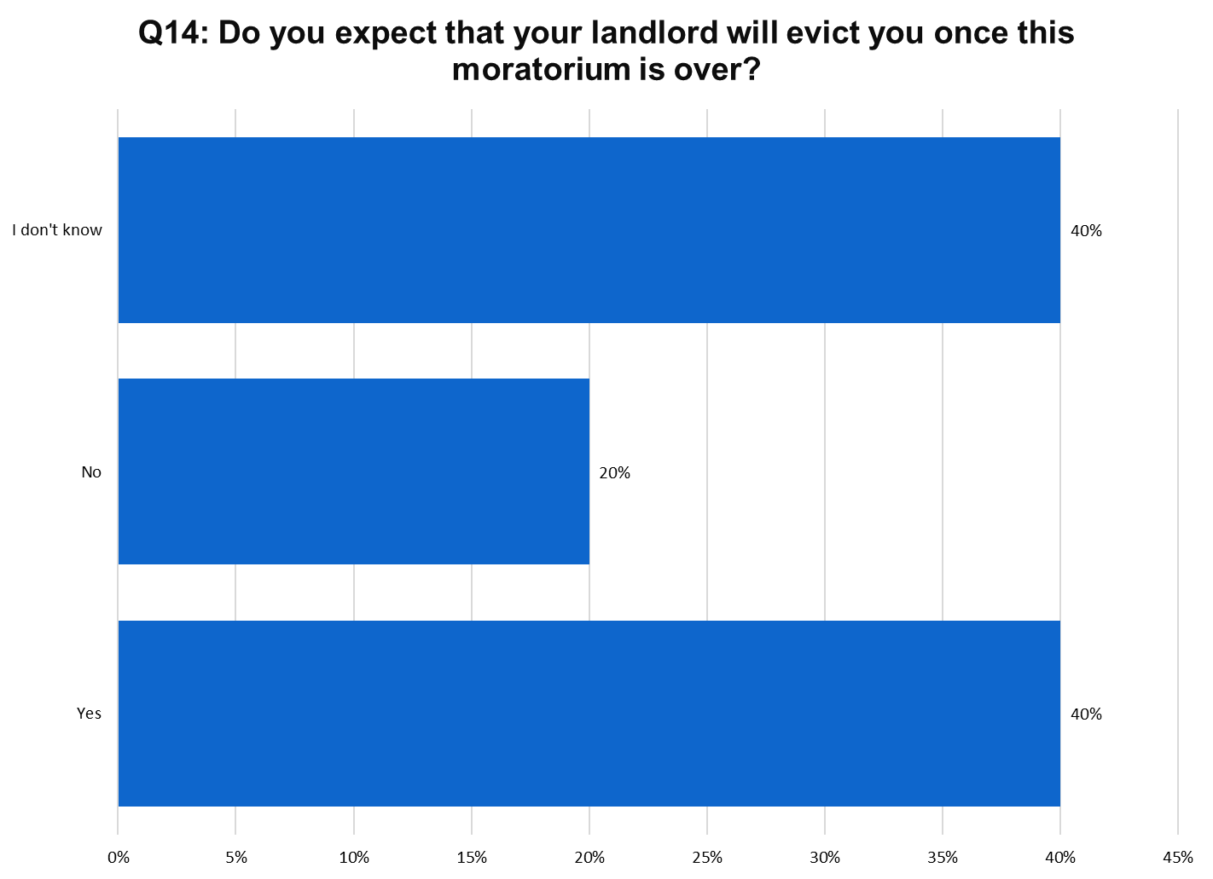
Notes:
N=6

Slide 25
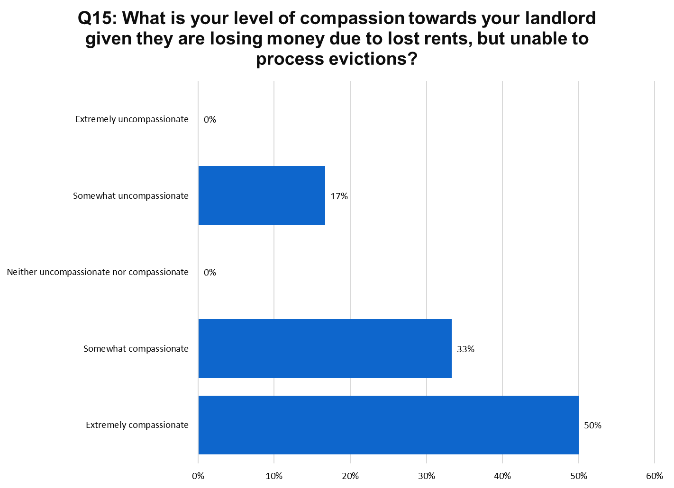
Notes:
N=6

Slide 26
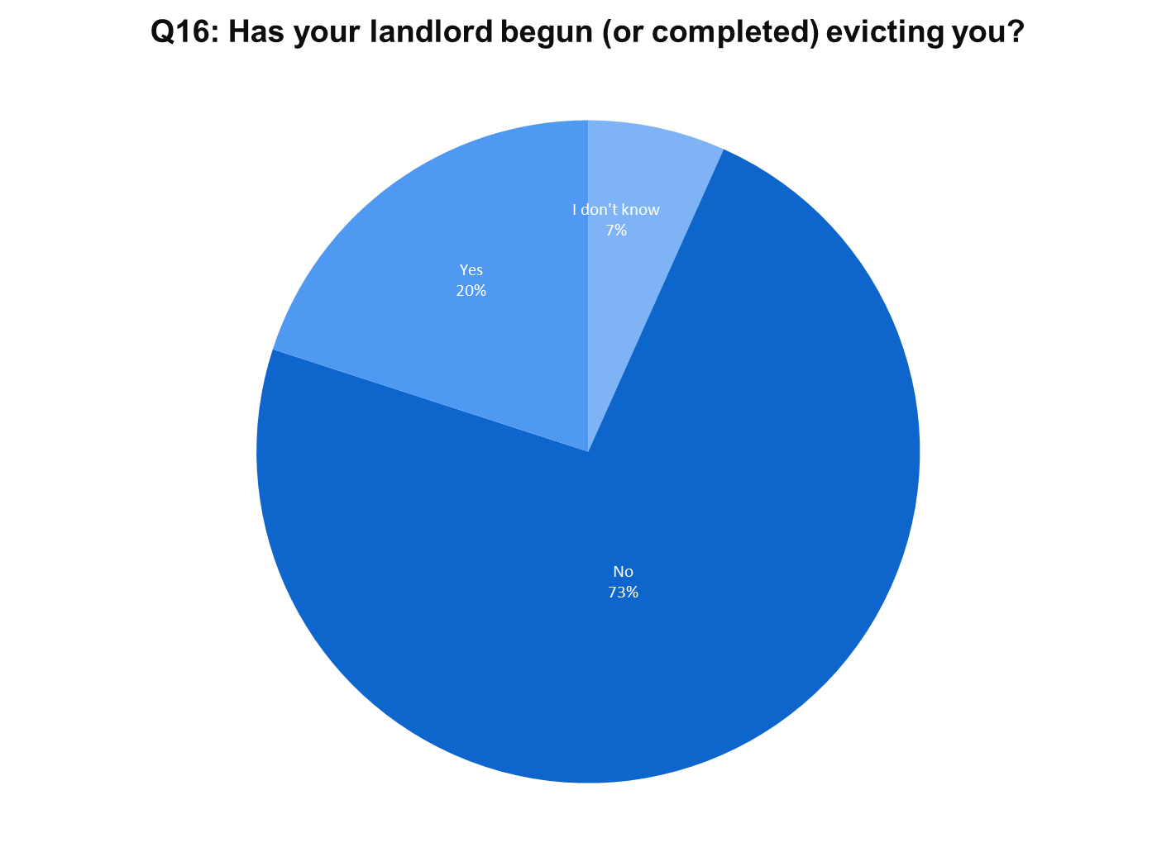
Notes:
N=15

Slide 27
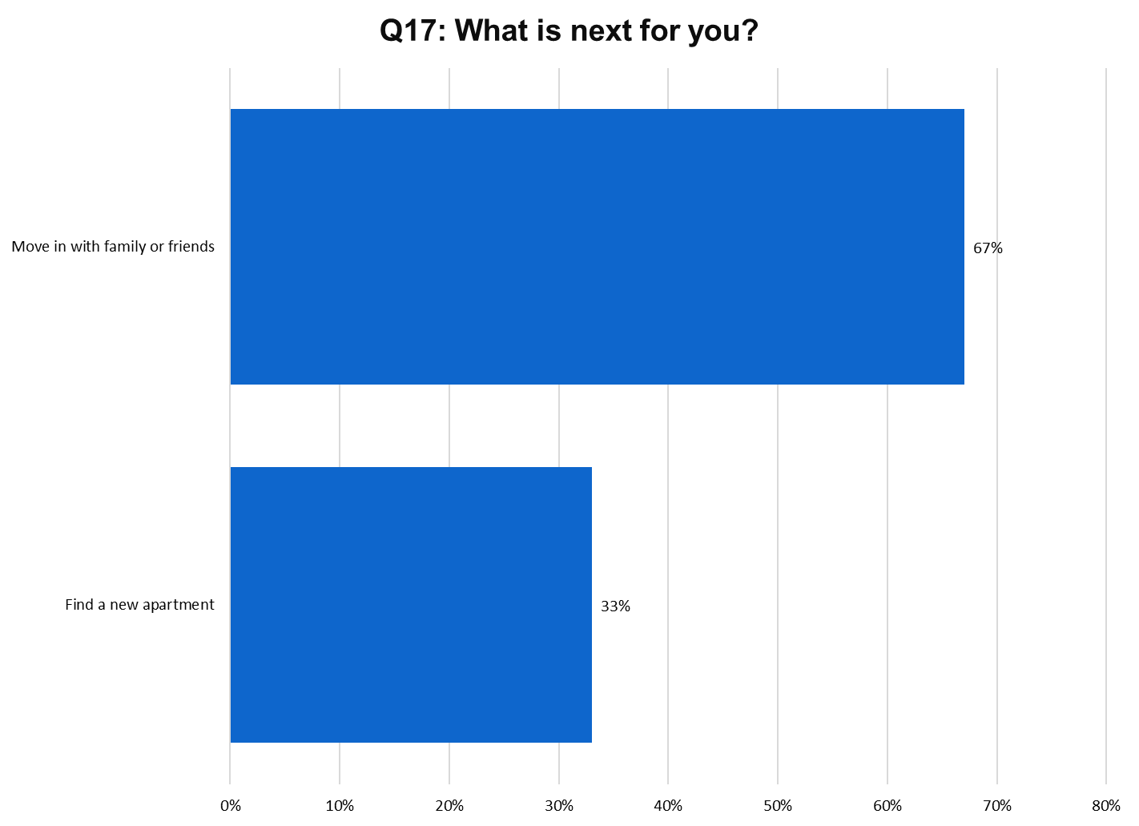
Notes:
N=3

Slide 28
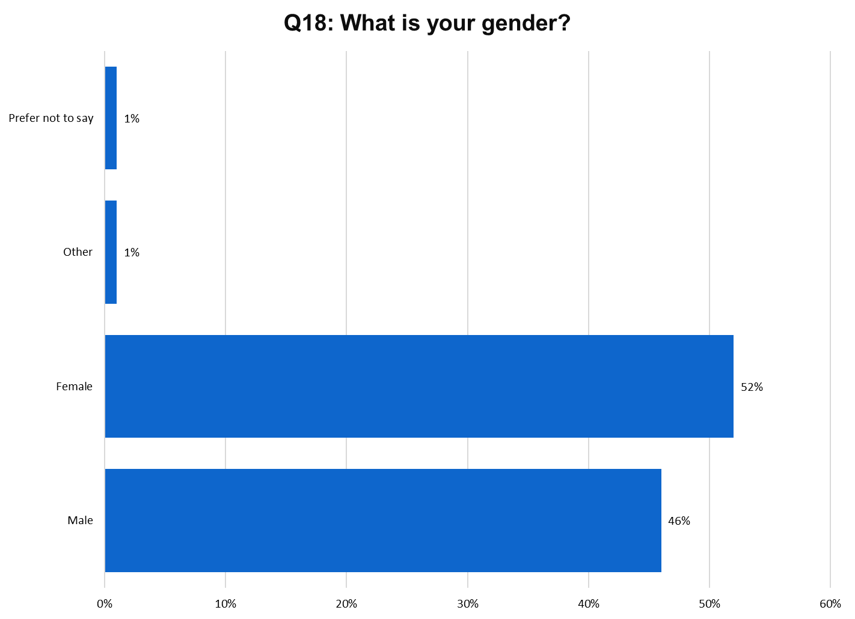
Notes:
N=120

Slide 29
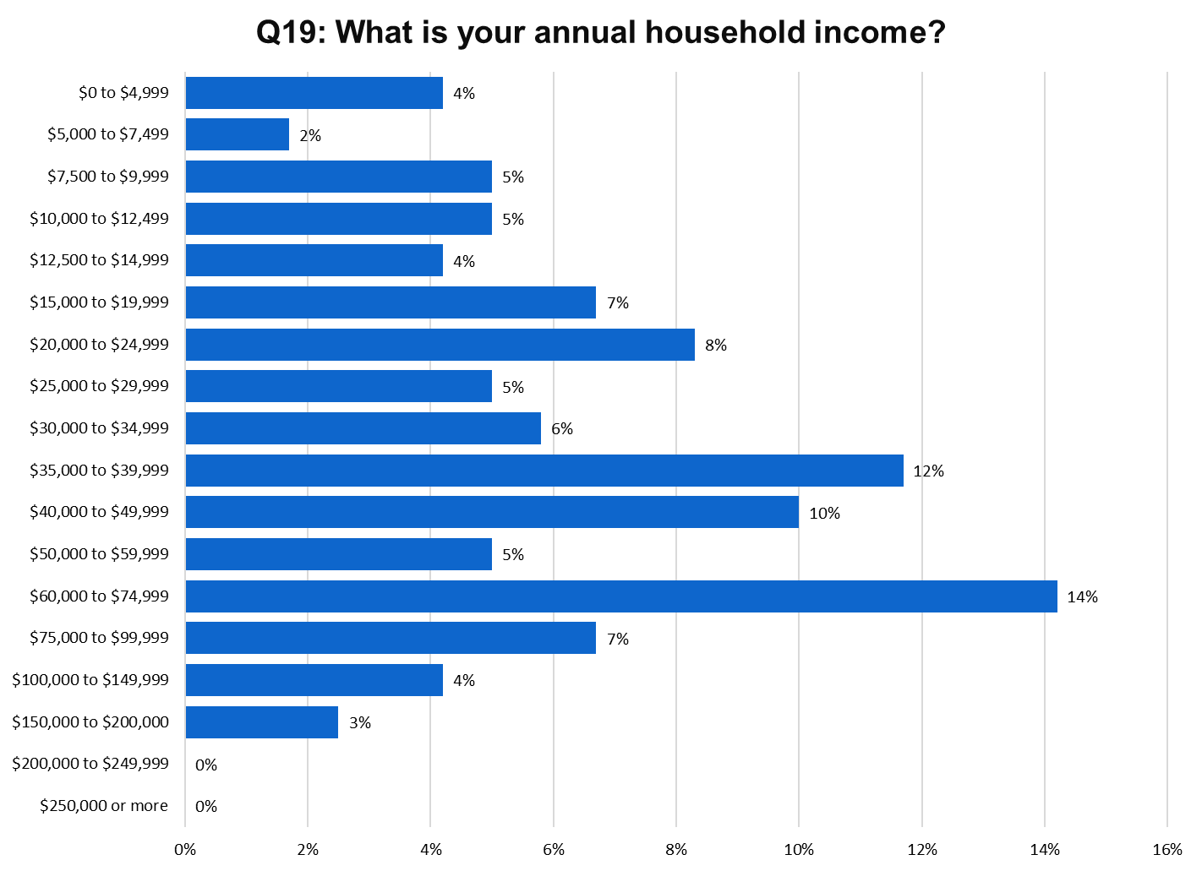
Notes:
N=120
Median = 35,000 to $39,999

Slide 30
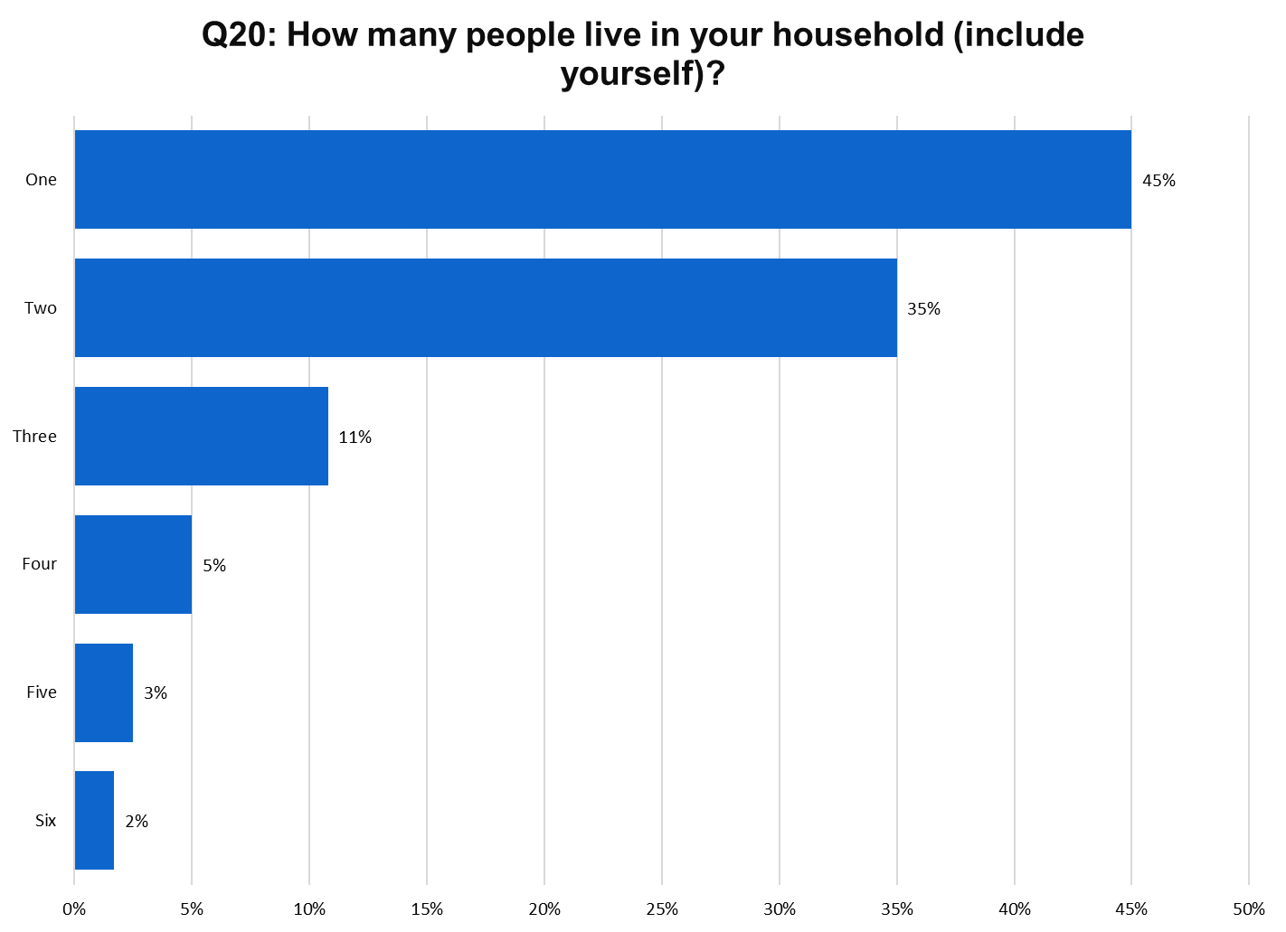
Notes:
N=120
Median = 2

Slide 31
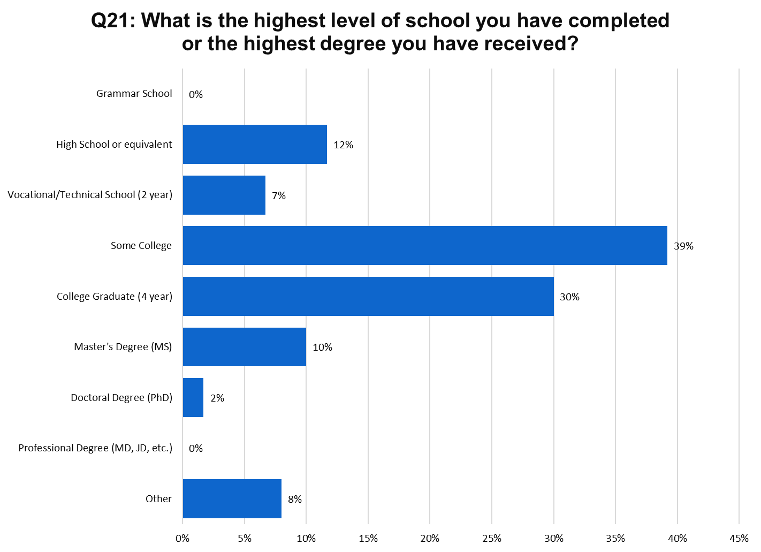
Notes:
N=120

Slide 32
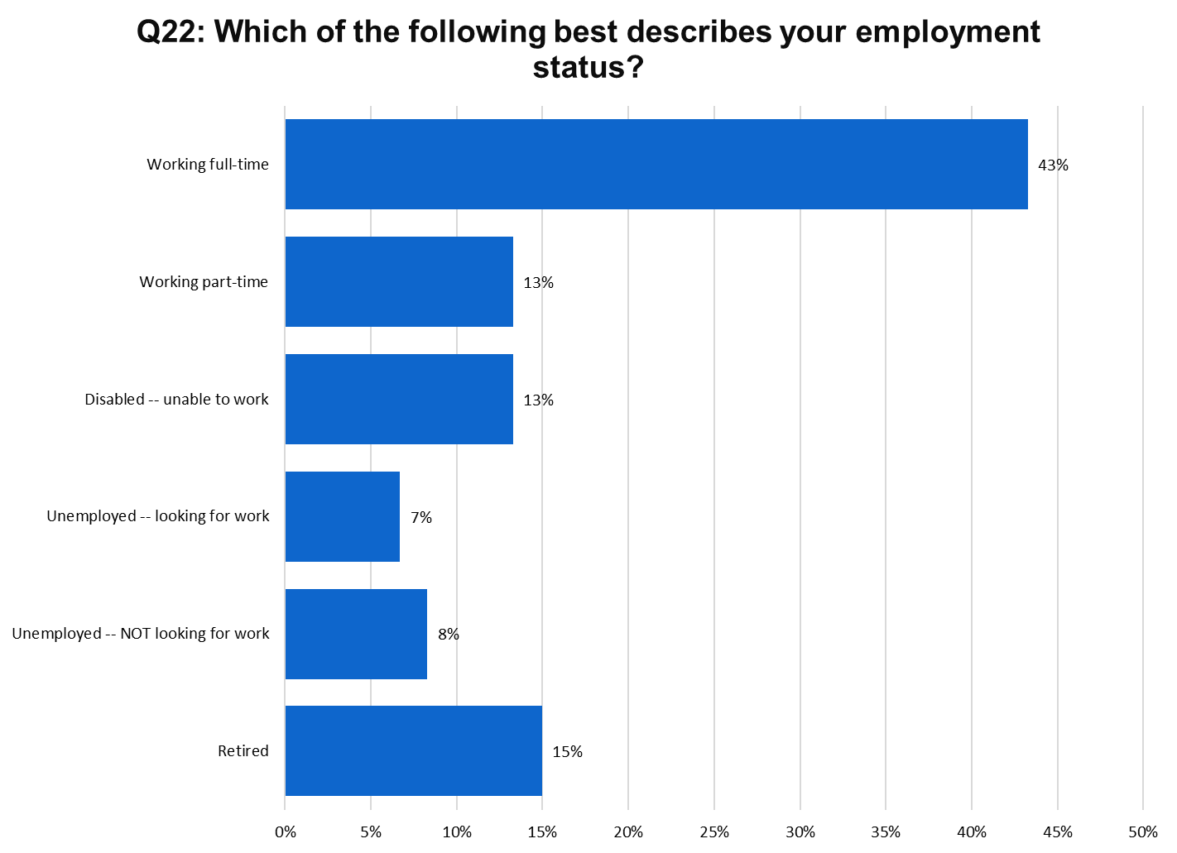
Notes:
N=120

Slide 33
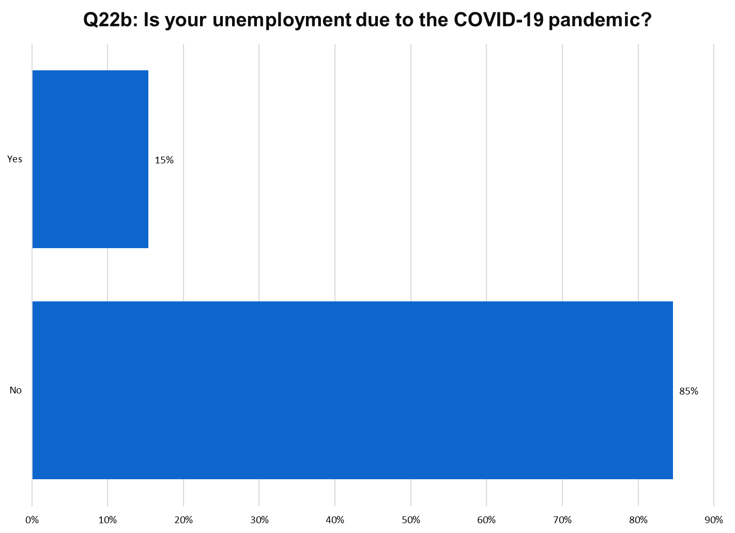
Notes:
N=120

Slide 34
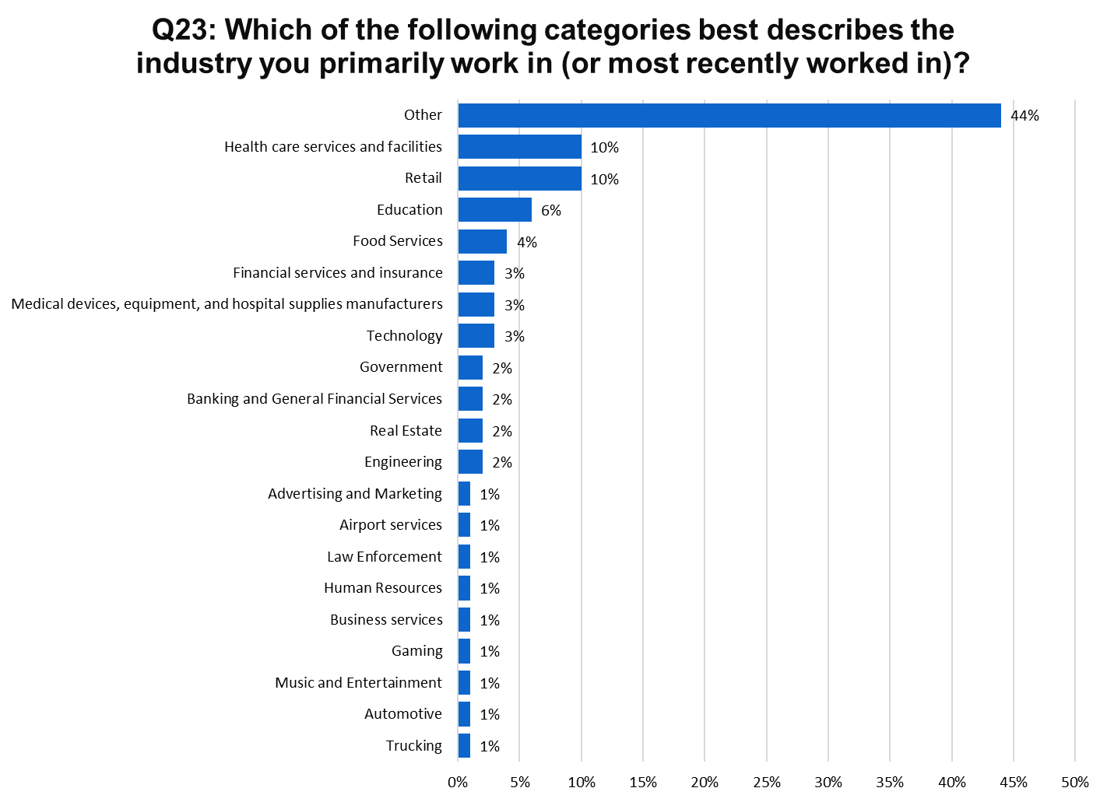
Notes:
N=120

Slide 35
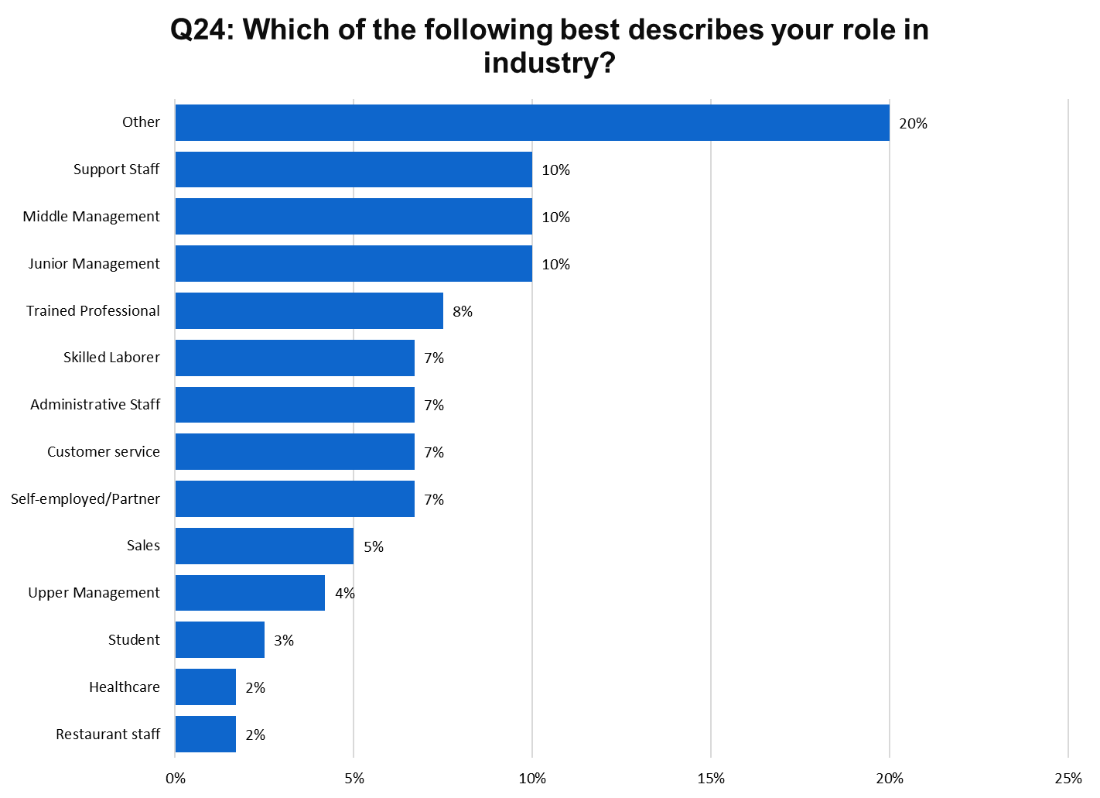
Notes:
N=120

Slide 36
Property Managers

Slide 37
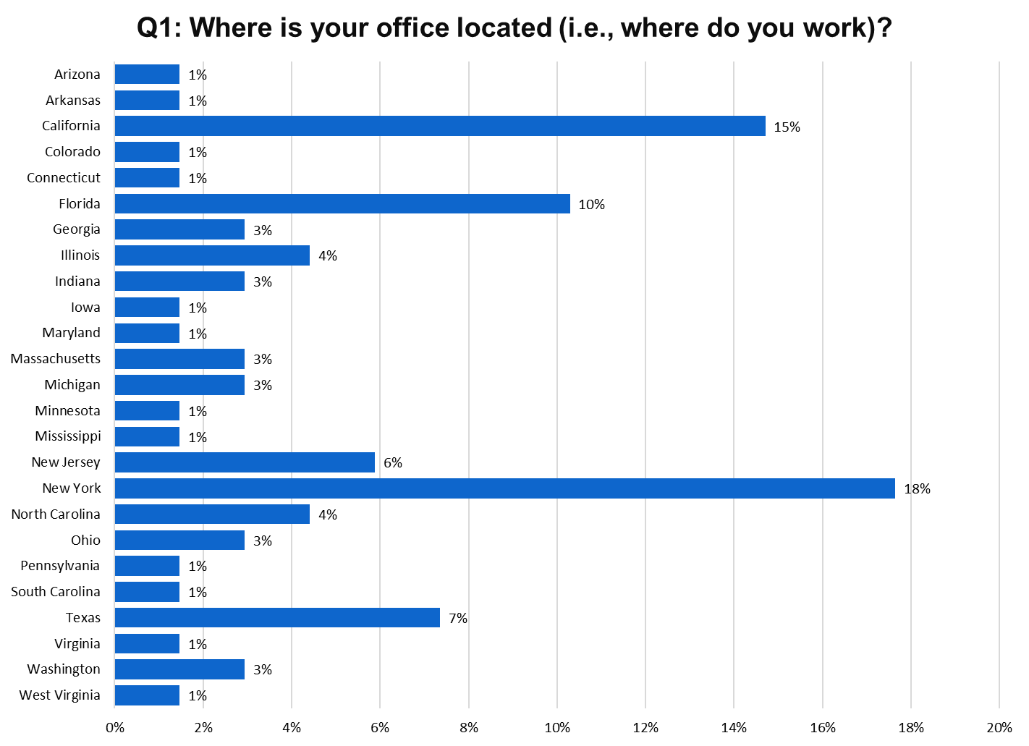
Notes:
N=100

Slide 38
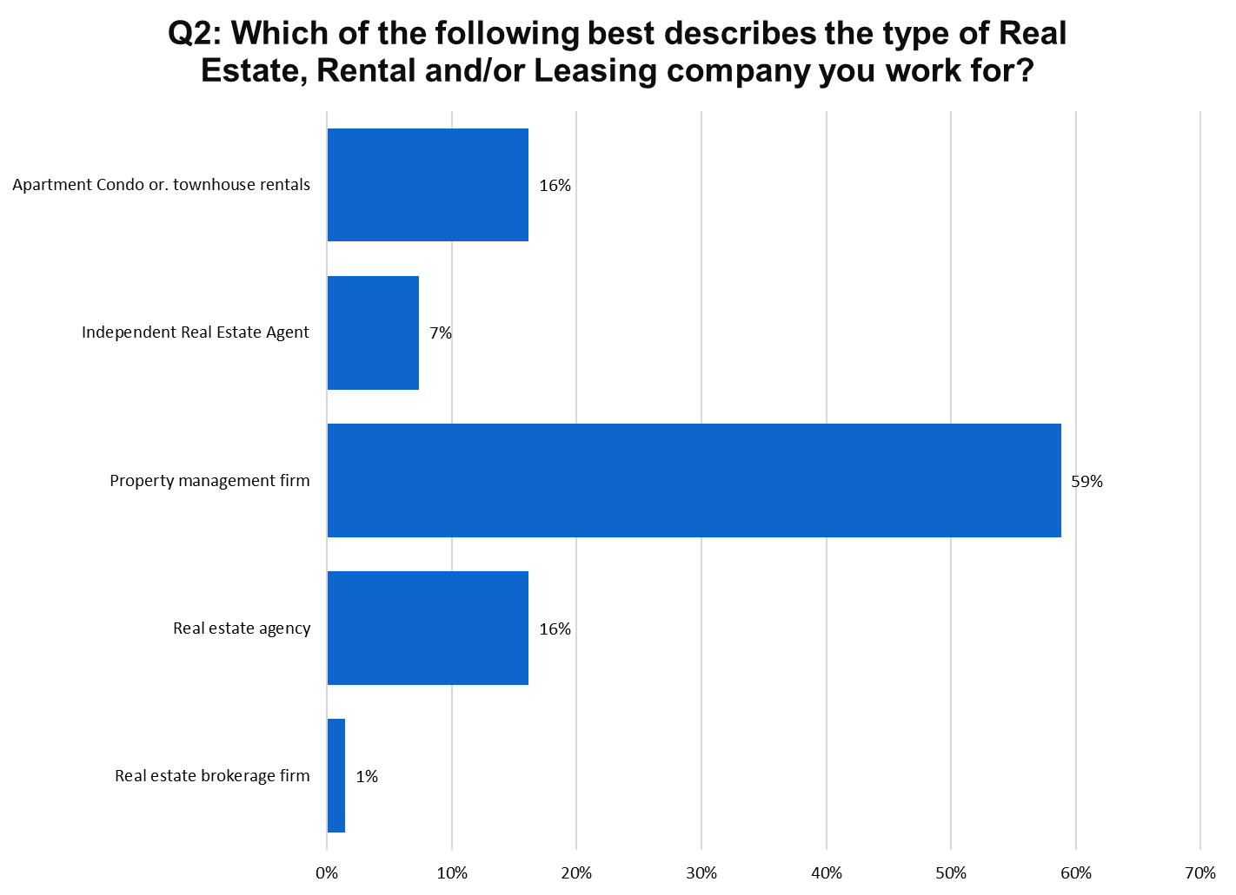
Notes:
N=100

Slide 39
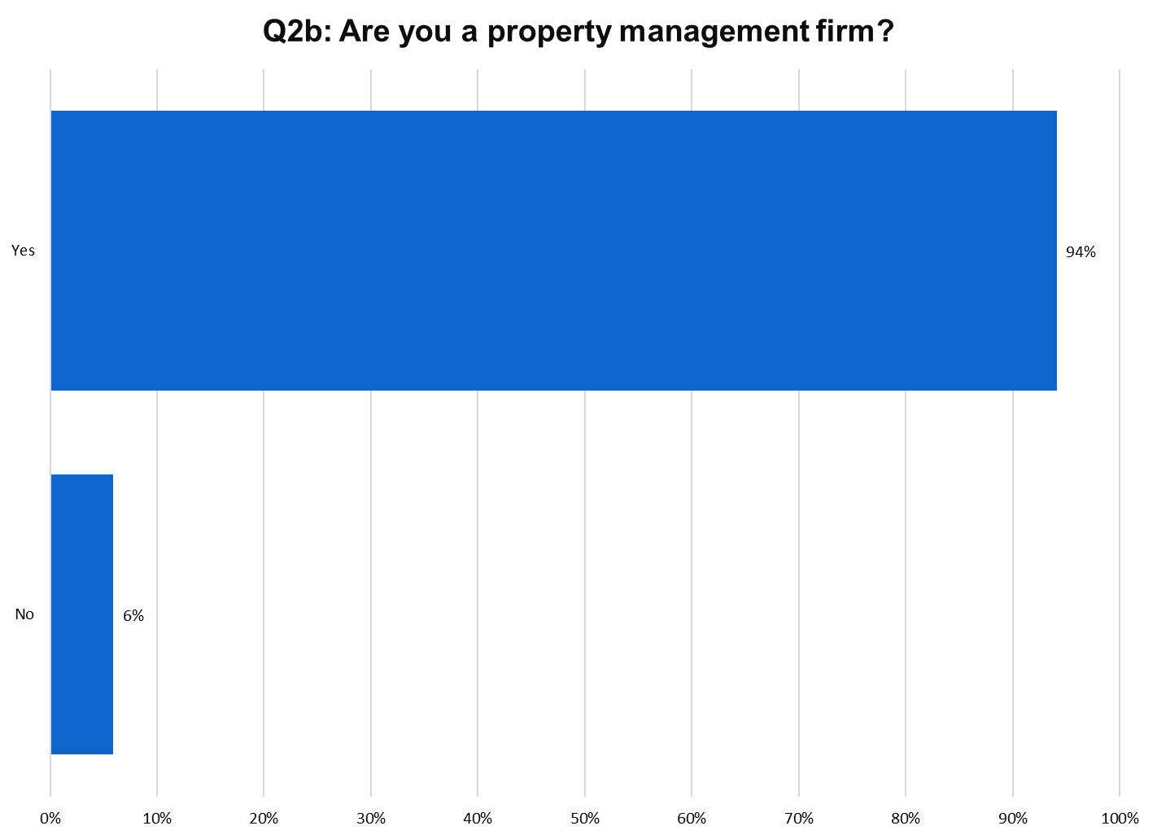
Notes:
N=100

Slide 40
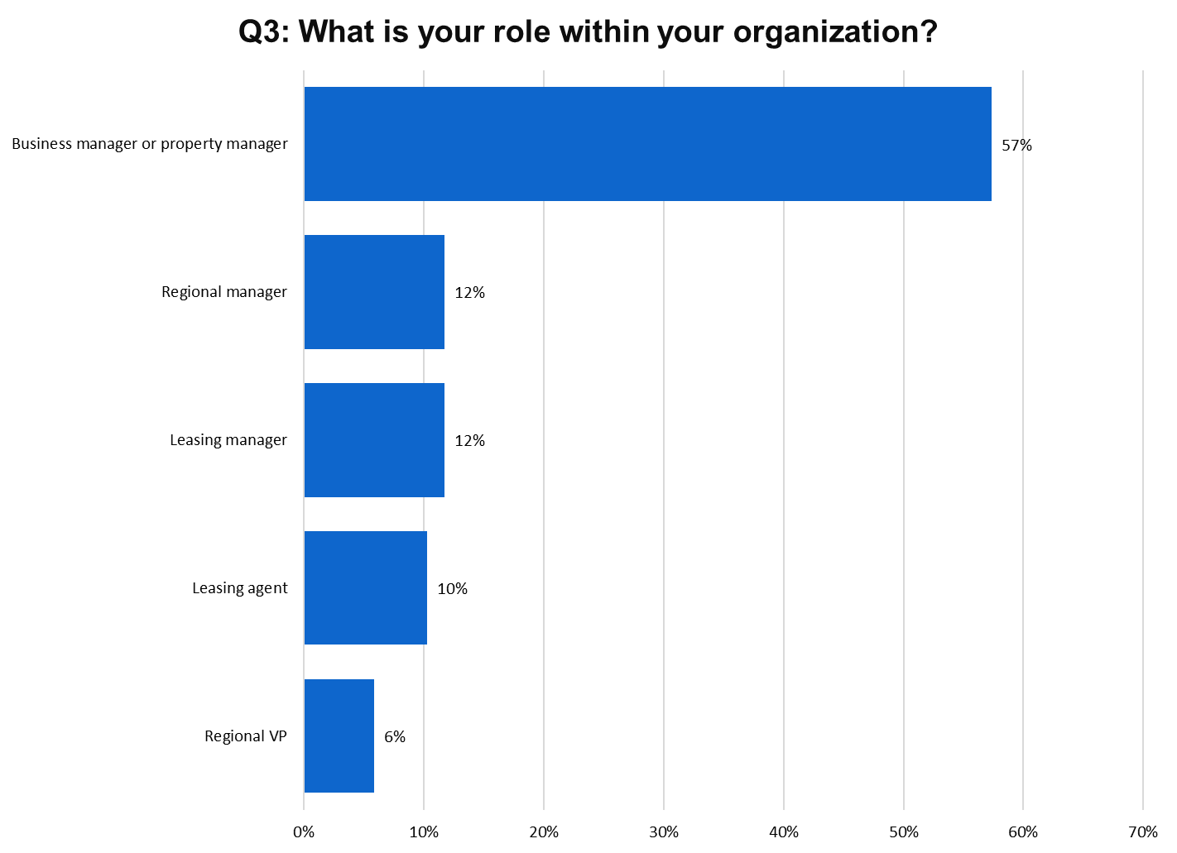
Notes:
N=100

Slide 41
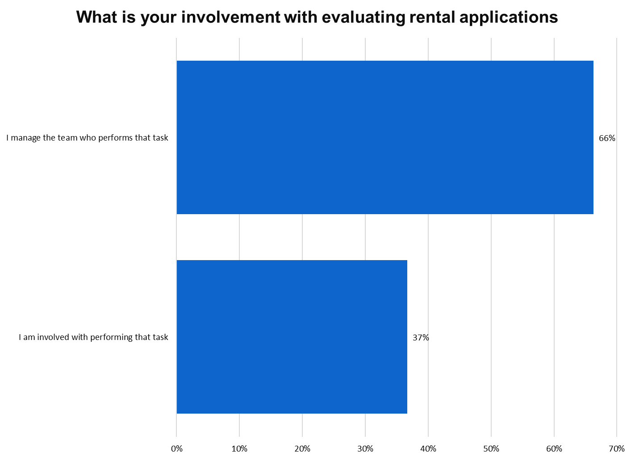
Notes:
N=100

Slide 42
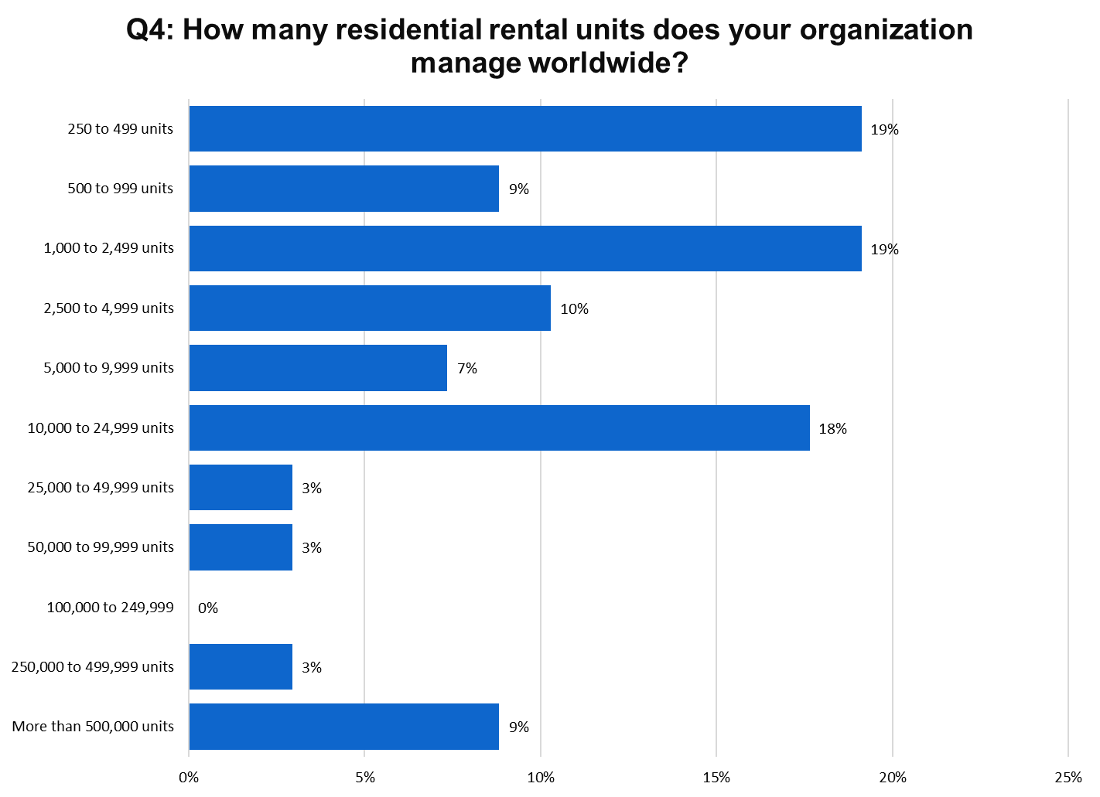
Notes:
N=100
Median = 2,500 to 4,999 units

Slide 43
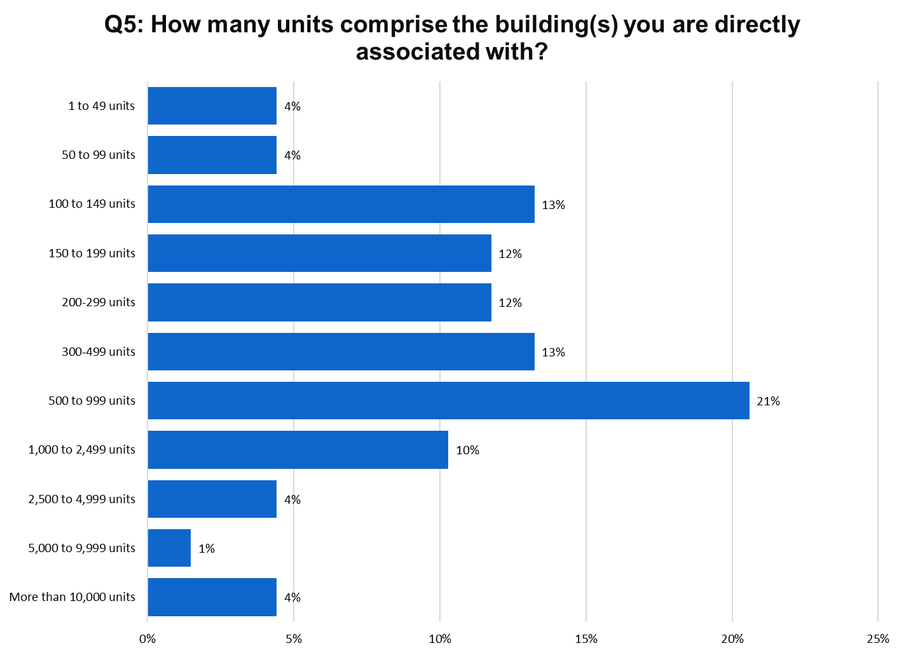
Notes:
N=100
Median = 300-499 units

Slide 44
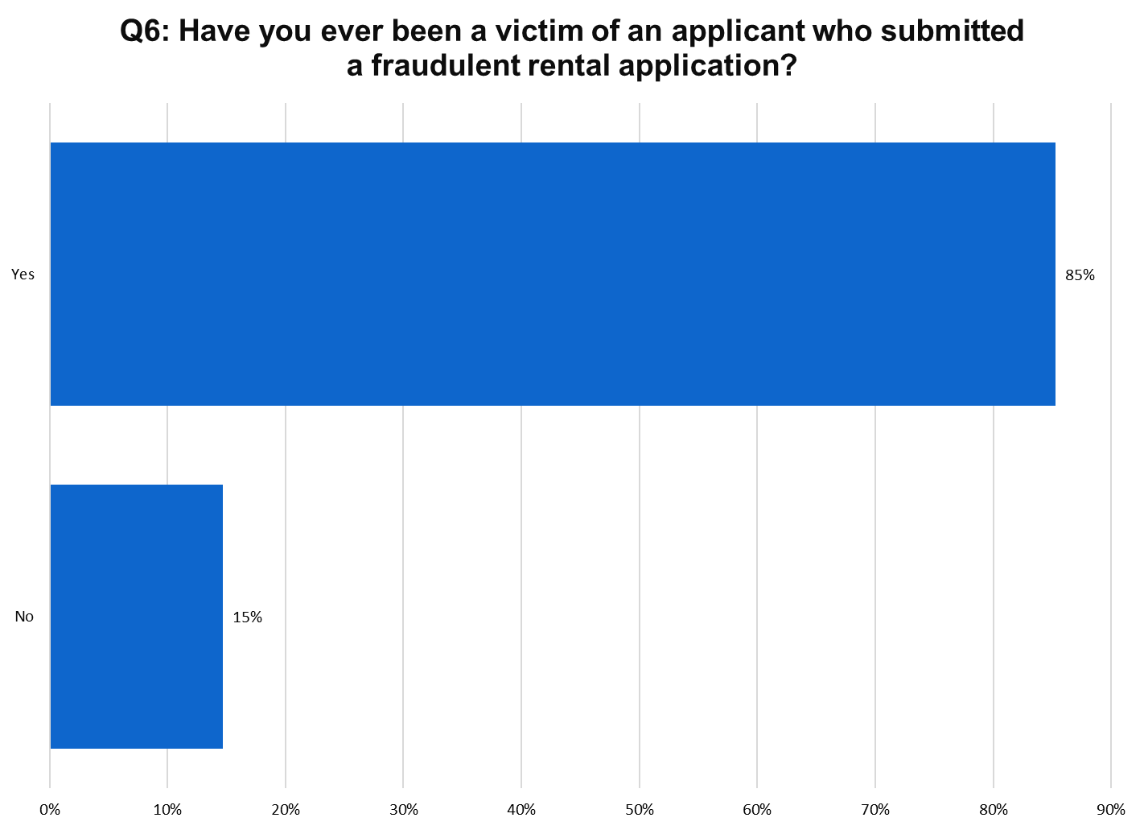
Notes:
N=100

Slide 45
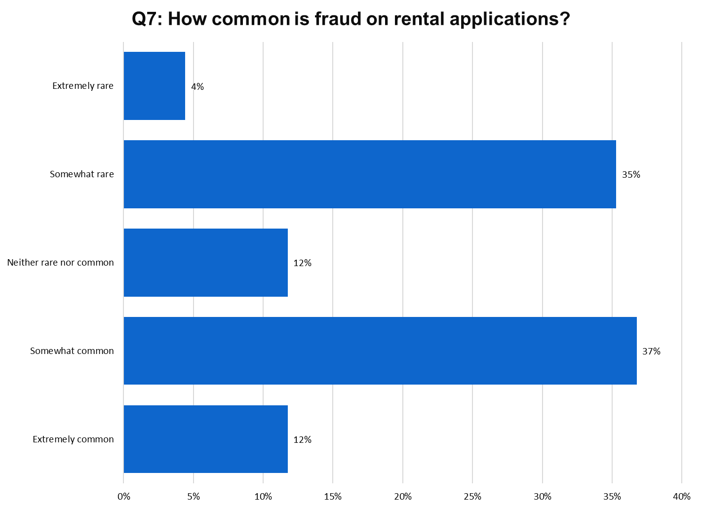
Notes:
N=100

Slide 46
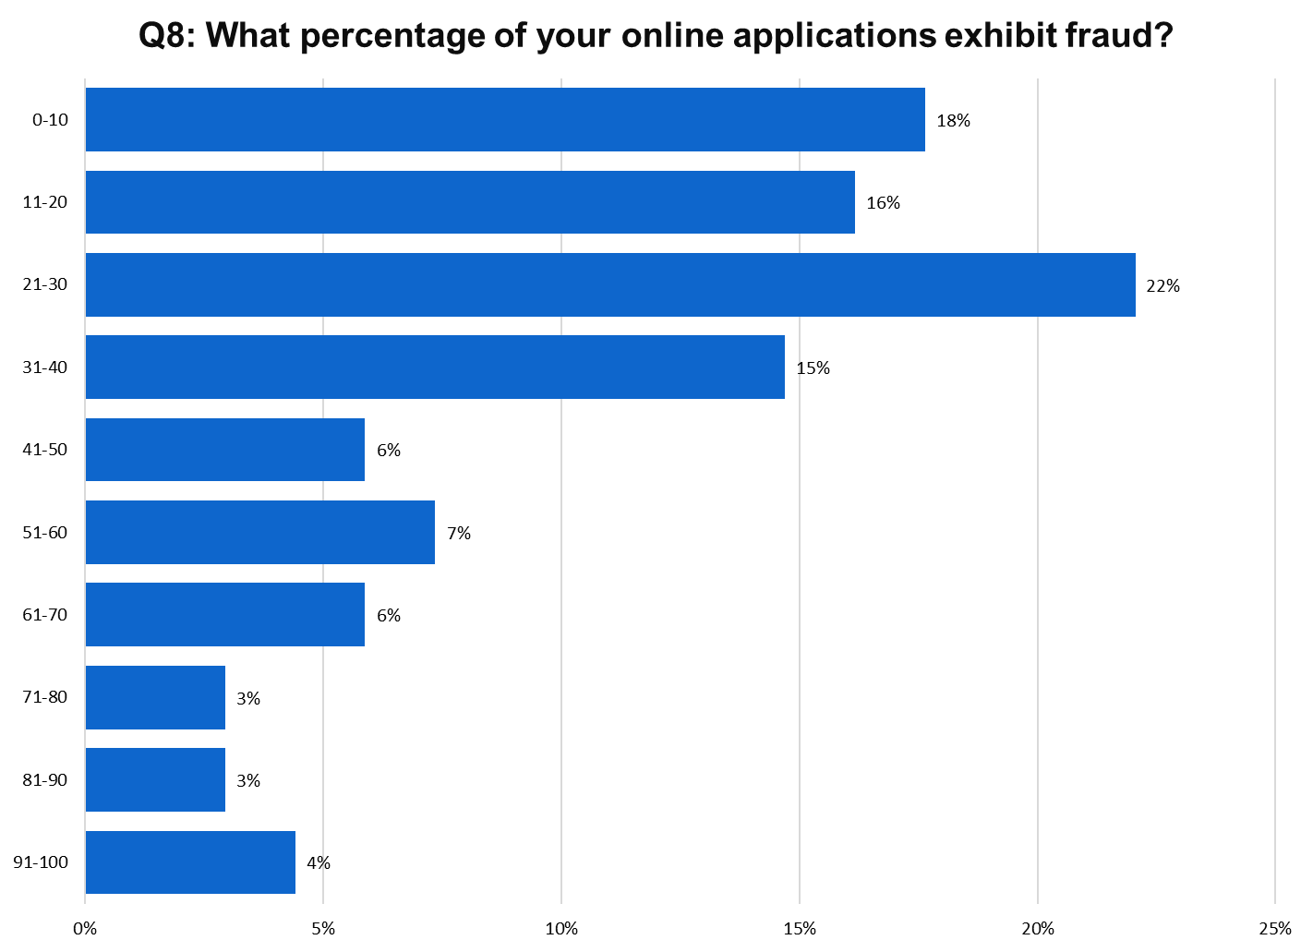
Notes:
N=100
Median = 29

Slide 47
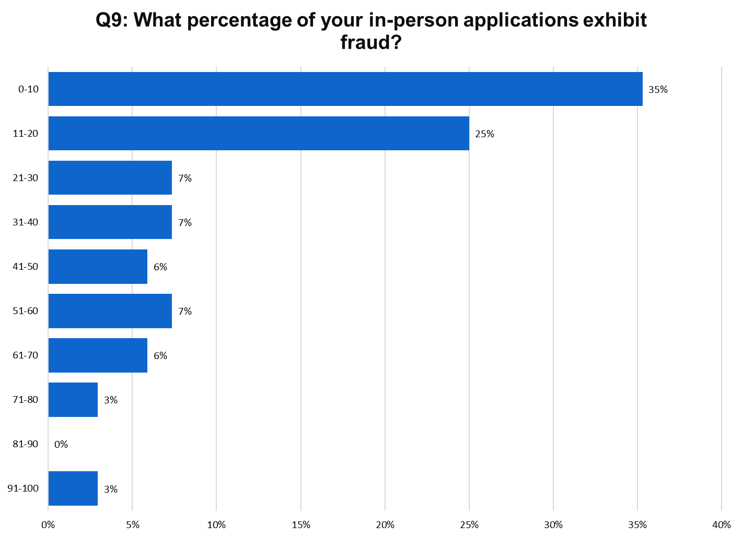
Notes:
N=100
Median = 17

Slide 48
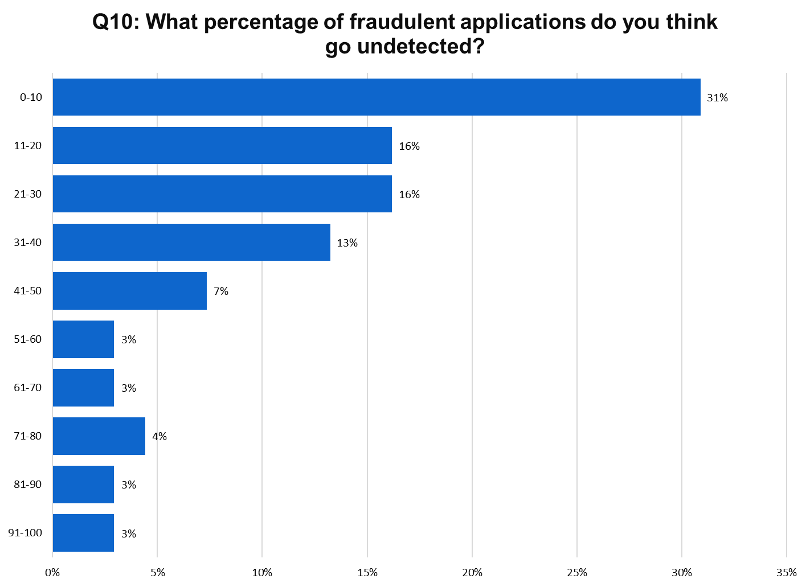
Notes:
N=100
Median = 22.5

Slide 49
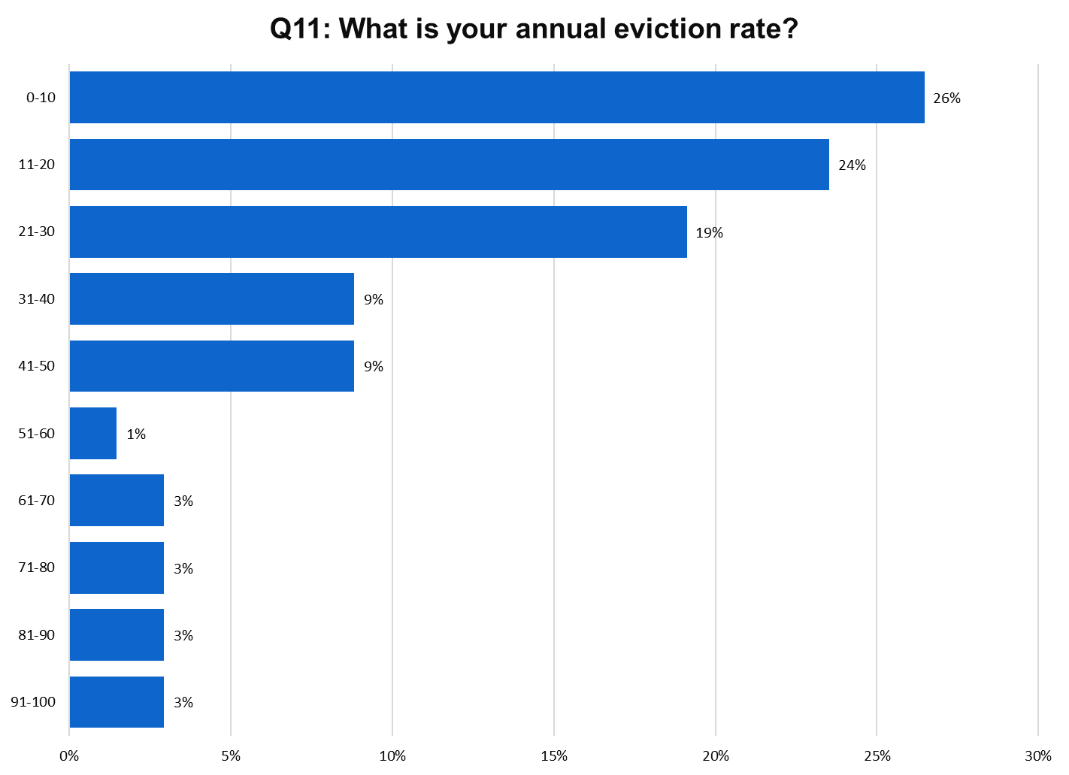
Notes:
N=100
Median = 21

Slide 50
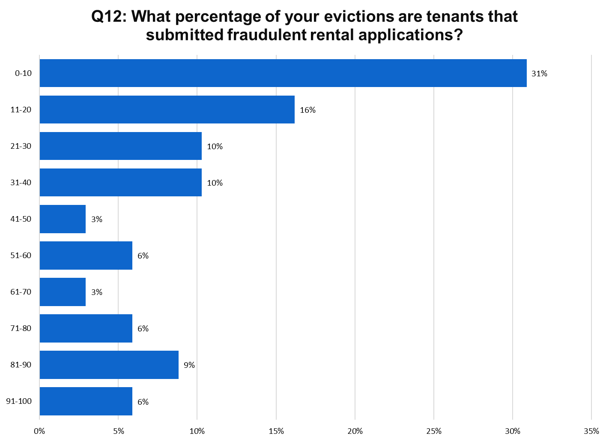
Notes:
N=100
Median = 25

Slide 51
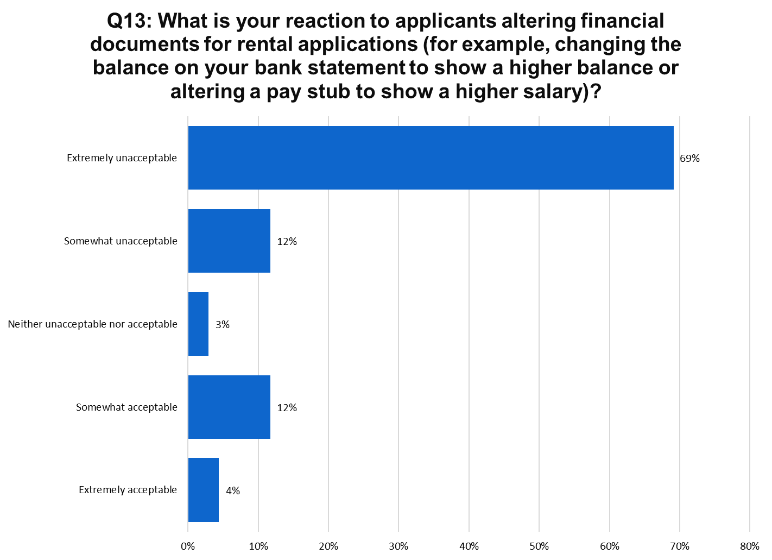
Notes:
N=100

Slide 52
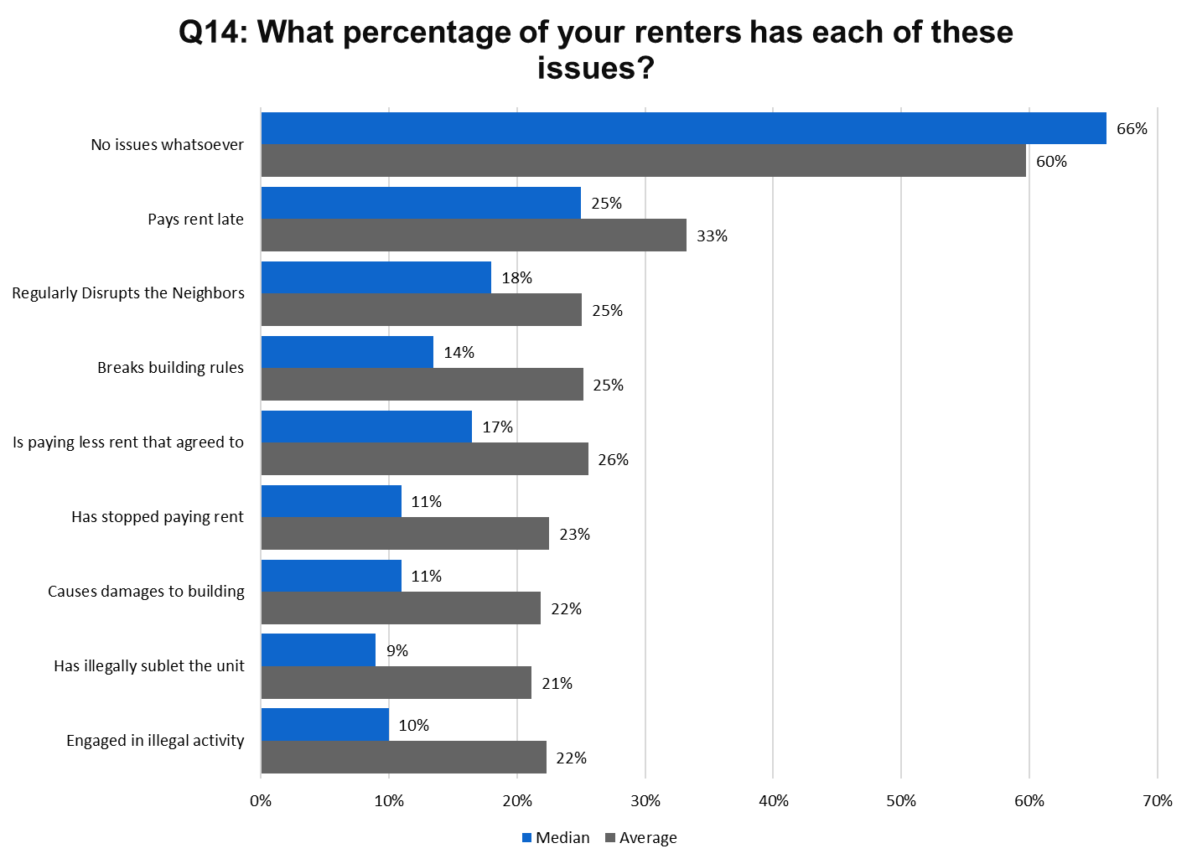
Notes:
N=100

Slide 53
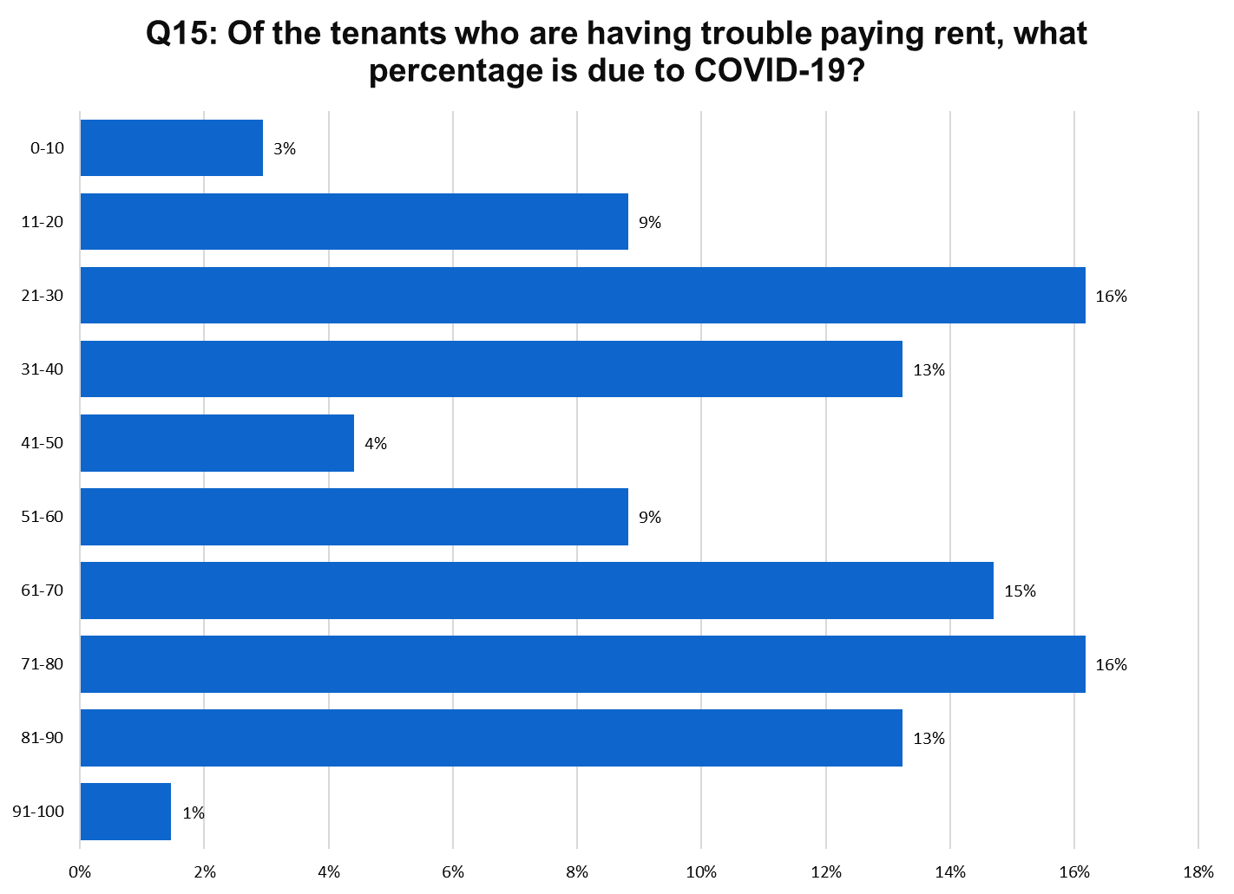
Notes:
N=100
Median = 56.5

Slide 54
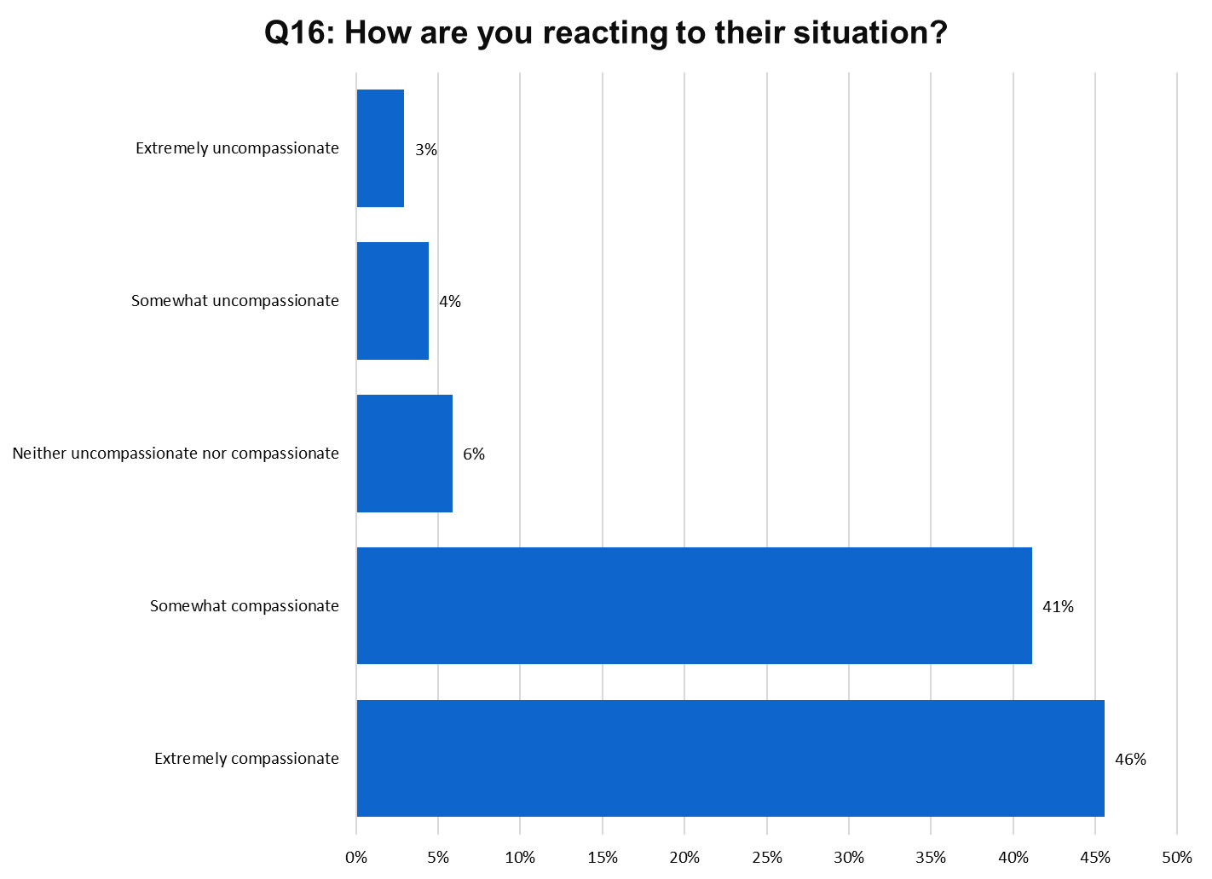
Notes:
N=100

Slide 55
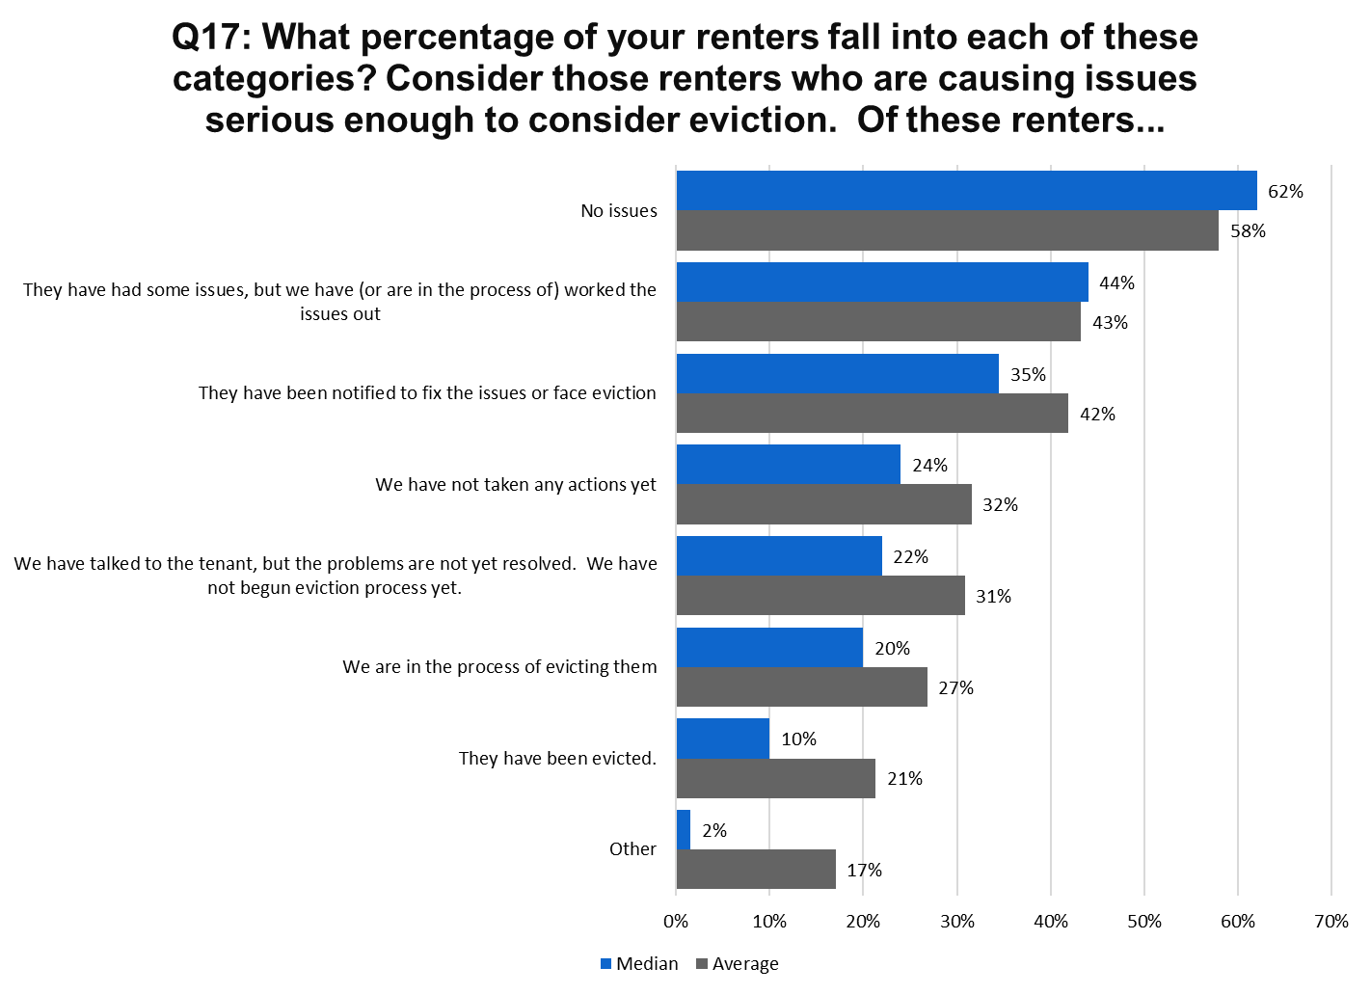
Notes:
N=100

Slide 56
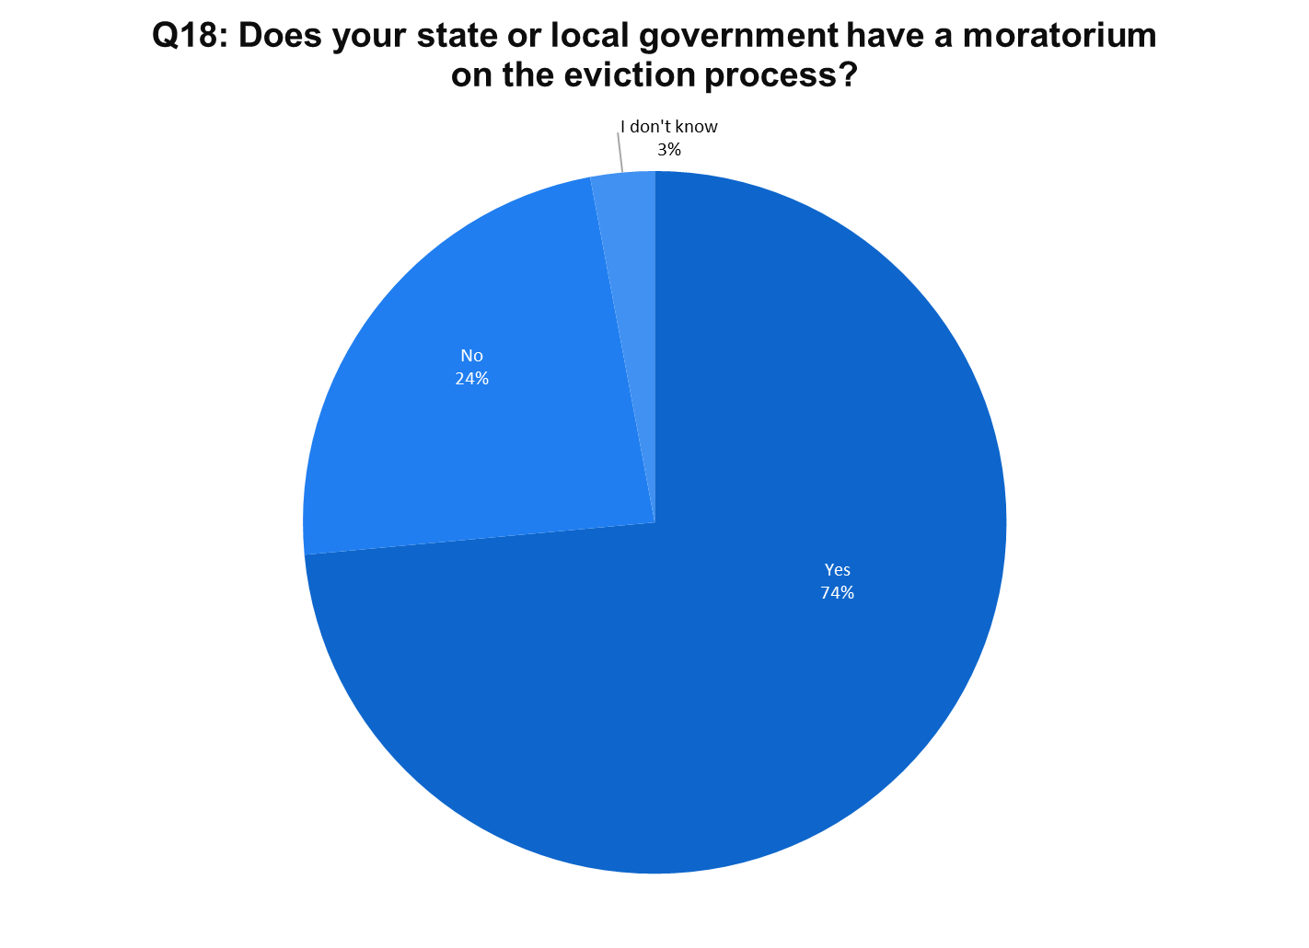
Notes:
N=100

Slide 57
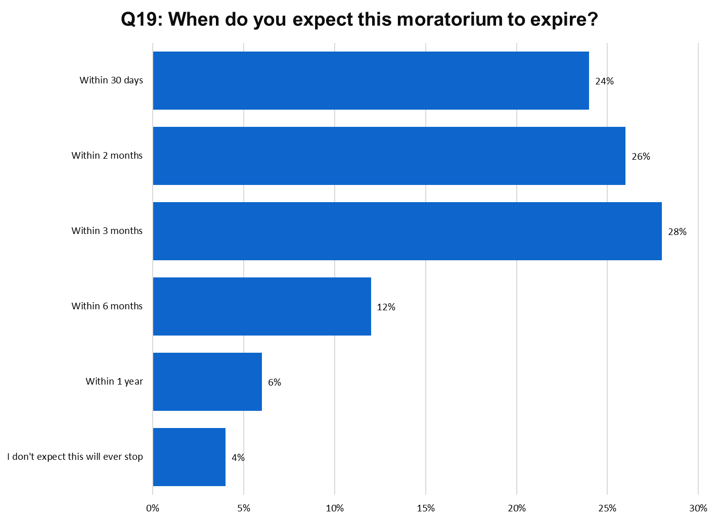
Notes:
N=74

Slide 58

Notes:
N=74
Median = 15

Slide 59

Notes:
N=100

Slide 60

Notes:
N=100

Slide 61

Notes:
N=100

Slide 62

Notes:
N=100

Slide 63

Notes:
N=100
Median = $71,500

Slide 64

Notes:
N=100

Slide 65

Notes:
N=100
Median = 332

Slide 66

Q28. What is your title?
Notes:
N=100
Median = 225

Slide 67

Notes:
N=100

Slide 68

Notes:
N=100

